Slide 1
Security in Computing, Fifth Edition
Chapter 7: Databases

Slide 2
Objectives for Chapter 7
Basic database terminology and concepts
Security requirements for databases
Database Disclosure/Protecting sensitive data
Data mining and big data

Slide 3
Database Terms
Database administrator
Database management system (DBMS)
Record
Field/element
Schema
Subschema
Attribute
Relation
Notes:
Database: A collection of data and a set of rules that organize the data by specifying certain relationships among the data
Database administrator: Person who defines the rules that organize the data and controls who should have access to what parts of the data
Database management system: The system through which users interact with the database
Record: One related group of data
Field/element: Elementary data items that make up a record (e.g., name, address, city)
Schema: Logical structure of a database
Subschema: The portion of a database a given user has access to
Attribute: A column in a database
Relation: A set of database columns

Slide 4
Database Example
Notes:
A database with three tables

Slide 5
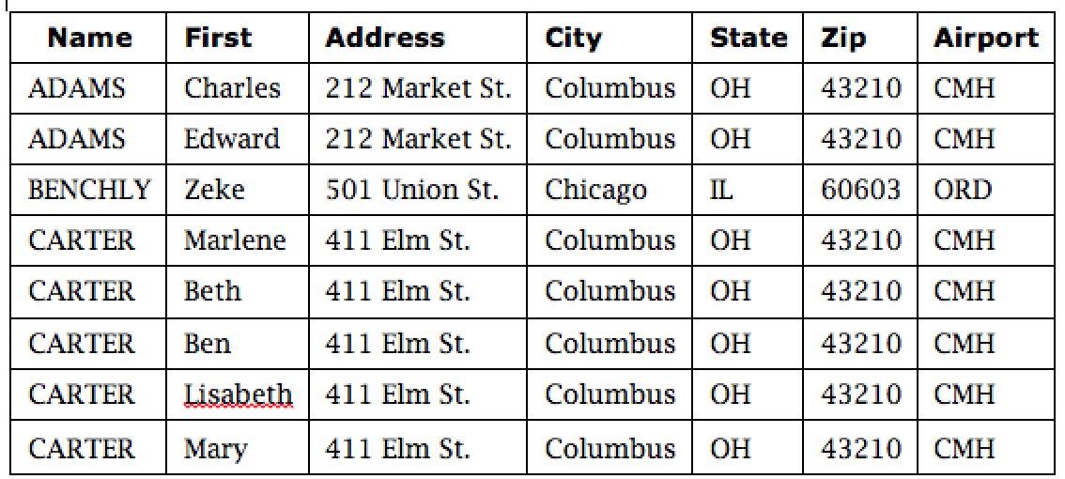
Schema Example
Notes:
The schema of the database from the previous slide

Slide 6
Queries
A query is a command that tells the database to retrieve, modify, add, or delete a field or record
The most common database query language is SQL

Slide 7
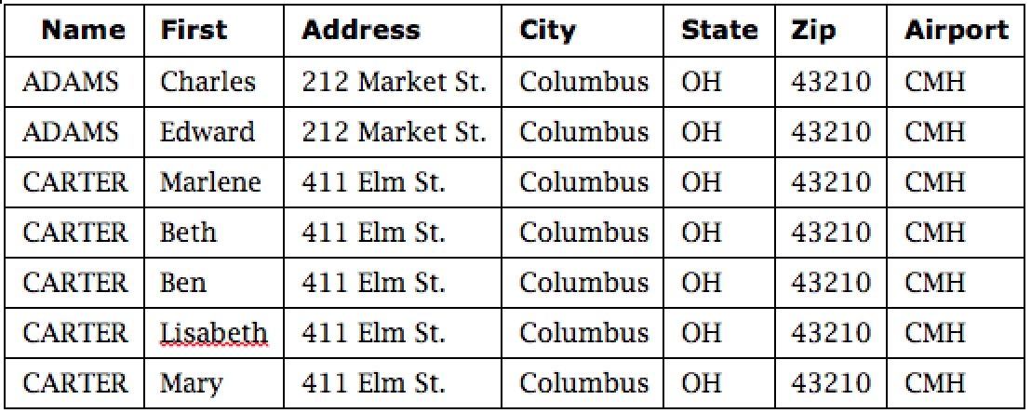
Example SQL Query
SELECT ZIP=‘43210’

Slide 8
Database Security Requirements
Physical integrity
Logical integrity
Element integrity
Auditability
Access control
User authentication
Availability
Notes:
This is a good time to encourage students to think about places databases are commonly used and all the purposes they may be used for. Examples such as banks, large retailers, and law enforcement quickly make clear why all of these requirements are critically important. We’ve already discussed many of the ways these requirements are achieved in previous chapters, but the remainder of this chapter covers special considerations for databases.

Slide 9
Other Database Security Concerns
Error detection and correction codes to protect data integrity
For recovery purposes, a database can maintain a change log, allowing it to repeat changes as necessary when recovering from failure
Databases use locks and atomic operations to maintain consistency
Writes are treated as atomic operations
Records are locked during write so they cannot be read in a partially updated state

Slide 10
Database Disclosure/Protecting Sensitive Data
Inherently sensitive
Passwords, locations of weapons
From a sensitive source
Confidential informant
Declared sensitive
Classified document, name of an anonymous donor
Part of a sensitive attribute or record
Salary attribute in an employment database
Sensitive in relation to previously disclosed information
An encrypted file combined with the password to open it

Slide 11
Types of Disclosures
Exact data
Bounds
Negative result
Existence
Probable value
Direct inference
Inference by arithmetic
Aggregation
Hidden data attributes
File tags
Geotags
Notes:
Keeping records from being dumped out of the database is not sufficient to actually prevent disclosure. There are many ways to deduce the content of a database listed on this slide, and all of them must be considered when protecting sensitive database information. It is important to understand both the range of possible contents of each attribute and the data available to potential attackers in order to apply the appropriate protection mechanisms.

Slide 12
Direct inference
Direct attack,
a user tries to determine values of sensitive fields by seeking them directly with queries that yield few records.
The most successful technique is to form a query so specific that it matches exactly one data item.
Example
List NAME where SEX=M ∧ DRUGS=1
List NAME where (SEX=M ∧ DRUGS=1) ∨ (SEX=M ∧ SEX=F) ∨ (DORM=AYRES)// less obvious

Slide 14
Inference by Arithmetic
An attack by sum tries to infer a value from a reported sum
Example
Next Figure might seem safe to report student aid total by sex and dorm.
This seemingly innocent report reveals that no female living in Grey is receiving financial aid.
Thus, we can infer that any female living in Grey (such as Liu) is certainly not receiving financial aid.
This approach often allows us to determine a negative result.

Slide 16
Inference by Arithmetic
The count can be combined with the sum to produce some even more revealing results.
Often these two statistics are released for a database to allow users to determine average values.
This table is innocuous by itself.
However, combined with the sum table, this table demonstrates that the two males in Holmes and West are receiving financial aid in the amount of $5000 and $4000, respectively.

Slide 17
Hidden Data Attributes
metadata,
properties or attributes
not displayed with the picture or document,
but they are not concealed;
in fact, numerous applications support selecting, searching, sorting, and editing based on metadata.
Risk of disclosing metadata
Who Is Number 4417749?

Slide 18
Preventing Disclosure
Suppress obviously sensitive information
Keep track of what each user knows based on past queries
Disguise the data

Slide 19
Security vs. Precision
Notes:
Precise, complete, and consistent responses to queries against sensitive information make it more likely that the sensitive information will be disclosed.

Slide 20
Suppression Techniques
Limited response suppression
Eliminates certain low-frequency elements from being displayed
Combined results
Ranges, rounding, sums, averages
Random sample
Blocking small sample sizes
Random data perturbation
Randomly add or subtract a small error value to/from actual values
Swapping
Randomly swapping values for individual records while keeping statistical results the same
Notes:
Less complex data makes for simpler inference and therefore is more likely to require suppression. The disclosure prevention must be balanced against the database requirements, as the loss of precision and completeness may make the database unusable.

Slide 21
Data Mining
Data mining uses statistics, machine learning, mathematical models, pattern recognition, and other techniques to discover patterns and relations on large datasets
The size and value of the datasets present an important security and privacy challenge, as the consequences of disclosure are naturally high

Slide 22
Data Mining Security
Data for data mining
Similar to database
Unstructured data, such as transaction log files
Security models for big data infrastructure, such as Hadoop
Sensitivity of data obtained from data mining
Firestone tire and Ford incidents

Slide 23
Data Mining Challenges
Correcting mistakes in data
Preserving privacy
Granular access control
Secure data storage
Transaction logs
Real-time security monitoring
Notes:
These remain open challenges, though some are partially solved or are solved in certain data mining packages. Access control, for instance, can often be performed in a coarse way. Correcting mistakes is a problem because data is often moved to more databases before the original database can be corrected—if the need for correction is ever discovered. Data storage is an issue because data may be collected globally and through cloud providers, where security details are largely unknown to users. As data mining platforms evolve, these features will mature.

Slide 24
Summary
Database security requirements include:
Physical integrity
Logical integrity
Element integrity
Auditability
Access control
User authentication
Availability
There are many subtle ways for sensitive data to be inadvertently disclosed, and there is no single answer for prevention
Data mining and big data have numerous open security and privacy challenges

