Slide 1

Cloud and Big Data
Hackathon
8 September, 2015
Tel Aviv

Slide 2
Agenda
The data Landscape
Big Data
Azure
Lab overviews

Slide 3
The data landscape

Slide 4
90% of the world’s data has been created in the last two years
George Lee. Chief Information Officer, Investment Banking Division, Goldman Sachs

Slide 5
Data created, replicated, consumed in a year:
130 billion GB in 2010
2.8 trillion GB in 2012
Projected: 40 trillion GB by 2020

Slide 6
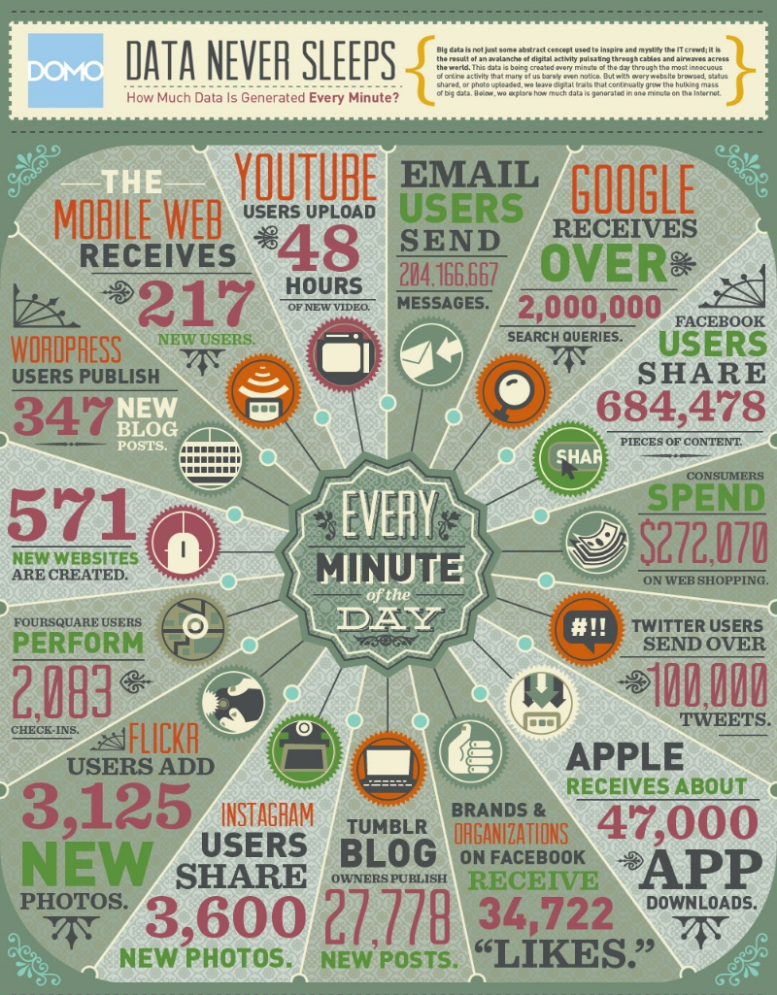
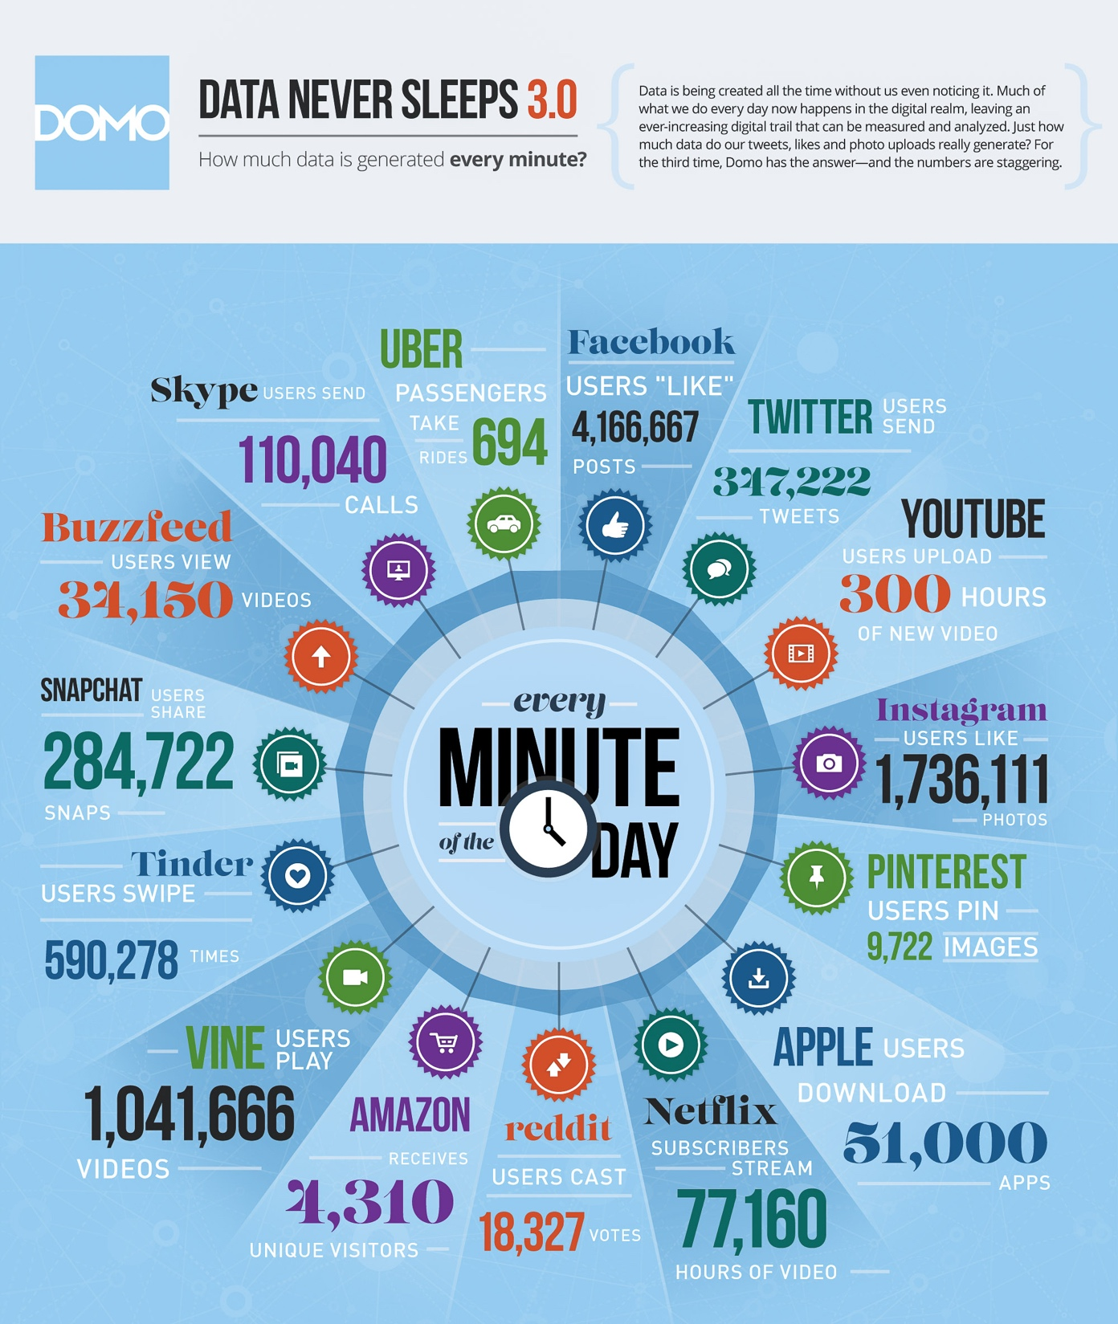
 | 2012 | 2015
YouTube | 48 hours | 300 hours
Twitter | 100,000 tweets | 347,000 tweets
Instagram | 3,600 shares | 1.7 million likes
Facebook | 684,000 shares | 4.1 million likes
Vine | Non-existent | 1 million views
Snapchat | Non-existent | 285,000 snaps
Tinder | Non-existent | 590,000 swipes
Data generated per minute:
2012

Slide 7
Internet population
2013: 2.4 billion people
2015: 3.2 billion people

Slide 8
Big Data

Slide 9
We live in a world of Big Data
Social media + Web
IoT
Smart TVs, Fitness trackers, fridges, connected cars, home automation, manufacturing, agriculture, medical devices…

Slide 10
Big Data is…
Not the size of the data
Not the technical tools
It's… A new paradigm
How to collect and use data efficiently
Big data. Small data. Any data.

Slide 11
90% of the world’s data has been created in the last two years…
The ultimate question is really what insight and value can we draw from that data.

Slide 12
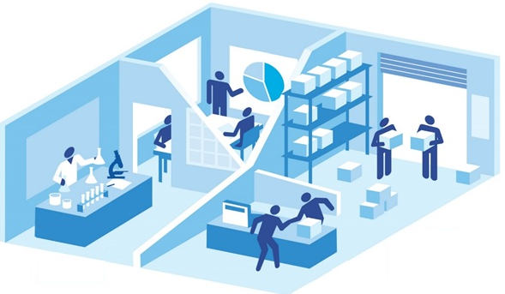
Data dividend: $1.6 trillion
Productivity:
$674 billion
Operations: $486 billion
Innovations: $235 billion
Customer-facing: $158 billion
Source: IDC Study: Realizing the Data Dividend, 2014.

Slide 13

How do we process all this data?
Cheaper, faster on-demand computing
45% of IT spend will be cloud-related by 2020

Slide 14
Azure

Slide 15
Azure is…
Microsoft's open, flexible cloud platform
Infrastructure-as-a-Service (IaaS)
Platform-as-a-Service (PaaS)
Language-agnostic
Linux + Windows

Slide 16
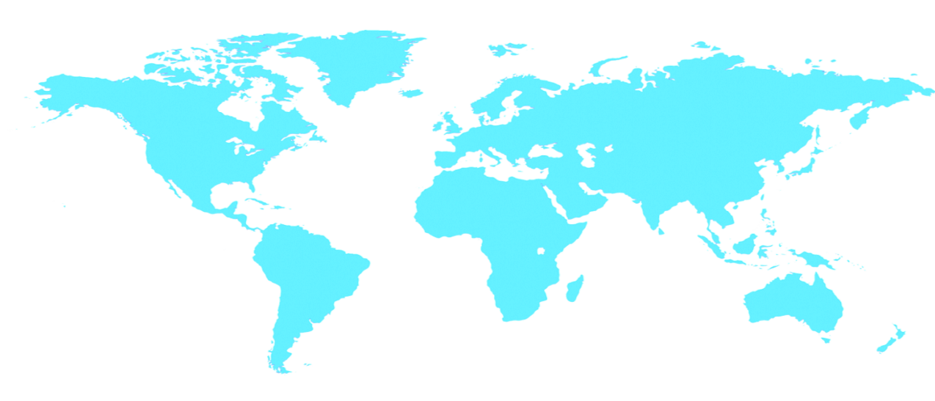

Azure global footprint
North Europe
Ireland
West Europe
Netherlands
Central US
Iowa
North Central US
Illinois
US Govt.
Iowa
China North *
Beijing
East US
Virginia
Japan East
Saitama
West US
California
China South *
Shanghai
East US 2
Virginia
Japan West
Osaka
India West
TBD
India East
TBD
South Central US
Texas
US Govt.
Virginia
East Asia
Hong Kong
SE Asia
Singapore
Australia East
Sydney
Brazil South
Sao Paulo
Australia West
Melbourne

Slide 17
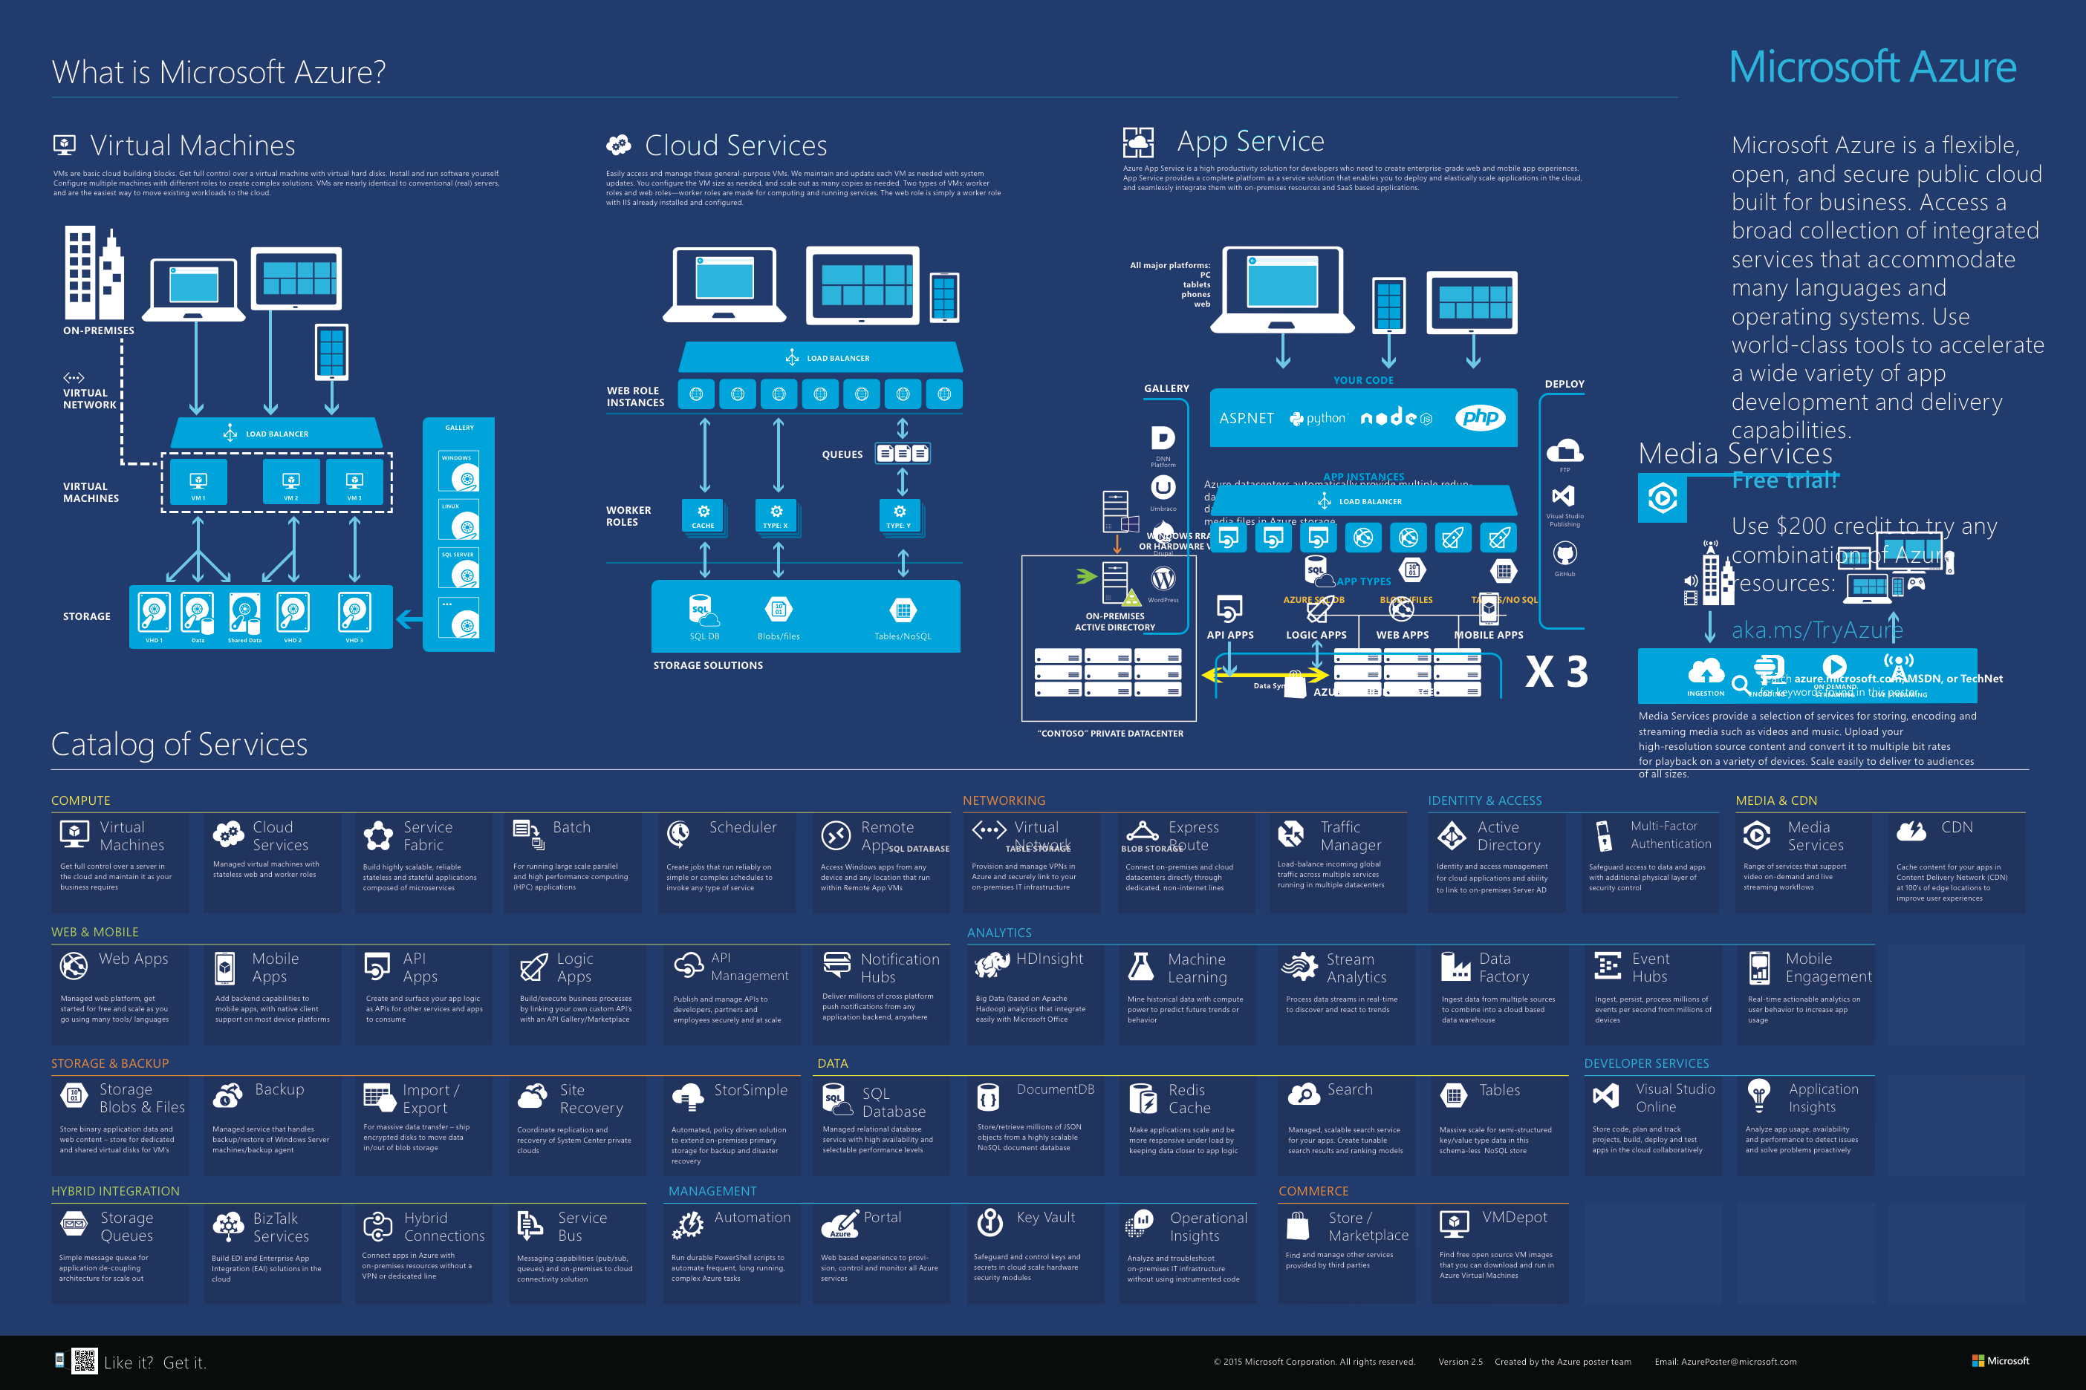

Slide 18
BI & Analytics | PowerBI Mobile BI, Natural Language Query, Dashboards
Predictive Analysis | Transform: Stream Analytics Event Hubs Data Factory | Predictive: Machine Learning
The Azure data stack
Data Platform | Structured: SQL Database | Unstructured: DocumentDB Tables, blobs Azure Search Redis | Structured: SQL Server DB2 Oracle | Unstructured: Hadoop Cloudera MongoDB CouchDB
 | Azure Data Warehouse Azure Data Lake
Azure | PaaS | IaaS
 | Microsoft Azure

Slide 19
Lab overviews

Slide 20
Five labs, five scenarios
100% "as-a-Service" – No VM's, no installations
Only service-level configuration
Possibly laptop tools (the mentors will assist)

Slide 21
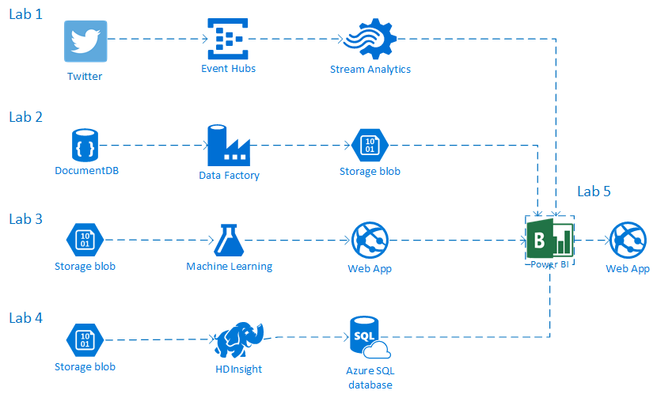

Slide 22
Lab 1
Social media analysis:
Real-time Twitter analysis in Azure Stream Analytics
Twitter →Event Hub →Stream Analytics →Blob storage

Slide 23
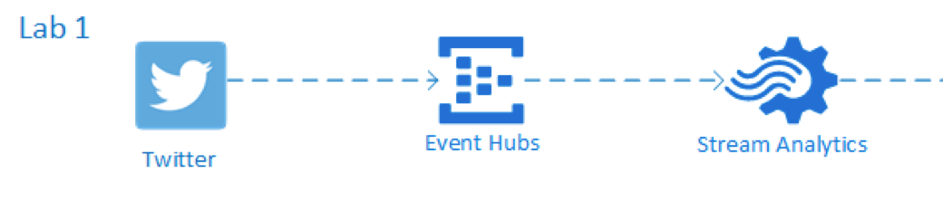
Technologies
Event Hub: Massive data ingestion
Stream Analytics: Inline query/aggregation
Blob: storage container for file-like objects

Slide 24
Use cases
Event Hub
Many data sources (Users, devices, messages…)
Large # of simultaneous data points
Imagine a solar farm:
each panel reporting output once per minute.
Topaz Solar Farm, California: 9 million panels

Slide 25
Use cases
Stream analytics
Live-stream data
Need for real-time queries / analysis in a time window
Imagine vending machines uploading inventory & temperature.
Imagine making decisions to refill, reboot, repair.

Slide 26
Lab 2
Movie data:
Transform from Document database to blob files
DocumentDB→ Data Factory →Blob storage

Slide 27
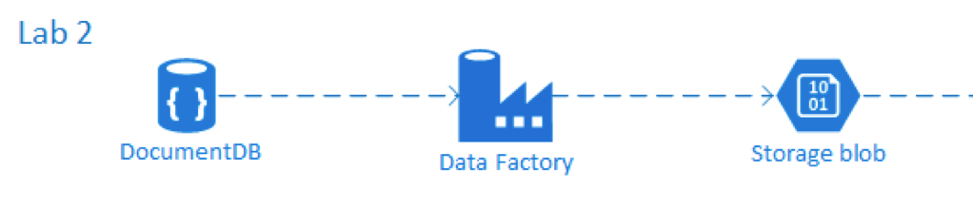
Technologies
DocumentDB: Document database (NoSQL)
Data Factory: Data orchestrator

Slide 28
Use cases
DocumentDB
Data that doesn't conform to strict schema
Storage/queries against heterogeneous data
Predictable, consistent performance required
Imagine an online store, selling hundreds of items:
Books, movies, music, watches, clothes…
Imagine each item type with different properties.
Imagine millions of items…

Slide 29
Use cases
Data Factory
Need to transform data between storage types
Need secure transfer (maybe from on-premises to cloud)
Imagine wanting to analyze data with different tools.
Imagine being able to convert source data
to match the needs of each tool (ML, logging, etc.)

Slide 30
Lab 3
Predict the profitability of a movie
Movie data →Azure ML → Web Service API

Slide 31
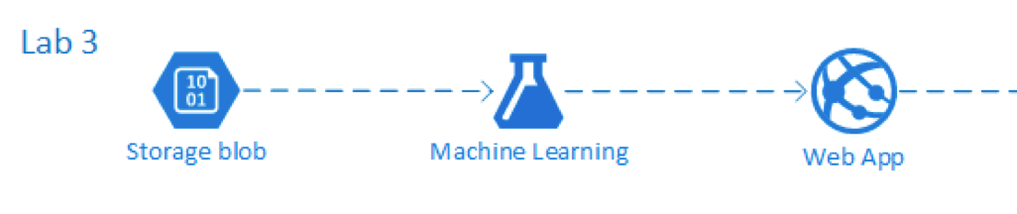
Technologies
AzureML: Machine Learning service

Slide 32
Use cases
Azure ML
Regression testing
Clustering / recommendations
Classification prediction
Imagine looking at someone's shopping history, and predicting new products to buy…
Imagine evaluating an insurance premium, based on historical data…

Slide 33
Lab 4
Discover highest-voted movies
Movie data →Blob → Hive → HDInsight → SQL Database

Slide 34
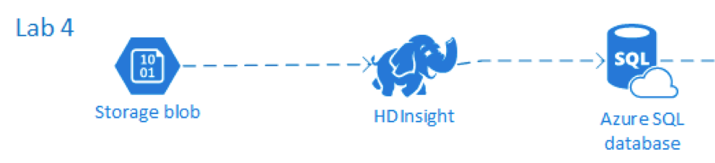
Technologies
Blob storage: file-like durable storage
HDInsight: Hadoop-as-a-Service
Hive: SQL-like query engine (auto-creates map/reduce)
SQL Database: SQL Server-as-a-Service

Slide 35
Use cases
HDInsight
Need to crunch massive amounts of data
Typically Large quantity in, small quantity out
Imagine looking through millions of game player data,
And determining top-100 scoreboard
Imagine millions of movies, and needing a count for each genre

Slide 36
Use cases
Hive
Simplified map-reduce queries:
Construct SQL, let Hive build mappers & reducers

Slide 37
Lab 5
Visualize vote average by movie genre
Movie data →SQL Database → PowerBI

Slide 38
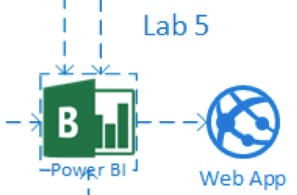
Technologies
SQL Database: SQL Server-as-a-Service
PowerBI: Data visualization tool
Azure Active Directory: Credentials management

Slide 39
Use cases
SQL Database
Managed, scalable SQL Server service
Imagine the ability to have built-in durability, backup / restore, DTU scaling, dynamic DTU/storage pools
Imagine moving your on-premises SQL Server to Azure without the need to maintain VMs/software

Slide 40
Use cases
PowerBI
Non-programmer visualizations from dozens of sources
Imagine a data-driven dashboard in your app, which changes dynamically
Imagine visualizing all the data from Labs 1-4: SQL Database, SQL Database, HDInsight, DocumentDB…

Slide 41
Summary
The Data Landscape is massive!
Big Data. Small Data. Any Data.
Azure provides many data services to work with
Labs will help introduce you to Azure + Data

Slide 42
Questions?

Slide 43


