Slide 1


1. local
portfolio
docker

Slide 2

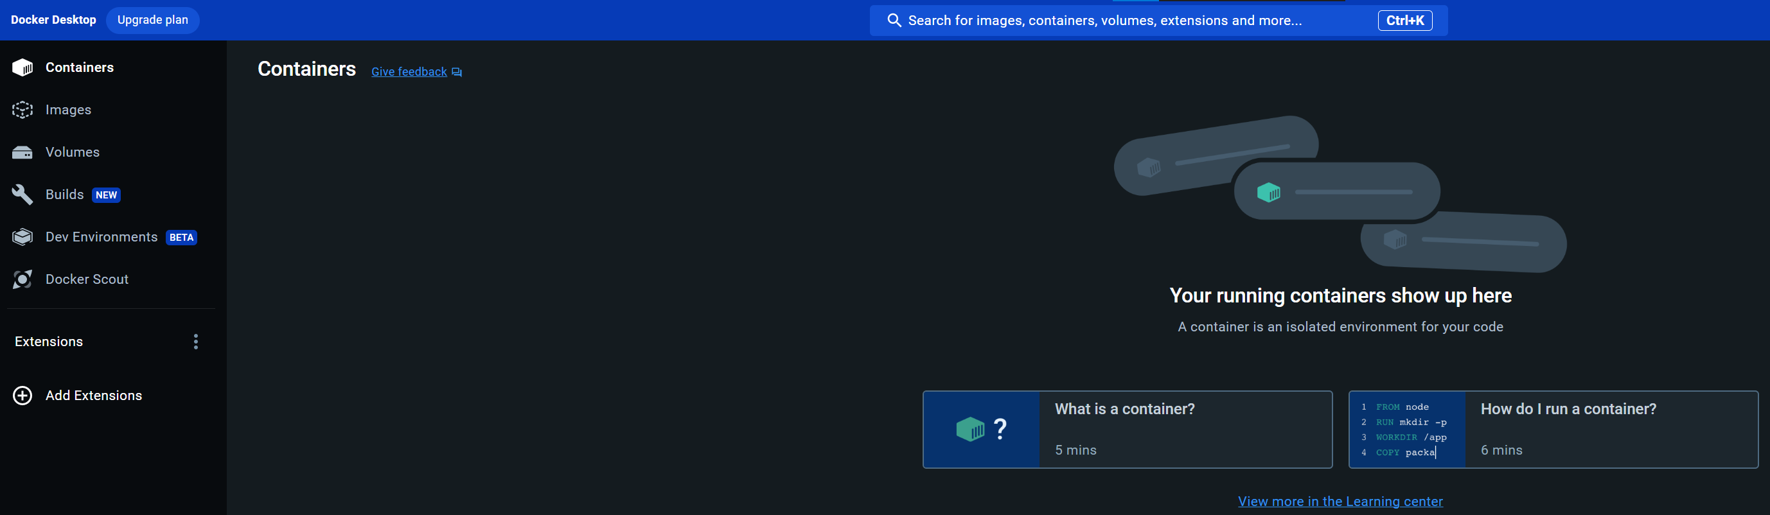
2. install
download
download
install
run the installer
reboot
don´t signup
run
docker course
overview

Slide 3
3. tutorial
tutorial
containerize-your-project
download
docker-python-example
..\..\docker-python-example

Slide 4
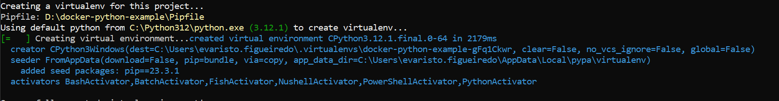
4. environment
see
..\..\python\environment\environment.pptx
4.1 pipenv
pipenv graph
created: Pipfile and Pipfile. Lock
without
running pipenv install,
virtual environment
was deleted
or
moved
pipenv install
without
any
packages
create
new virtual environment
based on
the information
in
your Pipfile
pipenv --venv
the environment

Slide 5
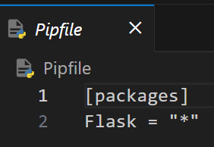
5. pipfile
what
..\..\docker-python-example\Pipfile

Slide 6
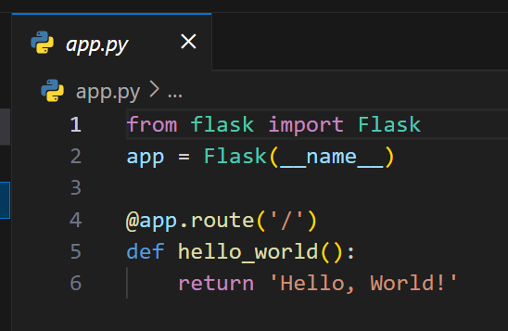
6. code
what
..\..\docker-python-example\app.py

Slide 7
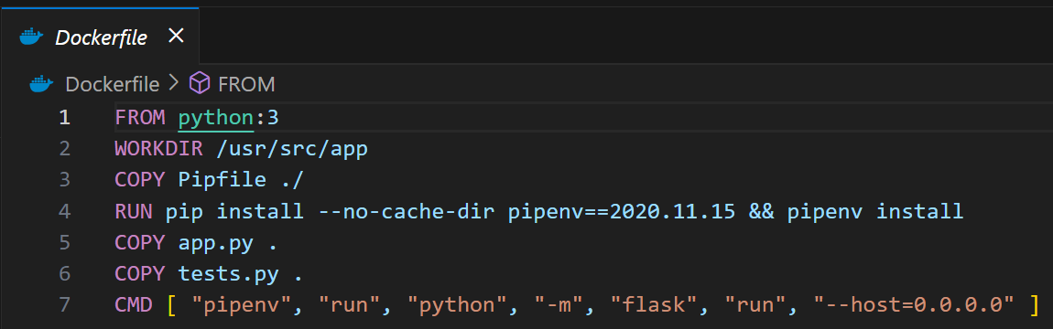
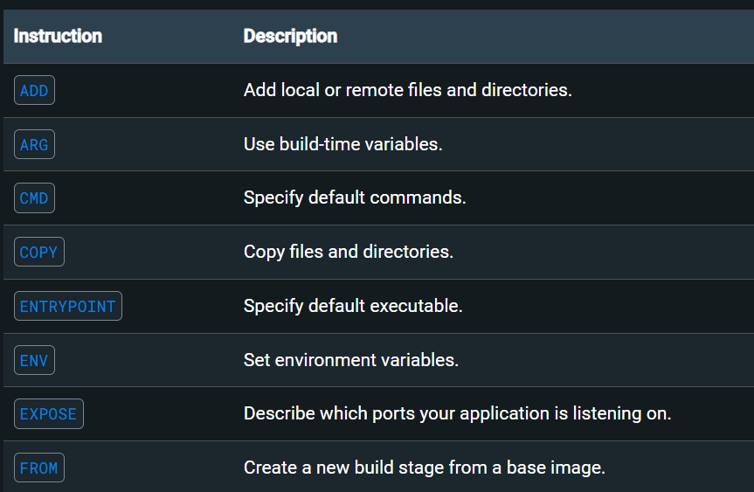
7. docker
what
..\..\docker-python-example\Dockerfile
reference

Slide 8
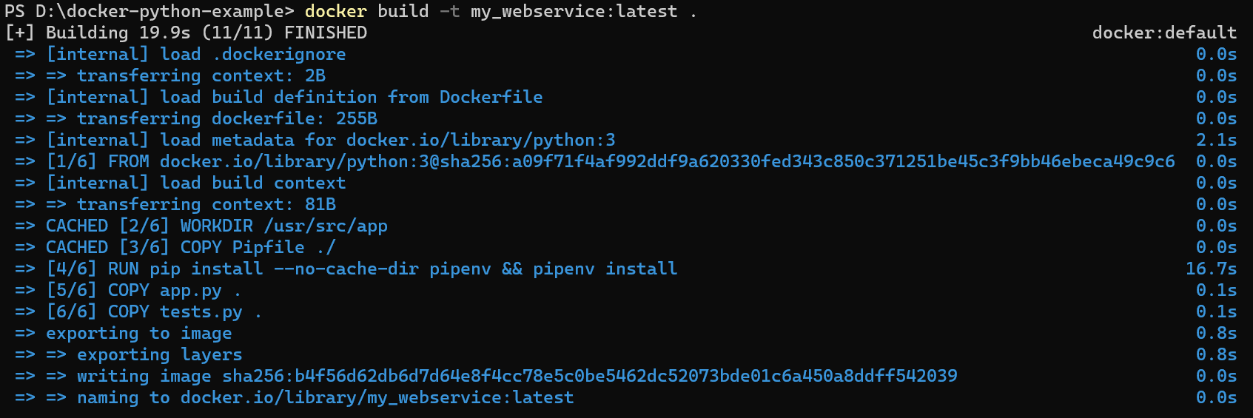
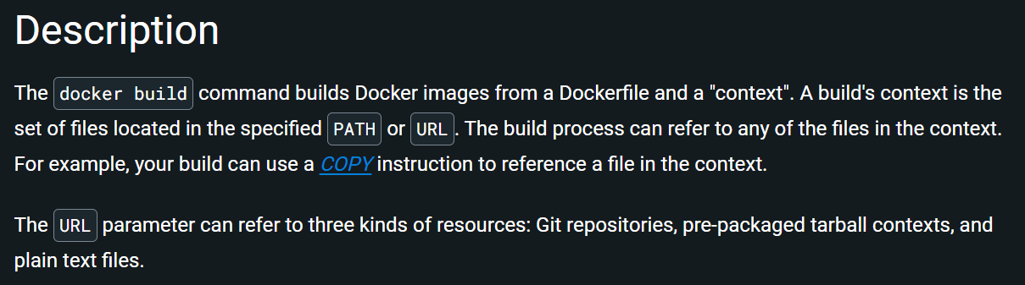
8. build
what
docker build -t my_webservice:latest .
reference/command line

Slide 9
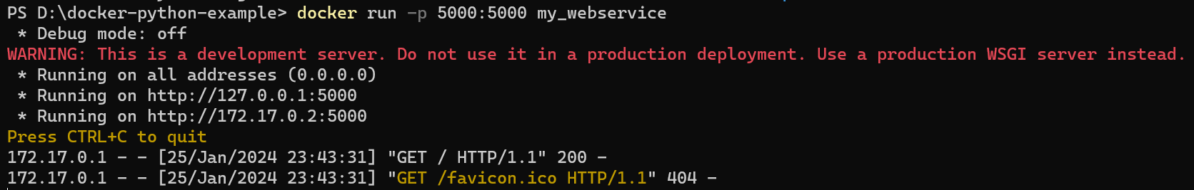
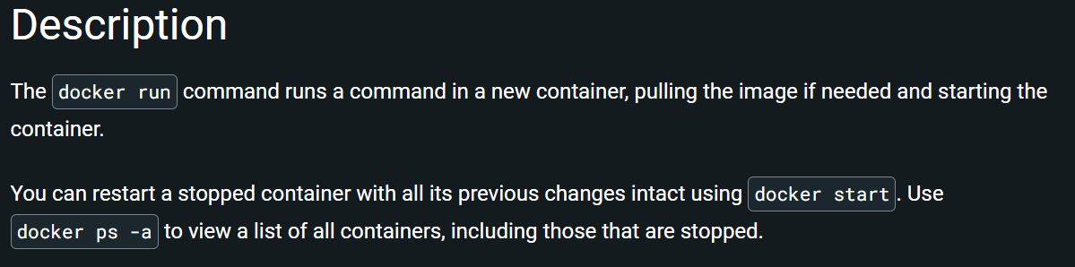
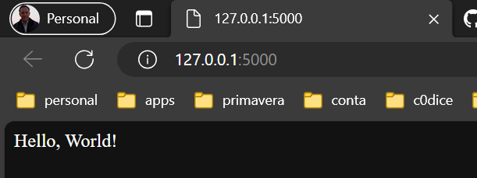
9. run
what
docker run -p 5000:5000 my_webservice
reference/command line

Slide 10
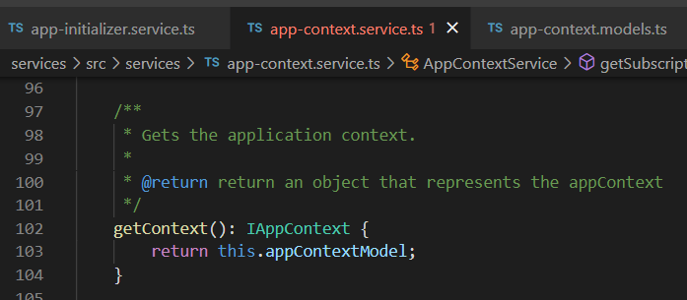

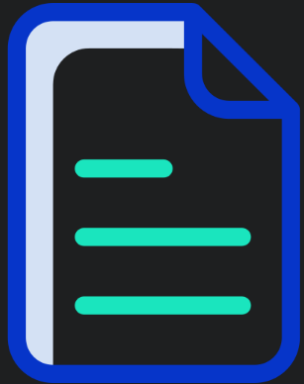

Z. template
new project
ExecuteAsync
square post-it
download
exe
download
exe
why
A slash
followed
by
two consecutive asterisks
D:\A1_research\C2_c0dice\B1_jmeter\A1_install
functionalities
introduction
build-exe
entity framework plus
zig help
⊂
4
every key-frame
defines the operation
success

