Slide 1
1. introduction
what
I want to evolve in the company
I have numerous skills, knowledge and experience that I think can be useful to the company
the experience I gained working in the teams:
core,
server
and client
was very valuable to understand how the company works: methodologies, technologies, products and source code base
in the context of the teams where I have been working
I tried to make the best work I could
according to the standard goals for the team
story points
issues
client assistance
I also tried to go beyond
core
Miguel corrections to the return results process
New techniques (Blazor WebAssembly,
server/core
to be
continued
but primavera is very well organized
and has very good professionals
talk is cheap
so I have some artifacts to show you
so you can see what I’m talking about
important: the artifacts are irrelevant and do not have value in then selves and can be not agile
but they can give you an idea about what I’m talking about and about methods and thecnics and processes and why doing it

Slide 2
2. client

Slide 3
3. server side

Slide 4
4. research
1. the research results must be reproducible by others and by you in the future (humans forget easily)
2. pears review: to validate the results of the research
3. all research is dated: the technologies, methodologies, tools, knowledge evolves

Slide 5
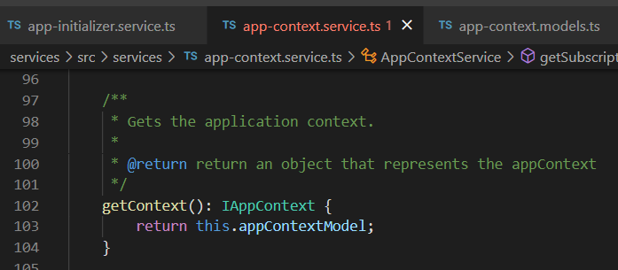





Z. template
new project
line 1
line 2
ExecuteAsync
square post-it
A slash
followed
by
two consecutive asterisks
D:\A1_research\C2_c0dice\B1_jmeter\A1_install
functionalities
introduction
entity framework plus
view code
⊂
4
every key-frame
defines the operation
success

