Slide 1

1. leadership
portfolio

Slide 2
1.1 index
project manager

Slide 3
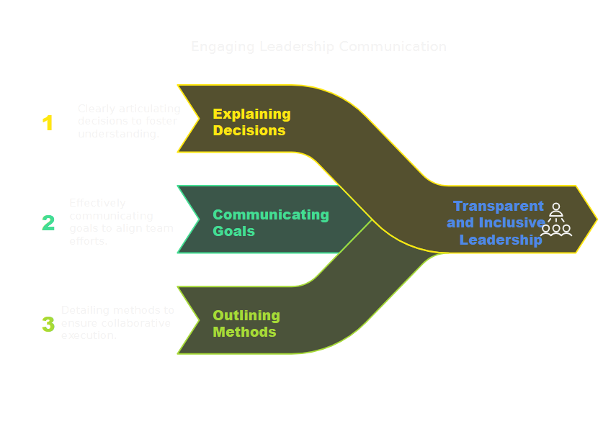
2. communication

Slide 4
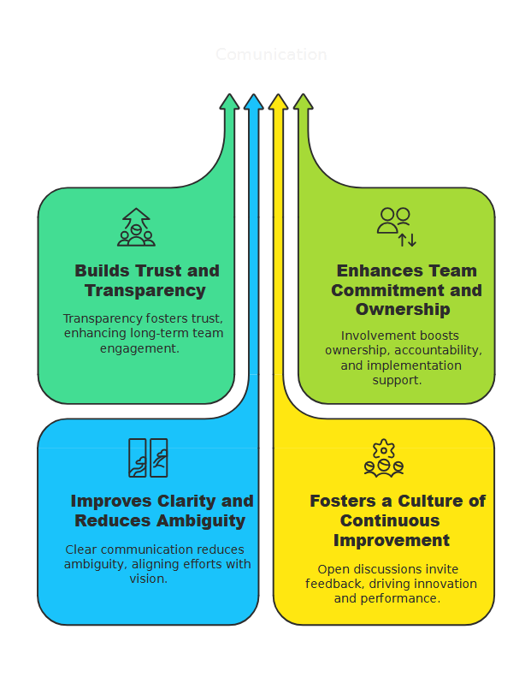
2.1 why

Slide 5
3. theories
Leadership Theory | Date | Description
Great Man | Mid-19th Century (c.1840s) | Proposes that leaders are born with inherent qualities that predestine them to lead; leadership is viewed as an innate, unchangeable trait.
Trait | 1930s–1940s | Focuses on identifying specific personality traits (e.g., intelligence, confidence) that differentiate leaders from non-leaders, suggesting these traits predict success
Behavioral | 1940s–1950s | Emphasizes observable leader actions and behaviors rather than inherent traits, arguing that effective leadership can be learned through practice and observation.
Transactional | Mid-20th Century | Based on an exchange process, this theory posits that leaders motivate followers through rewards and punishments to achieve defined goals and maintain order.
Contingency | 1960s | Proposes that the effectiveness of a leadership style depends on situational factors, meaning there is no single best style for all circumstances.
Situational | 1969 | A form of contingency theory that suggests leaders should adjust their style—from directing to delegating—based on the followers’ competence and readiness.
Servant | Early 1970s (1970) | Focuses on serving the needs of followers first, emphasizing empathy, stewardship, and the growth and development of team members as the basis for effective leadership.
Transformational | 1978 | Centers on leaders who inspire and motivate followers to exceed self-interests for organizational benefit, fostering significant change and innovation.
Full Range | 1991 | Integrates transformational, transactional, and laissez-faire styles into a comprehensive framework that assesses leadership across a full spectrum of behaviors.
Shared | Late 1990s–Early 2000s | Argues that leadership is distributed among team members rather than centralized in a single leader, promoting collaborative decision-making and mutual influence.
Authentic | Early 2000s | Emphasizes the importance of leaders being genuine, transparent, and morally grounded to build trust and inspire commitment among followers.

Slide 6
3.1 summary
Dimension | Transformational | Other Theories
Adaptability/Context | Consistent inspiring style | Situational/Contingency: adjust style based on: followers situational factors directive vs supportive approach
Rewards & Accountability | Long-term vision Intrinsic motivation | Transactional: reward–punishment systems to: ensure accountability; maintain structure; immediate outcomes matter
Development Focus | Personal growth Collective innovation | Servant Leadership: stronger emphasis on serving others’ needs fostering an environment prioritize: personal development well-being
Authenticity & Self-Awareness | Behavior: ethical value-driven (honor, loyalty, absolute transparence) that motivates | Authentic Leadership: self-awareness and transparency => genuine => builds trust

Slide 7
4. styles
Leadership Theory | Date | Description
Great Man | Mid-19th Century (c.1840s) | Proposes that leaders are born with inherent qualities that predestine them to lead; leadership is viewed as an innate, unchangeable trait.
Trait | 1930s–1940s | Focuses on identifying specific personality traits (e.g., intelligence, confidence) that differentiate leaders from non-leaders, suggesting these traits predict success
Behavioral | 1940s–1950s | Emphasizes observable leader actions and behaviors rather than inherent traits, arguing that effective leadership can be learned through practice and observation.
Transactional | Mid-20th Century | Based on an exchange process, this theory posits that leaders motivate followers through rewards and punishments to achieve defined goals and maintain order.
Contingency | 1960s | Proposes that the effectiveness of a leadership style depends on situational factors, meaning there is no single best style for all circumstances.
Situational | 1969 | A form of contingency theory that suggests leaders should adjust their style—from directing to delegating—based on the followers’ competence and readiness.
Servant | Early 1970s (1970) | Focuses on serving the needs of followers first, emphasizing empathy, stewardship, and the growth and development of team members as the basis for effective leadership.
Transformational | 1978 | Centers on leaders who inspire and motivate followers to exceed self-interests for organizational benefit, fostering significant change and innovation.
Full Range | 1991 | Integrates transformational, transactional, and laissez-faire styles into a comprehensive framework that assesses leadership across a full spectrum of behaviors.
Shared | Late 1990s–Early 2000s | Argues that leadership is distributed among team members rather than centralized in a single leader, promoting collaborative decision-making and mutual influence.
Authentic | Early 2000s | Emphasizes the importance of leaders being genuine, transparent, and morally grounded to build trust and inspire commitment among followers.

Slide 8


5. pending
what
finish PPT
D:\research\portfolio\leadership\_resources
\leadership
leadership.md
lidership.log
questions.md
report.md
chat GPT
project manager
\intelligence_prodution
my_prompt.md
review_prompt.md
questions.md

Slide 9
5.2 Marcos
to reason
think, understand, and form judgments by a process of logic
raciocinar
Fazer uso da razão para depreender, julgar ou conhecer
razão
Entendimento, em oposição à emoção

Slide 10
5.1 lexicon
what
My objective: money
Limit: None
  why? mediocrity and less value
  Competition with superiors?
  Superior does want to progress?
  what you want?
  how can I help you achieve your goals?
  no goals? no problem?
    you want me to keep quiet? not to progress?
  someone progressing makes the others look bad
    be clear in the objectives
    and tell the underachievers why
Why: ROI
  if I keep ROI constant
  value to company augments
  salary augments
Problem
  my value to the company is difficult to measure
  solution: Marcos is the company
    perceived value
need
value description
Fernando
the unknown unknowns
you should give me the benefice of the doubt

Slide 11
5.1 lexicon
what
intelligence
    needs to be very well
      communicated
    needs to be shared
    needs to be adopted
  otherwise has no value
need
value description
power
sources
is not a pizza
is infinite
no competition
language
  one image is better then 1000 words
  clear, concise, objective
  well formatted
  small messages
communication
  perceived value
  what is the point of being the best?
    if no one knows

Slide 12
5.4 me
what
leader needs:
  respect
  admiration?
  trust
this is why you question my leadership
so I need to communicate my value
  because the problem is the perceived value
me
  my value to the team?
    I’m at least as smarter as anyone
    I have more energy
    I have more experience
    I’m not very emphatic
      but fair
      flexible
      reasonable
  my value to each of you?

Slide 13




Z. template
new project
ExecuteAsync
square post-it
download
  exe
download
  exe
why
A slash
  followed
by
  two consecutive asterisks
D:\A1_research\C2_c0dice\B1_jmeter\A1_install
functionalities
introduction
build-exe
entity framework plus
zig help
⊂
4
every key-frame
defines the operation
deploy

