Slide 1

1. kafka
1. kafka
events
portfolio

Slide 2

1.1 index
https://docs.docker.com/guides/kafka/

Slide 3
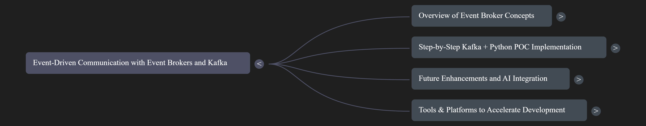
2. what

Slide 4
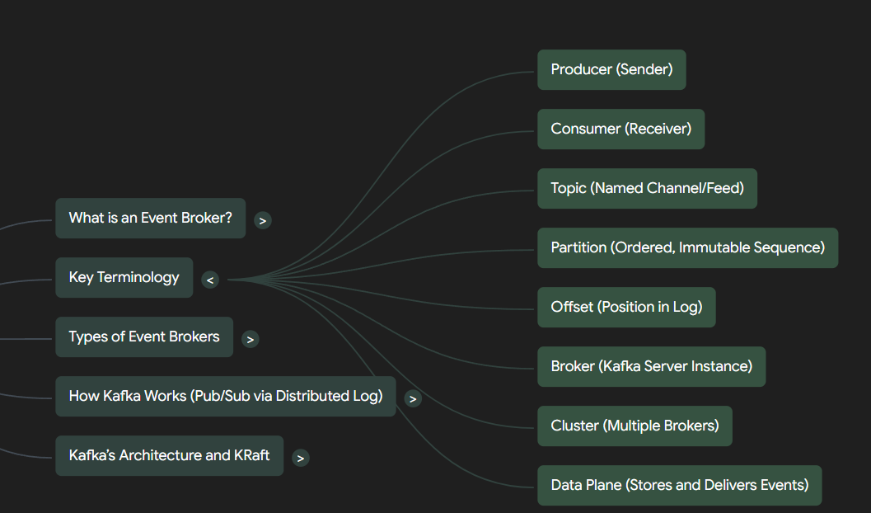
3. concepts

Slide 5

3.1 event/multiple topics
what
an event (or message)
  is produced
to a specific topic
cannot be
  directly assigned
to
  multiple topics
simultaneously
kafka-use-cases-event-driven-architecture
what-is-an-event-in-the-apache-kafka-ecosystem
D:\research\portfolio\events\_resources\kafka\multi_topic_events.md

Slide 6
3.2 topics hierarchy
what
topics are organized
in
a flat name-space
without
inherent hierarchical
relationships.
Hierarchical Topics
D:\research\portfolio\events\_resources\kafka\topics_hierachy.md

Slide 7
3.4 kafka vs redis
what
topics are organized
in
a flat name-space
without
inherent hierarchical
relationships.
Hierarchical Topics
D:\research\portfolio\events\_resources\kafka\topics_hierachy.md

Slide 8




Z. template
new project
ExecuteAsync
square post-it
download
  exe
download
  exe
why
A slash
  followed
by
  two consecutive asterisks
D:\A1_research\C2_c0dice\B1_jmeter\A1_install
functionalities
introduction
build-exe
entity framework plus
zig help
⊂
4
every key-frame
defines the operation
deploy

