Slide 1

1. postman
authentication

Slide 2


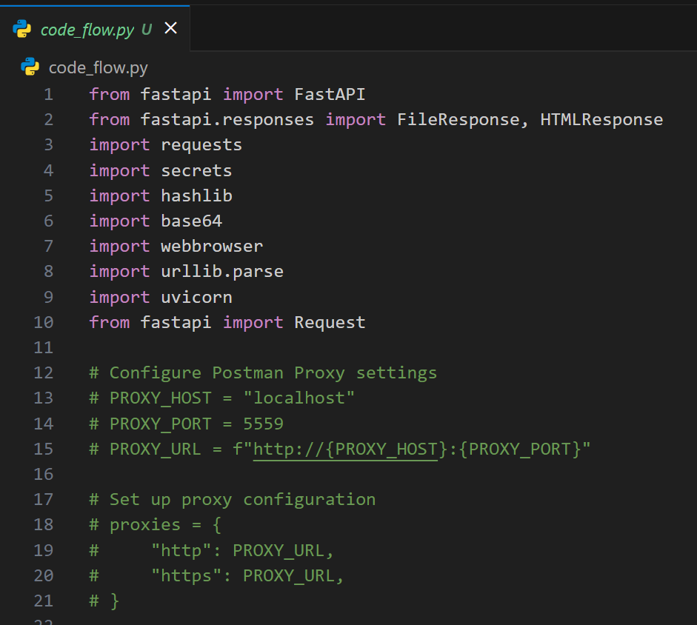
1.1 sources
sending-requests/capturing-request-data/capture-overview/
/sending-requests/capturing-request-data/capture-with-proxy/
..\_projects\sign_in_python

Slide 3
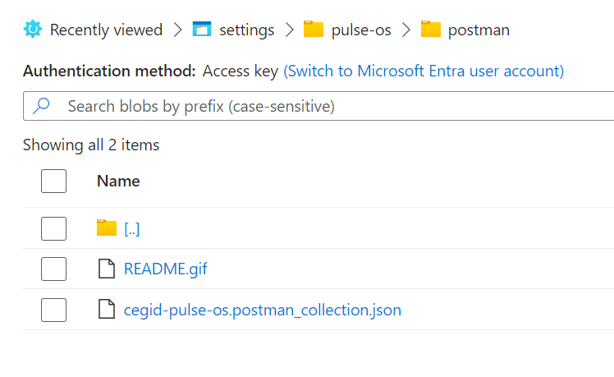
2. what
description
this is the work I made for CTU product directly (machine to machine) connect to our backend
they use postman to access to implement authentication
I created an postman workspace:
this corresponds to the next slide
explains postman

Slide 4
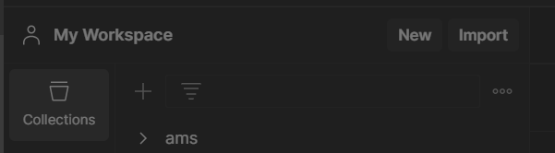
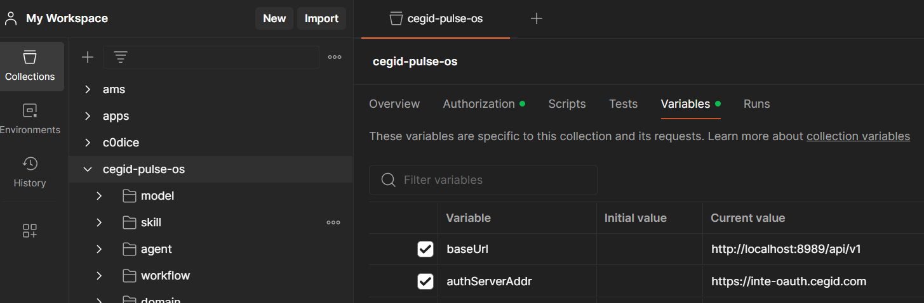
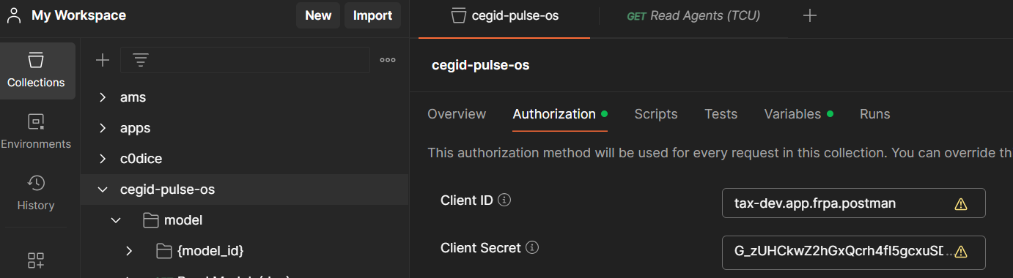
3. read me
1
2
setup variables
3
authorization
for
CTU product

Slide 5
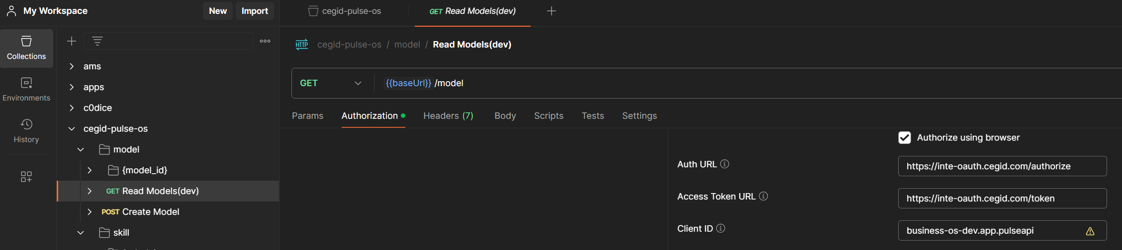
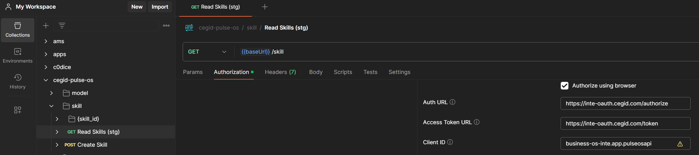
3.1 read me 1
4
authorization
for
DEV
needs to
setup variables
accordingly
5
authorization
for
STG

Slide 6
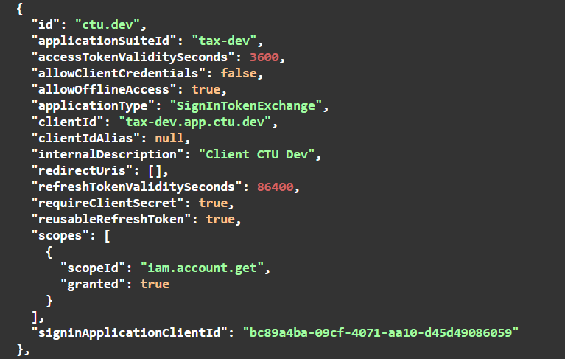
4. CTU
refresh token
token exchange
requires client secret

Slide 7
4.1 scopes
dev
devisfact-dev.aiapi.global
stg
devisfact-inte.aiapi.global
production
devisfact.aiapi.global

Slide 8
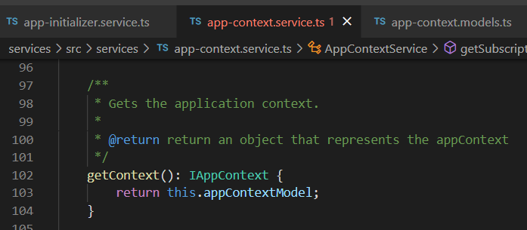



Z. template
new project
ExecuteAsync
square post-it
download
exe
download
exe
why
A slash
followed
by
two consecutive asterisks
D:\A1_research\C2_c0dice\B1_jmeter\A1_install
functionalities
introduction
build-exe
entity framework plus
zig help
⊂
4
every key-frame
defines the operation
deploy

