Slide 1

1. tests
authentication

Slide 2


1.1 index
problem
c# code

Slide 3

2. problem
what
skunk’s automated tests
needs a token without
browser login
approach
create python project with minimalistic CLIENT CREDENTIALS workflow
research how to do the onboarding

Slide 4
3. email

Slide 5
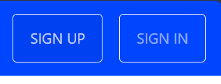
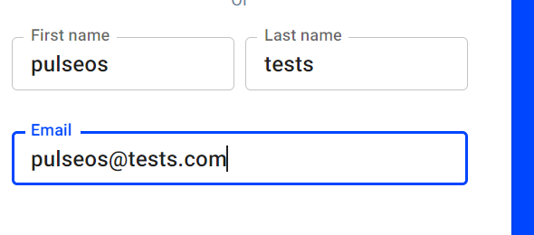
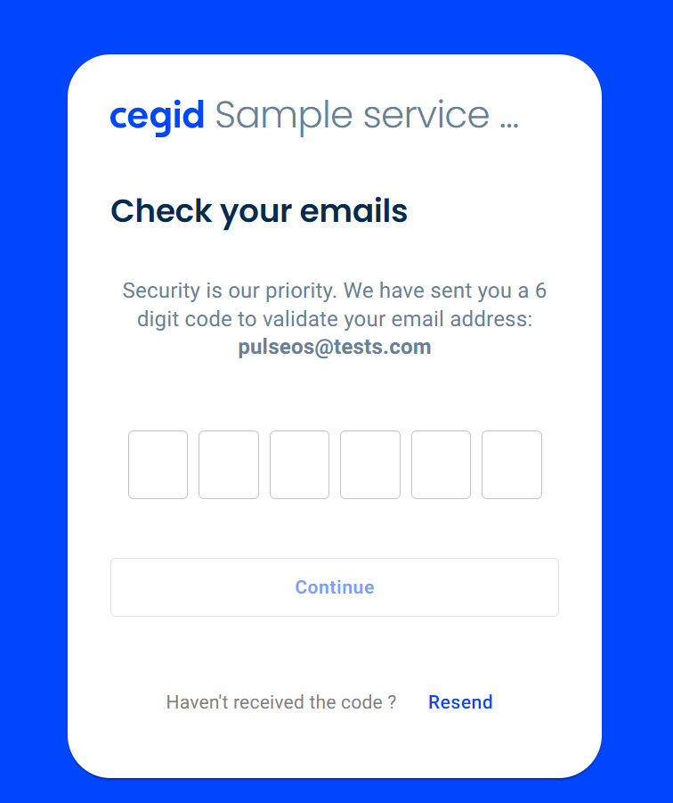
3.1 create
create new email
open in private window
pulseos@tests.com

Slide 6
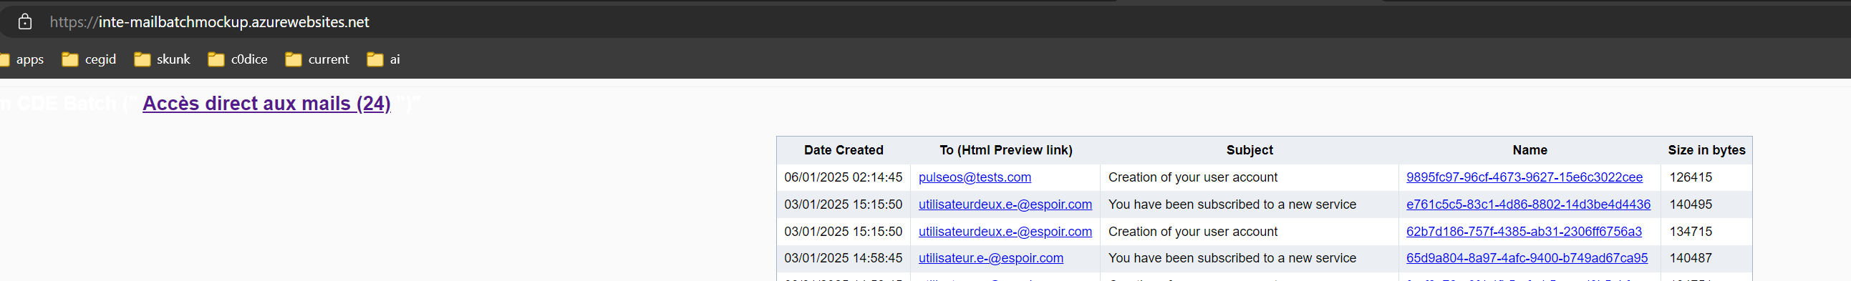
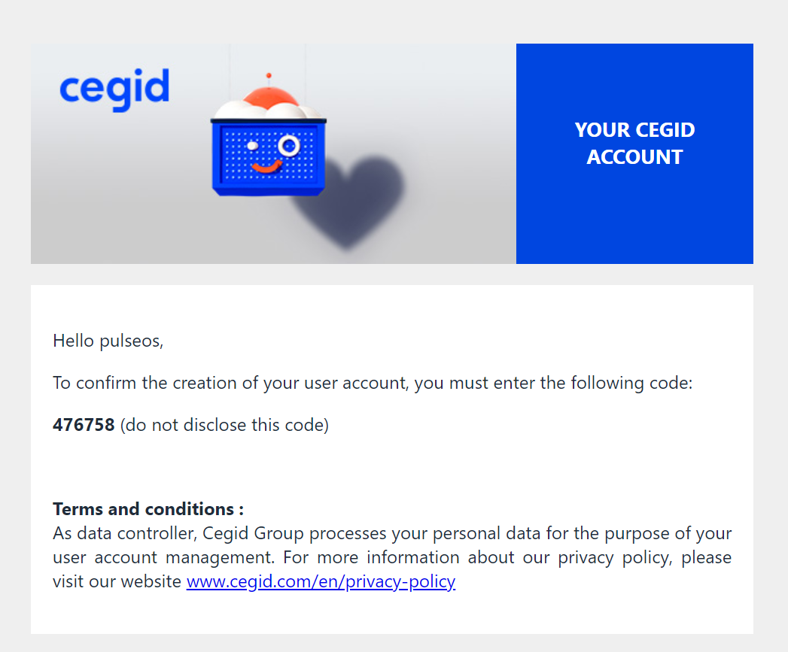
3.2 verification
view email confirmation
click
copy code to past in verification menu

Slide 7
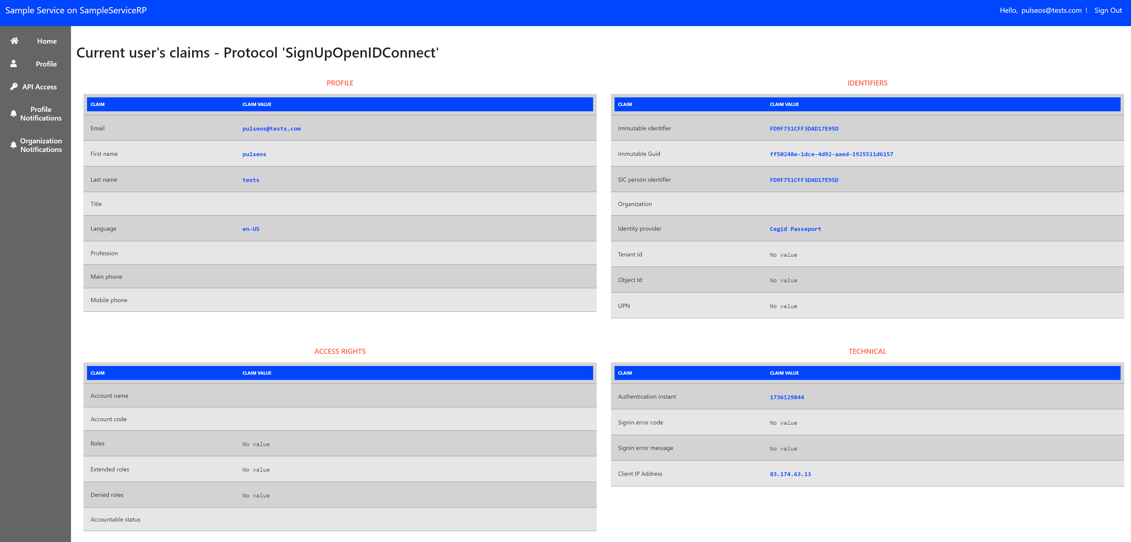
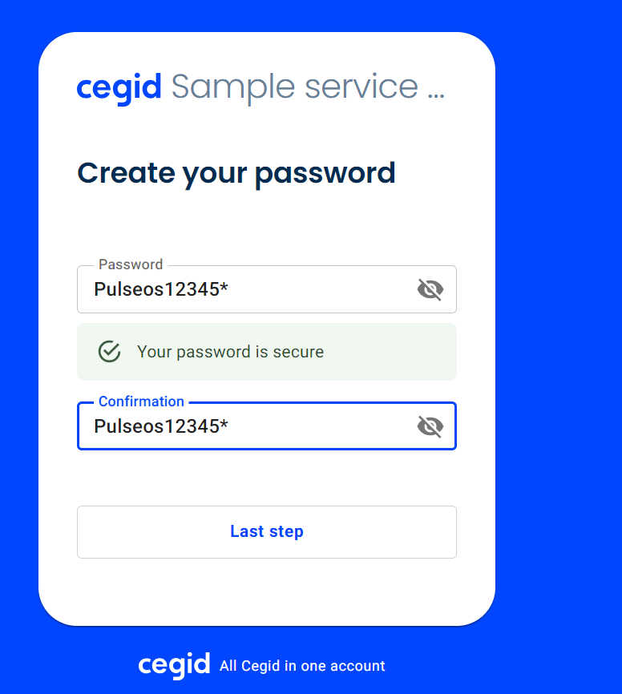
3.3 password
past code
setup password
pulseos@tests.com
Pulseos12345*

Slide 8
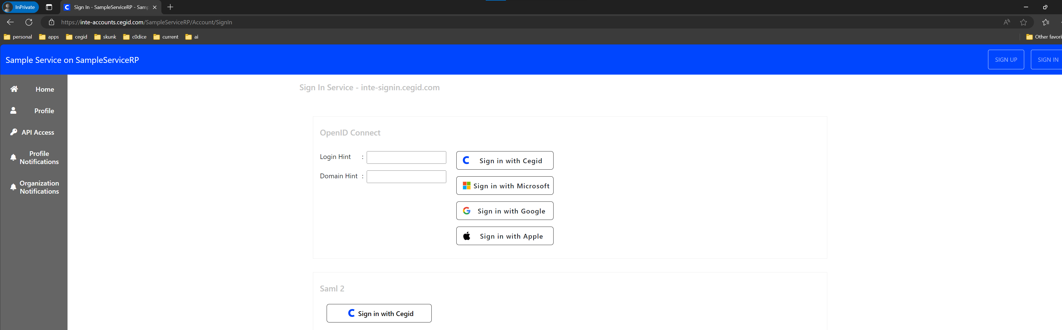
3.4 login
pulseos@tests.com
Pulseos12345*

Slide 9
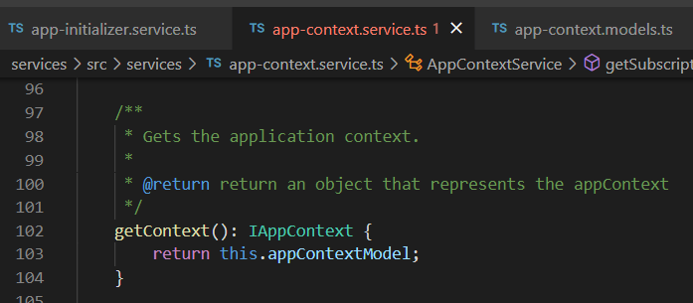



Z. template
new project
ExecuteAsync
square post-it
download
exe
download
exe
why
A slash
followed
by
two consecutive asterisks
D:\A1_research\C2_c0dice\B1_jmeter\A1_install
functionalities
introduction
build-exe
entity framework plus
zig help
⊂
⊂
4
every key-frame
defines the operation
deploy

