Slide 1


1. docker
portfolio
portfolio

Slide 2

1.1 index
theory
overview
commands
push
internals
compose
examples
local
aws
configuration file: hosts

Slide 3

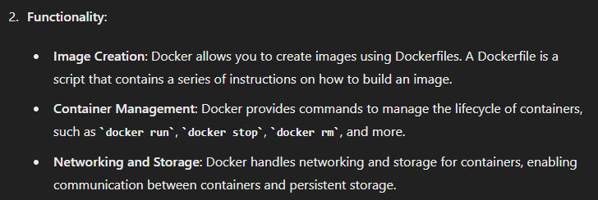
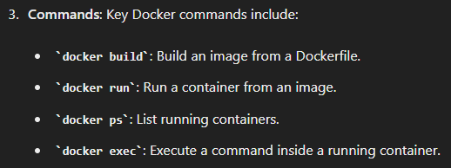
2. what
description

Slide 4
3. tests
playwright

Slide 5




Z. template
new project
ExecuteAsync
square post-it
download
  exe
download
  exe
why
A slash
  followed
by
  two consecutive asterisks
D:\A1_research\C2_c0dice\B1_jmeter\A1_install
functionalities
introduction
build-exe
entity framework plus
zig help
⊂
4
every key-frame
defines the operation
success

