Slide 1

1. bOS
skunk

Slide 2
1.1 index
autogen
studio
semantic kernel
orchestrator

Slide 3

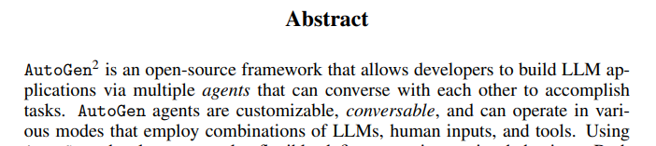
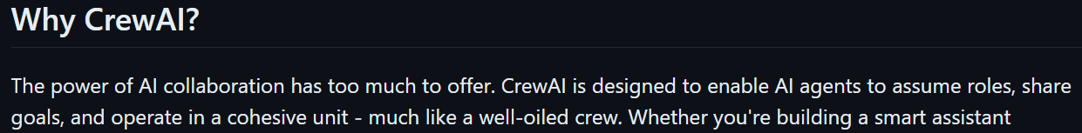
1.2 sources
auto gen - paper
auto gen vs semantic kernel
crew ai: github
crew ai

Slide 4
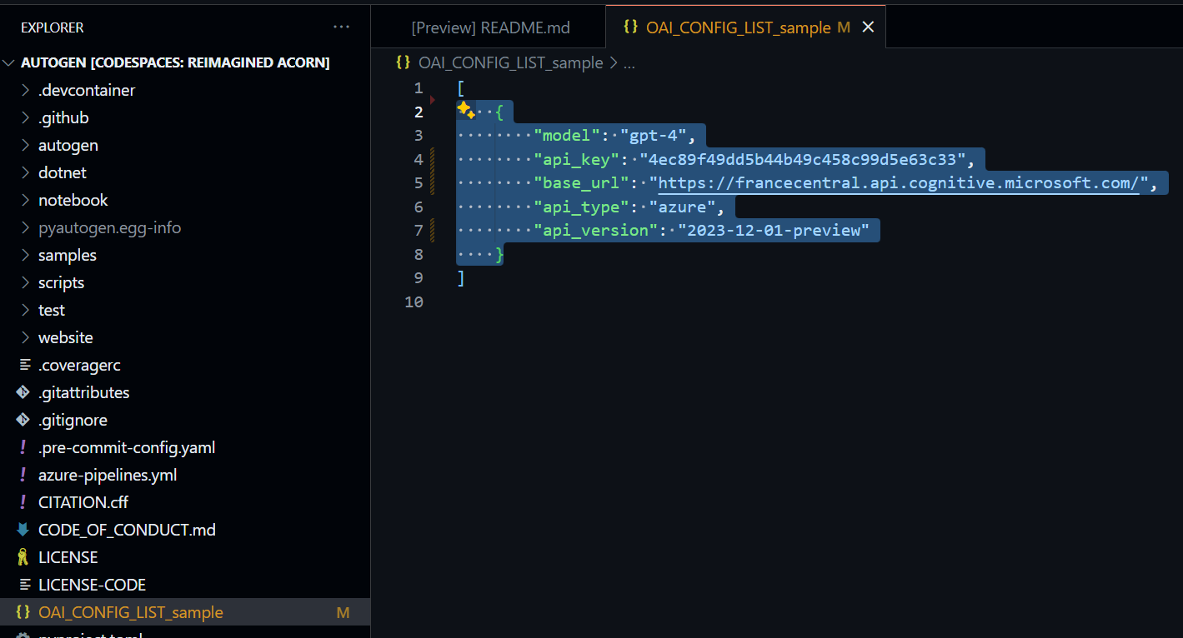
2. credentials
what
{
"model": "gpt-4",
"api_key": "4ec89f49dd5b44b49c458c99d5e63c33",
"base_url": "https://francecentral.api.cognitive.microsoft.com/",
"api_type": "azure",
"api_version": "2023-12-01-preview"
}
autogen repository vsCode online
github codespaces

Slide 5
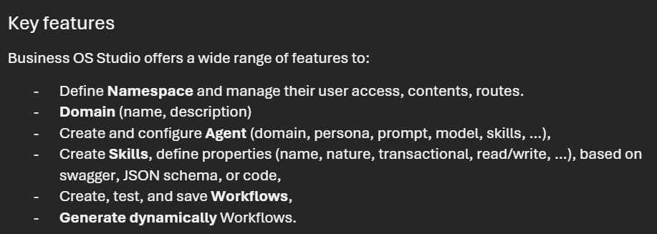
3. requirements
what
cegidgroup-my.sharepoint.com

Slide 6
3.1 use cases
what
excel: use cases

Slide 7
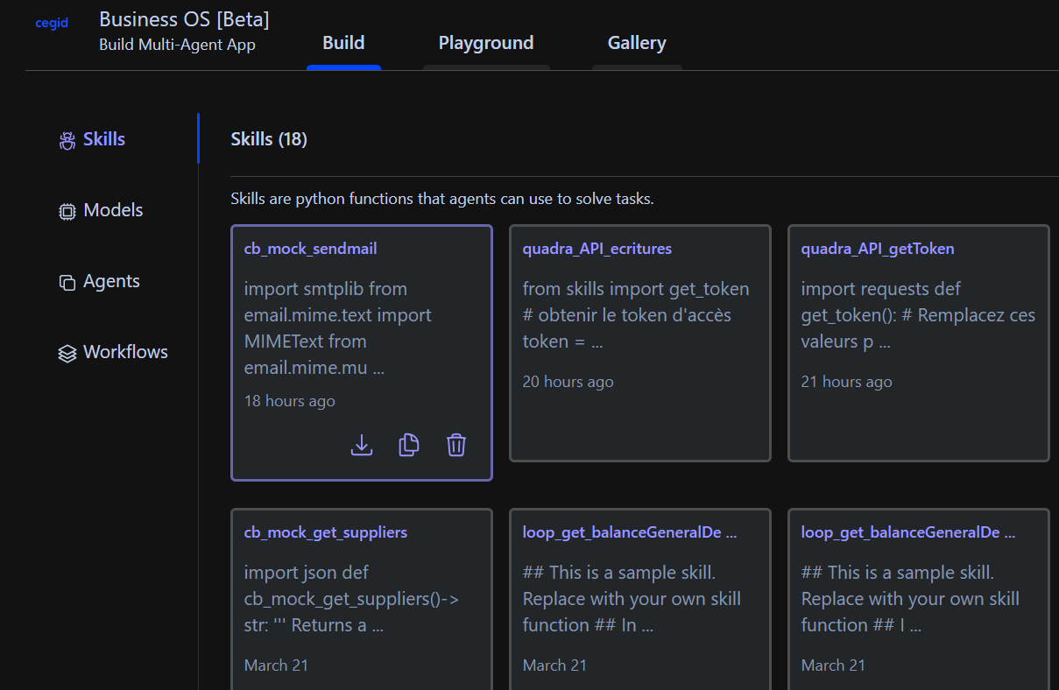
4. studio POC
what
aiOS auto gen studio

Slide 8






Z. template
new project
ExecuteAsync
square post-it
download
  exe
download
  exe
why
A slash
  followed
by
  two consecutive asterisks
D:\A1_research\C2_c0dice\B1_jmeter\A1_install
functionalities
introduction
build-exe
entity framework plus
zig help
⊂
4
every key-frame
defines the operation
success

