Slide 1

1. cdk
skunk
IaC

Slide 2
1.1 sources

Slide 3

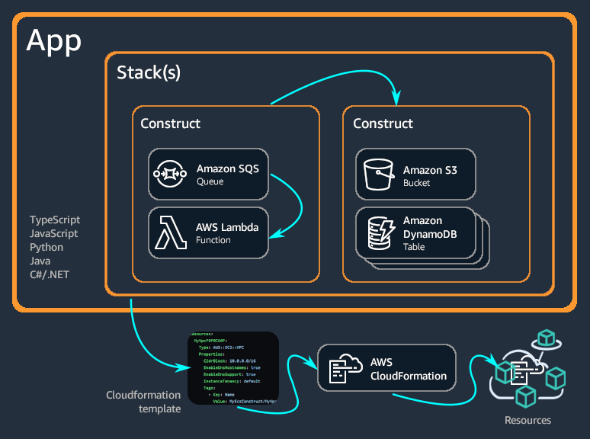
2. what
is an
  open-source
  software development framework
for defining
  cloud infrastructure
in
  code
provisioning it
  through
AWS CloudFormation
what is CDK

Slide 4

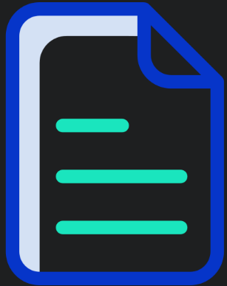

3. install
1
step 1
IAM/latest/User Guide/getting-set-up
IAM/latest/User Guide/security-creds
2
..\aws\cli.pptx
use
  access key
step 2
3
step 3
..\..\..\cdk open search\.commands
npm install -g aws-cdk
cdk –version
npm uninstall -g aws-cdk
4
step 4
AWS sts get-caller-identity
Account: '211125414460’
Arn: arn:aws:iam::211125414460:user/efigueiredo@cegid.com
UserId: AIDATCKAOFI6IOEYBWYK7
CDK bootstrap aws://211125414460/us-west-2

Slide 5
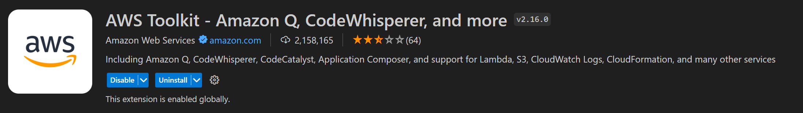
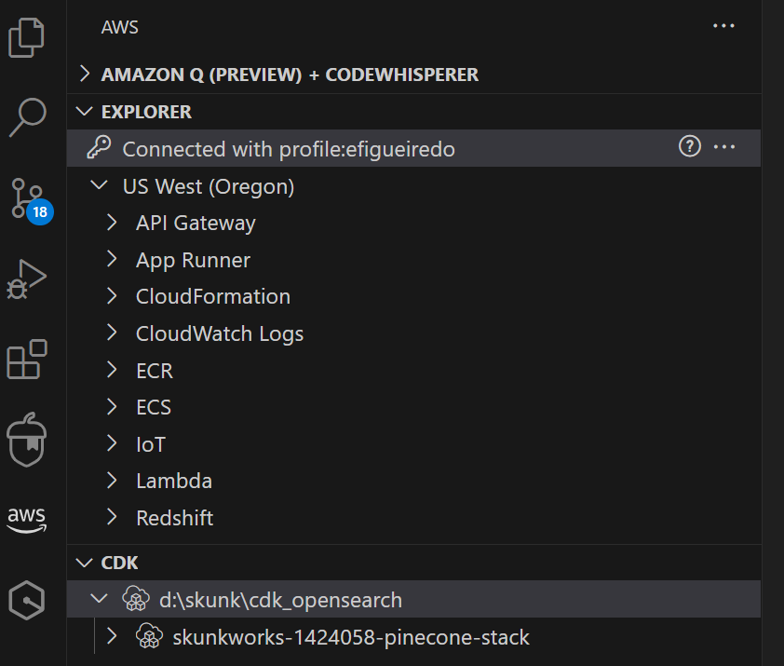
3.1 vsCode
plugin
vsCode AWS

Slide 6
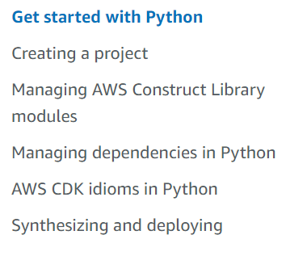
3.2 python
what
work-with-cdk-python
python tutorial

Slide 7
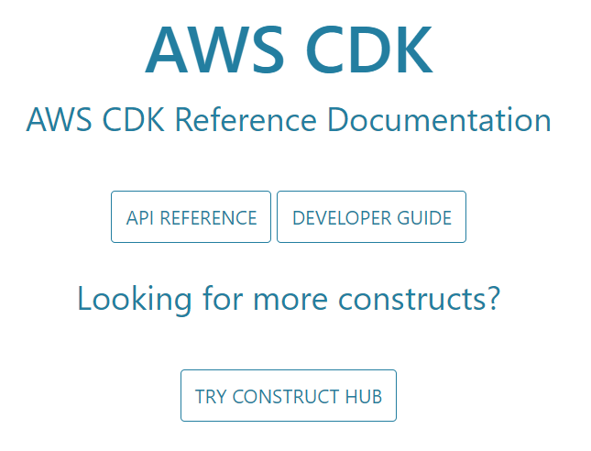
4. reference
what
CDK API reference

Slide 8
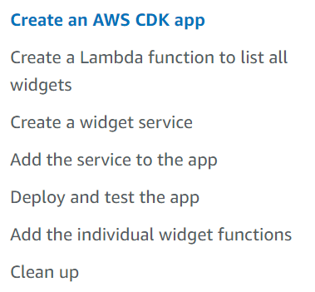
4.1 examples
what
examples

Slide 9
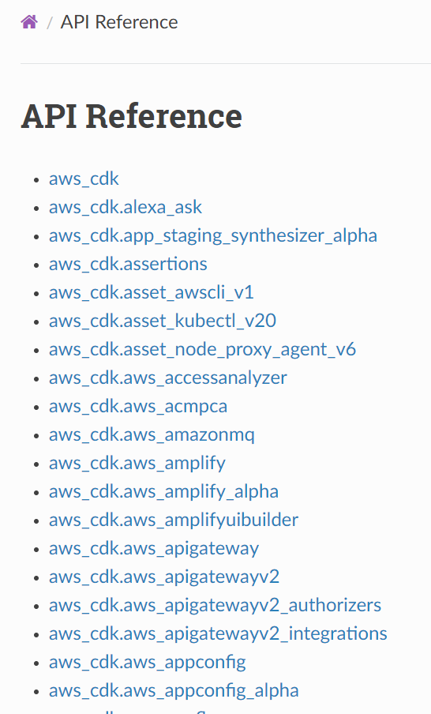
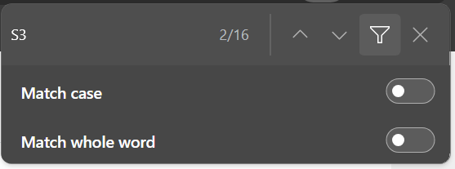
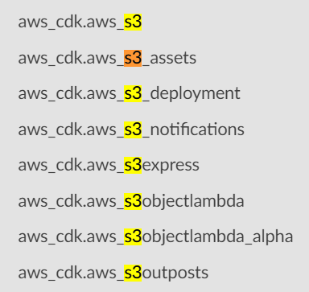
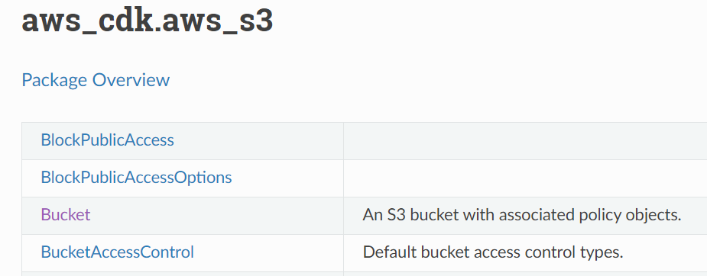
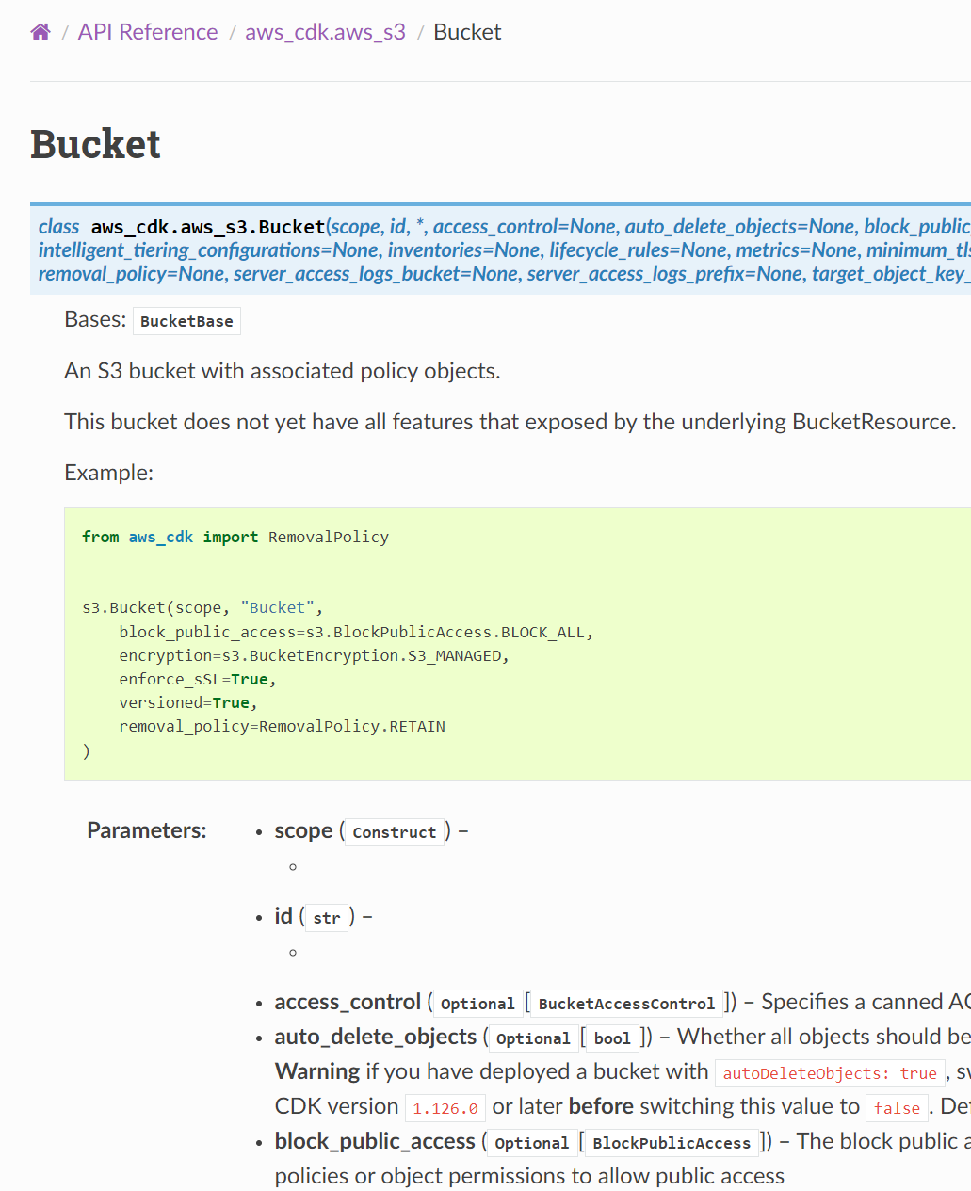
4.2 python
what
search
cdk/api/v2/python/
boto3 vs cdk

Slide 10
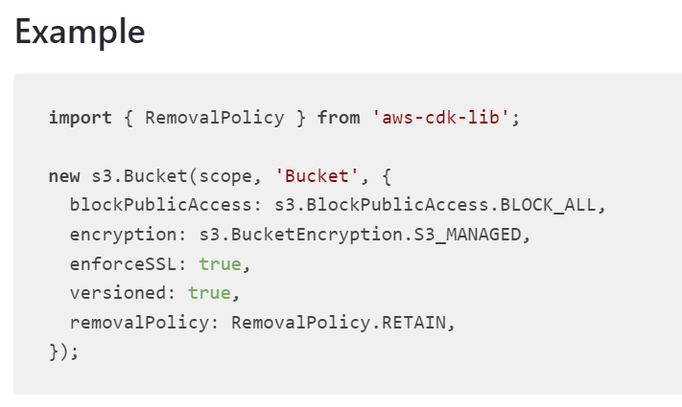
4.1 bucket
what
CDK reference: bucket

Slide 11
5. run

Slide 12
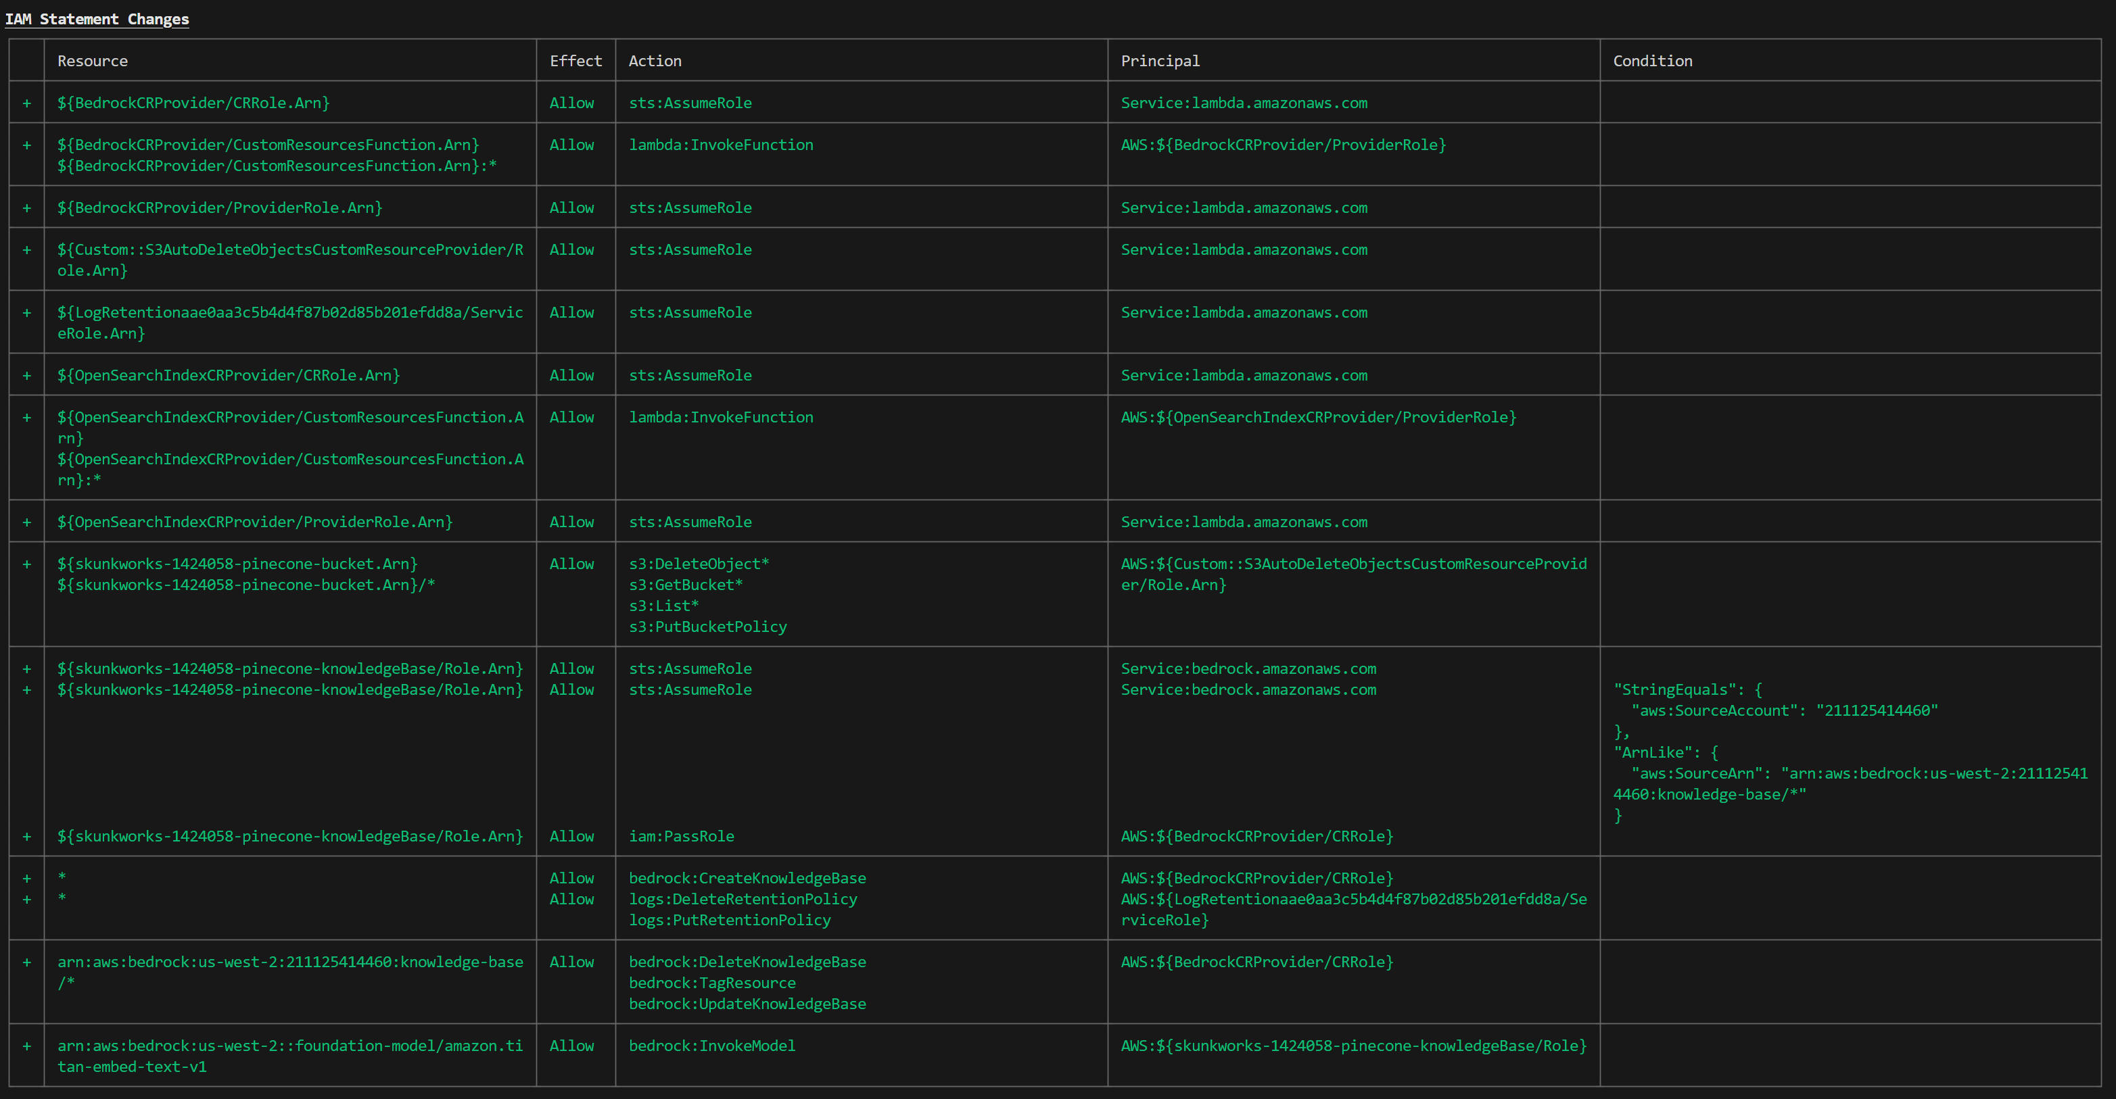
5.1 IAM statement

Slide 13
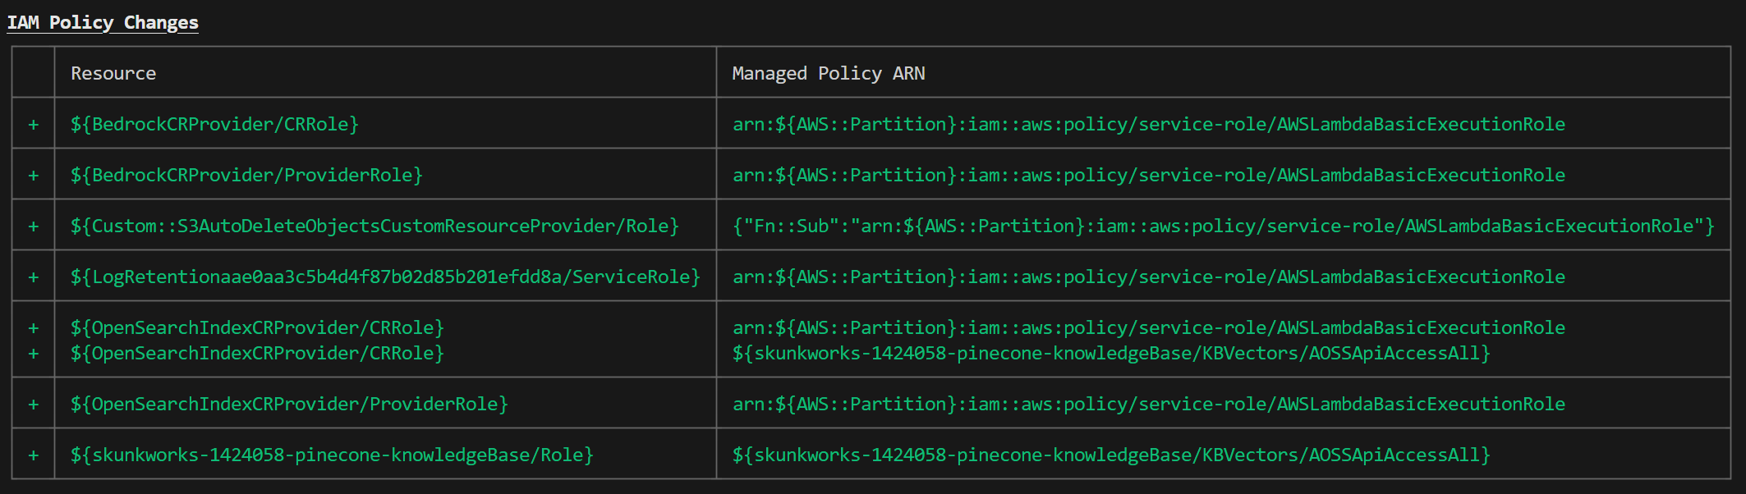
5.2 policy changes

Slide 14
6. tutorials

Slide 15
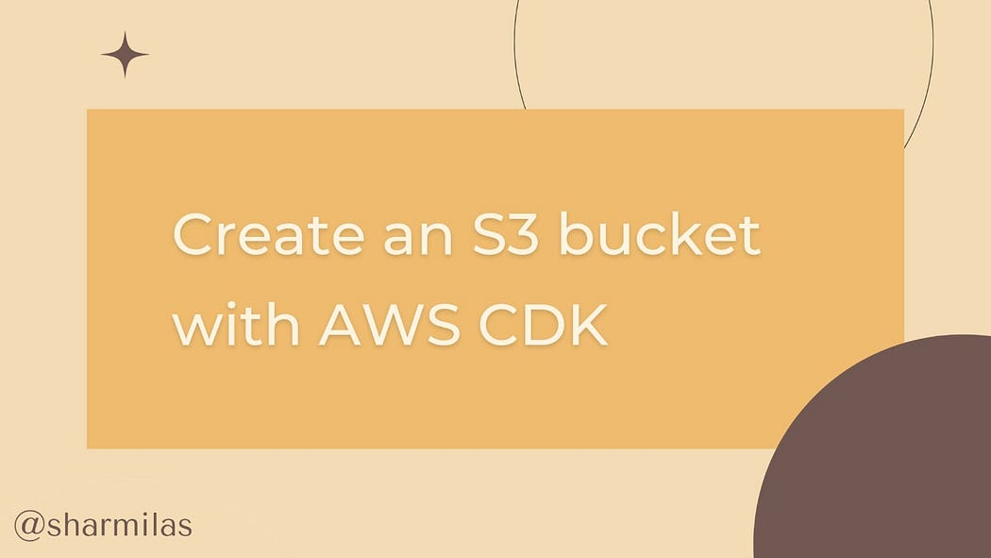
6.1 bucket (phyton)
what
tutorial

Slide 16
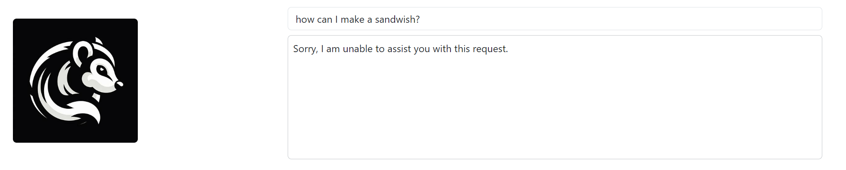
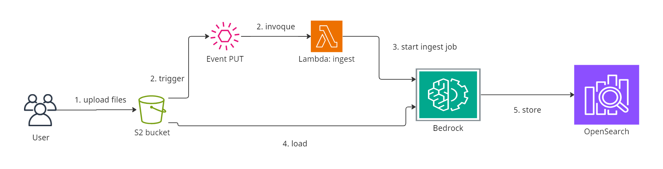
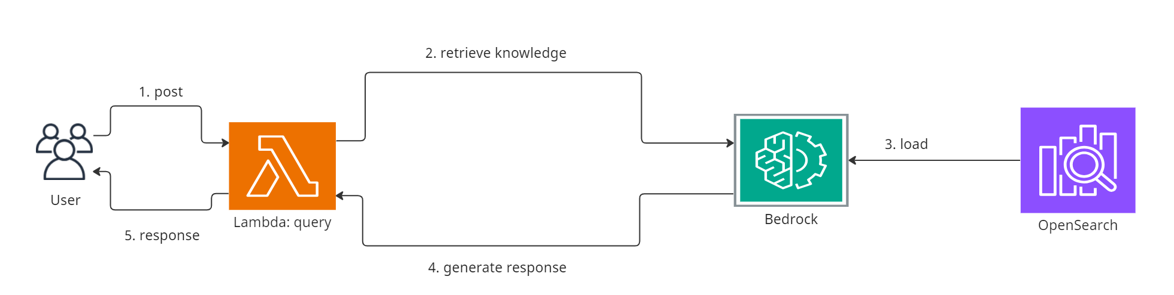
6.2 open search (TS)
easy-rag-with-amazon-bedrock-knowledge-base
diagrams

Slide 17
6.3 kendra (TS)
kendra

Slide 18
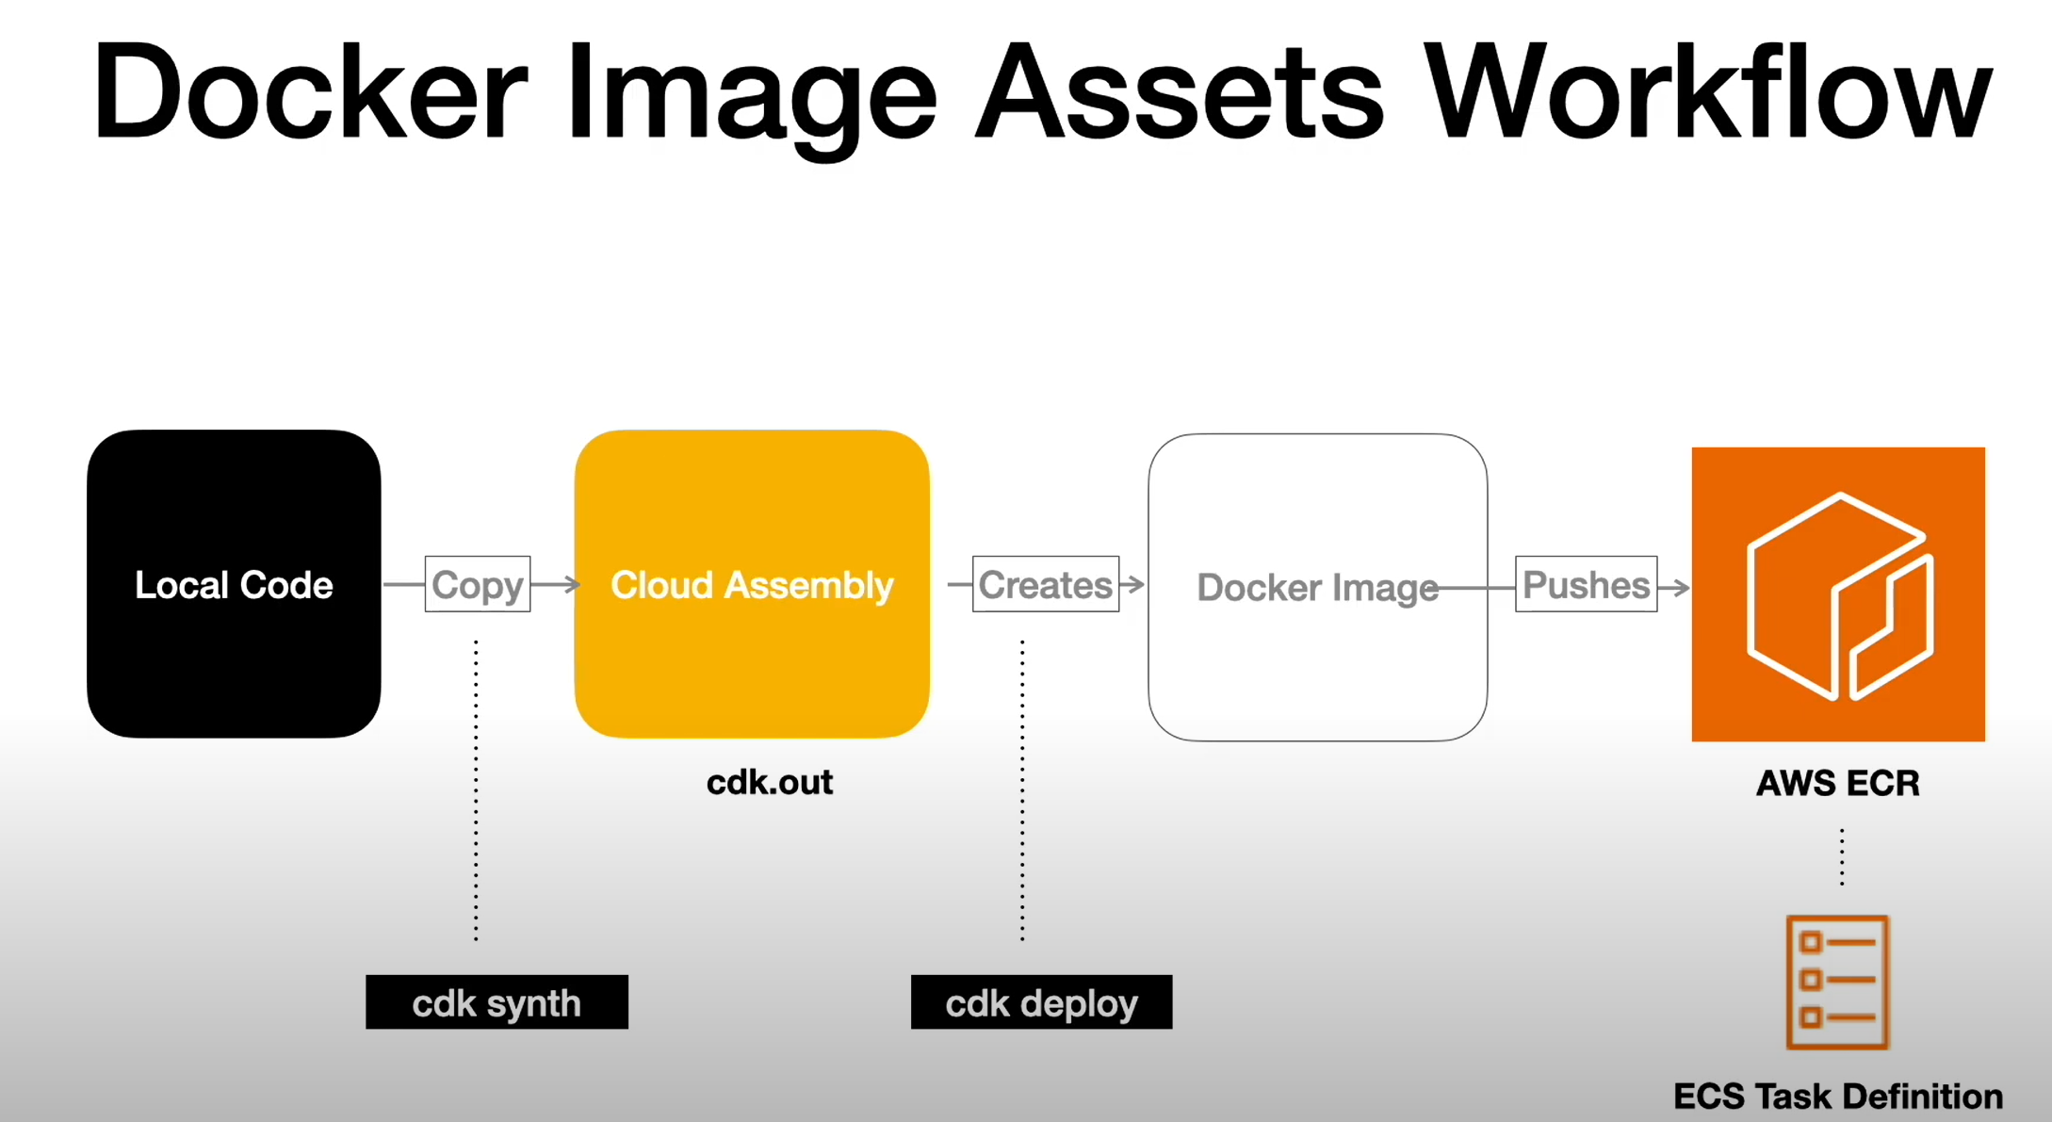
6.4 docker
what
fargate + ecr

Slide 19
6.4.1 ecs fargate task
what
task_definition = ecs.FargateTaskDefinition(
self,
TASK_NAME,
memory_limit_mib=512,
cpu=256
)

Slide 20
6.4.2 ecr docker asset
what
asset = ecr_assets.DockerImageAsset(
self,
ASSET_NAME,
asset_name=ASSET_NAME,
directory=os.path.join(os.path.dirname(__file__), "../rest_api"),
file="Dockerfile"
)

Slide 21
6.4.3 ecs container image
what
image = ecs.ContainerImage.from_docker_image_asset(asset)
task_definition.add_container(
CONTAINER_NAME,
image=image,
)

Slide 22
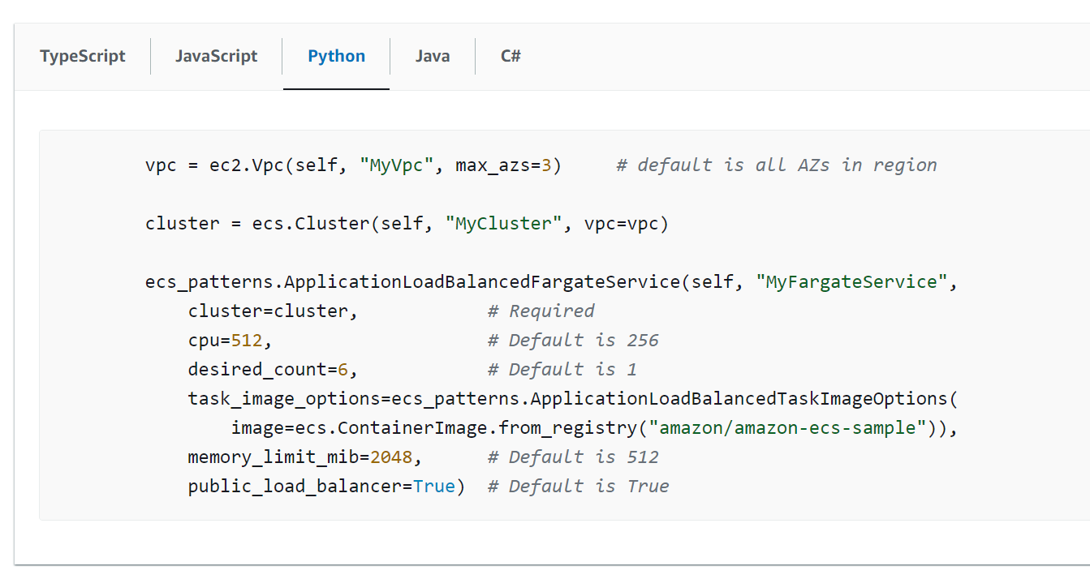
6.5 ECS example
what
vpc = ec2.Vpc(
self,
"skunkworks-1436399-vpc",
max_azs=3
)
cluster = ecs.Cluster(
self,
"skunkworks-1436399-cluster",
vpc=vpc
)
current_dir = os.path.dirname(__file__)
asset_path = os.path.join(current_dir, "../rest_api")
asset = ecr_assets.DockerImageAsset(
self,
ASSET_NAME,
asset_name=ASSET_NAME,
directory=,
file="Dockerfile"
)
amazon.com/cdk/v2/guide/ecs example

Slide 23



Z. template
new project
ExecuteAsync
square post-it
download
  exe
download
  exe
why
A slash
  followed
by
  two consecutive asterisks
D:\A1_research\C2_c0dice\B1_jmeter\A1_install
functionalities
introduction
build-exe
entity framework plus
zig help
⊂
4
every key-frame
defines the operation
success

