Slide 1

1. cloud formation
skunk
IaC

Slide 2

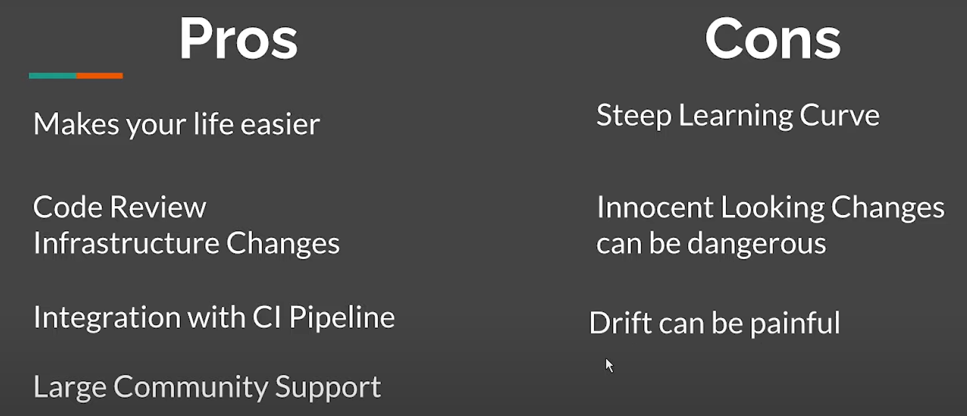
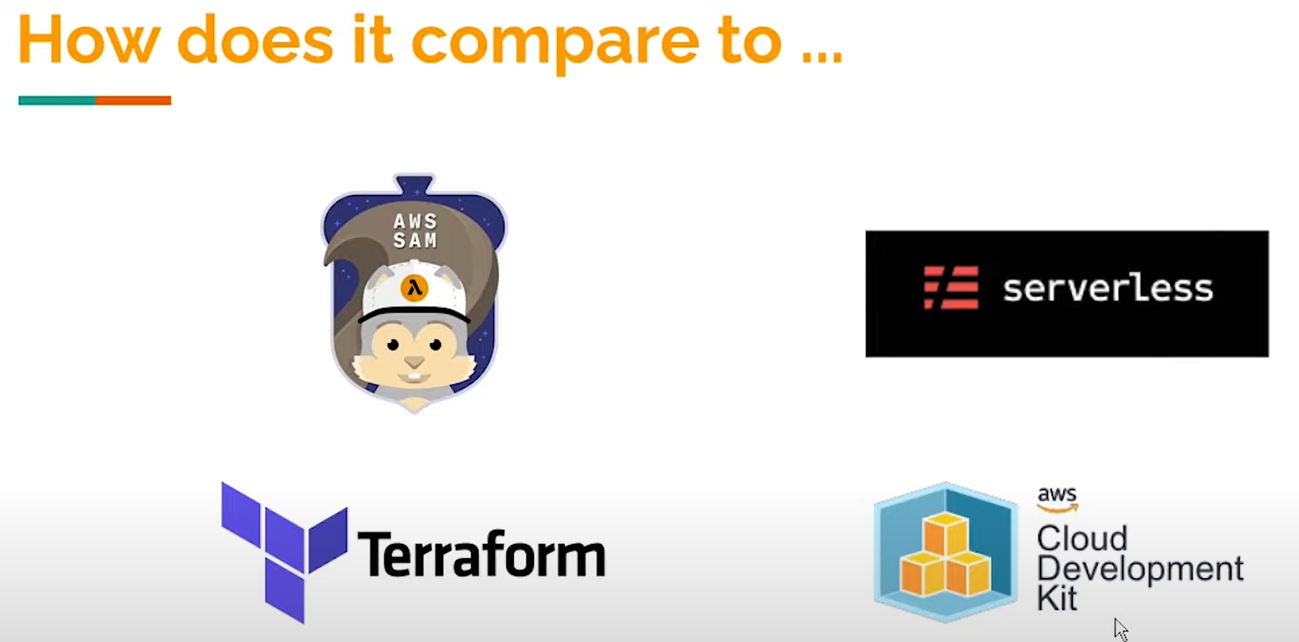

2. what
What is AWS Cloud formation? Pros and Cons?
pros and cons
compare
aws sam
aws serverless
terraform

Slide 3
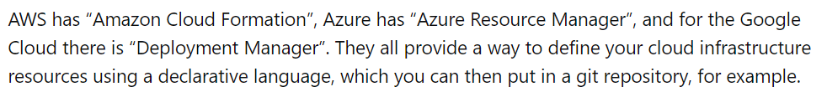
2.1 azure
azure resource manager
what
does-azure-have-an-iac-tool-just-like-cloud formation-of-aws
arm templates
azure-resource-manager/templates/overview

Slide 4
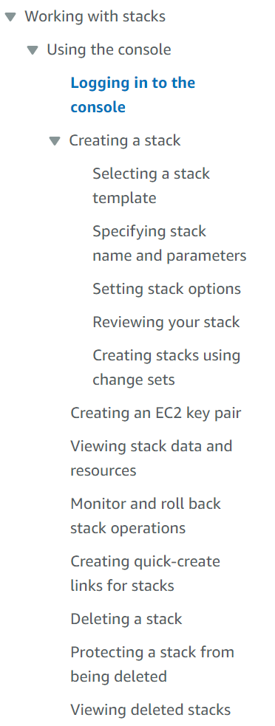
3. how
User Guide

Slide 5
3.1 create stack
1
console-create-stack

Slide 6
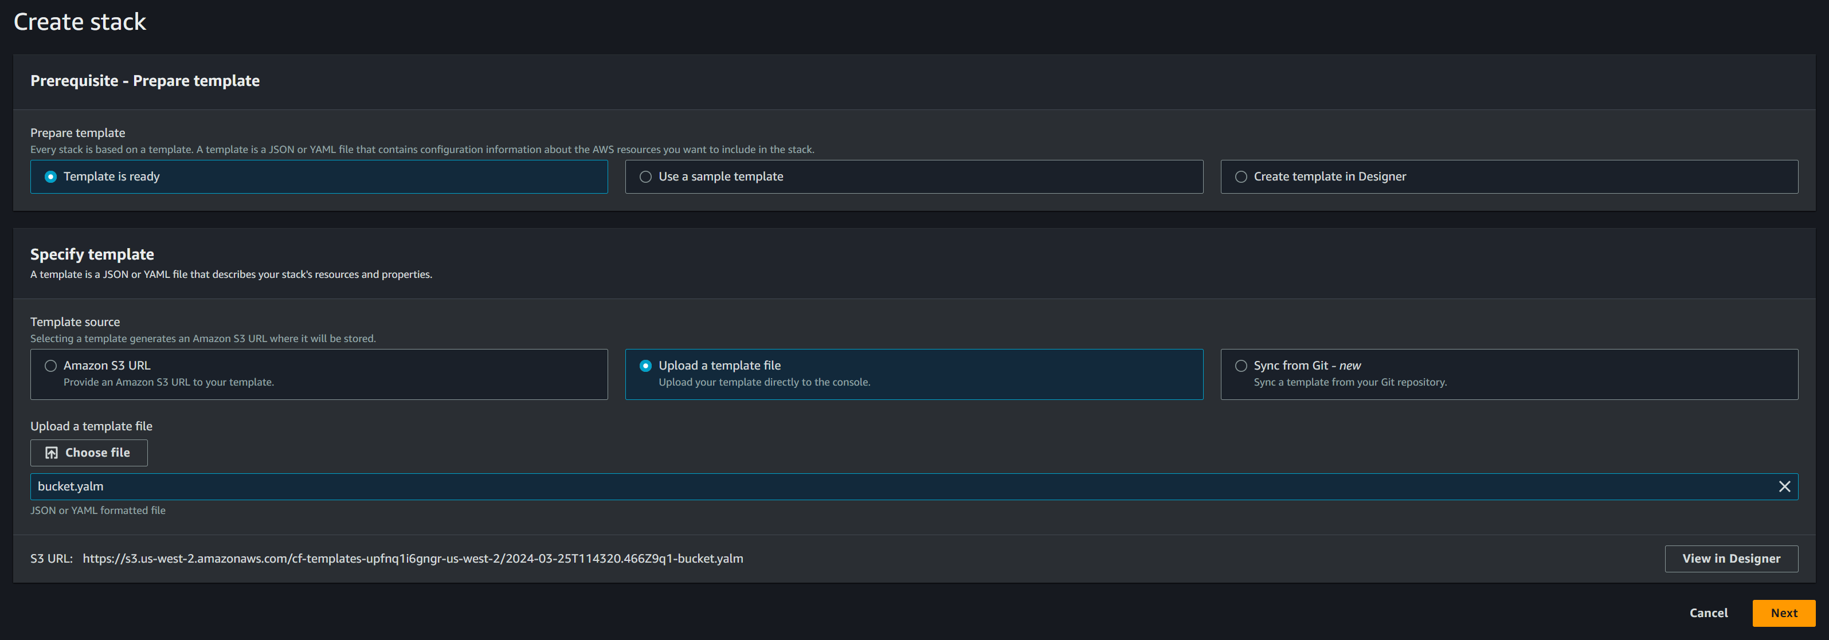
3.2 stack template
2
select a template
what
formatted text files
  in
JSON
  or
YAML
describe
  the resources
to provision
  in stacks
editor
AWS CloudFormation Designer
  or
text editor
template-guide
template-anatomy

Slide 7
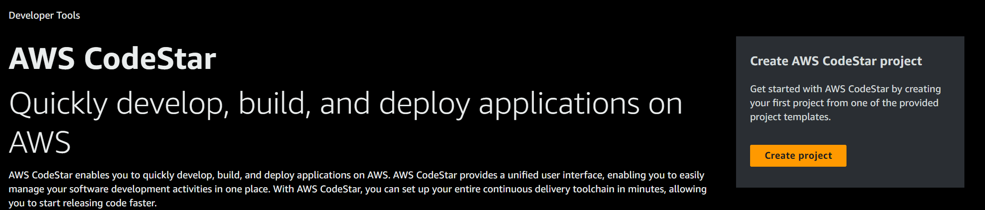
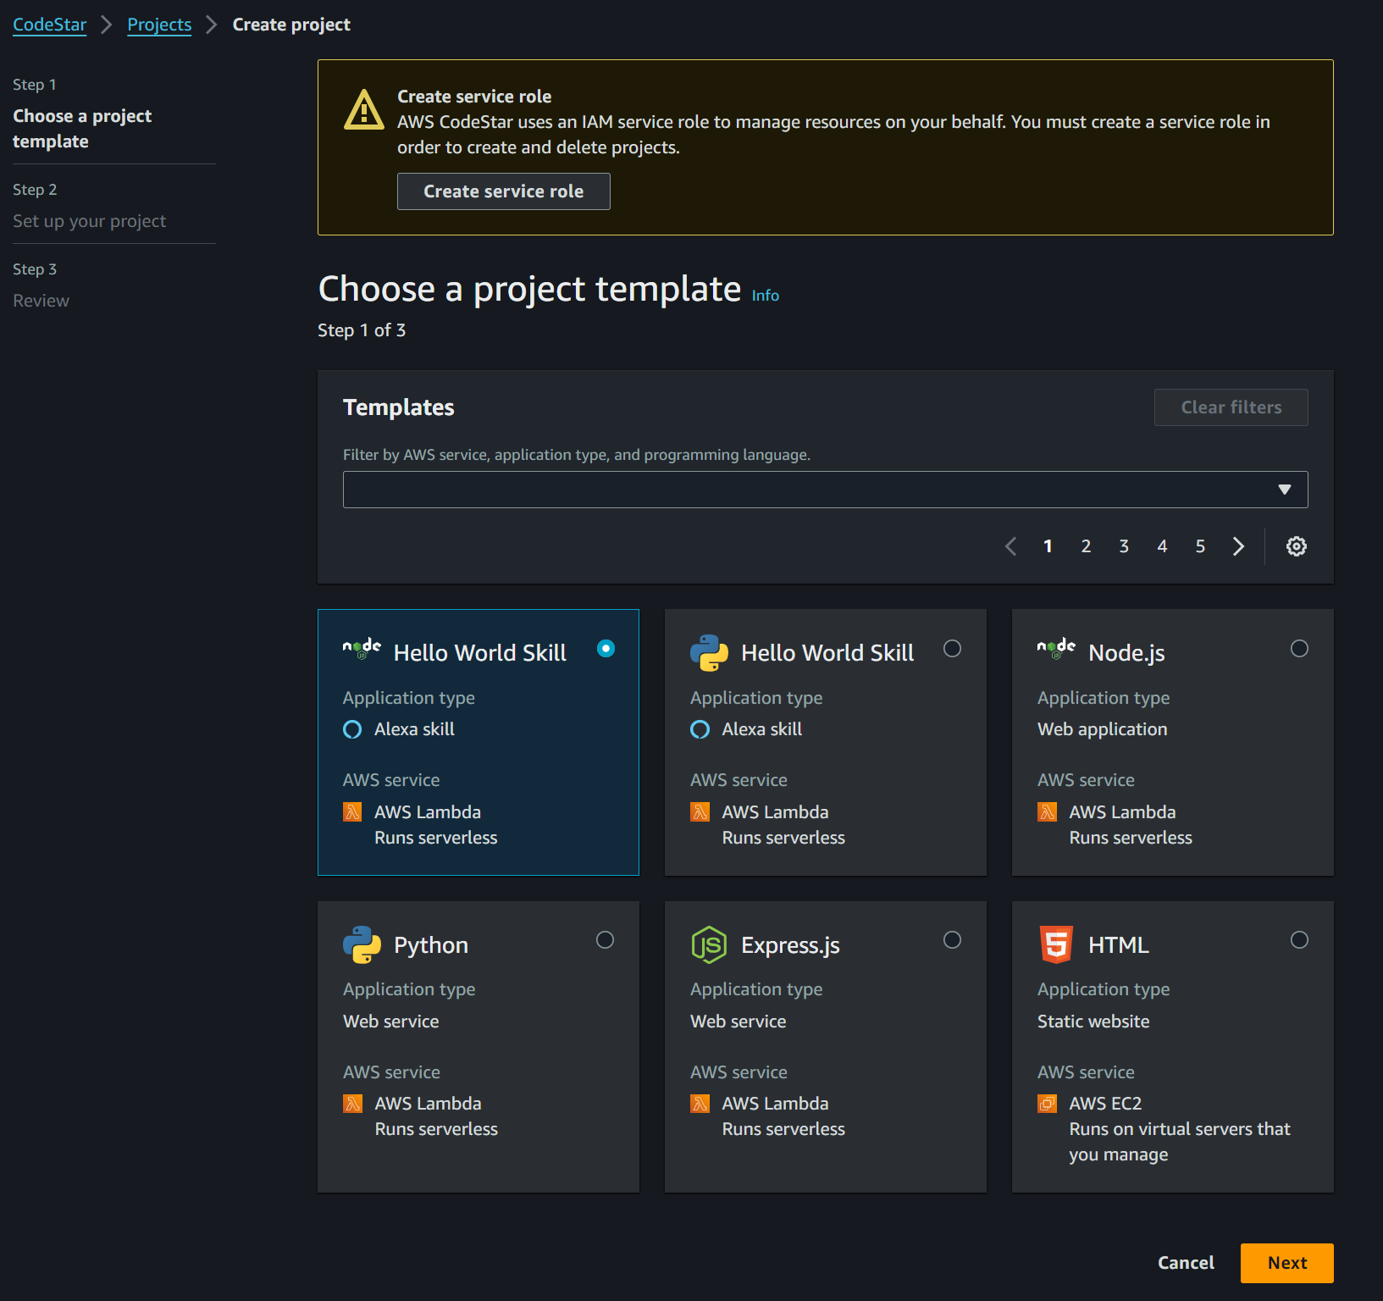
3.2.1. github
code star
will be
deprecated

Slide 8
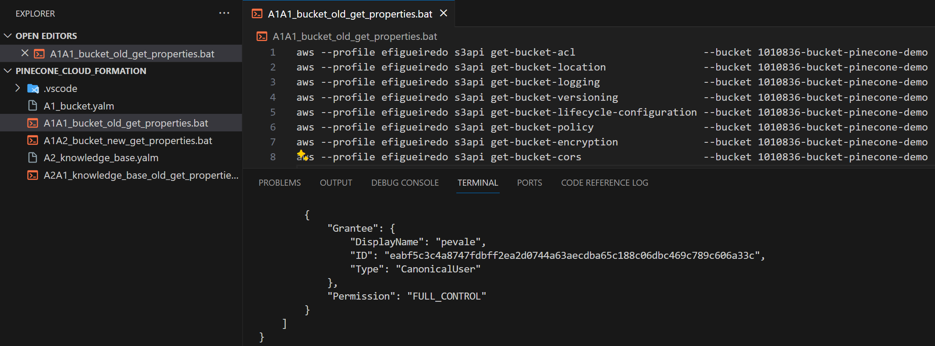

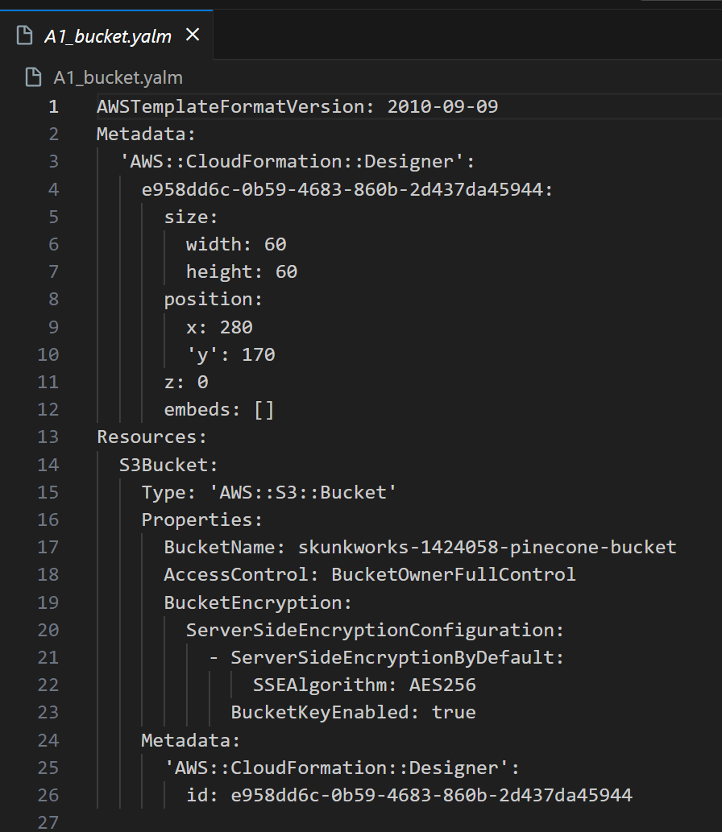
3.3 create template
3
in aws console
  create
resources
use aws cli
  to get
properties
..\..\..\pinecone cloud formation
create yaml
  file
using
  the previous
    obtained
  properties

Slide 9
3.4 designer
need prints
  how to use designer
to de
done
designer

Slide 10
3.5 run
need prints
  how to run stack
  how to see events
to de
done

Slide 11
3.6 results
is very complex
  JSON
  YAML
the documentation
    is
  sparse
designer
  requires
    the definition
  of components
    properties
  in YAML/JSON
when using cdk
  it creates IAM roles
      and
    other dependencies
  require for correct
    deployment
use sdk

Slide 12




Z. template
new project
ExecuteAsync
square post-it
download
  exe
download
  exe
why
A slash
  followed
by
  two consecutive asterisks
D:\A1_research\C2_c0dice\B1_jmeter\A1_install
functionalities
introduction
build-exe
entity framework plus
zig help
⊂
4
every key-frame
defines the operation
success

