Slide 1

1. cli
reference/

Slide 2

1.1 index
sso

Slide 3
2. install
install
download
run MSI
test
aws --version

Slide 4
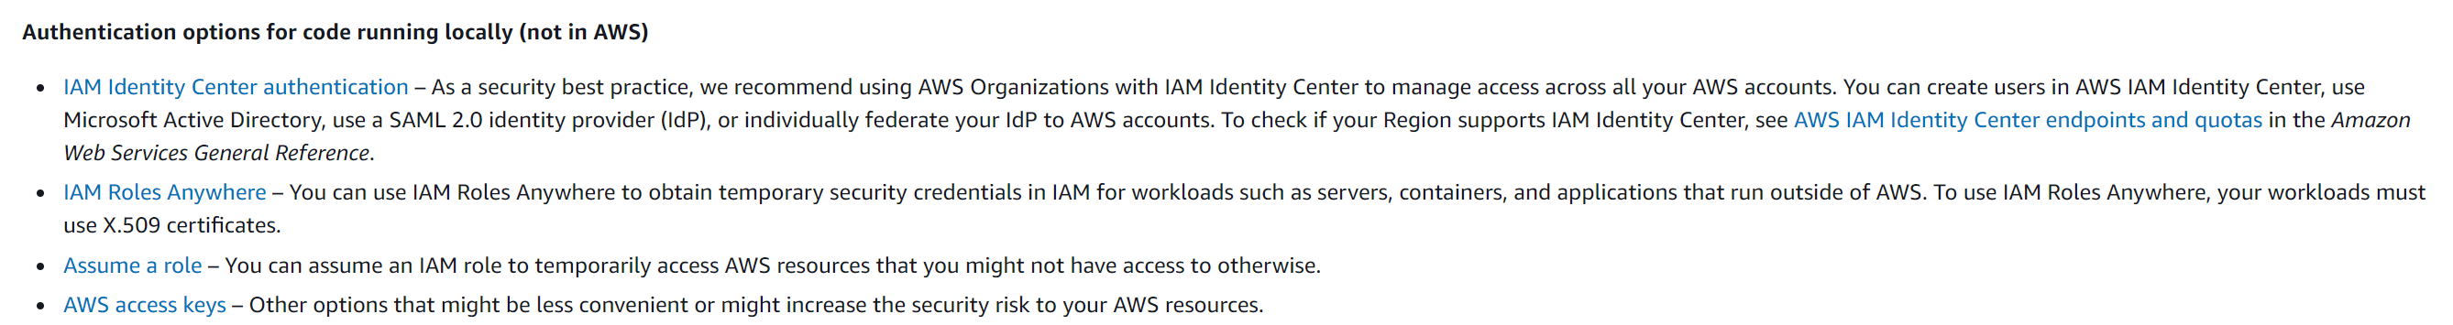
3. setup
what
no access
authentication and access
what

Slide 5
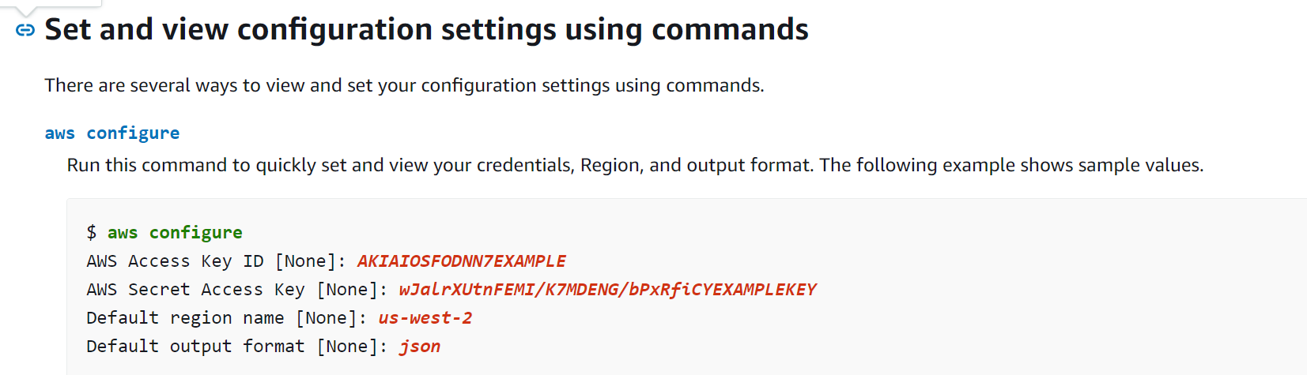
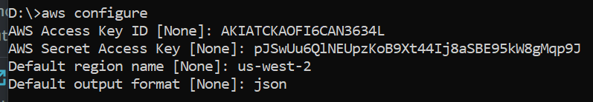

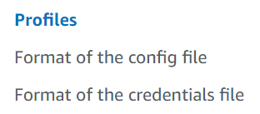
4.1 configure
what
cli-configure-files-methods
command
aws configure
aws.pptx/4. keys
reference
shared config and credentials files

Slide 6
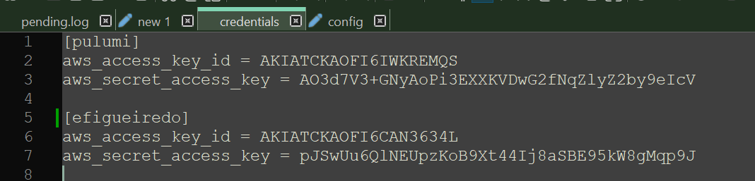

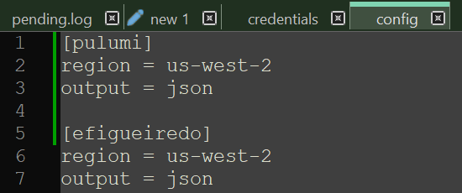
4.2 result
what
C:\Users\evaristo.figueiredo\.aws\credentials
C:\Users\evaristo.figueiredo\.aws\config

Slide 7
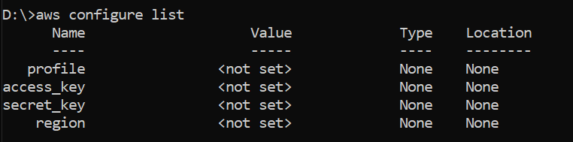
4.3 list
command
aws configure list

Slide 8
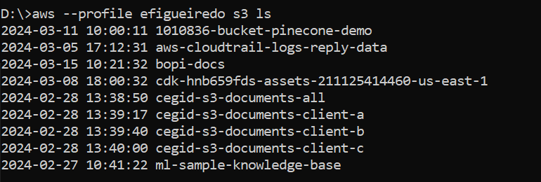
4.5 test
command
aws -–profile efigueiredo s3 ls

Slide 9
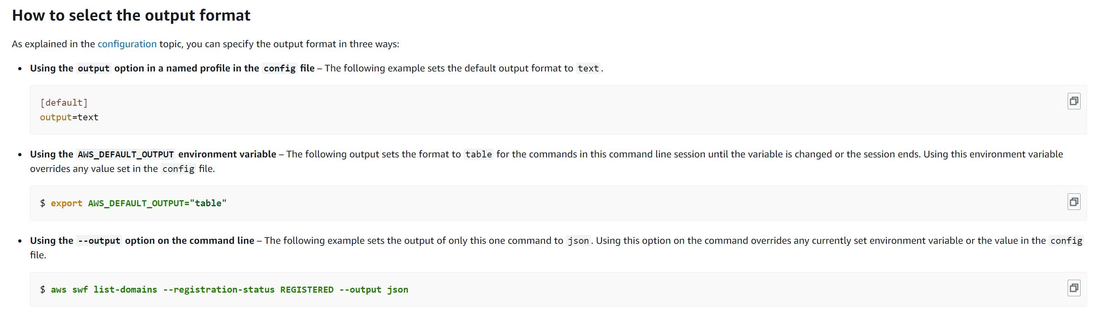
4.6 output
command
SET AWS_DEFAULT_OUTPUT=yaml
cli-usage-output-format

Slide 10



Z. template
new project
ExecuteAsync
square post-it
download
  exe
download
  exe
why
A slash
  followed
by
  two consecutive asterisks
D:\A1_research\C2_c0dice\B1_jmeter\A1_install
functionalities
introduction
build-exe
entity framework plus
zig help
⊂
4
every key-frame
defines the operation
success

