Slide 1

1. autogen
skunk
BOS

Slide 2
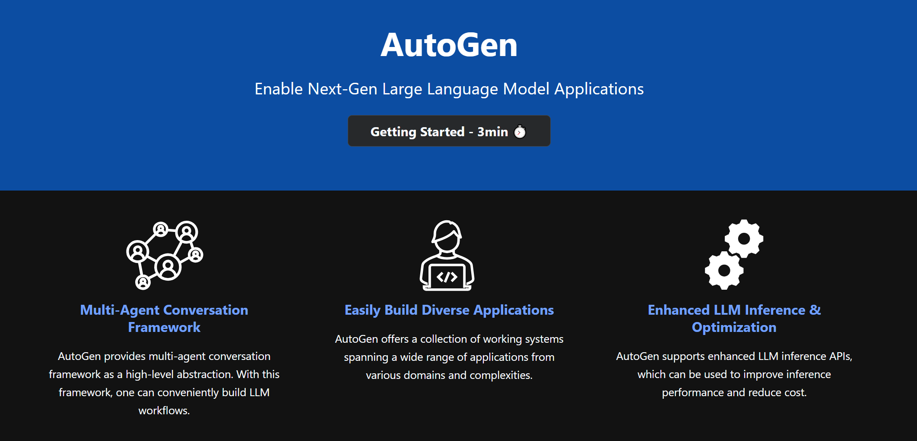

2. main
what
main site
repository
github: repository

Slide 3
3. repository
what
main site

Slide 4
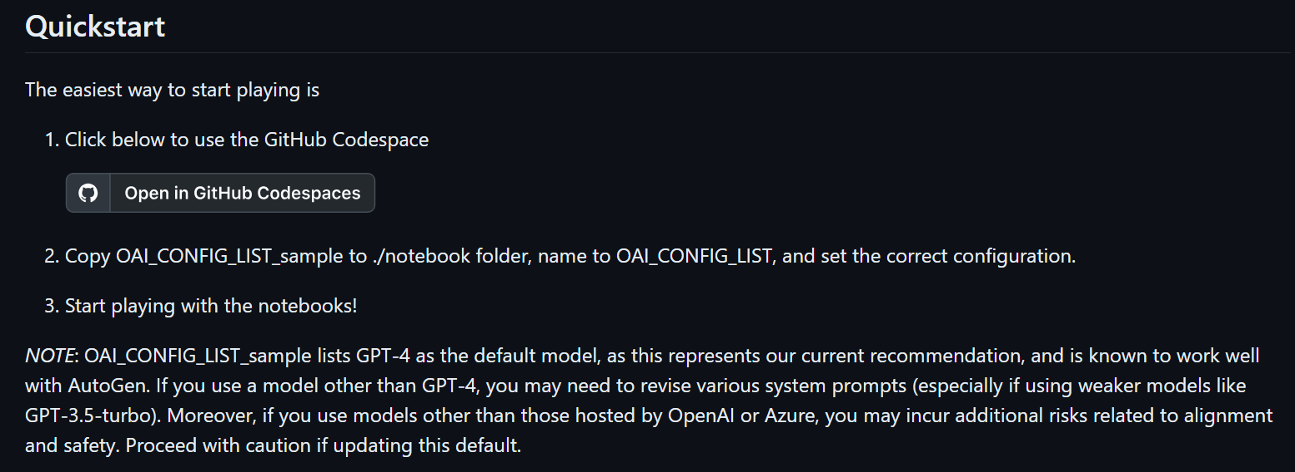
3.1 quick start
what
code spaces
note books
quick start

Slide 5
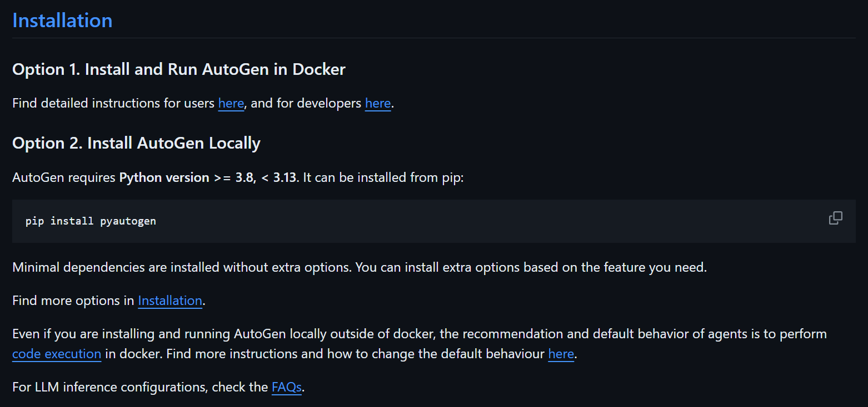
3.2 installation
what
docker
locally
installation

Slide 6

2. tutorial
github.io/autogen/docs/Getting-Started/

Slide 7





Z. template
new project
ExecuteAsync
square post-it
download
  exe
download
  exe
why
A slash
  followed
by
  two consecutive asterisks
D:\A1_research\C2_c0dice\B1_jmeter\A1_install
functionalities
introduction
build-exe
entity framework plus
zig help
⊂
4
every key-frame
defines the operation
success

