Slide 1

1. studio
skunk
BOS

Slide 2
1.1 index
main: install from package
repository: install from code
commands
architecture python
Gatsby

Slide 3



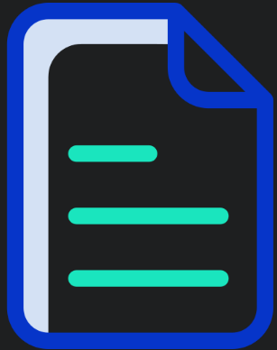


Z. template
new project
ExecuteAsync
square post-it
download
  exe
download
  exe
why
A slash
  followed
by
  two consecutive asterisks
D:\A1_research\C2_c0dice\B1_jmeter\A1_install
functionalities
introduction
build-exe
entity framework plus
zig help
⊂
4
every key-frame
defines the operation
success

