Slide 1

1. architecture python
skunk
BOS
studio

Slide 2
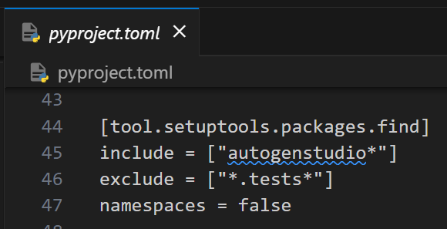
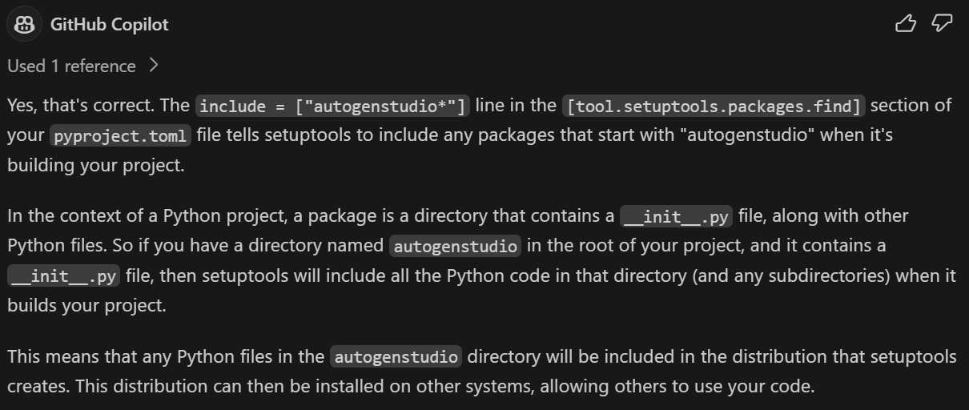
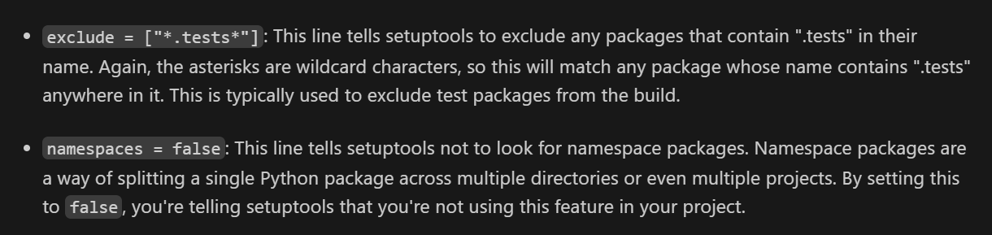
2. code
where

Slide 3
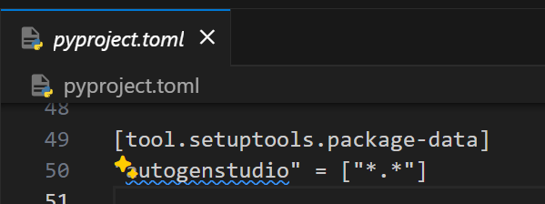
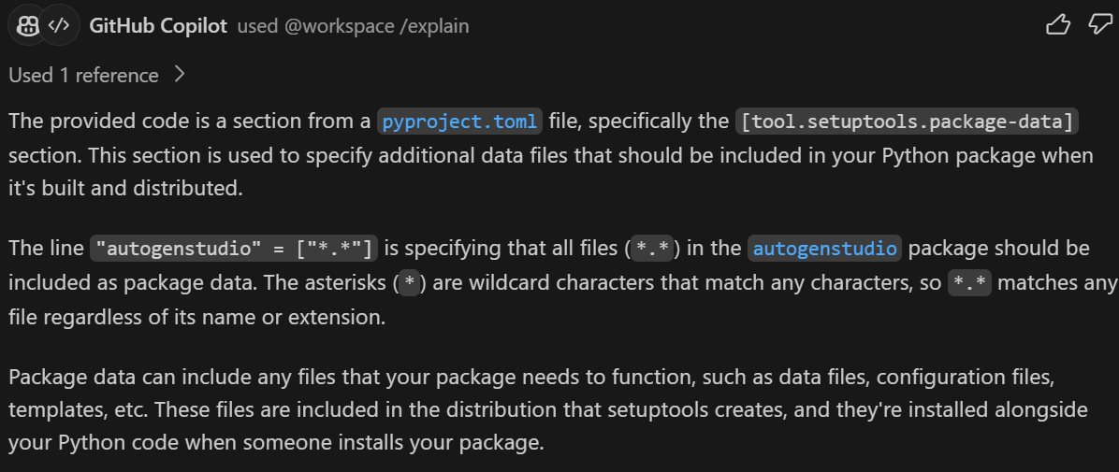
3. data
where

Slide 4
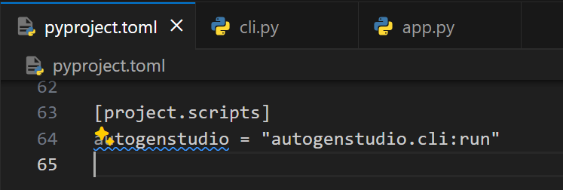
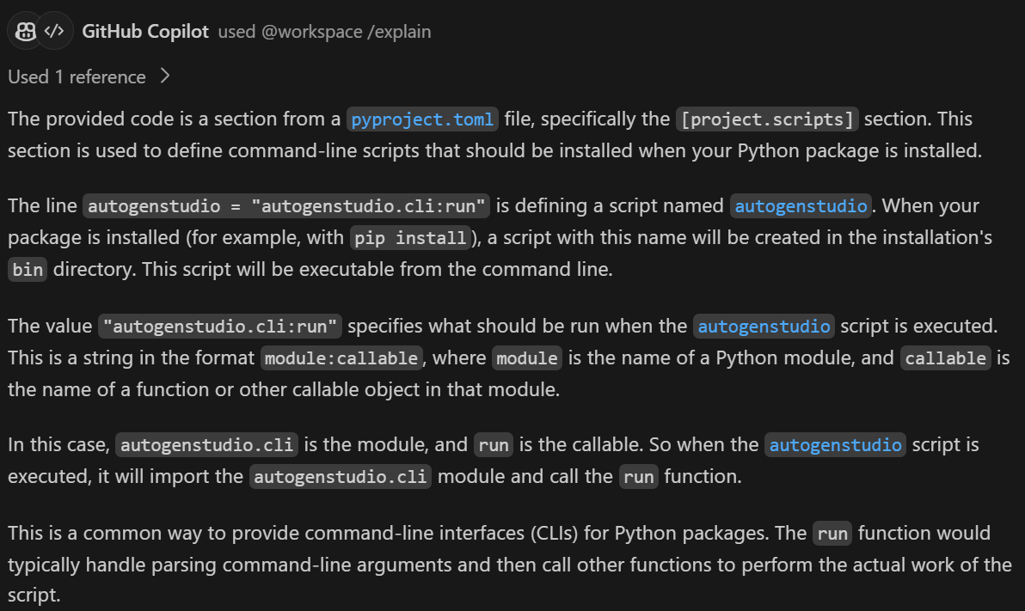
4. cli
where

Slide 5



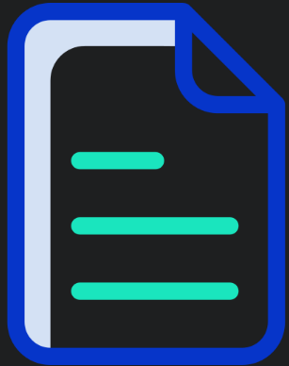


Z. template
new project
ExecuteAsync
square post-it
download
  exe
download
  exe
why
A slash
  followed
by
  two consecutive asterisks
D:\A1_research\C2_c0dice\B1_jmeter\A1_install
functionalities
introduction
build-exe
entity framework plus
zig help
⊂
4
every key-frame
defines the operation
success

