Slide 1

1. code
skunk
BOS
studio

Slide 2


2. tutorial
what
TL;DR
Introduction
Getting Started with AutoGen Studio
  Configuring an LLM Provider
  Installation
  Running the Application
What Can You Do with AutoGen Studio?
  Build
  Playground
  Gallery
The AutoGen Studio API
Road Map and Next Steps
Contribution Guide
  FAQ
repository
pip install autogenstudio
github: blog/autogen studio

Slide 3
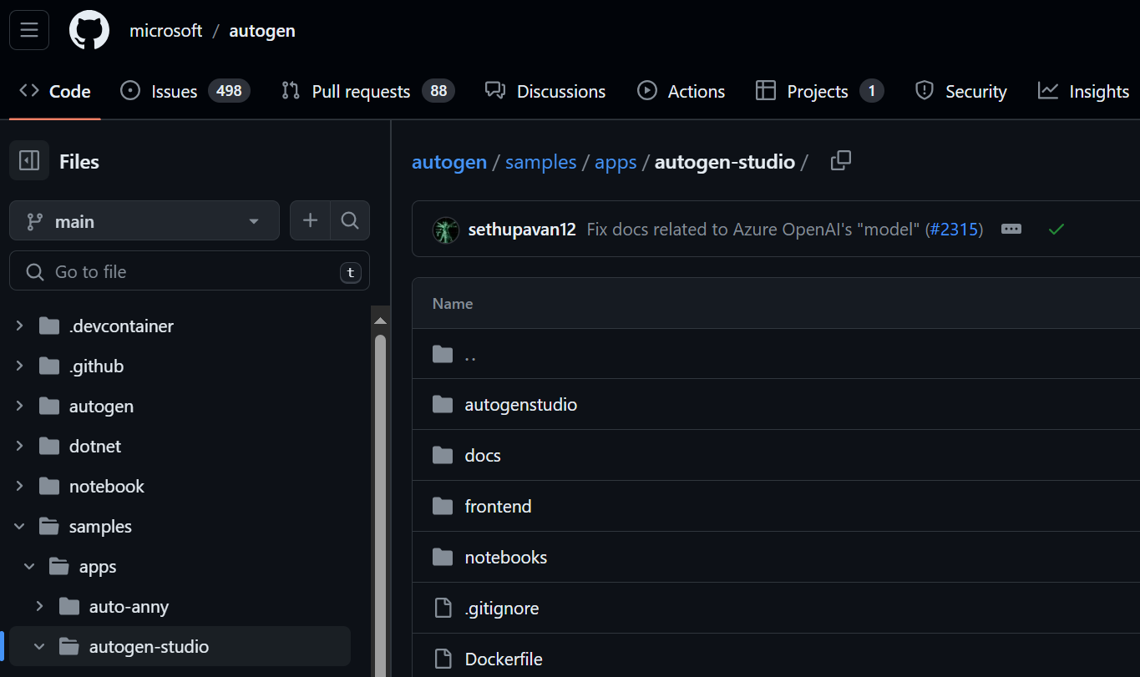
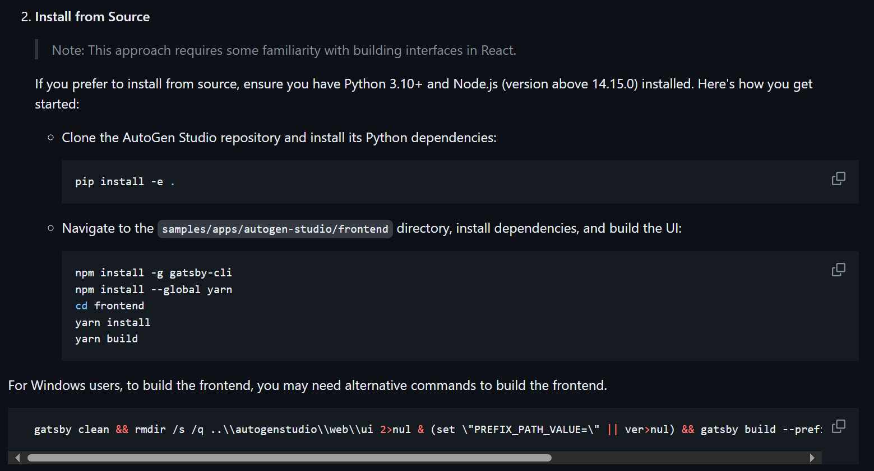
3. repository
what
github: autogen

Slide 4

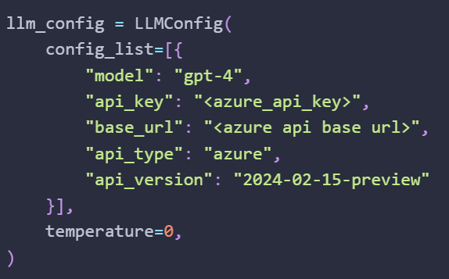

4. LLM
what
configuring an llm provider
credentials
{
"model": "gpt-4",
"api_key": "4ec89f49dd5b44b49c458c99d5e63c33",
"base_url": "https://francecentral.api.cognitive.microsoft.com/",
"api_type": "azure",
"api_version": "2023-12-01-preview"
}
..\..\..\..\autogen\OAI_CONFIG_LIST

Slide 5
5. install
package
pip install autogenstudio
installation
source
github: installation
step
by
step
clone repository
what
  pip install –e .
does
..\..\..\..\autogen
in: root
pip install
run details
pip install -e .
py project toml
pip/3.1 editable
in: samples/apps/autogen-studio/frontend
npm install -g gatsby-cli
Gatsby js
npm install --global yarn
yarn
yarn install
change the build command in package.json
old
"gatsby clean && rm -rf ../autogenstudio/web/ui && PREFIX_PATH_VALUE='' gatsby build --prefix-paths && rsync -a --delete public/ ../autogenstudio/web/ui/",
yarn build
new
"build": "gatsby clean && rmdir /s /q ..\\autogenstudio\\web\\ui 2>nul & (set \"PREFIX_PATH_VALUE=\" || ver>nul) && gatsby build --prefix-paths && xcopy /E /I /Y public ..\\autogenstudio\\web\\ui",
use the command
build.bat

Slide 6
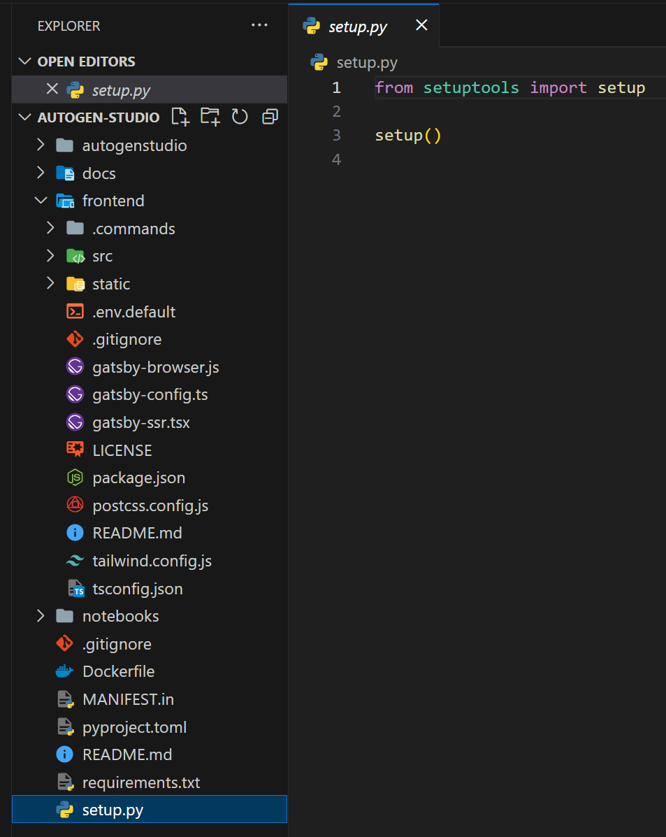
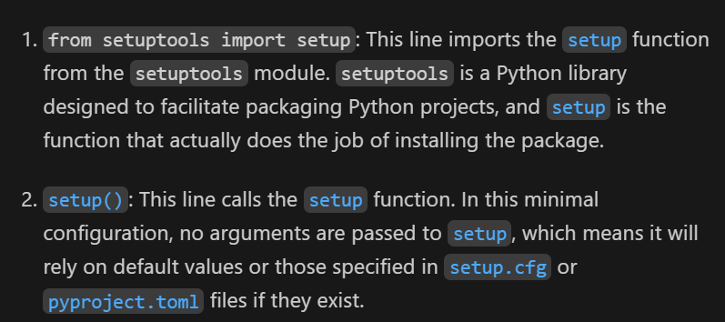
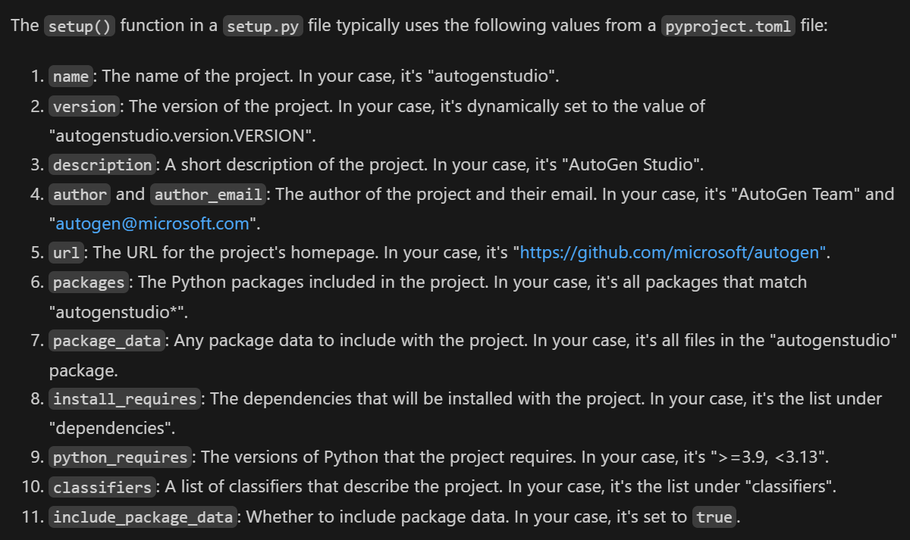
5.1 setup
what
when a I run
pip install -e .
pip/3.1 editable
it uses the setup file to install my package

Slide 7
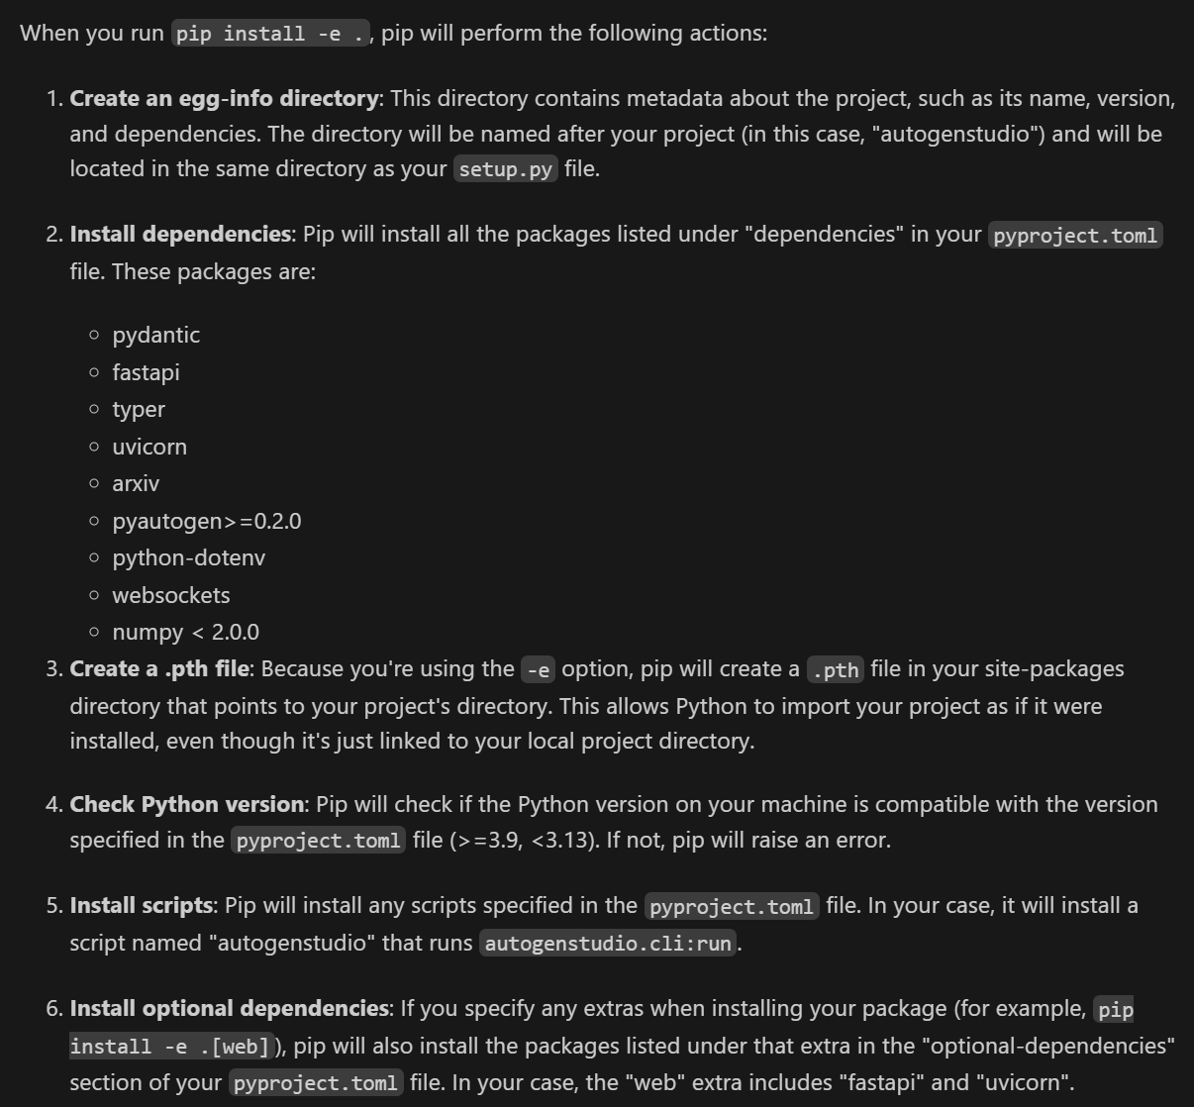
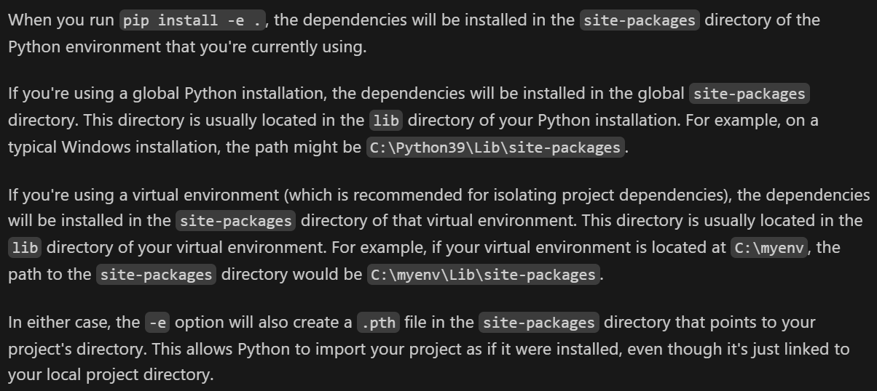
5.2 result
what

Slide 8
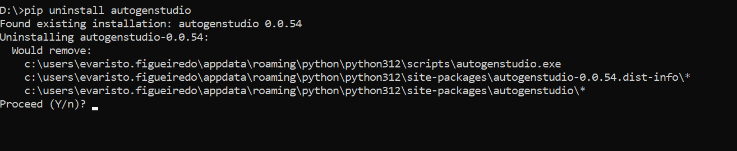
8. uninstall
what

Slide 9
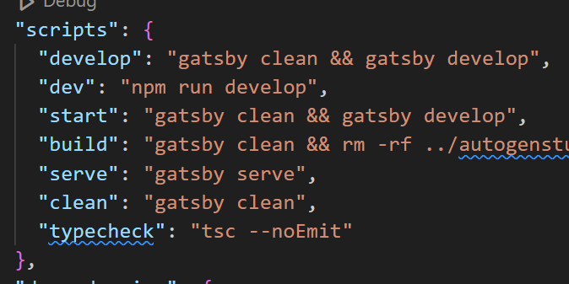
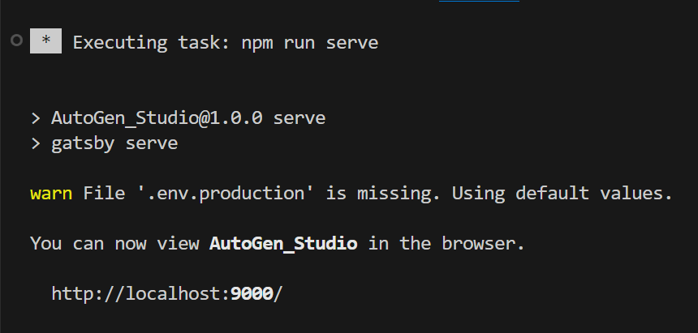
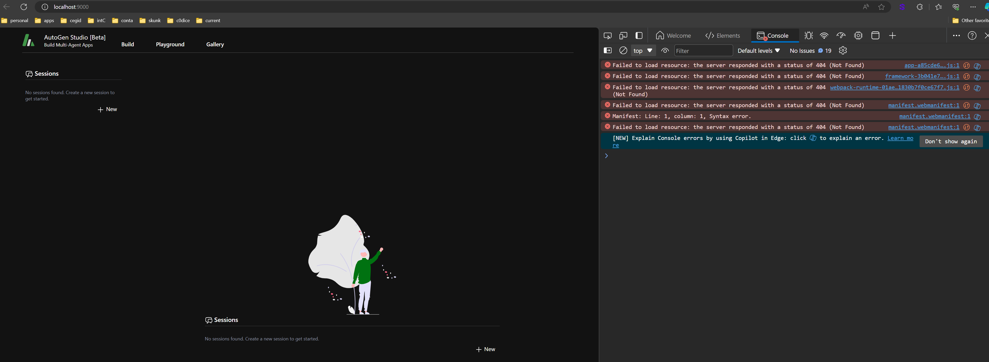
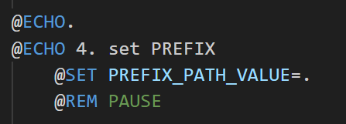
9. run
package
gatsby serve
cli
autogenstudio ui --port 8081
..\..\..\..\autogen\samples\apps\autogen-studio\frontend\package.json
does not
work
solution

Slide 10




Z. template
new project
ExecuteAsync
square post-it
download
  exe
download
  exe
why
A slash
  followed
by
  two consecutive asterisks
D:\A1_research\C2_c0dice\B1_jmeter\A1_install
functionalities
introduction
build-exe
entity framework plus
zig help
⊂
4
every key-frame
defines the operation
success

