Slide 1

1. run steps
skunk
BOS
studio

Slide 2

2. install
in
D:\autogen\samples\apps\autogen-studio
pip install -r requirements.txt
pip install fastapi uvicorn

Slide 3
3. build
in
D:\autogen\samples\apps\autogen-studio
python setup.py build

Slide 4
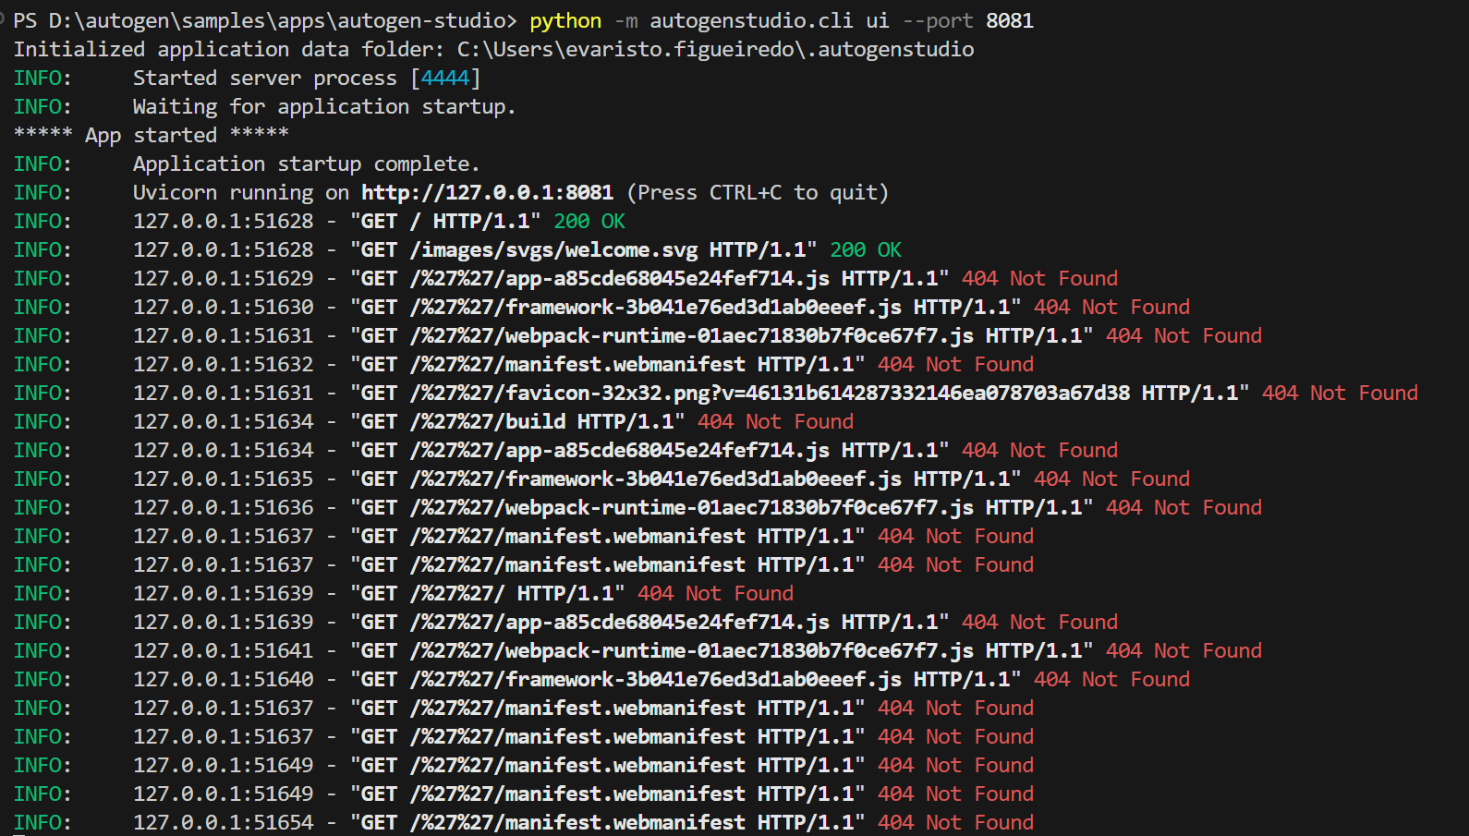
4. run
in
D:\autogen\samples\apps\autogen-studio
python -m autogenstudio.cli --help
python -m autogenstudio.cli ui --port 8081
does not
work

Slide 5





Z. template
new project
ExecuteAsync
square post-it
download
  exe
download
  exe
why
A slash
  followed
by
  two consecutive asterisks
D:\A1_research\C2_c0dice\B1_jmeter\A1_install
functionalities
introduction
build-exe
entity framework plus
zig help
⊂
4
every key-frame
defines the operation
success

