Slide 1

1. main
skunk
BOS
studio

Slide 2
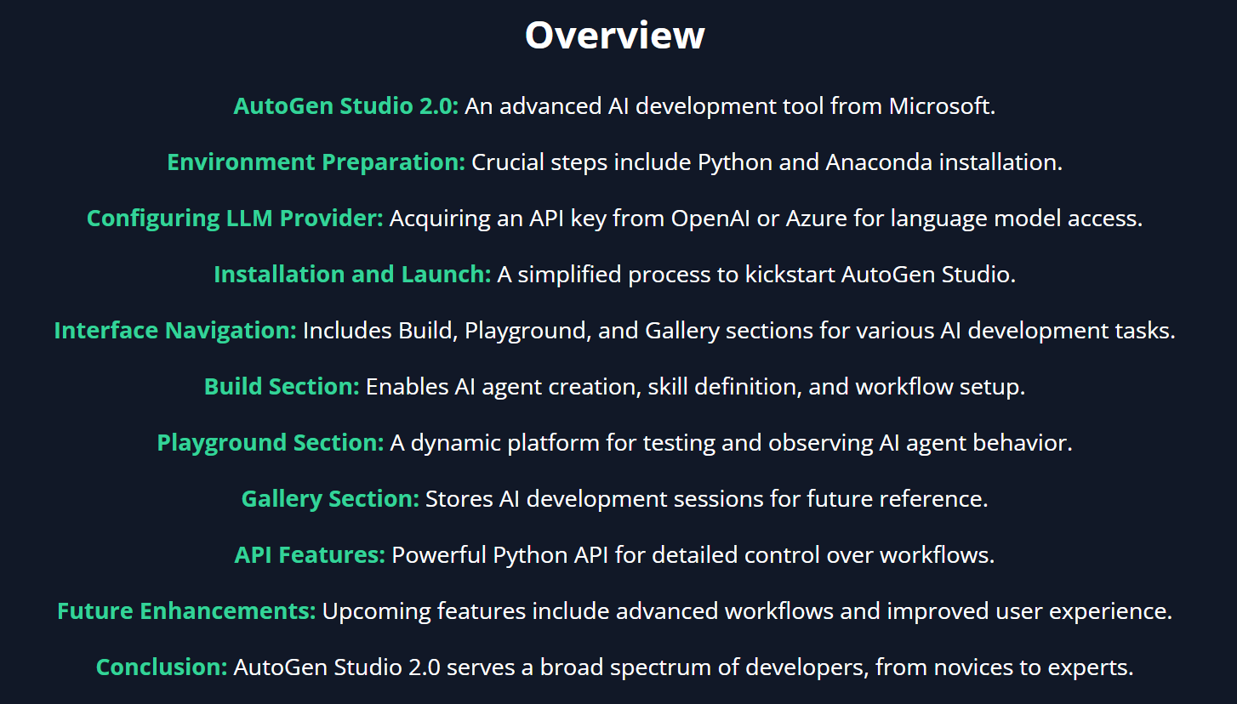

2. overview
what
main site
repository
github: studio

Slide 3
3. install
what
main site: install

Slide 4
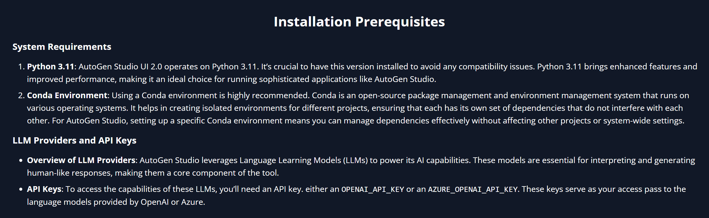
3.1 prerequisites
what
main site: prerequisites

Slide 5
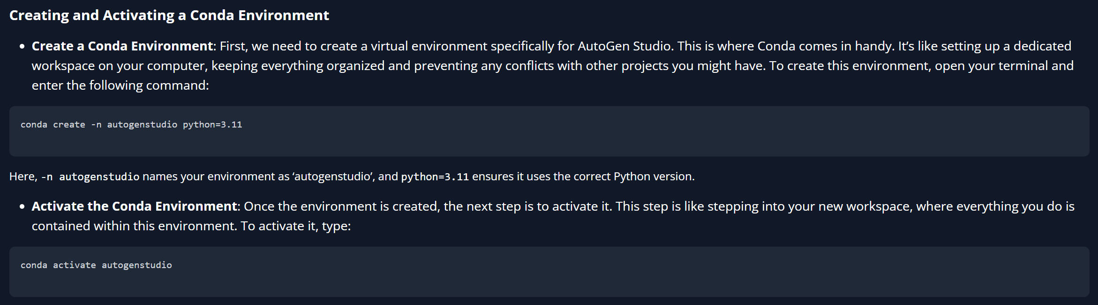
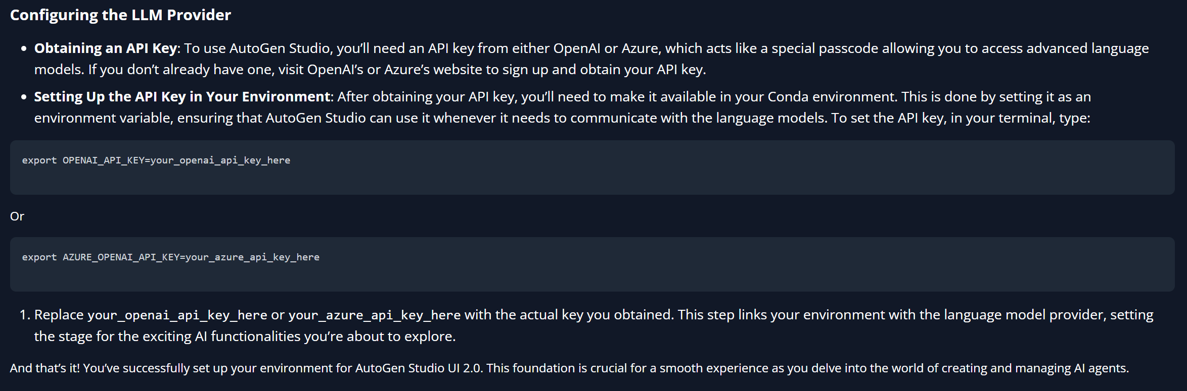
3.2 setup
environment
main site: setup
llm

Slide 6
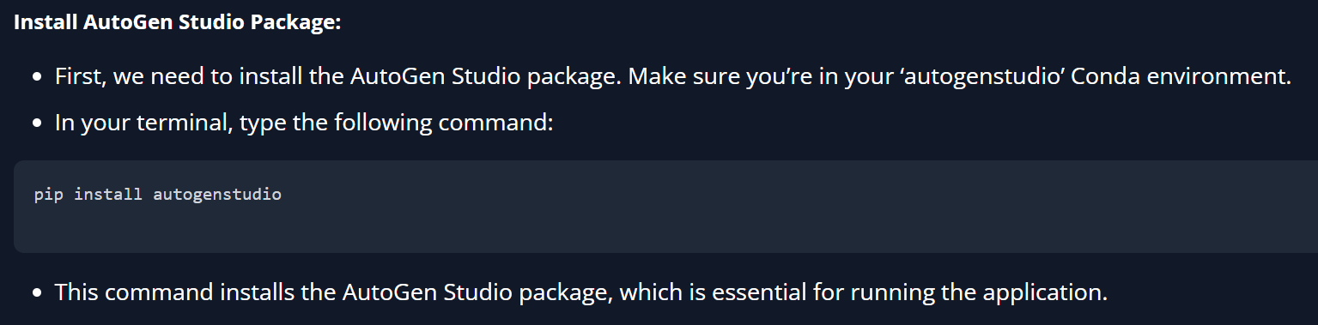
3.3 install
install
main site: install

Slide 7
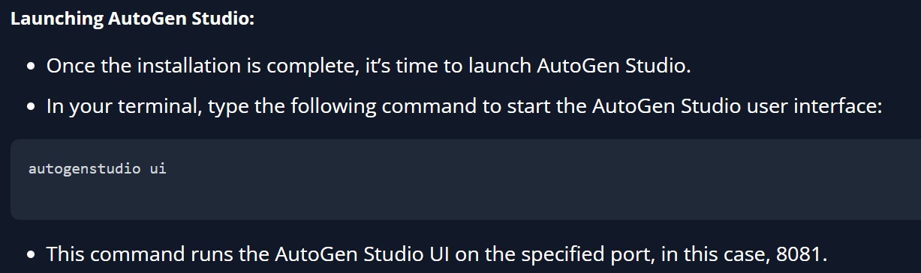
3.4 launch
what
main site: install

Slide 8
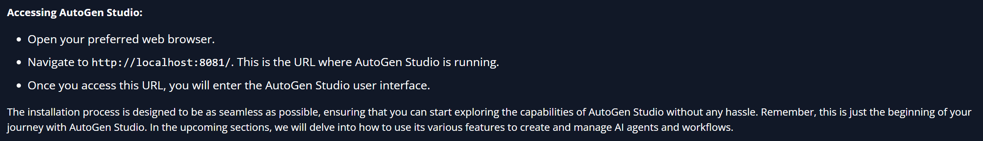
2.1.5 run
what
main site: install

Slide 9
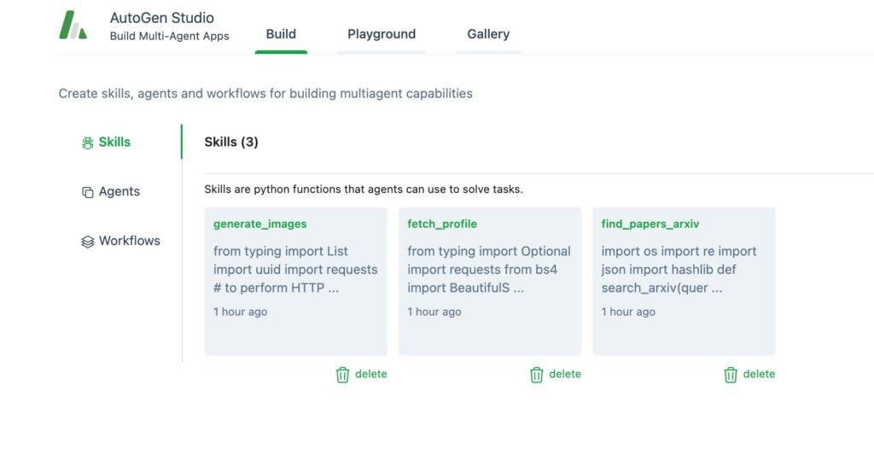
4. features
what
to be studied
find a video
main site: features
video

Slide 10






Z. template
new project
ExecuteAsync
square post-it
download
  exe
download
  exe
why
A slash
  followed
by
  two consecutive asterisks
D:\A1_research\C2_c0dice\B1_jmeter\A1_install
functionalities
introduction
build-exe
entity framework plus
zig help
⊂
4
every key-frame
defines the operation
success

