Slide 1

1. lexicon
skunk

Slide 2
1.1 index
infrastructure

Slide 3

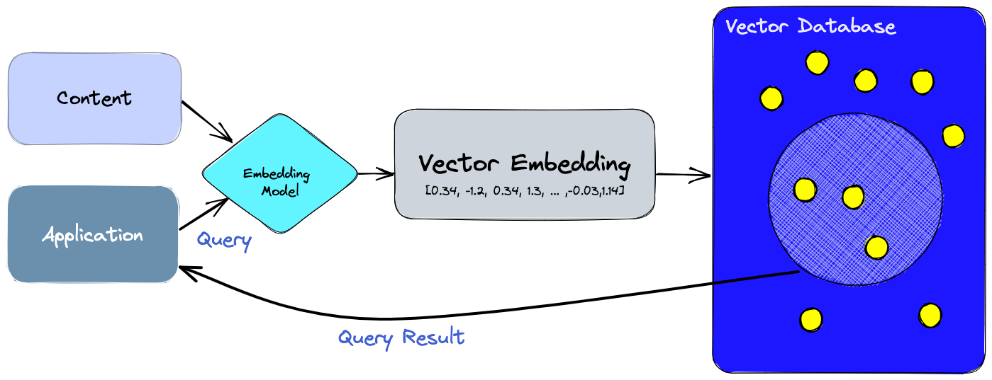
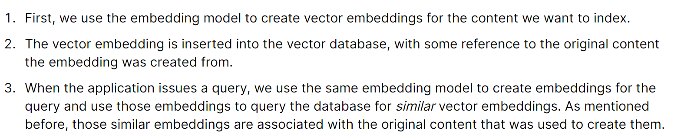
2. vector database
what
A vector database
  indexes
    and
  stores
vector embeddings
for
  fast retrieval
    and
  similarity search,
with capabilities like
  CRUD operations,
  metadata filtering,
  horizontal scaling,
  serverless
vector database

Slide 4
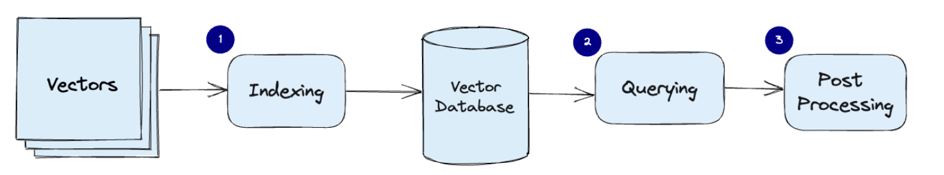
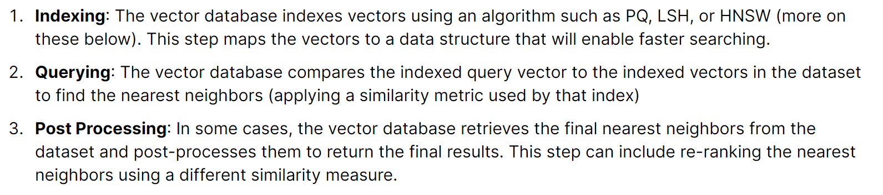
2.1 how
what
How does a vector database work?

Slide 5
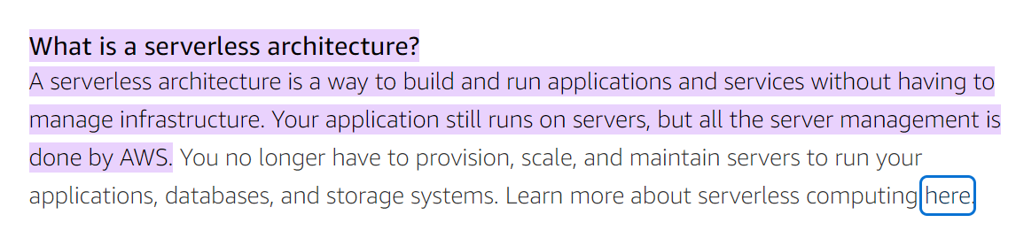
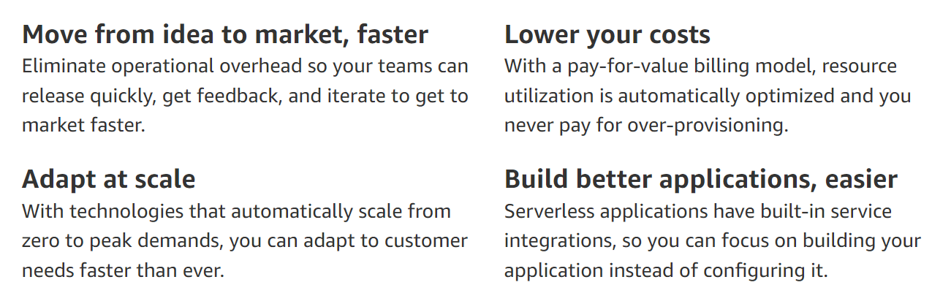
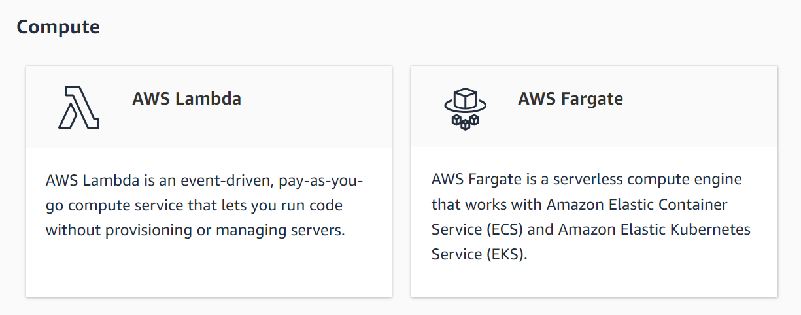
3. serverless
what
aws/serverless/architecture
aws.amazon.com/serverless/

Slide 6
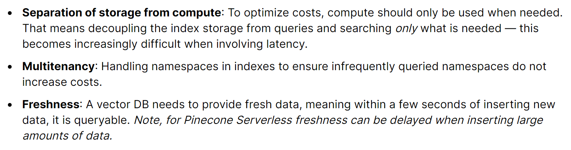
3.1 pinecone
what
Serverless Vector Databases

Slide 7
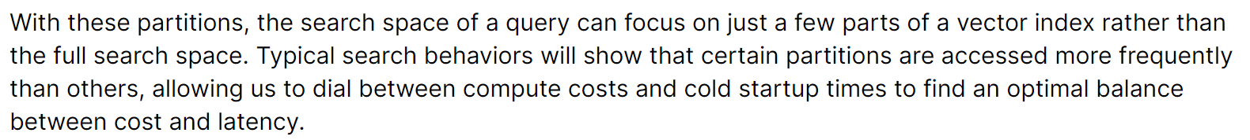
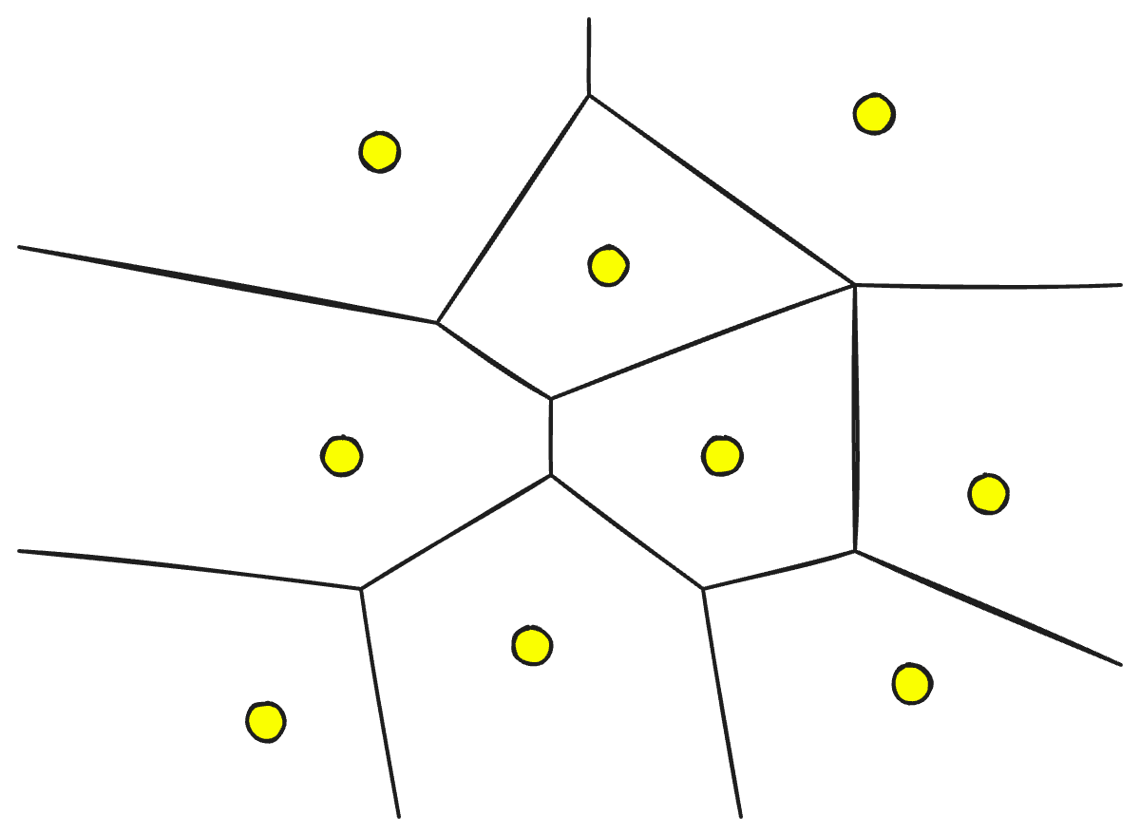
3.1.1 partitions
what

Slide 8
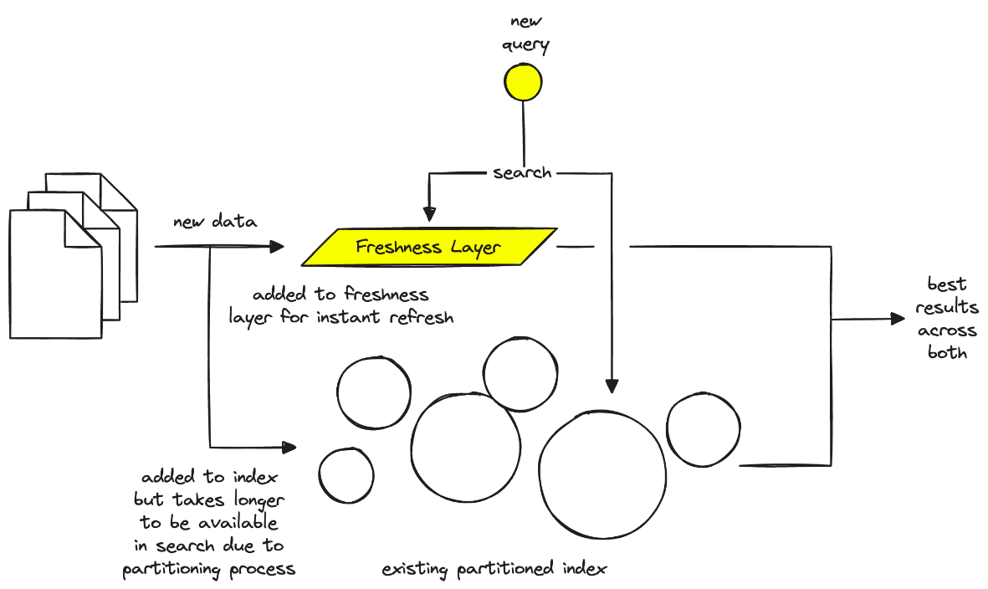
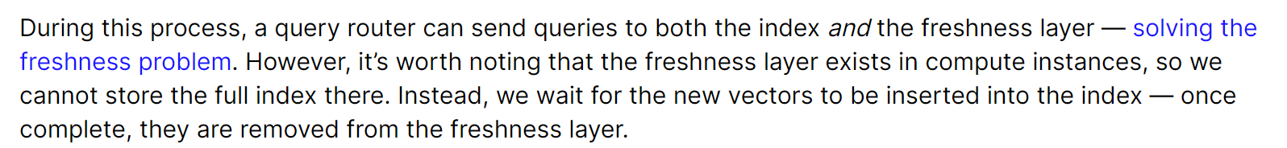
3.1.1 freshness
what
freshness

Slide 9
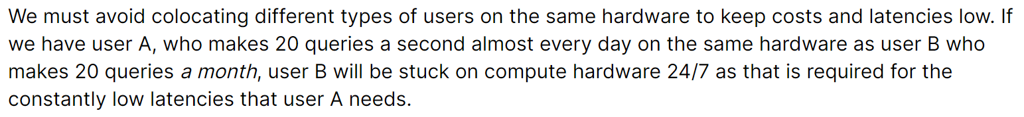
3.1.2 multitenancy
what
multitenancy

Slide 10
3.1.3 algorithms
what
Random Projection
Product Quantization
Locality-sensitive hashing
Hierarchical Navigable Small World (HNSW)
algorithms
need
research

Slide 11
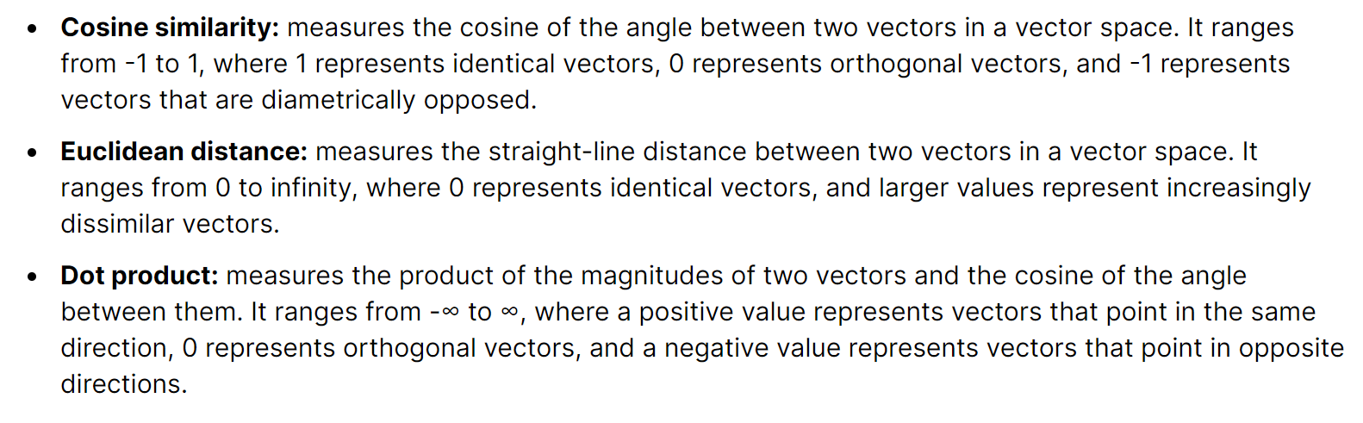
3.1.4 similarity measures
what
similarity measures
need
research

Slide 12
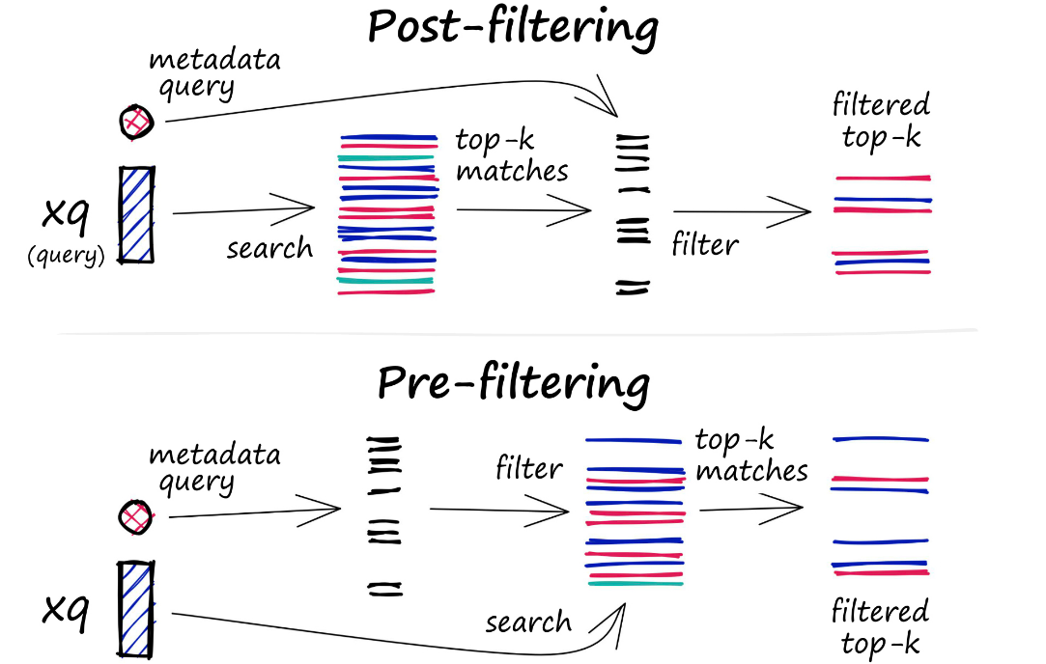
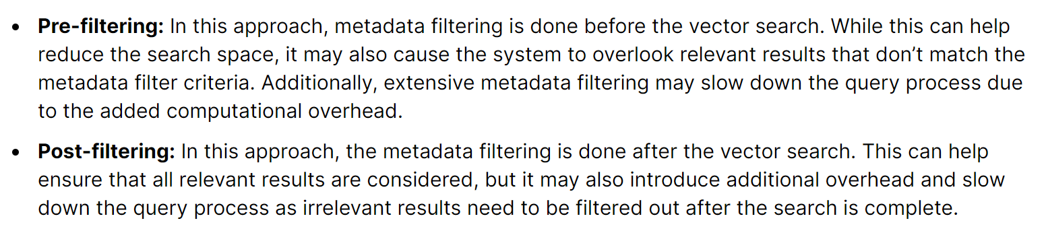
3.1.5 filtering
what
need
research
filtering
vector-search-filtering/

Slide 13
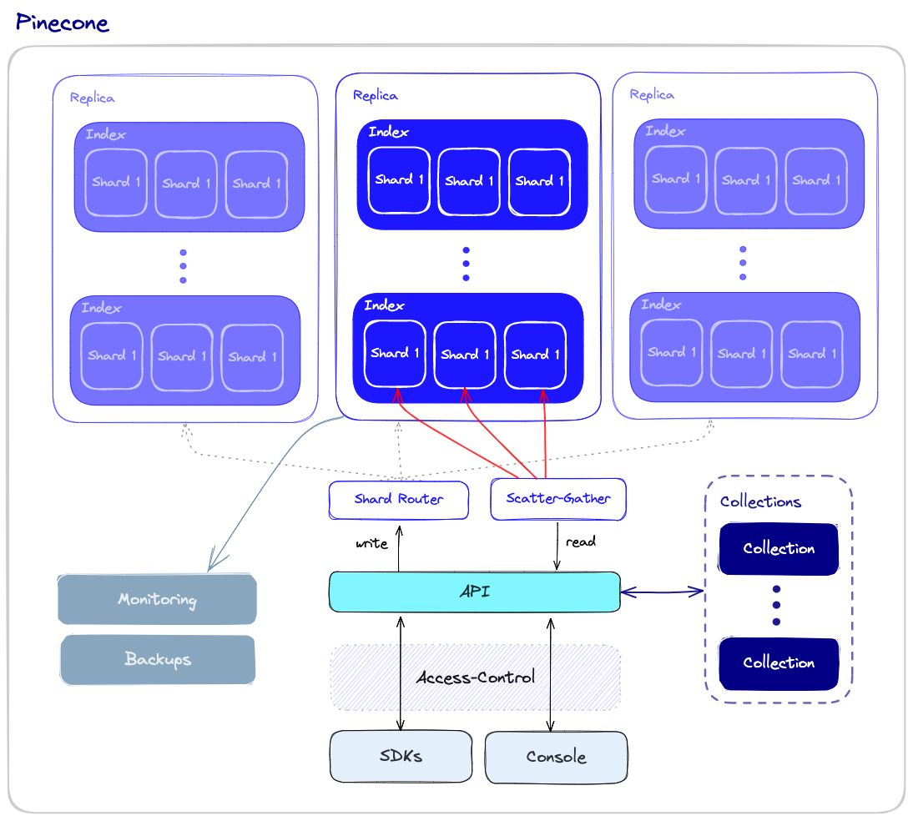
3.1.6 operations
what
filtering

Slide 14
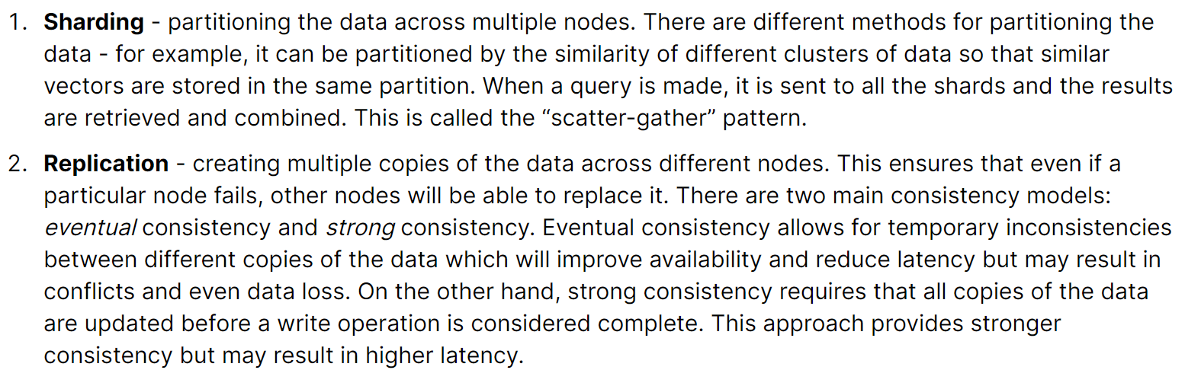
3.1.6.1 performance/fault tolerance
what
performance and fault tolerance

Slide 15
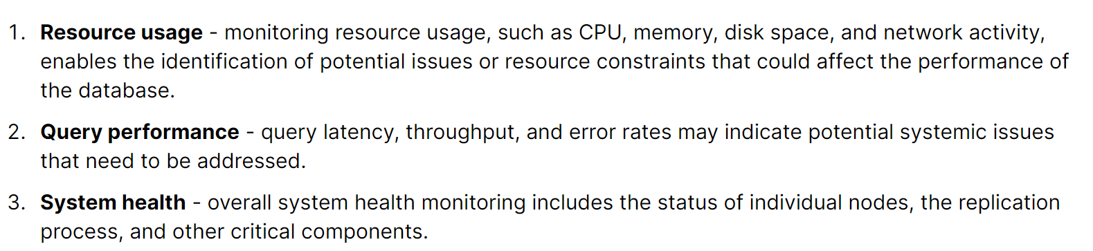
3.1.6.2 monitoring
what
monitoring

Slide 16
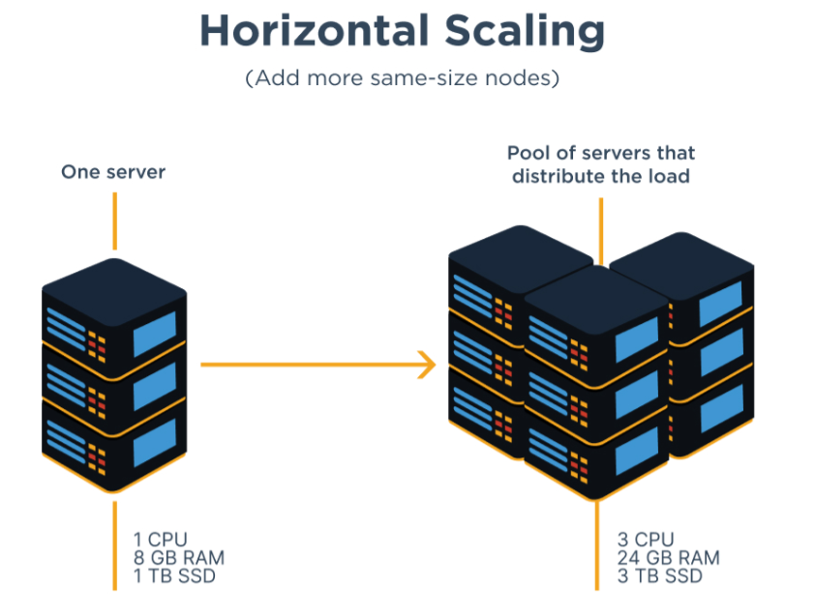
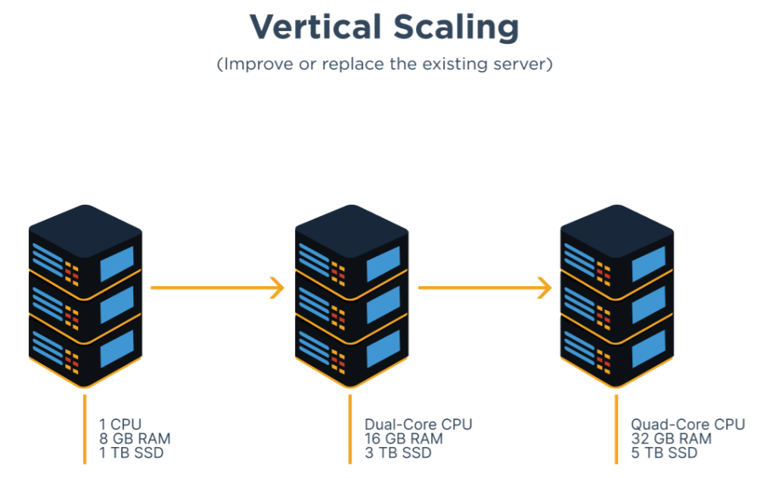

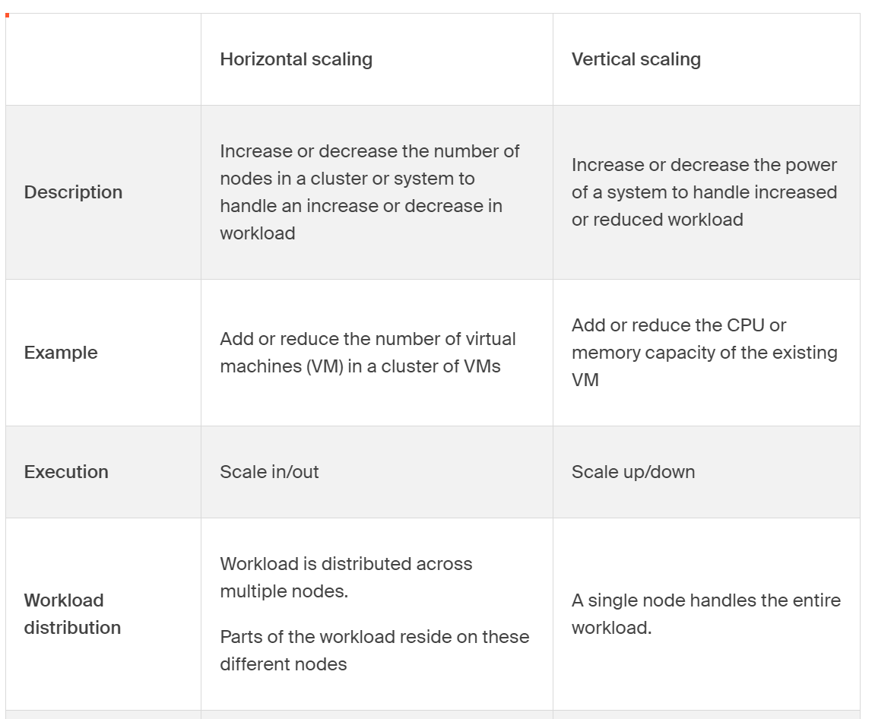
4. scaling
what
Horizontal Vs. Vertical Scaling

Slide 17
5. vector embedding
need more
research
what
vector-embeddings-for-developers/
what

Slide 18
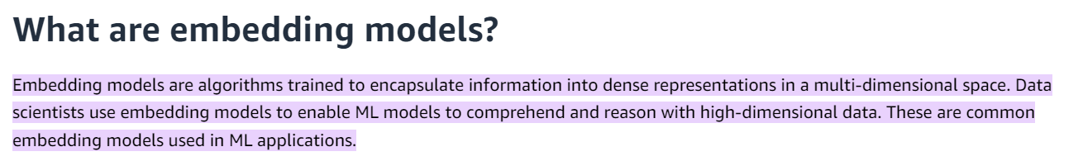
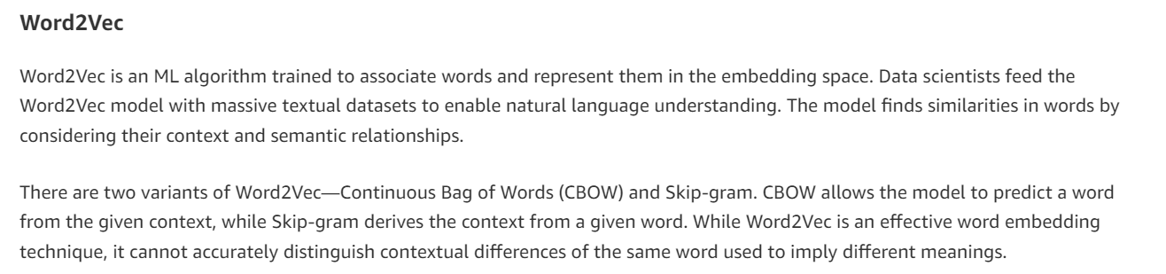
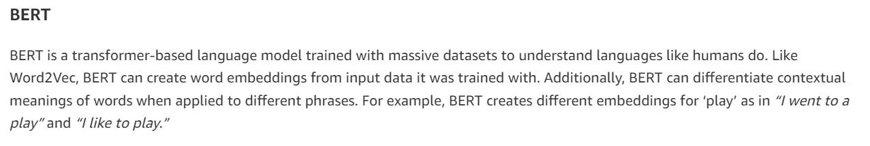
6. embedding model
what
embedding model
aws
research in this page
details
tensorflow.org/text/tutorials/word2vec

Slide 19
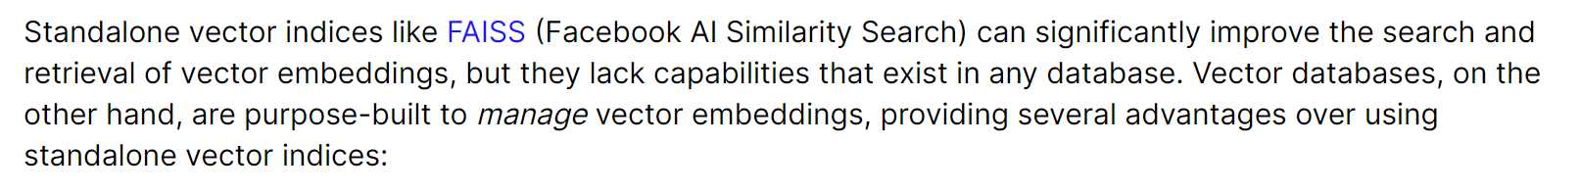
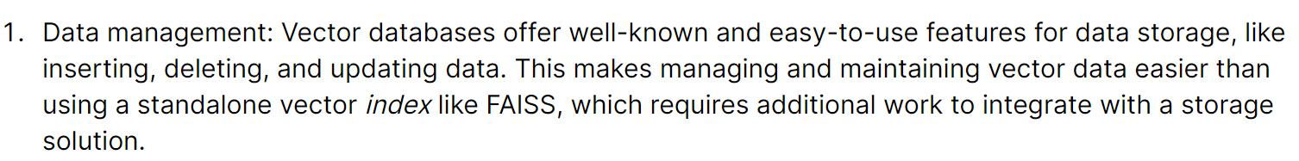
7. vector index
what
What’s the difference between a vector index and a vector database?
read source
for more
differences

Slide 20



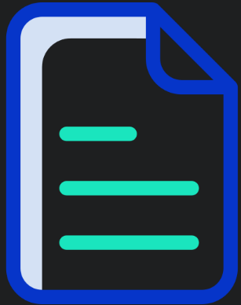

Z. template
new project
ExecuteAsync
square post-it
download
  exe
download
  exe
why
A slash
  followed
by
  two consecutive asterisks
D:\A1_research\C2_c0dice\B1_jmeter\A1_install
functionalities
introduction
build-exe
entity framework plus
zig help
⊂
4
every key-frame
defines the operation
success

