Slide 1
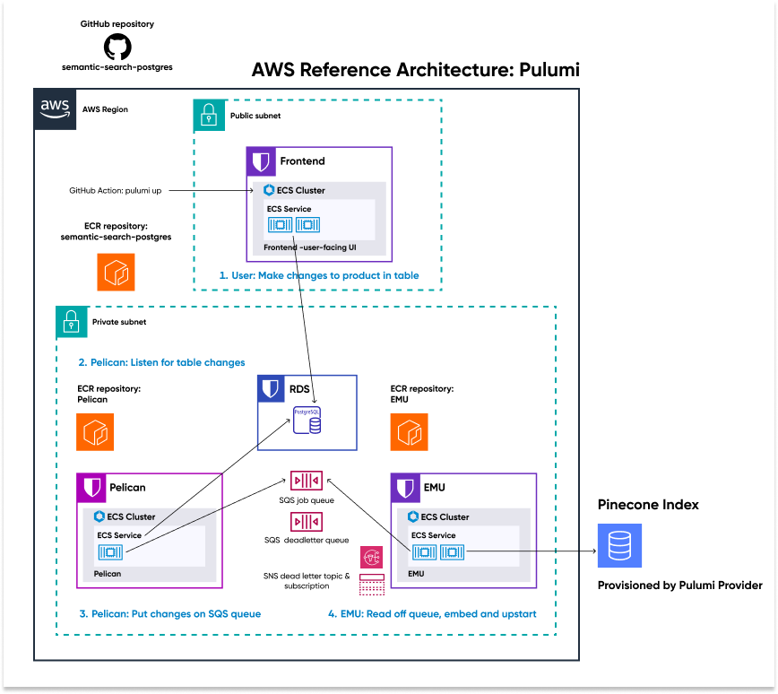


1. architecture
what
skunk
pinecone
github: aws-reference-architecture-pulumi

Slide 2

1.1 sources
videos
uses IaC
uses pulumi
pinecone.io/learn/aws-reference-architecture/
github.com/pinecone-io/aws-reference-architecture-pulumi
amazon.com/marketplace/pelican
learn: start here
multitenancy
multitenancy: serverless

Slide 3

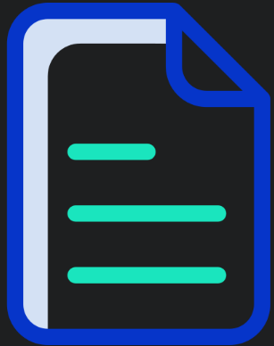
2. steps
github tutorial
github tutorial
video tutorial
videos
pulumi
administrator
prerequisites
2. aws
create a new IAM user
IAM permissions
2.1 key
key
3. pinecone
pinecone
3.1 key
key
3.2 index
index
4. pulumi
pulumi
4.1 key
clone repo
execute setup in this folder
setup
2. aws cli
linux
node js 18
credentials
config pulumi
3. pulumi aws
aws cli
pulumi aws
aws access key
test
4. pulumi stack
docker
pulumi stack
verify
5. pulumi region
docker run
6. pulumi pinecone
7. pulumi index
pulumi up
pulumi up
needs docker

Slide 4
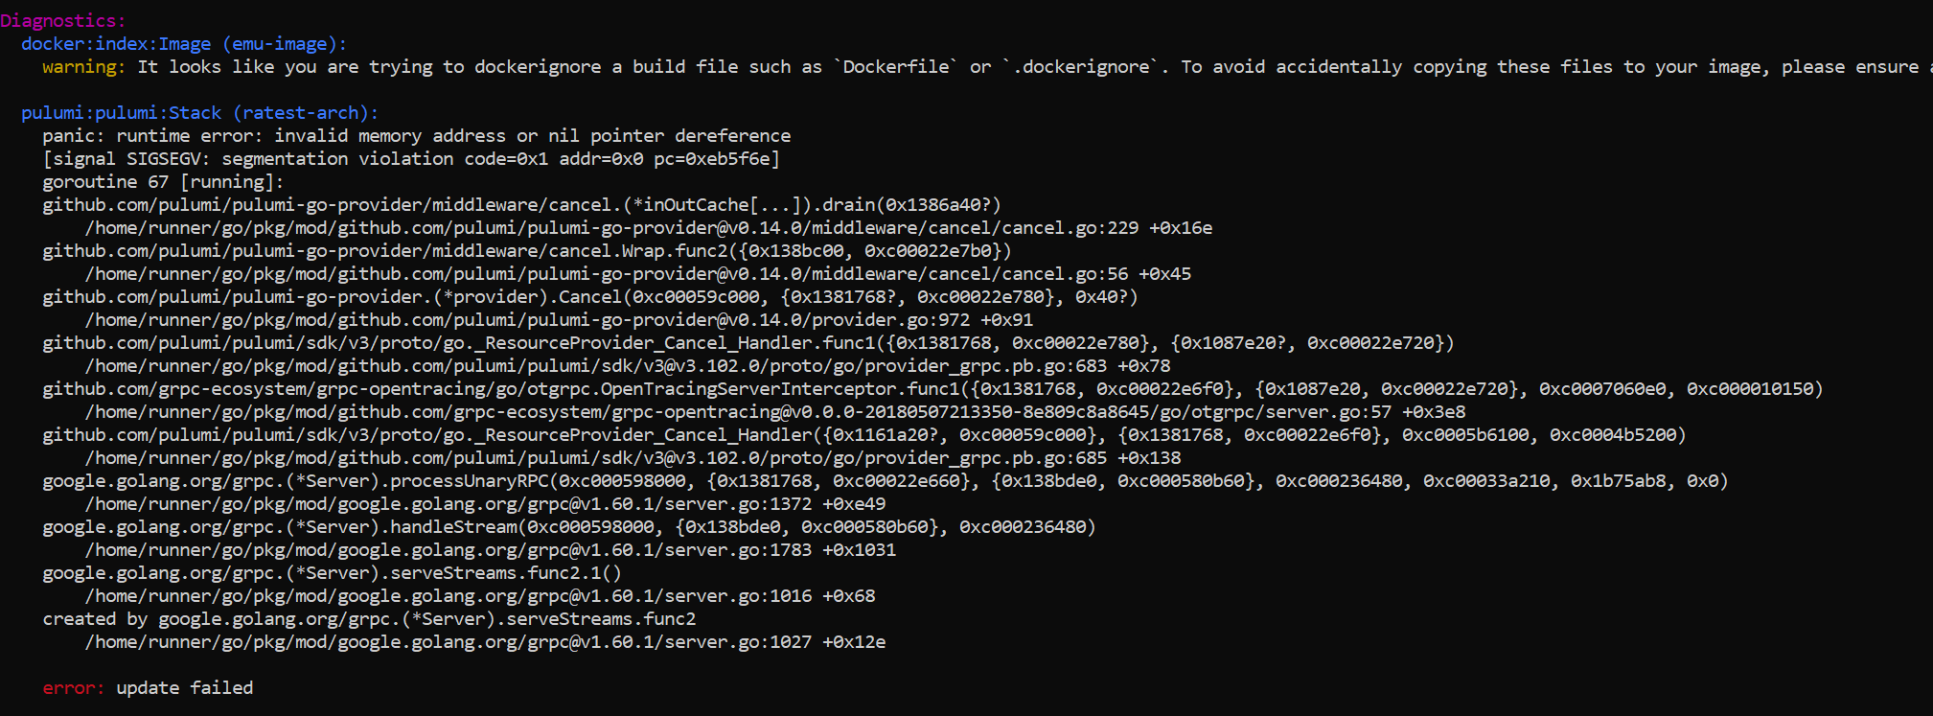
3. error
what

Slide 5
4. serverless
what
serverless: product
serverless: text what
serverless: tech
serverless: video detailed what
serverless: video tutorial

Slide 6

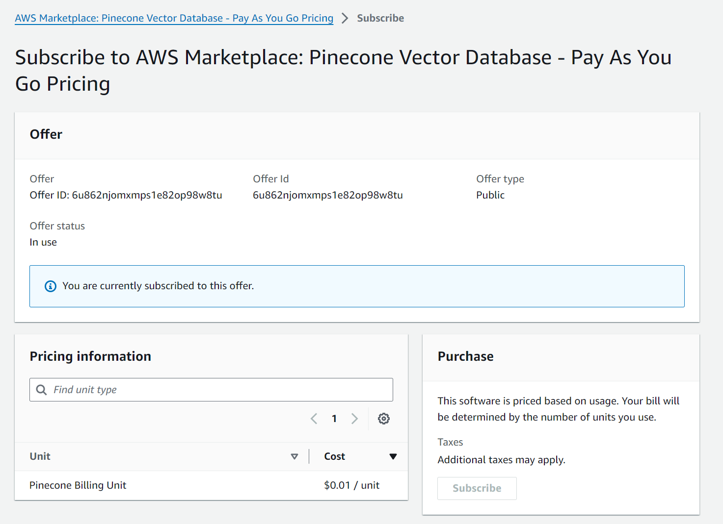

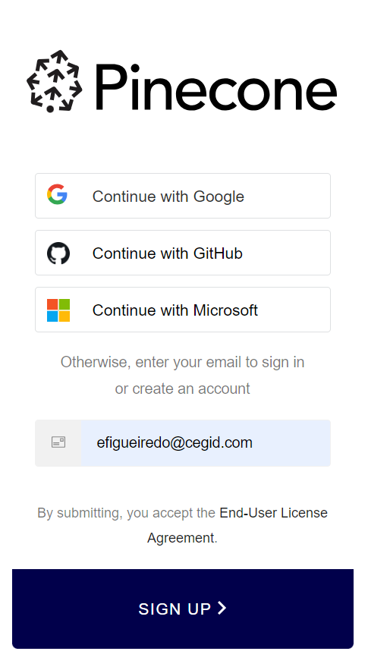
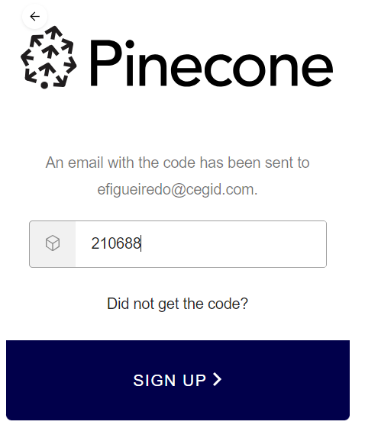
4.1 how
what
in pinecone
  click
sends to aws
next
aws marketplace

Slide 7




Z. template
new project
ExecuteAsync
square post-it
download
  exe
download
  exe
why
A slash
  followed
by
  two consecutive asterisks
D:\A1_research\C2_c0dice\B1_jmeter\A1_install
functionalities
introduction
build-exe
entity framework plus
zig help
⊂
4
every key-frame
defines the operation
success

