Slide 1

1. setup
architecture

Slide 2
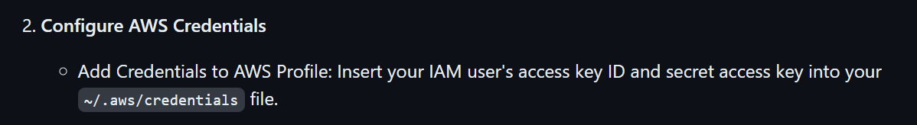
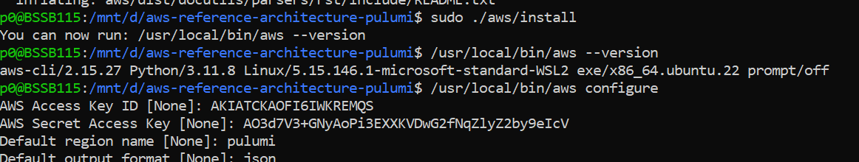
2. aws cli
what
cli
4. credentials
test
aws –-profile pulumi s3 ls

Slide 3
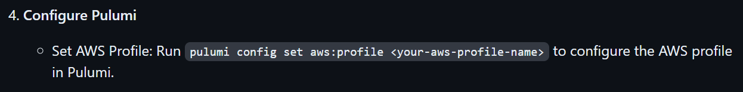

3. pulumi aws
what
pulumi config set aws:profile pulumi
github tutorial
video
the first time we access pulumi
  we need the key
the first time we access pulumi
  we need to create the stack
name
1010836/arch

Slide 4
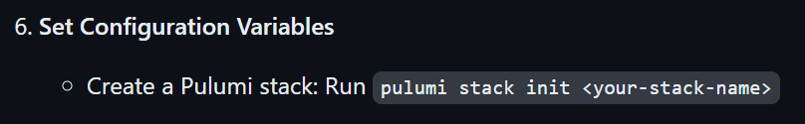
4. pulumi stack
what
github tutorial
video
pulumi stack init 1010836/arch
verify
pulumi stack ls

Slide 5
5. pulumi region
what
github tutorial
video
pulumi config set aws:region us-west-2

Slide 6
6. pulumi pinecone
what
github tutorial
video
pulumi config set --secret PINECONE_API_KEY 2d2ef014-acb6-4b1e-ac3b-6579f3e69318

Slide 7
7. pulumi index
what
github tutorial
video
pulumi config set PINECONE_INDEX 1010836-arch

Slide 8



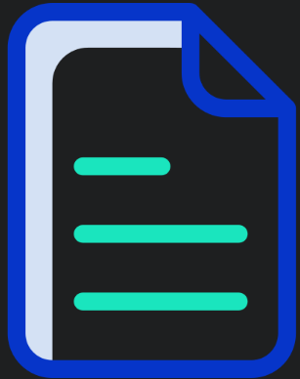


Z. template
new project
ExecuteAsync
square post-it
download
  exe
download
  exe
why
A slash
  followed
by
  two consecutive asterisks
D:\A1_research\C2_c0dice\B1_jmeter\A1_install
functionalities
introduction
build-exe
entity framework plus
zig help
⊂
4
every key-frame
defines the operation
success

