Slide 1

1. bedrock
skunk
pinecone

Slide 2

1.1 sources
bedrock
aws tutorial
setting-up-your-knowledge-base-for-amazon-bedrock
blog/amazon-bedrock-integration/
does not use IaC
steps
creating a pinecone index
setting-up-secrets
set up your data source
create-the-knowledge-base
connect-pinecone-to-the-knowledge-base
setting-up-an-agent
creating-an-alias-for-your-agent
testing-the-bedrock-agent

Slide 3
2. pinecone - register
why
Creating a Pinecone index
  The knowledge base we’ll build is going to rely on a Pinecone index.
  After signing up to Pinecone, follow the quick start guide to create your Pinecone index,
  and retrieve your index’s endpoint and Api Key from the Pinecone console.
bedrock
how
architecture
2. sign up

Slide 4
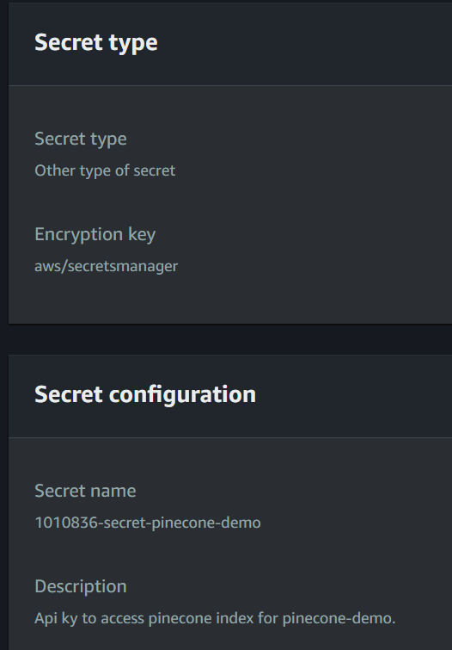
2. secret
what
arn
arn:aws:secretsmanager:us-east-1:211125414460:secret:1010836-secret-pinecone-demo-Gm50tG

Slide 5





Z. template
new project
ExecuteAsync
square post-it
download
  exe
download
  exe
why
A slash
  followed
by
  two consecutive asterisks
D:\A1_research\C2_c0dice\B1_jmeter\A1_install
functionalities
introduction
build-exe
entity framework plus
zig help
⊂
4
every key-frame
defines the operation
success

