Slide 1

1. logs
portfolio

Slide 2
1.1 index

Slide 3

1.2 sources
Azure Monitor
App insights

Slide 4
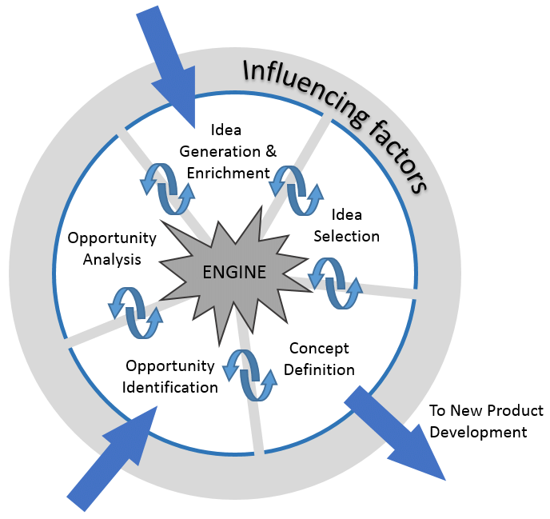
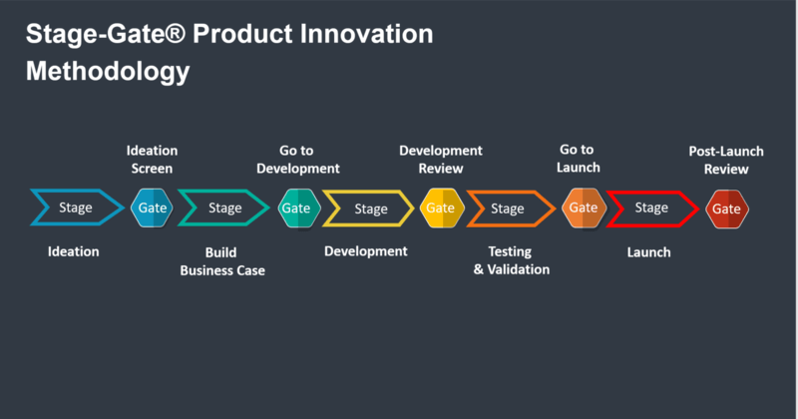
2. glossary
NCD – New Concept Definition Process
+
Stage Gate
NCD process
Opportunity identification
Product development
GATE 0

Slide 5
2.1 NFR
non functional requirements
performance
How fast does the system return results?
reliability
How often does the system experience critical failures?

Slide 6
2.1.1 monitoring
monitoring
looking at the dashboard
  of
a car
observability
being able to understand
  how
every part of the engine
  works
by
  looking inside the car
you get predefined information like
  speed,
  fuel level,
  engine temperature
diagnosing a problem
  based
on how various parts
  are
behaving
  and
interacting
  in real-time
which will alert you
  if something
is
  wrong

Slide 7
2.1.2 observability
Aspect | Monitoring | Observability
Definition | Tracking system health and performance via predefined metrics or logs. | Understanding the internal state of a system based on telemetry (logs, metrics, and traces).
Focus | Known issues or expected behaviors. | Unknown issues and gaining insights into system behavior.
Approach | Reactive, based on set thresholds and predefined alerts. | Proactive and diagnostic, focused on exploring and diagnosing system behaviors.
Proactive/Reactive | Primarily reactive—alerts when something goes wrong. | Both proactive and diagnostic—helps in understanding and solving unknown issues.
Tools | Azure Monitor, Prometheus, Datadog, Zabbix. | Open Telemetry, Jaeger, Honeycomb, Datadog.
Telemetry Type | Predefined metrics and logs. | Metrics, logs, and traces for comprehensive analysis.
Scope | Answers "Is the system working as expected?" | Answers "Why did this error happen?" and "What is causing performance issues?"
Predefined/Dynamic | Focuses on predefined metrics and logs. | Flexible, involves gathering telemetry for unknown failures.
Use Case | Best for systems with known, predictable failure modes. | Essential for complex, distributed, microservices-based architectures.
Response | Triggers alerts to notify when something is wrong. | Enables investigation and root cause analysis of issues.

Slide 8
2.2 azure monitor
what
set of integrated Azure resources
  that
    collects
      and
    aggregate
  data
across multiple
  Azure subscriptions
collects and aggregates
  the data
from
  every layer and component
of
  your system
stores this data
  in
a common
  data platform
this stored data
  is then
consumed by
  a common set
    of
  tools
these tools
  can
    correlate,
    analyze,
    visualize,
    and/or respond
to the data.
Azure Monitor - What

Slide 9
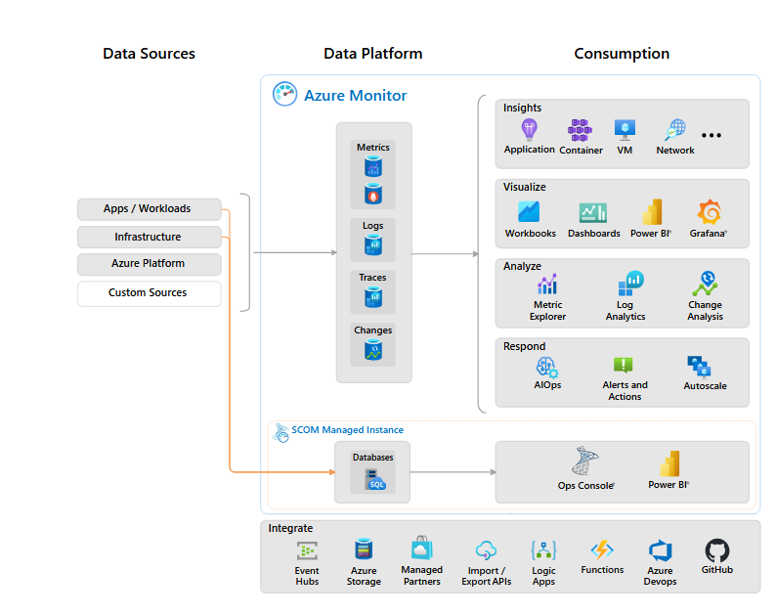
2.2.1 components
types of resources
  being
monitored
stores
  the collected
monitoring data
components
  that use
data
  from
the data platform
what
data sources
data sources
data platform
azure monitor's core data platform
  has stores for
    metrics,
    logs,
    traces,
    and changes.
System Center Operations Manager MI
  uses
    its own database
  hosted
    in SQL Managed Instance
to be
researched

Slide 10

2.2.2 data collection
why
gathering data
  to
populate
  data sources
Collection method | Description
Application instrumentation | Application Insights is enabled through either Auto-Instrumentation (agent) or by adding the Application Insights SDK to your application code. In addition, Application Insights is in process of implementing Open Telemetry. For more information, reference How do I instrument an application?.
Agents | Agents can collect monitoring data from the guest operating system of Azure and hybrid virtual machines.
Data collection rules | Use data collection rules to specify what data should be collected, how to transform it, and where to send it.
Zero Config | Data is automatically sent to a destination without user configuration. Platform metrics are the most common example.
Diagnostic settings | Use diagnostic settings to determine where to send resource log and activity log data on the data platform.
Azure Monitor REST API | The Logs Ingestion API in Azure Monitor lets you send data to a Log Analytics workspace in Azure Monitor Logs. You can also send metrics into the Azure Monitor Metrics store using the custom metrics API.
what
app insights
data collection

Slide 11
2.3 app insights
what
a feature
  of
Azure Monitor
used for
  Application Performance Management (APM)
for
  live web applications
Azure Monitor - What
how
provides many experiences
  to
enhance the
  performance,
  reliability,
  and quality
of
  your applications
Application dashboard: An at-a-glance assessment of your application's health and performance.
Application map: A visual overview of application architecture and components' interactions.
Live metrics: A real-time analytics dashboard for insight into application activity and performance.
Transaction search: Trace and diagnose transactions to identify issues and optimize performance.
Availability view: Proactively monitor and test the availability and responsiveness of application endpoints.
Failures view: Identify and analyze failures in your application to minimize downtime.
Performance view: Review application performance metrics and potential bottlenecks.

Slide 12




Z. template
new project
ExecuteAsync
square post-it
download
  exe
download
  exe
why
A slash
  followed
by
  two consecutive asterisks
D:\A1_research\C2_c0dice\B1_jmeter\A1_install
functionalities
introduction
build-exe
entity framework plus
zig help
⊂
4
every key-frame
defines the operation
success

