Slide 1

1. research
portfolio

Slide 2
1.1 index

Slide 3
1.2 resources

Slide 4
research process
2. summary
constraints
overview research
Glossary
create bird’s eye view map
select research path
problem
SOTA
detailed research
sources
experiments
POCS
(optional)
publish
review
team
review
journaling
keep track of your thoughts, challenges, findings, and decisions as you progress through the research. This documentation is essential for reflection and future reference.
start by clearly identifying the issue we're trying to solve or the question we need to answer.
review the current state of the field by looking at existing solutions, methodologies, and technologies. this helps to understand what has already been done.
taking a step back to view the problem from a broader perspective, will help to understand the problem within the context of related issues or the bigger picture.
decide on the direction for further research, either as an overview for general knowledge or detailed investigation into specific areas.
test your hypotheses or ideas through small-scale experiments or POCs to validate approaches or explore potential solutions.
description
the initial problem was how to effectively add logs to the application to improve traceability and debugging.
researching how logging is implemented in modern applications, evaluating various logging frameworks, and understanding how different companies approach this.
realizing that logging is just one aspect of a larger concern—application quality, which includes aspects like performance monitoring, observability, etc.
shifting the research focus from just logs to a more comprehensive understanding of application quality, then drilling down to specific areas like log strategies in high-quality apps.
implementing a custom logging system within a small part of the application to see if it improves the traceability and monitoring of requests.
example

Slide 5
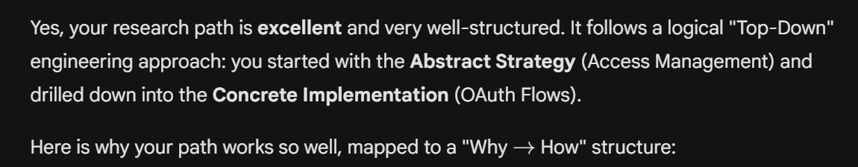
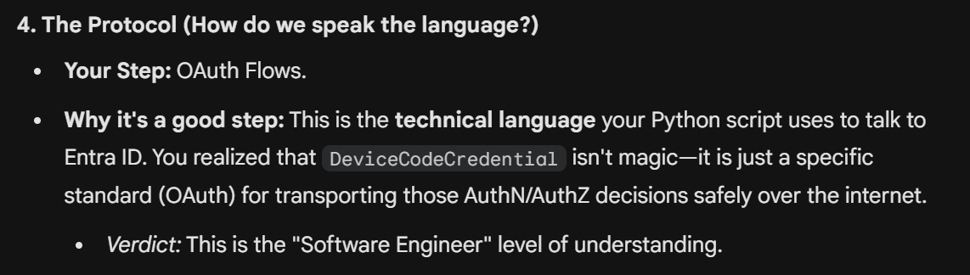
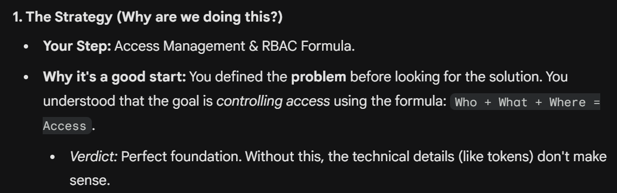
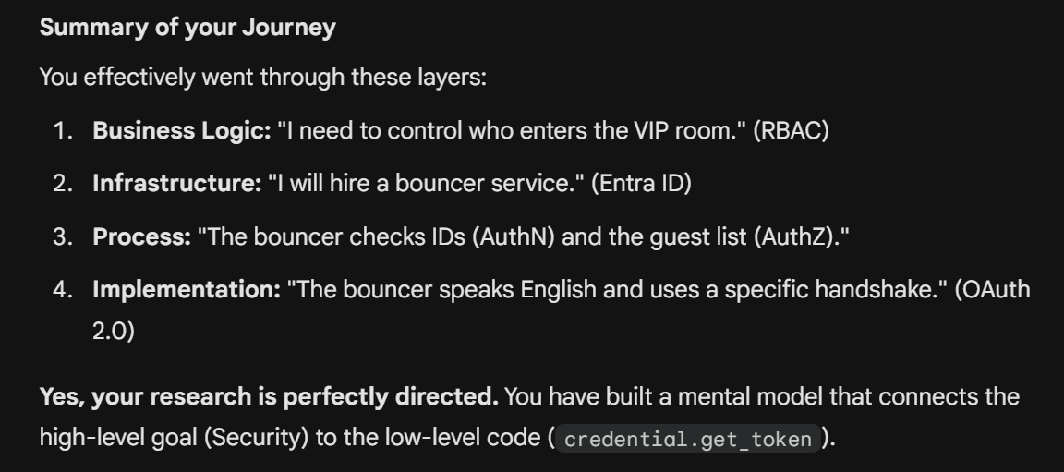
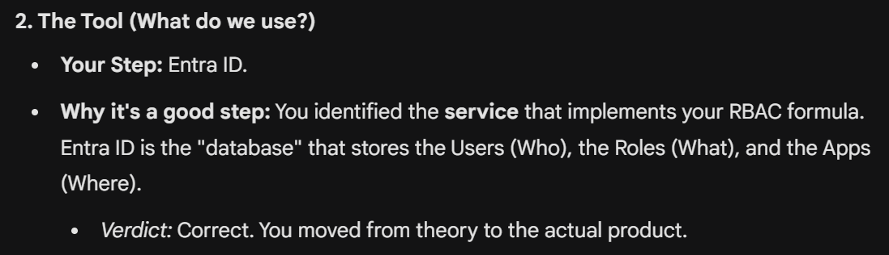
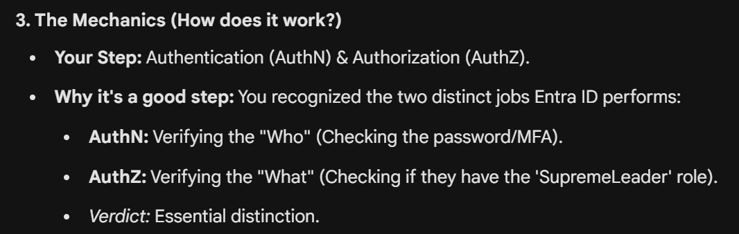
research process
3. example

Slide 6




Z. template
V
2. FOUNDRY
1. project
download
  exe
foundry
engines
build-exe
foundry
D:\repos\minerva\lumen\lumen\ai\tools.py
4
success

