Slide 1

1. environment
portfolio
python

Slide 2

1.1 index
deployment
first
modules
package management
pip
pipenv
poetry
pdm
packages
scopes
shell
structure
virtual environments
wsl

Slide 3
2. lexicon
packages
modules
internals
scopes
virtual environments

Slide 4
3. structure
structure

Slide 5
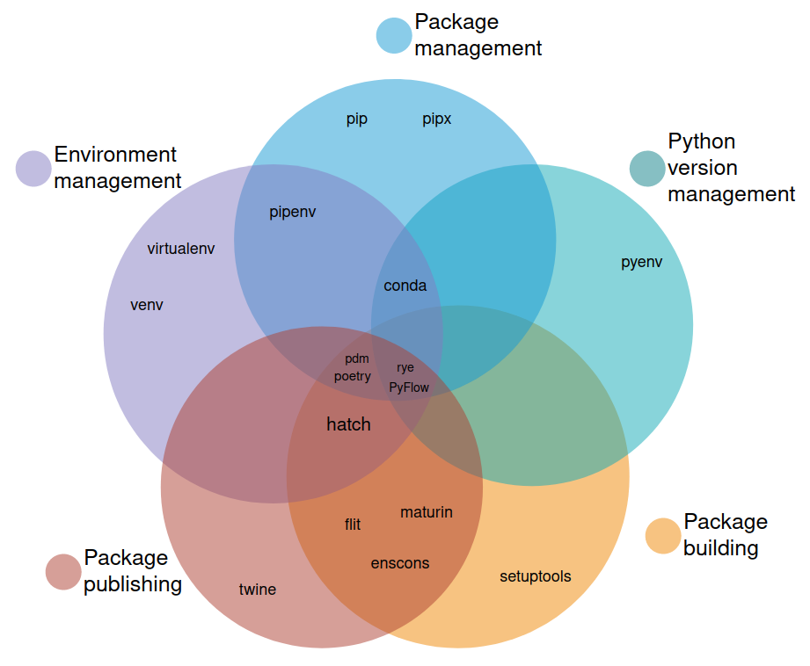
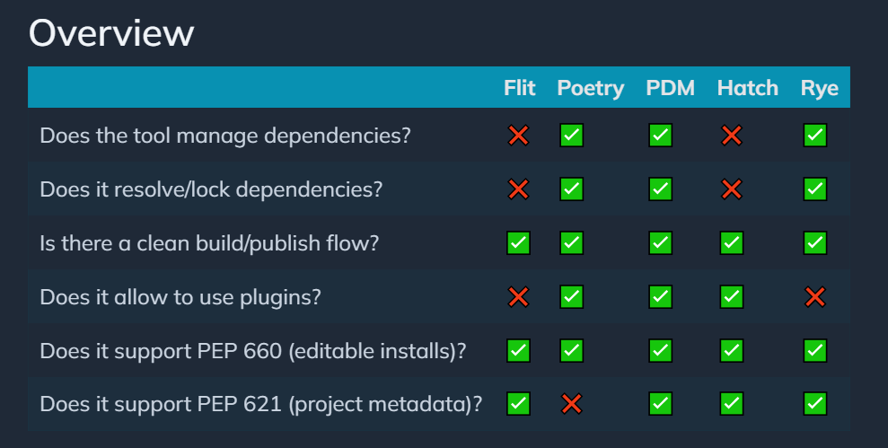

4. environment
an unbiased evaluation of Python packaging tools
site
video

Slide 6
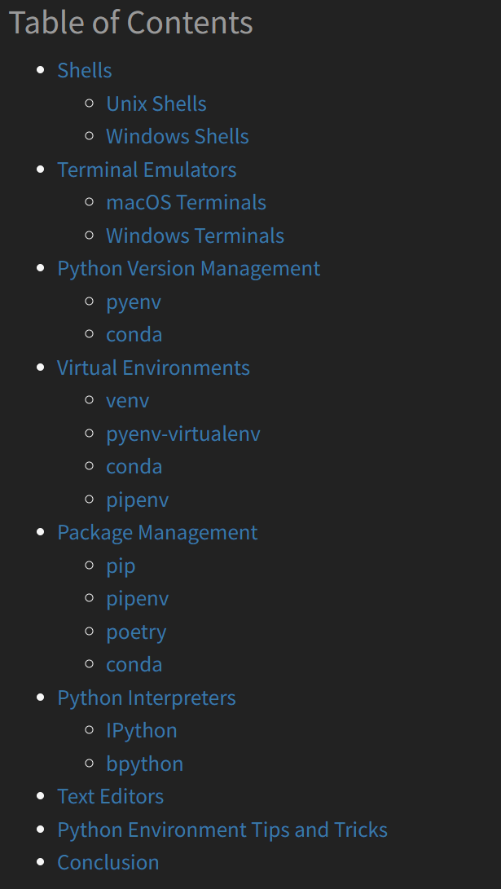
4.1 how
An Effective Python Environment: Making Yourself at Home – Real Python
shell
windows terminal
pyenv
virtual environments
venv
python -m venv .venv
missing vsCode
missing poetry
pipenv
package management
tree
pip
poetry
pdm
deployment
python site

Slide 7
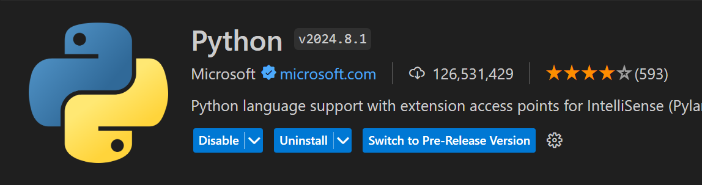
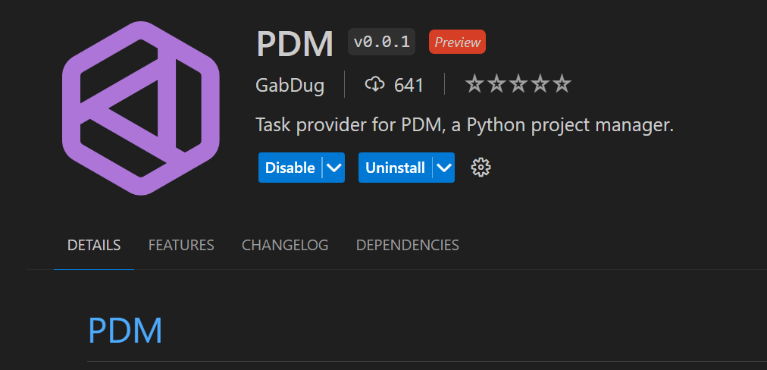
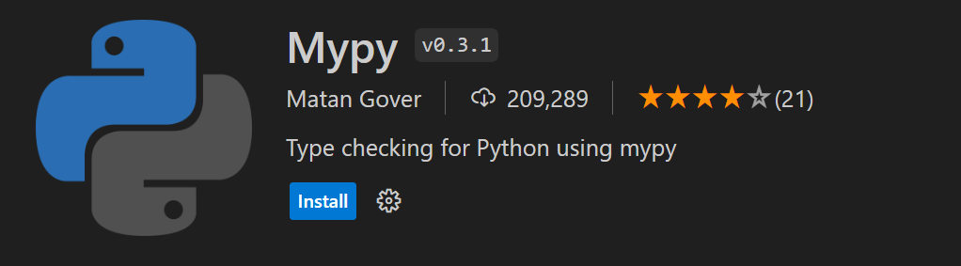
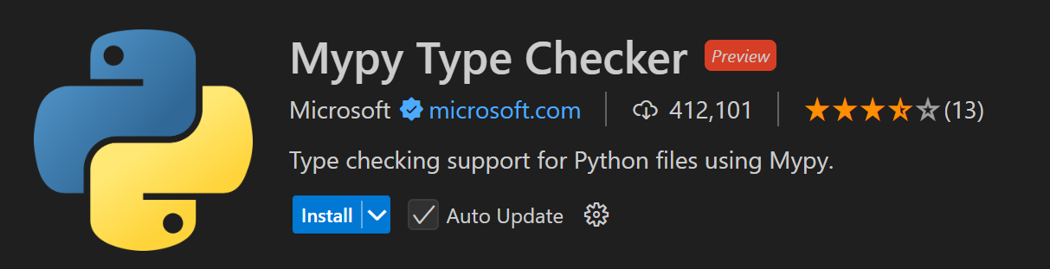
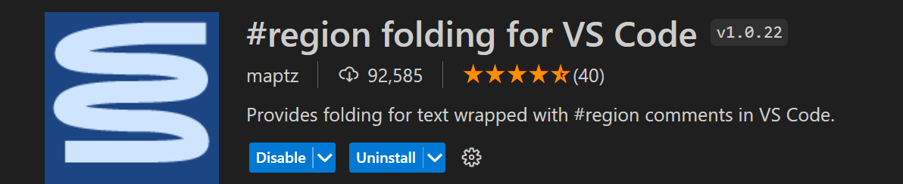
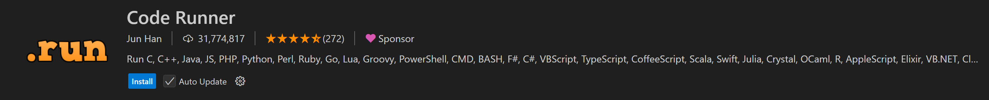
4.2 vsCode

Slide 8
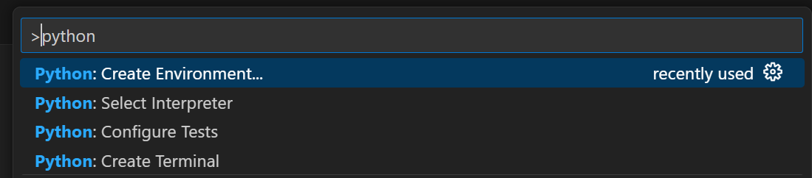
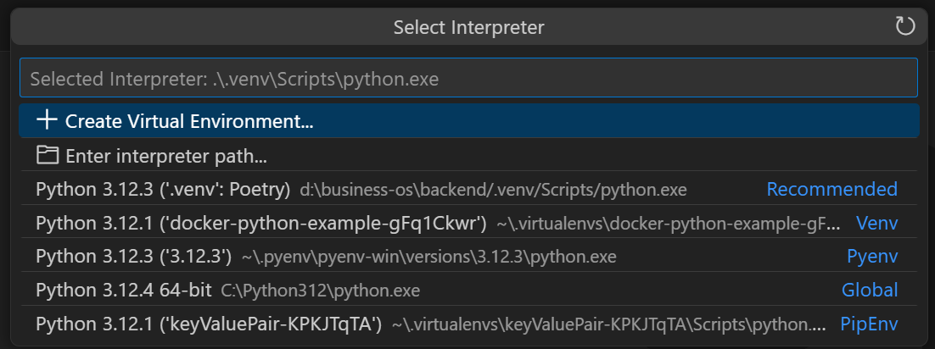
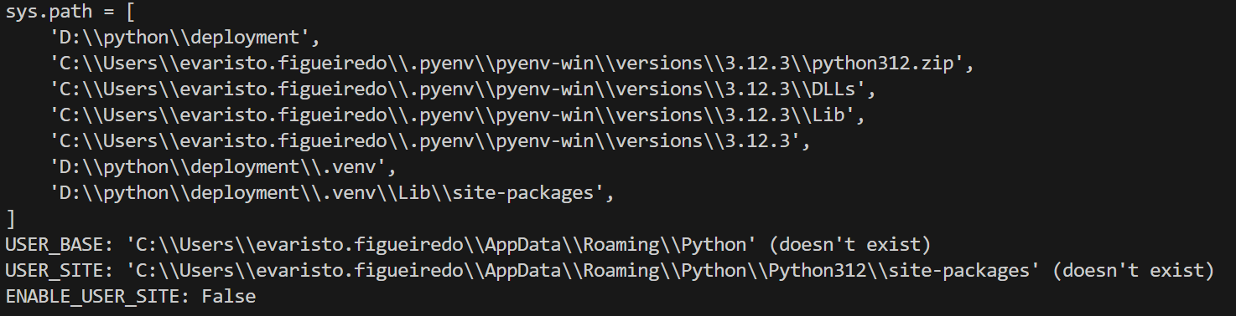
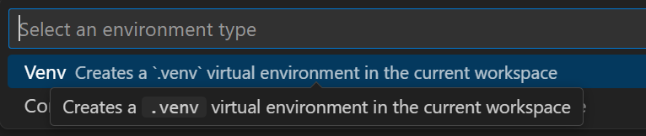
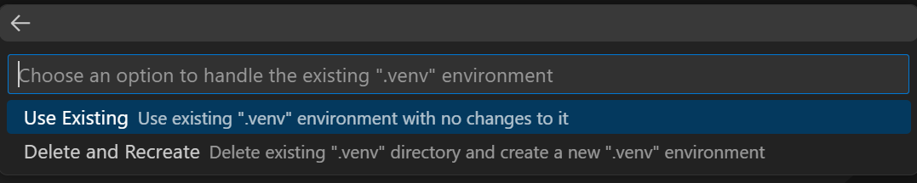
4.2.1 env

Slide 9
5. deployment
deployment
formats
devpi
azure

Slide 10
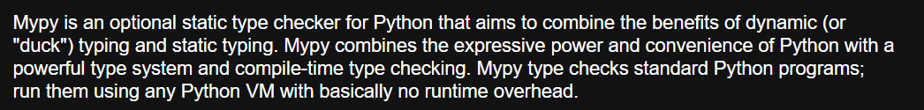
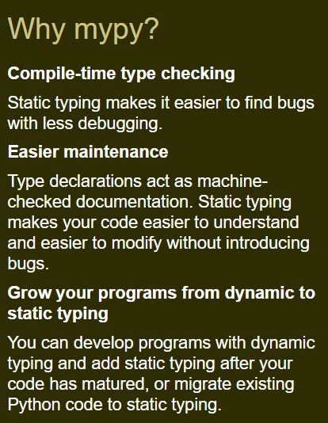
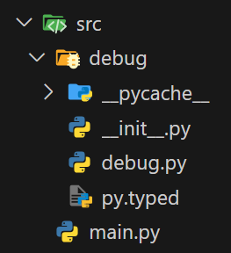

6. myPy
site
importance-of-adding-py-typed-file-to-your-typed-package
don't-forget-py.typed-for-your-typed-python-package/

Slide 11
A. conclusion
vsCode
pyenv
pdm
mypy
CI/CD
  azure devops
repository: devpi
  deployment
  packages
future:
  create team code style
  pylint
  black
  sphinx

Slide 12




Z. template
new project
ExecuteAsync
square post-it
download
  exe
download
  exe
why
A slash
  followed
by
  two consecutive asterisks
D:\A1_research\C2_c0dice\B1_jmeter\A1_install
functionalities
introduction
build-exe
entity framework plus
zig help
⊂
4
every key-frame
defines the operation
success

