Slide 1

1. pyenv
python
environment

Slide 2

2. what
what
can manage
  which Python
to use
  in
    current session,
    globally,
    per-project basis
pyenv
  will make
the python command
  point to
whichever
  Python
is specified
none of these
  overrides
the
  default system Python
for
  other applications
is safe to use
  them
however
  they work best
within
    a Python
  environment
tutorial: pyenv
video: environments

Slide 3
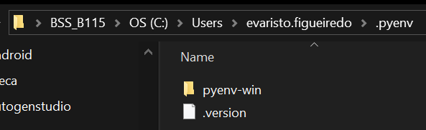
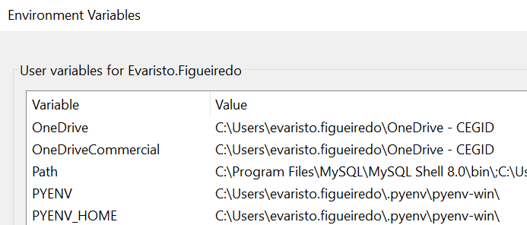


3. download
what
path
C:\Users\evaristo.figueiredo\.pyenv
site: tutorial
github/pyenv-win
video: install

Slide 4
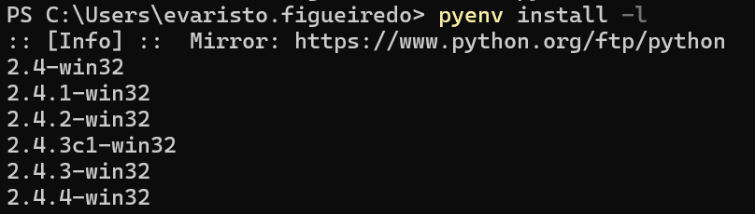

4. available
what
pyenv install -l
list
  all available
python versions
  to install
video: list available

Slide 5
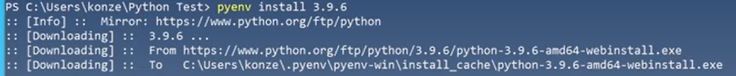
5. install
what
pyenv install 3.12.3
video: install

Slide 6
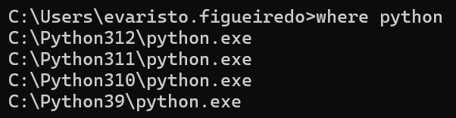

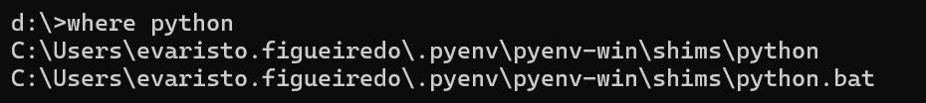
6. installed
what
pyenv versions
video: list installed
I remove all

Slide 7
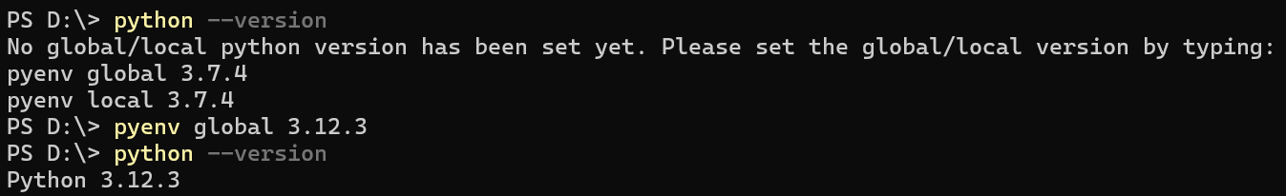
7. shell
what
pyenv global 3.12.3
video: shell

Slide 8
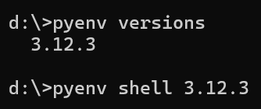
8. global
what
pyenv global 3.12.3
video: global

Slide 9
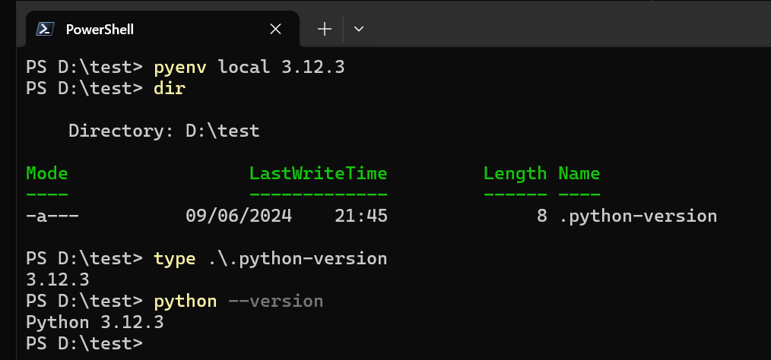
8. local
what
pyenv local 3.12.3
video: local

Slide 10




Z. template
new project
ExecuteAsync
square post-it
download
  exe
download
  exe
why
A slash
  followed
by
  two consecutive asterisks
D:\A1_research\C2_c0dice\B1_jmeter\A1_install
functionalities
introduction
build-exe
entity framework plus
zig help
⊂
4
every key-frame
defines the operation
success

