Slide 1

1. oop
language
python

Slide 2
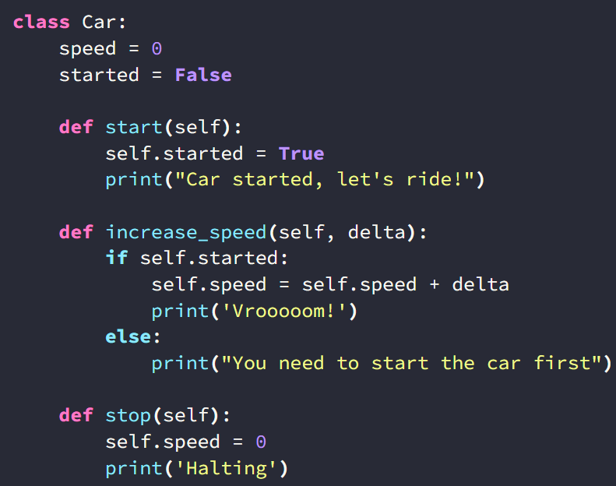

2. class
what
class

Slide 3
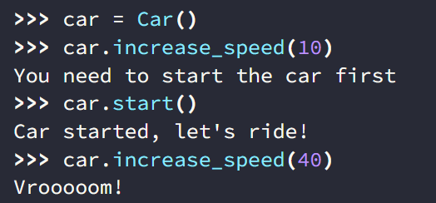
3. objects
what
objects

Slide 4
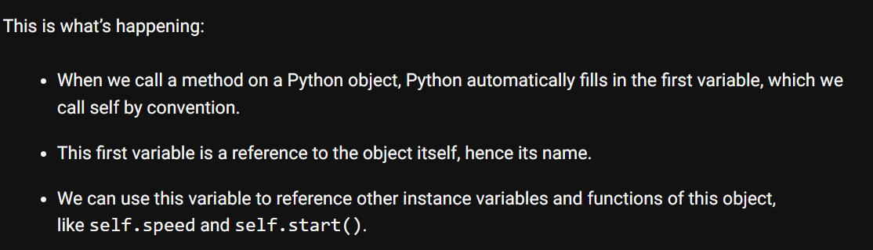
4. self
what
self

Slide 5
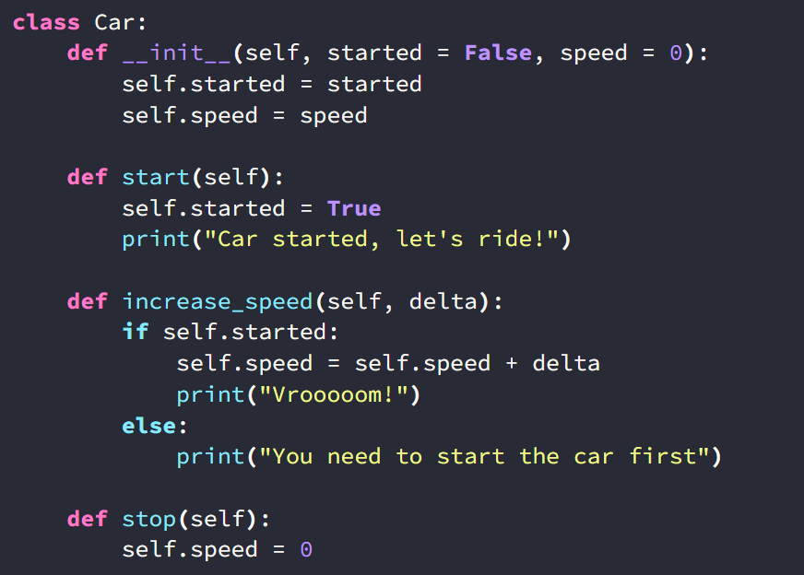
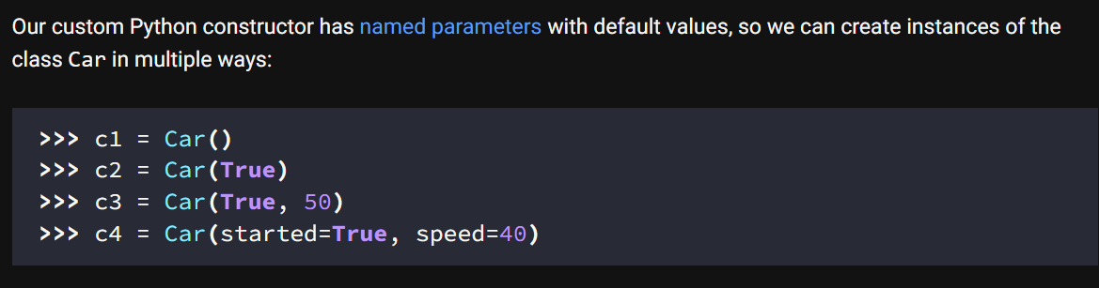
5. constructor
what
python-constructors

Slide 6
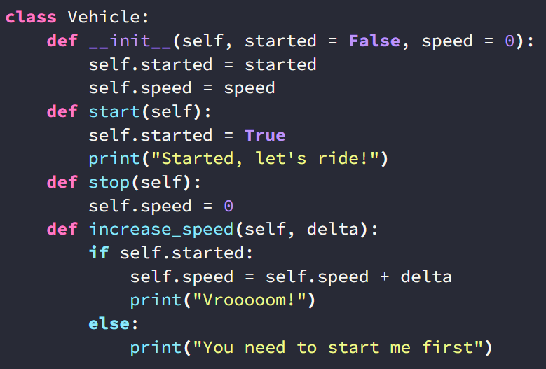
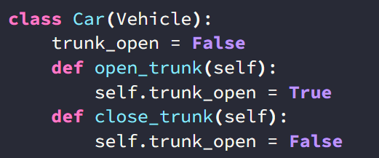
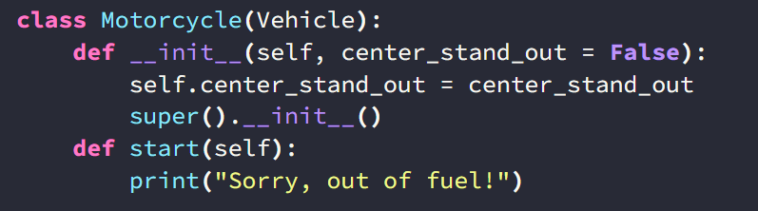
6. inheritance
what
python-inheritance
overriding

Slide 7
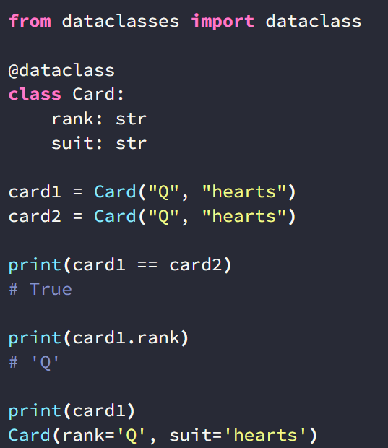
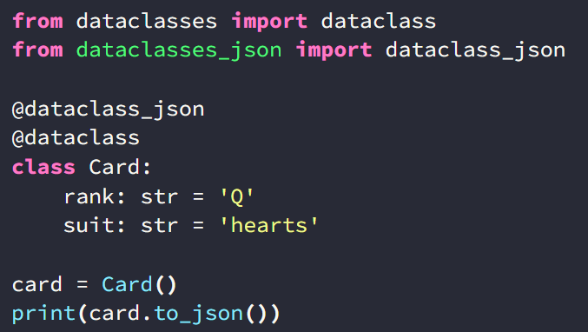


7. data class
what
json
python-data-classes
how-to-use-python-data-classes

Slide 8
7.1 sources
tutorial: how-to-use-python-data-classes
video

Slide 9
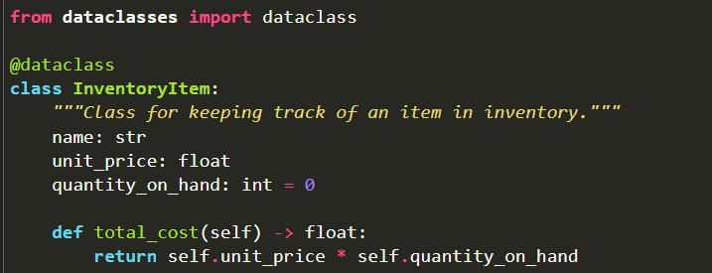
7.2 what
definition
python docs
example

Slide 10
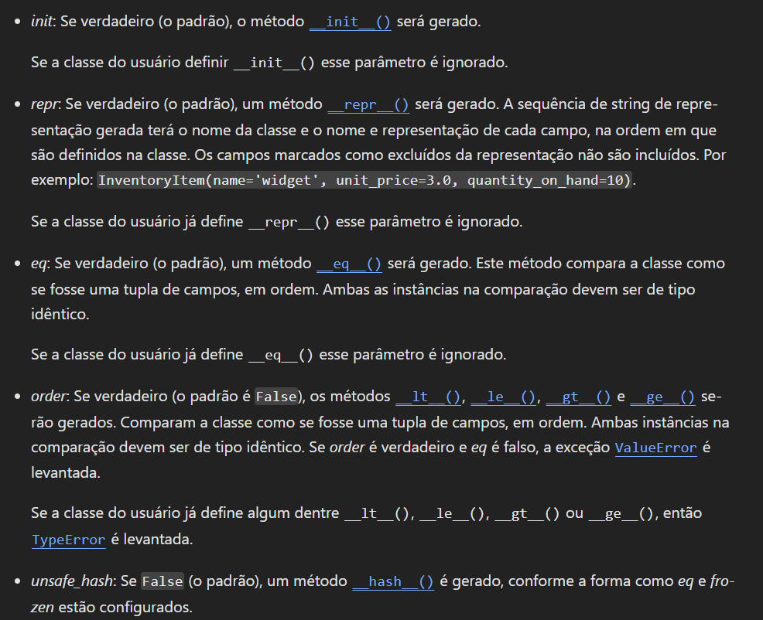
7.3 special methods
what
special methods

Slide 11
7.4 tutorial
what
Alternatives to Data Classes
Basic Data Classes
  Default Values
  Type Hints
  Adding Methods
More Flexible Data Classes
  Advanced Default Values
  You Need Representation?
  Comparing Cards
Immutable Data Classes
Inheritance
Optimizing Data Classes
Conclusion & Further Reading
/realpython.com/python-data-classes/

Slide 12
8. decorators
what
decorator | description | OOP
@classmethod | Defines a method that is bound to the class and not the instance. The first parameter is cls, which refers to the class itself. | class-level method inheritance
@staticmethod | Defines a method that does not receive an implicit first argument. It behaves like a regular function that belongs to the class’s namespace. | utility method encapsulation
@property | Defines a method as a property, which can be accessed like an attribute. | encapsulation, getter/setter methods

Slide 13

8.1 abstraction
what
Requires import from abc module.
decorator | description | OOP
@abstractmethod | Defines an abstract method in an abstract base class. | abstraction inheritance
@abstractclassmethod | Defines an abstract class method in an abstract base class. Requires import from abc module. | abstraction class-level method inheritance
@abstractstaticmethod | Defines an abstract static method in an abstract base class. Requires import from abc module. | abstraction, utility method inheritance
@abstractproperty | Defines an abstract property in an abstract base class. Requires import from abc module. | abstraction encapsulation inheritance
abstract base class

Slide 14

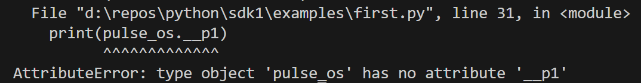
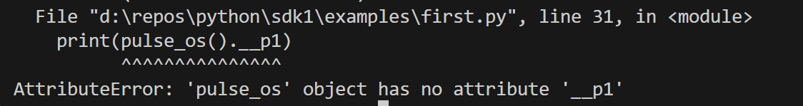
7. data class
private class variables

Slide 15





Z. template
new project
ExecuteAsync
square post-it
download
  exe
download
  exe
why
A slash
  followed
by
  two consecutive asterisks
D:\A1_research\C2_c0dice\B1_jmeter\A1_install
functionalities
introduction
build-exe
entity framework plus
zig help
⊂
4
every key-frame
defines the operation
success

