Slide 1

1. obeo
python
generation
mdd

Slide 2
1.1 index

Slide 3
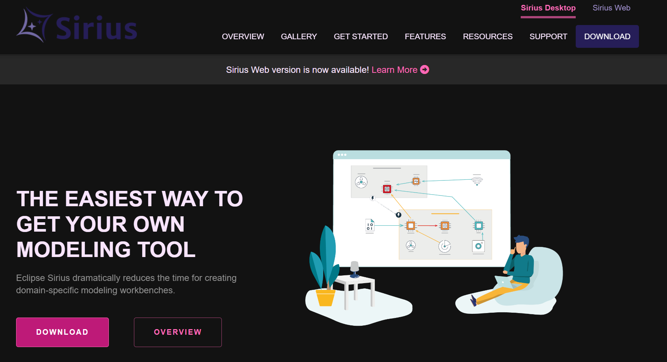

2. what
what
main site

Slide 4

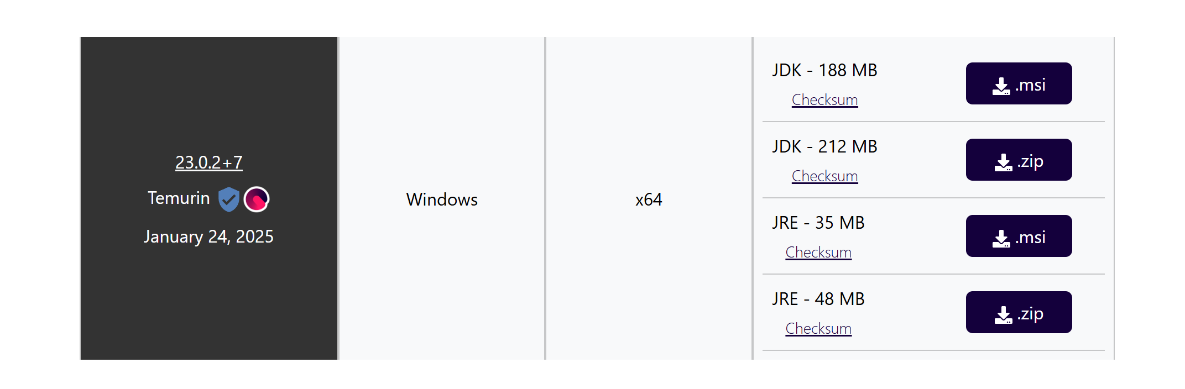
3. install
download
sirius-desktop-7.4.6
releases/2024-12
C:\obeo
..\..\..\..\..\obeo
need to document
java and libraries and paths
java releases

Slide 5
4. training
course
course 2
videos list
Code generation from visual models using Eclipse Sirius and Acceleo

Slide 6
4.1 index
exercises | edom | Obeo | Resources
Modeler Setup Papyrus
EMF project: DSL(Ecore) Editor code OCL constrains | Empty EMF Project | Install Ecore modelling project Draw the diagram Generate code | Ecore
M2M Transformations in MDSE ATL: Atlas Transformation Language Setup of the ATL Tools File/New ATL file
M2T Transformations Acceleo Setup of the Acceleo Tools File/New Acceleo Project
EMFText Textual editors
Final

Slide 7
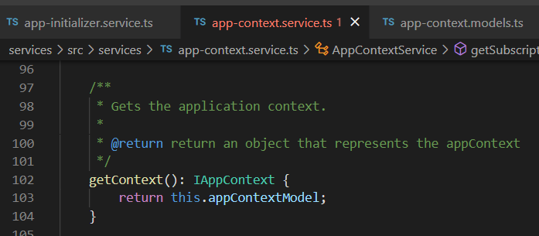





Z. template
new project
ExecuteAsync
square post-it
download
exe
download
exe
why
A slash
followed
by
two consecutive asterisks
D:\A1_research\C2_c0dice\B1_jmeter\A1_install
functionalities
introduction
build-exe
entity framework plus
zig help
⊂
⊂
4
every key-frame
defines the operation
deploy

