Slide 1

1. mdd
python
generation

Slide 2
1.1 index
site
modeler
emf
obeo

Slide 3
1.1.1 edom
exercise | week | theory | exercises | index | resources
 | 1
1 | 2 |  | Modeler Setup Papyrus
 | 3
2 | 4 |  | EMF project: DSL(Ecore) Editor code OCL constrains |  | Emf Tutorial
 | 5
3 | 6 |  | M2M Transformations in MDSE ATL: Atlas Transformation Language Setup of the ATL Tools File/New ATL file
 | 7
4 | 8 |  | M2T Transformations Acceleo Setup of the Acceleo Tools File/New Acceleo Project |  | Acceleo tutorial
 | 9
5 | 10 |  | EMFText Textual editors
 | 11
6 | 12 |  | Final
modeler
emf

Slide 4

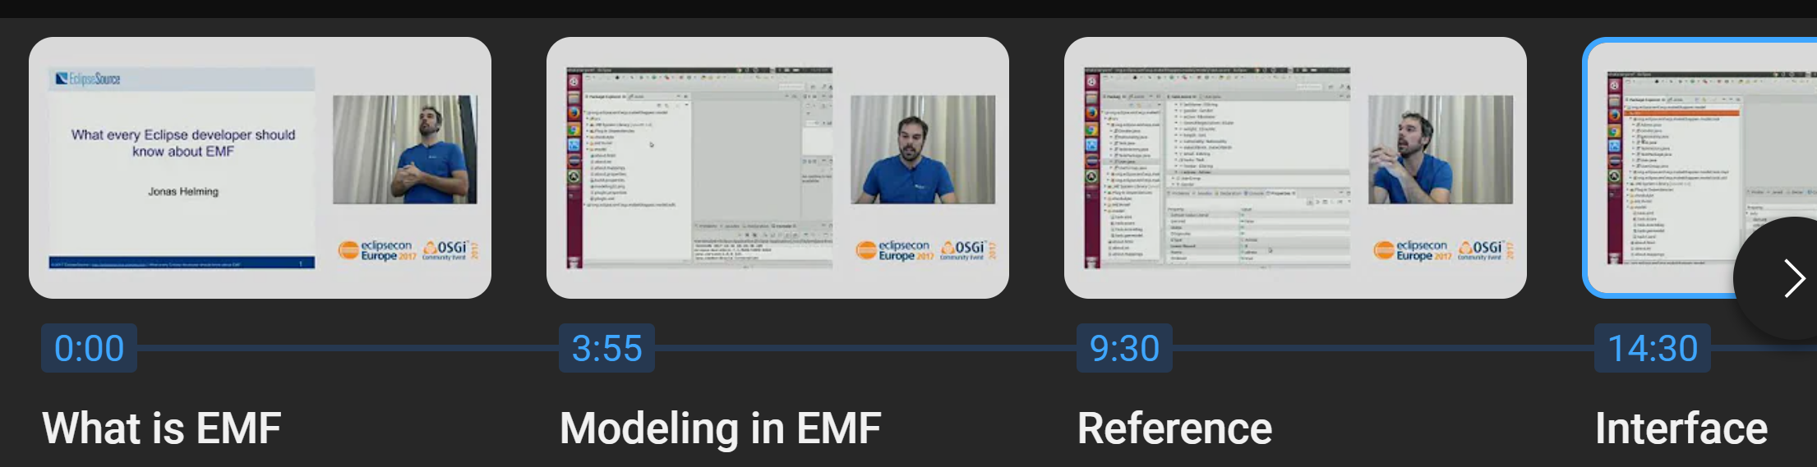
1.2 sources
tools
py ecore gen
py ecore
ecore tools
start
video: What every developer should know about EMF

Slide 5
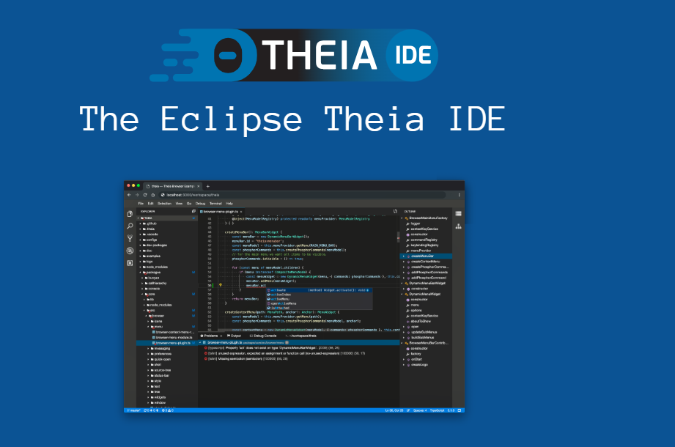
5. theia
what
very new
not mature
theia main site
eclipse/projects/theia
github
theia vs vscode
video: modeling tools
video: introduction
documentation
video: 2024 status

Slide 6
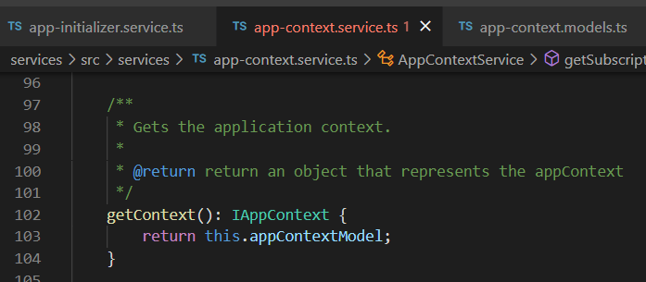






Z. template
new project
ExecuteAsync
square post-it
download
exe
download
exe
why
A slash
followed
by
two consecutive asterisks
D:\A1_research\C2_c0dice\B1_jmeter\A1_install
functionalities
introduction
build-exe
entity framework plus
zig help
⊂
⊂
4
every key-frame
defines the operation
deploy

