Slide 1

1. modeler
python
generation
mdd

Slide 2

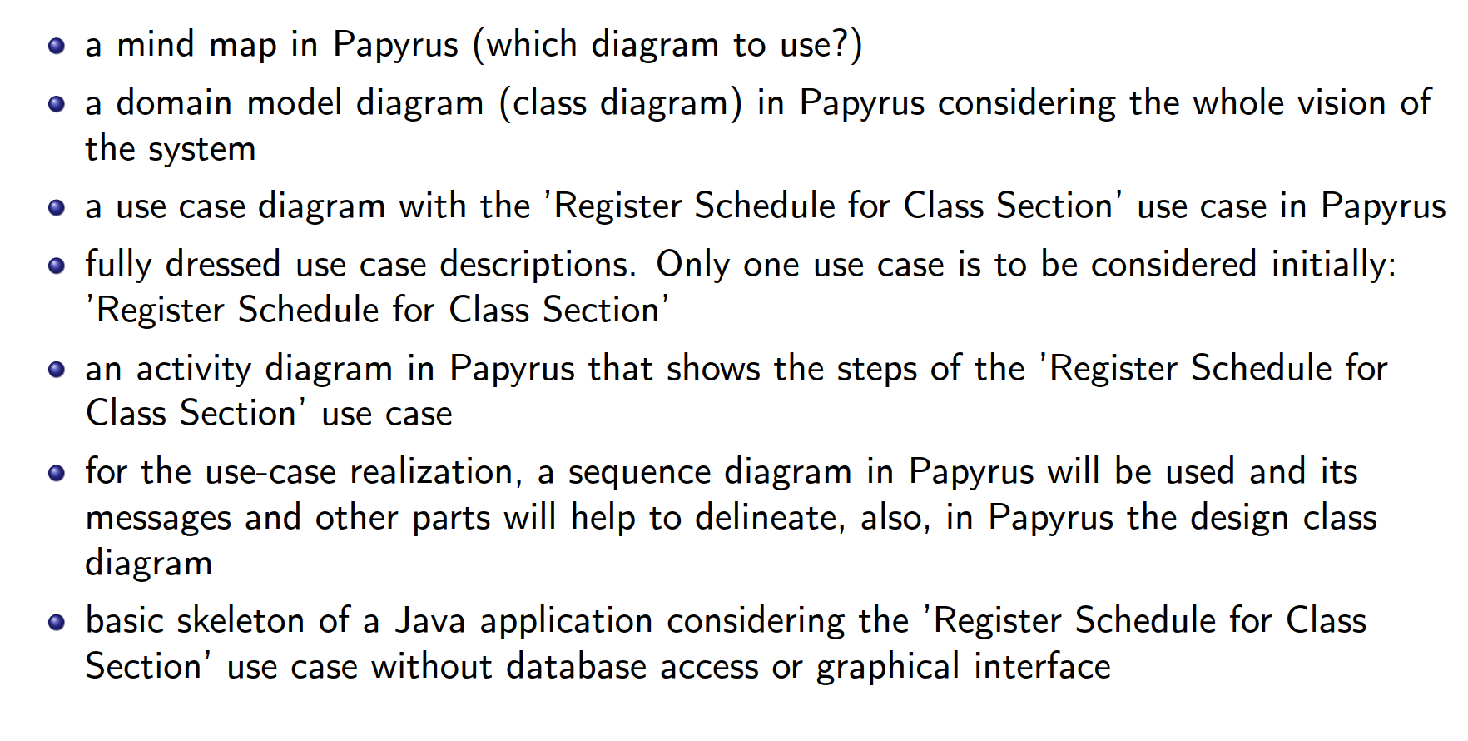
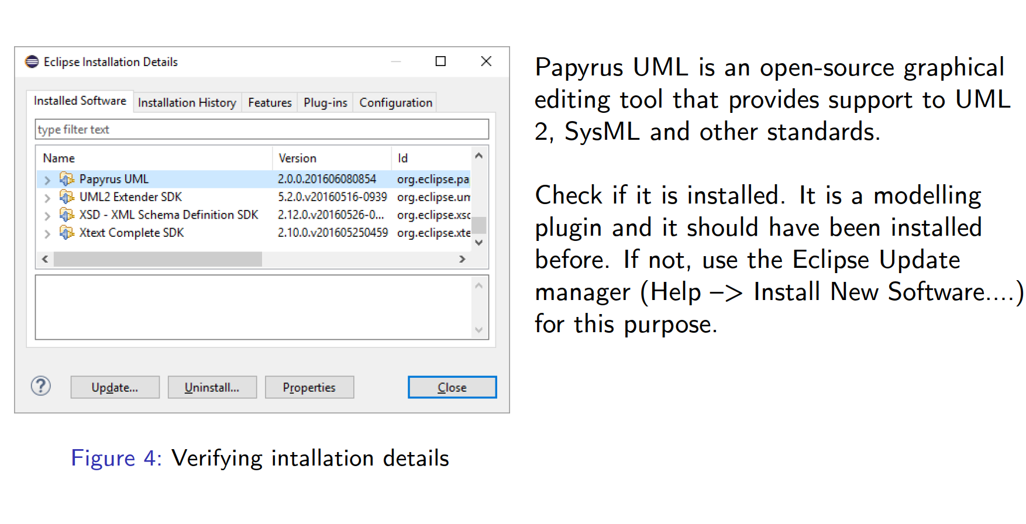

2. what
in this step (exercise 1)
I should only
create a mind map
with papyrus
where
only analyze graphic tools
Exercise1\PL\Semana2
nothing to learn
nothing to do
conclusion: use sirius
replacement for papyrus
sirius UML designer

Slide 3
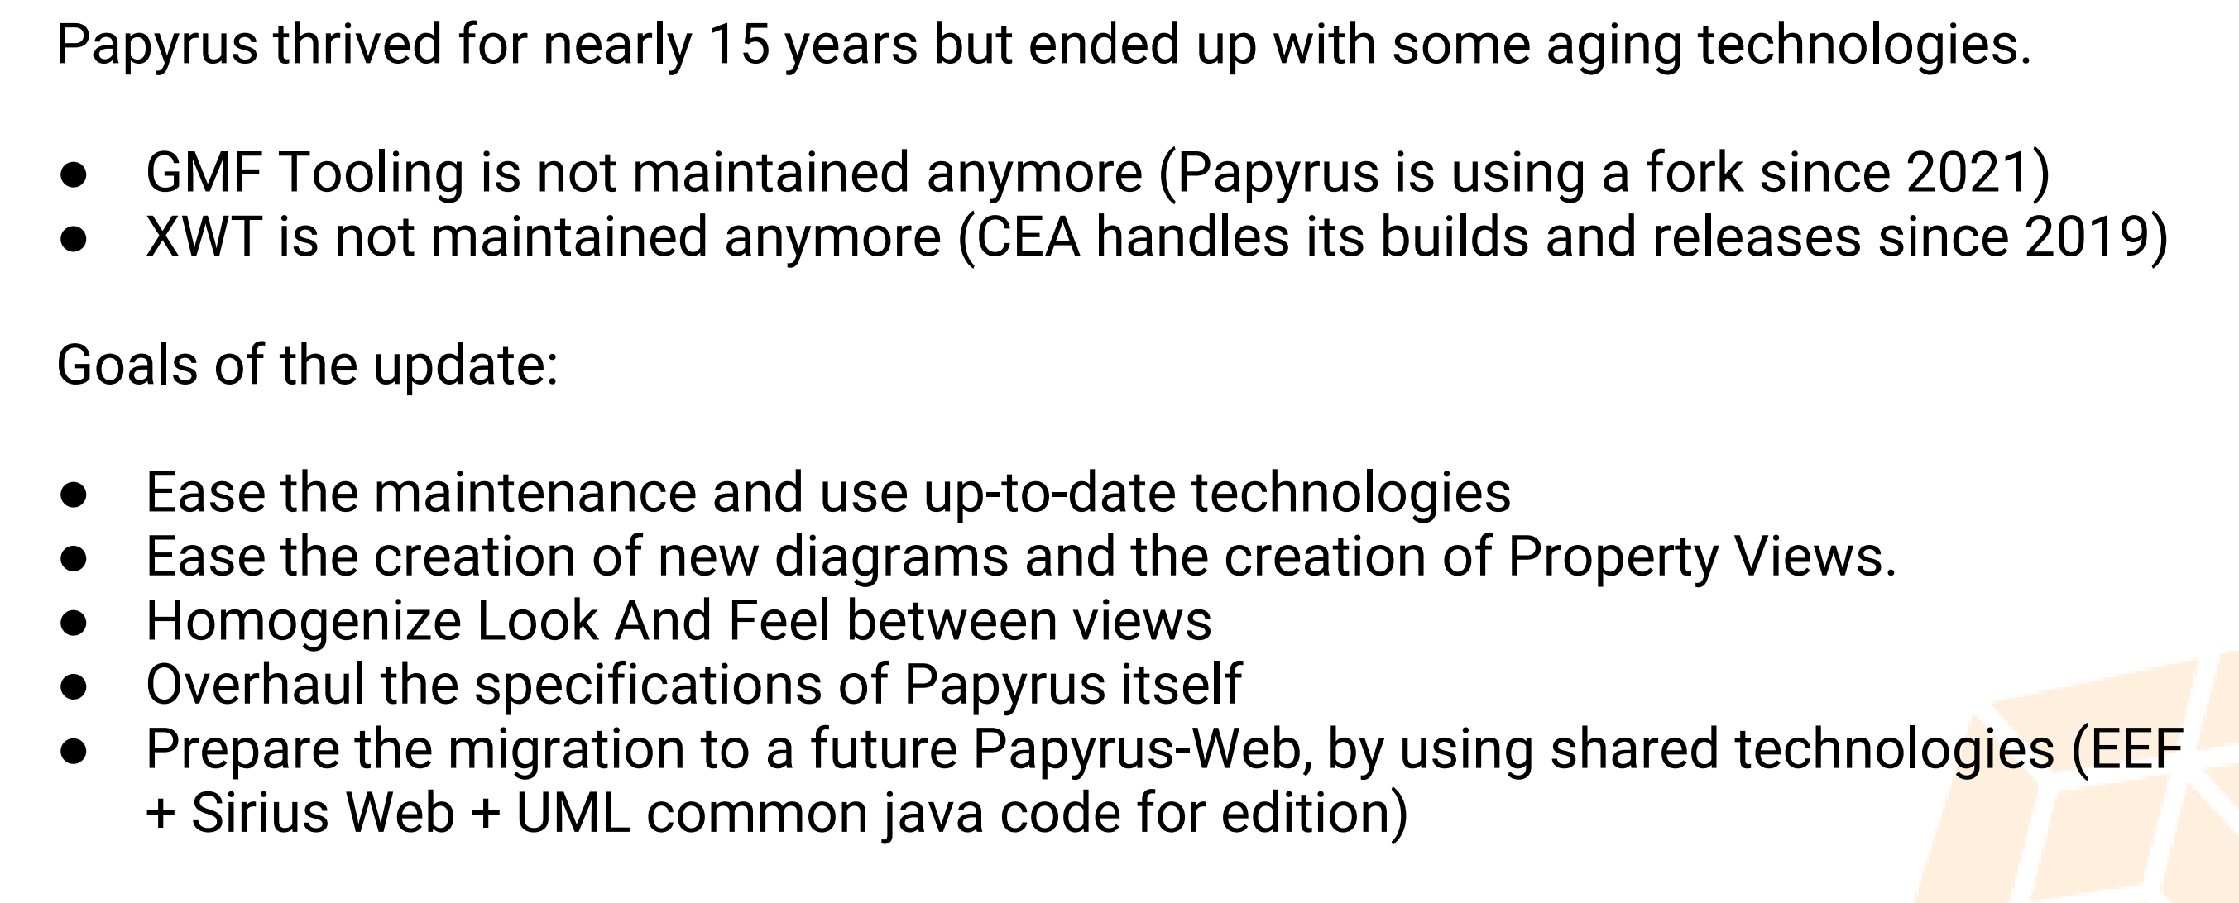
3. papyrus
what
Sirius
Papyrus
projects are unrelated
use some common libraries,
fill some similar needs
eclipse forum
historically
papyrus
sirius
standard UML
Graphical
Modeler
customizable
EMF-based
graphical model editor
UML-based
customization
support
UML implementation
(UML Designer).
both
based on
GMF Diagram/Runtime
the serialization
of
diagrams
is based on
GMF Notation
UML Designer and Papyrus
manipulate
Eclipse UML (semantic) models.
Sirius/UML Designer and Papyrus
cannot share
their Diagrams
papyrus
migrating sirius
papyrus -> sirius

Slide 4
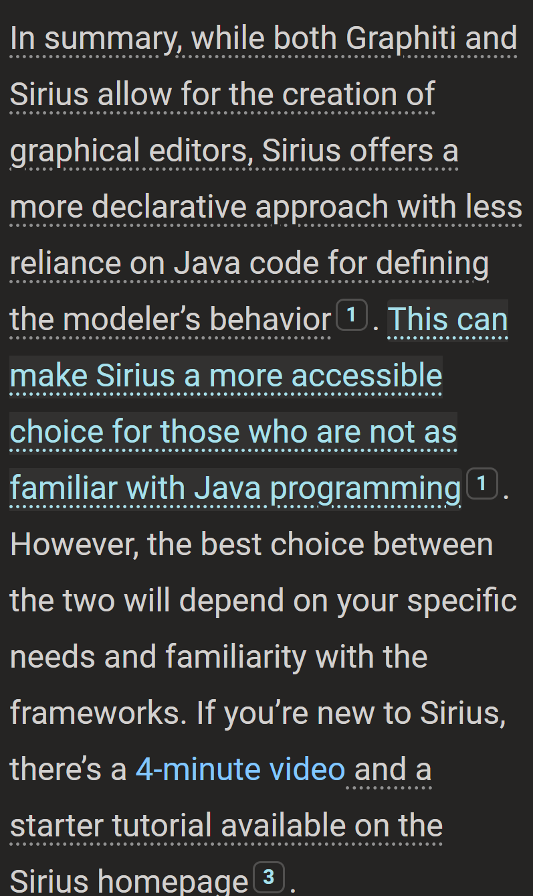
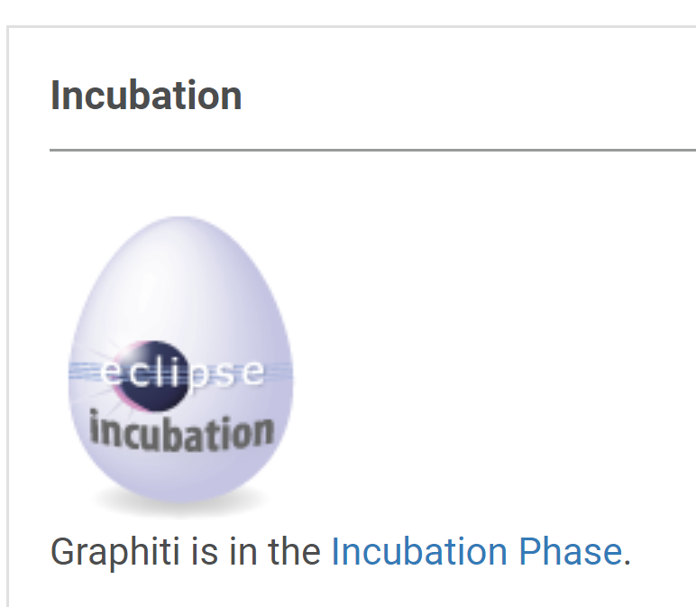
4. graphiti
graphiti
not good
what
graphiti not finished

Slide 5
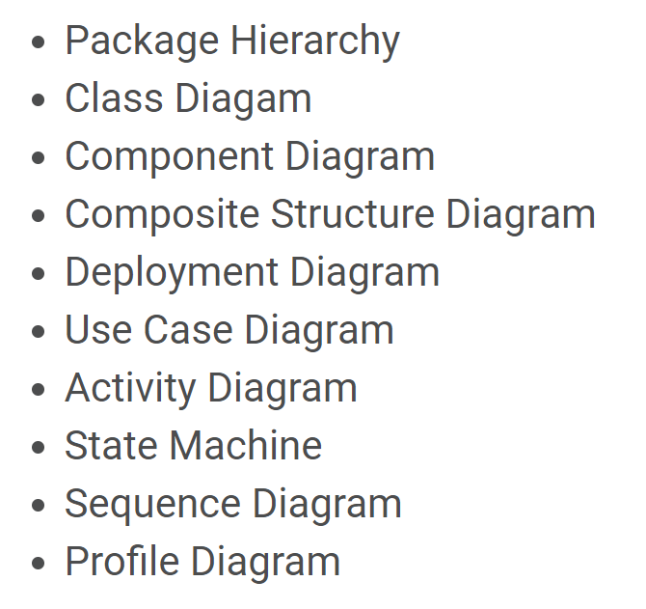
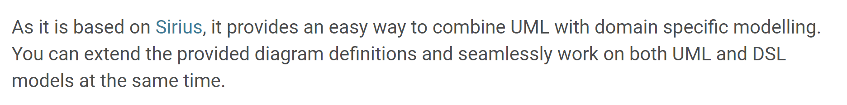
5. sirius
sirius UML designer
sirius

Slide 6
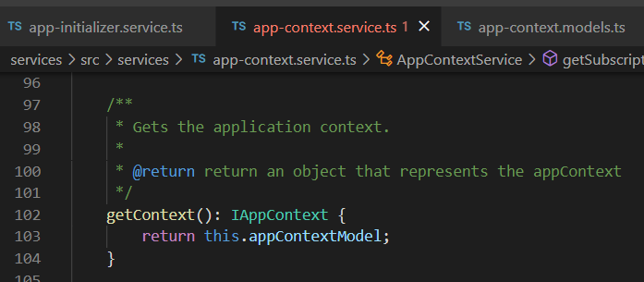





Z. template
new project
ExecuteAsync
square post-it
download
exe
download
exe
why
A slash
followed
by
two consecutive asterisks
D:\A1_research\C2_c0dice\B1_jmeter\A1_install
functionalities
introduction
build-exe
entity framework plus
zig help
⊂
⊂
4
every key-frame
defines the operation
deploy

