Slide 1

1. site
python
generation
mdd

Slide 2
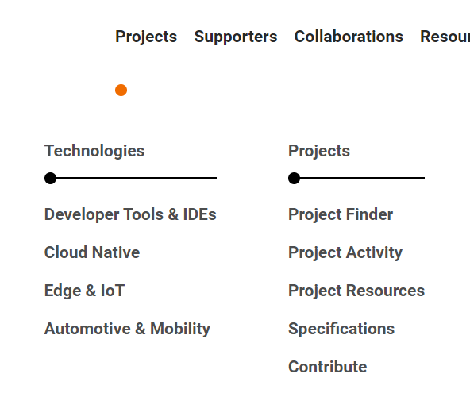





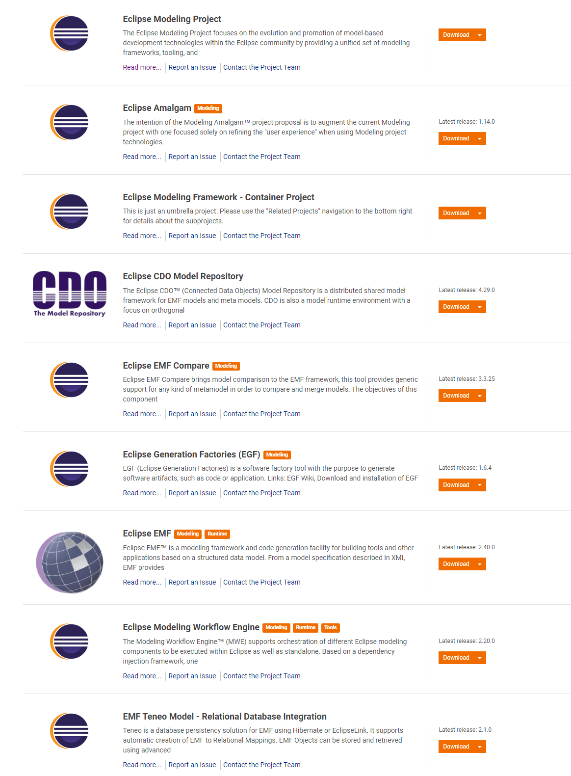
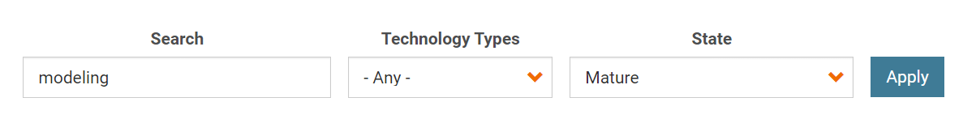
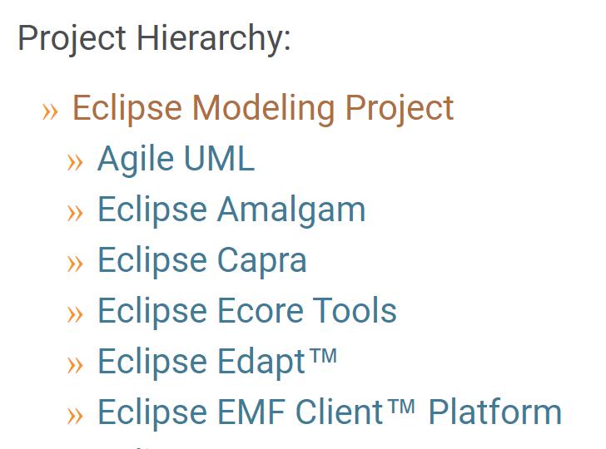
2. org
main
main site
projects
find projects: modeling
modeling
project: modeling

Slide 3

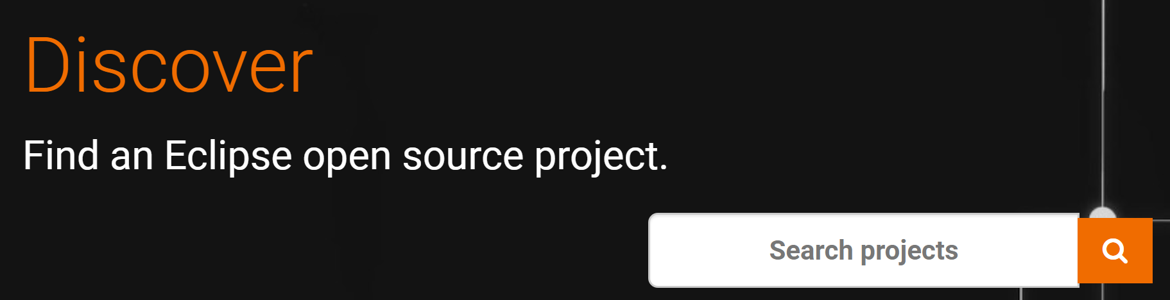

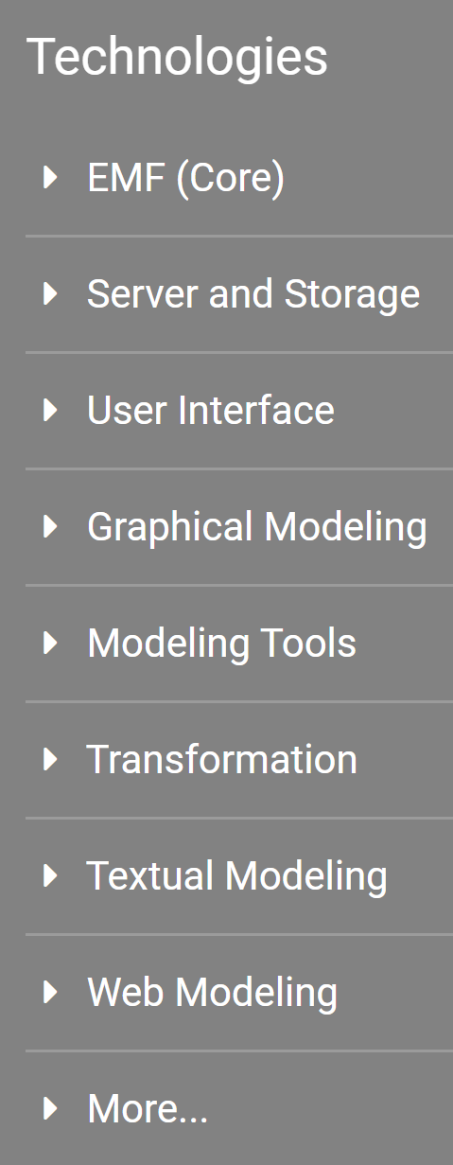
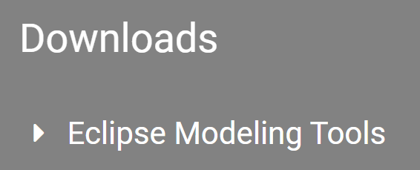
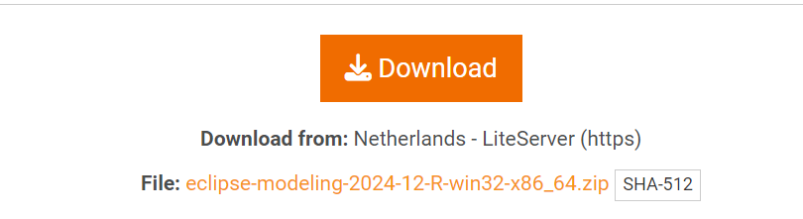

3. dev
main
main site
projects
modeling
download (24/12/29)
..\..\..\..\mdd
modeling

Slide 4
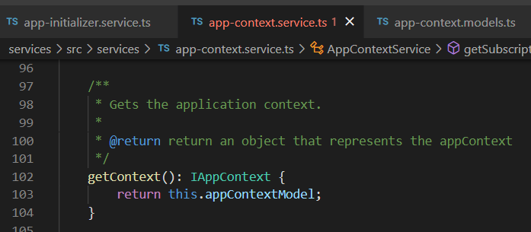





Z. template
new project
ExecuteAsync
square post-it
download
exe
download
exe
why
A slash
followed
by
two consecutive asterisks
D:\A1_research\C2_c0dice\B1_jmeter\A1_install
functionalities
introduction
build-exe
entity framework plus
zig help
⊂
⊂
4
every key-frame
defines the operation
deploy

