Slide 1

1. profile
python

Slide 2
1.1 sources
Feature Description Official Documentation
sys.setprofile The core engine for deterministic profiling.
This function registers a callback that the Python interpreter executes for events like function calls (call, c_call)
and returns (return, c_return), allowing you to hook into the execution flow to record data.[1][2] sys — System-specific parameters and functions
Metaclasses A feature for customizing class creation itself.[3][4] A metaclass can automatically wrap all methods of a class
with profiling logic, enabling seamless, class-level profiling without requiring manual
decorators on each method.[5][6] What are Metaclasses?
Decorators Functions that modify or enhance other functions.[7][8][9]
They provide a clean, "Pythonic" syntax (@my_profiler) for applying profiling logic to specific, targeted functions
or methods.[10][11] Glossary - Decorator
Context Managers Objects that manage a block of code executed within a with statement.[12][13][14]
They are perfect for profiling arbitrary code sections by starting a timer on __enter__ and
stopping it on __exit__, which is guaranteed to run.[15] contextlib — Utilities for with-statement contexts
inspect Module A powerful tool for introspection of live Python objects like modules, classes, and functions.[16][17][18]
It's essential for retrieving metadata from frame objects—such as function names, line numbers, and source
files—to generate useful and readable profiling reports.[19][20] inspect — Inspect live objects

Slide 3

1.1.1 tools
sys
Category Description Packages with Tutorial Links
Essential Core modules that provide fundamental insight into Python's runtime behavior, object system,
and memory management.
These are the building blocks for understanding how Python works internally. sys • inspect • types • dis • gc
Intermediate Advanced introspection and system internals that build on the essential modules.
Critical for understanding Python's compilation process, import system, and debugging capabilities. ast • code • importlib • traceback • threading
Advanced Low-level system interaction and memory analysis tools.
These provide deep insights into Python's C implementation and are essential for performance optimization
and debugging complex issues. ctypes • marshal • frame objects • tracemalloc • faulthandler
Specialized Performance analysis and advanced code inspection tools. Use these when you need detailed performance
metrics, code coverage analysis, or want to understand Python's tokenization and compilation phases. profile/cProfile • trace • tokenize • opcode

Slide 4
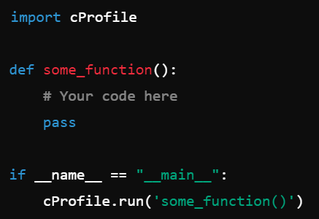
2. cProfile

Slide 5
3. profile

Slide 6
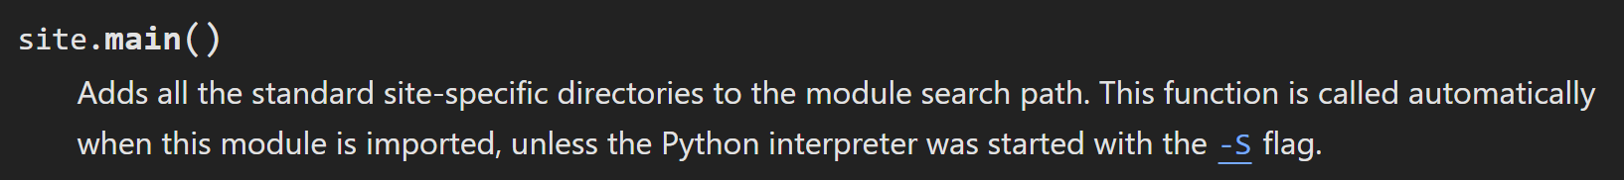
3. profile
4. sites
what
appends
  site-specific paths
    to
  module search path
adds callables,
  including help()
to
  the built-in name-space
site - what
flag
python startup option -S
  blocks this
and this module
  can be safely imported
    with no automatic modifications to
      the module search path
      additions to the builtins
to explicitly trigger
  the usual site-specific additions
call
  the main() function

Slide 7
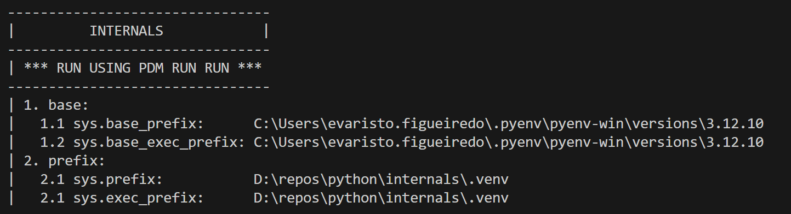
3. profile
4.1 startup
startup
uses sys . prefix and sys . exec _ prefix
empty heads are skipped.
It starts by
  constructing up to four directories
    from
  a head and a tail part
head
tail
it uses the empty string
then:
    lib/site-packages (on Windows)
    lib/python X.Y[t]/site-packages (on Unix and macOS).
site - startup
For each of the distinct head-tail combinations,
  it sees if it refers to an existing directory,
    if so, adds it to sys . path
inspects the newly added path
  for
configuration files
sys . prefix
string
    giving the site-specific directory prefix
  where
    the platform independent Python files
      are installed
sys . prefix

Slide 8
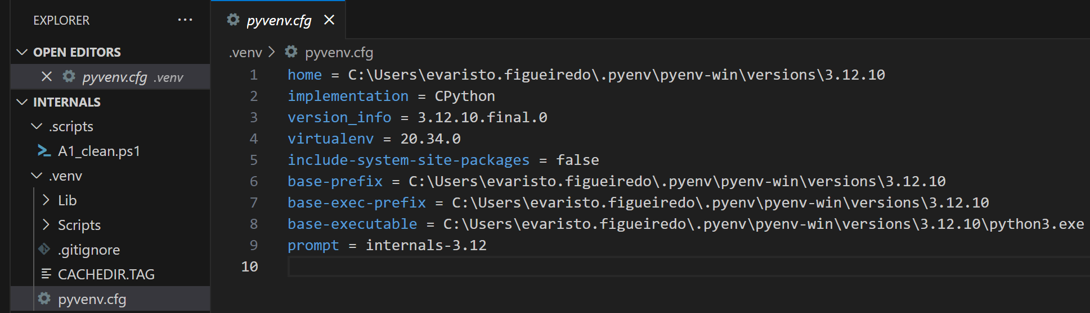
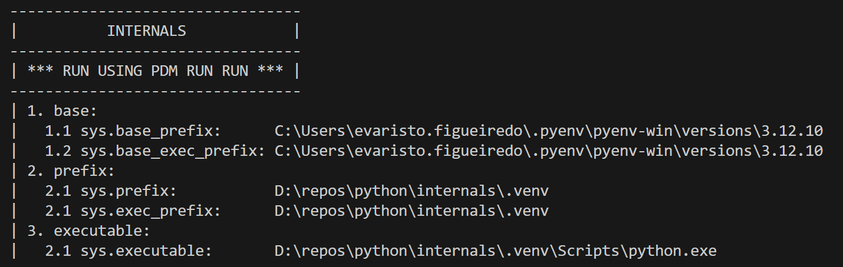
3. profile
4.2 configuration
what
If a file named “pyvenv.cfg” exists
  one
directory above sys.executable
site - configuration
sys.prefix and sys.exec_prefix
  are set to
that directory
that directory
  is also checked
    for
  site-packages
If “pyvenv.cfg”
  contains
the key “include-system-site-packages”
  set to
anything other than “true”
the system-level prefixes
    will not
  be searched for
      site-packages
otherwise
  they will
sys.base_prefix and sys.base_exec_prefix
will always be
  the “real” prefixes
    of
  the Python installation

Slide 9
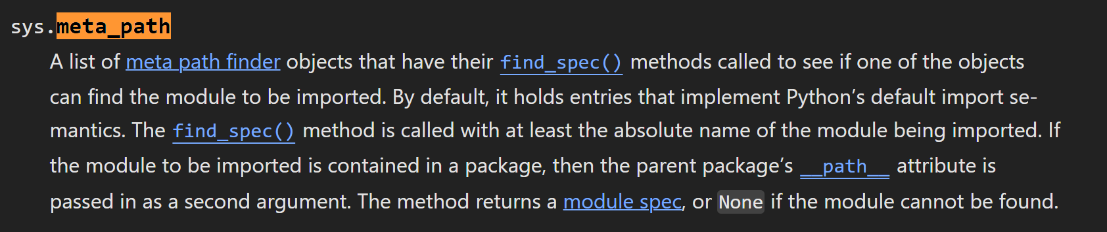
3. profile
4.2.1 paths
  its contents are
    additional items (one per line)
  to be added to sys.path
A path configuration file
  is
a file
  whose name has the form name.pth
  exists in one of the four directories mentioned above;
what
  non-existing items
    are never added to sys.path
  no check is made
    that the item refers to a directory
      rather than
    a file
site - configuration - paths
  No item is added
    to
  sys.path
    more than once
Blank lines and lines beginning with #
  are skipped
Lines starting with import (followed by space or tab)
  are executed.
tbd

Slide 10





Z. template
new project
ExecuteAsync
square post-it
download
  exe
download
  exe
why
A slash
  followed
by
  two consecutive asterisks
D:\A1_research\C2_c0dice\B1_jmeter\A1_install
functionalities
introduction
build-exe
entity framework plus
zig help
⊂
4
every key-frame
defines the operation
success

