Slide 1

1. foundry
portfolio

Slide 2
1.1 index
cpa
foundry
what
projects
client
inference

Slide 3

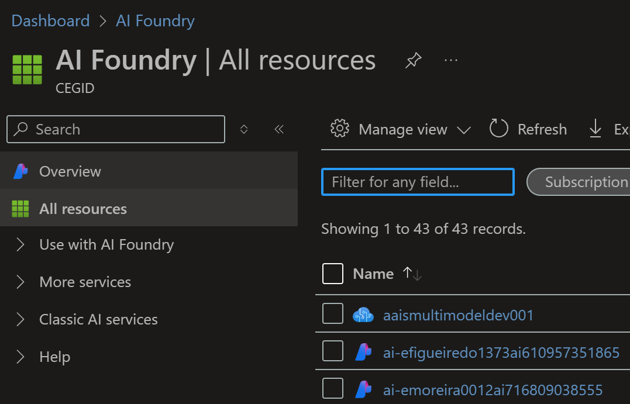
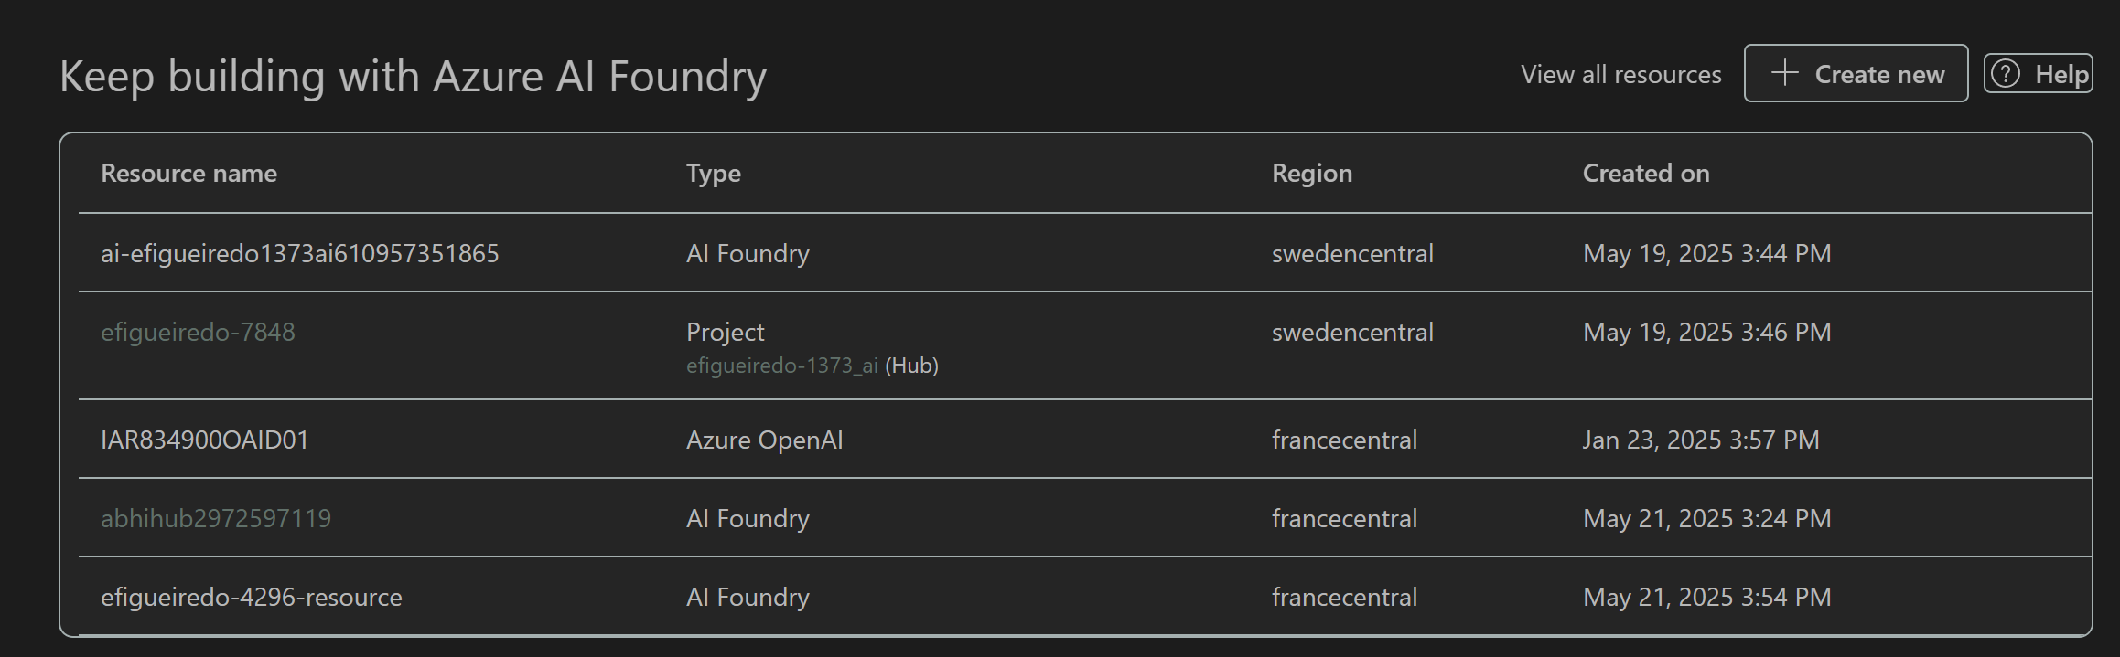
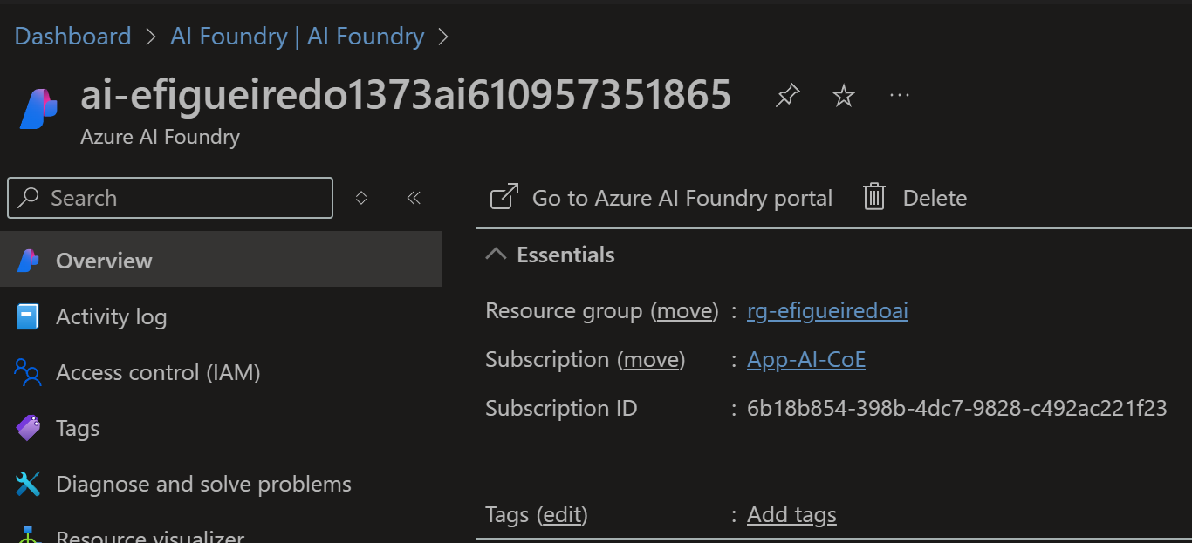
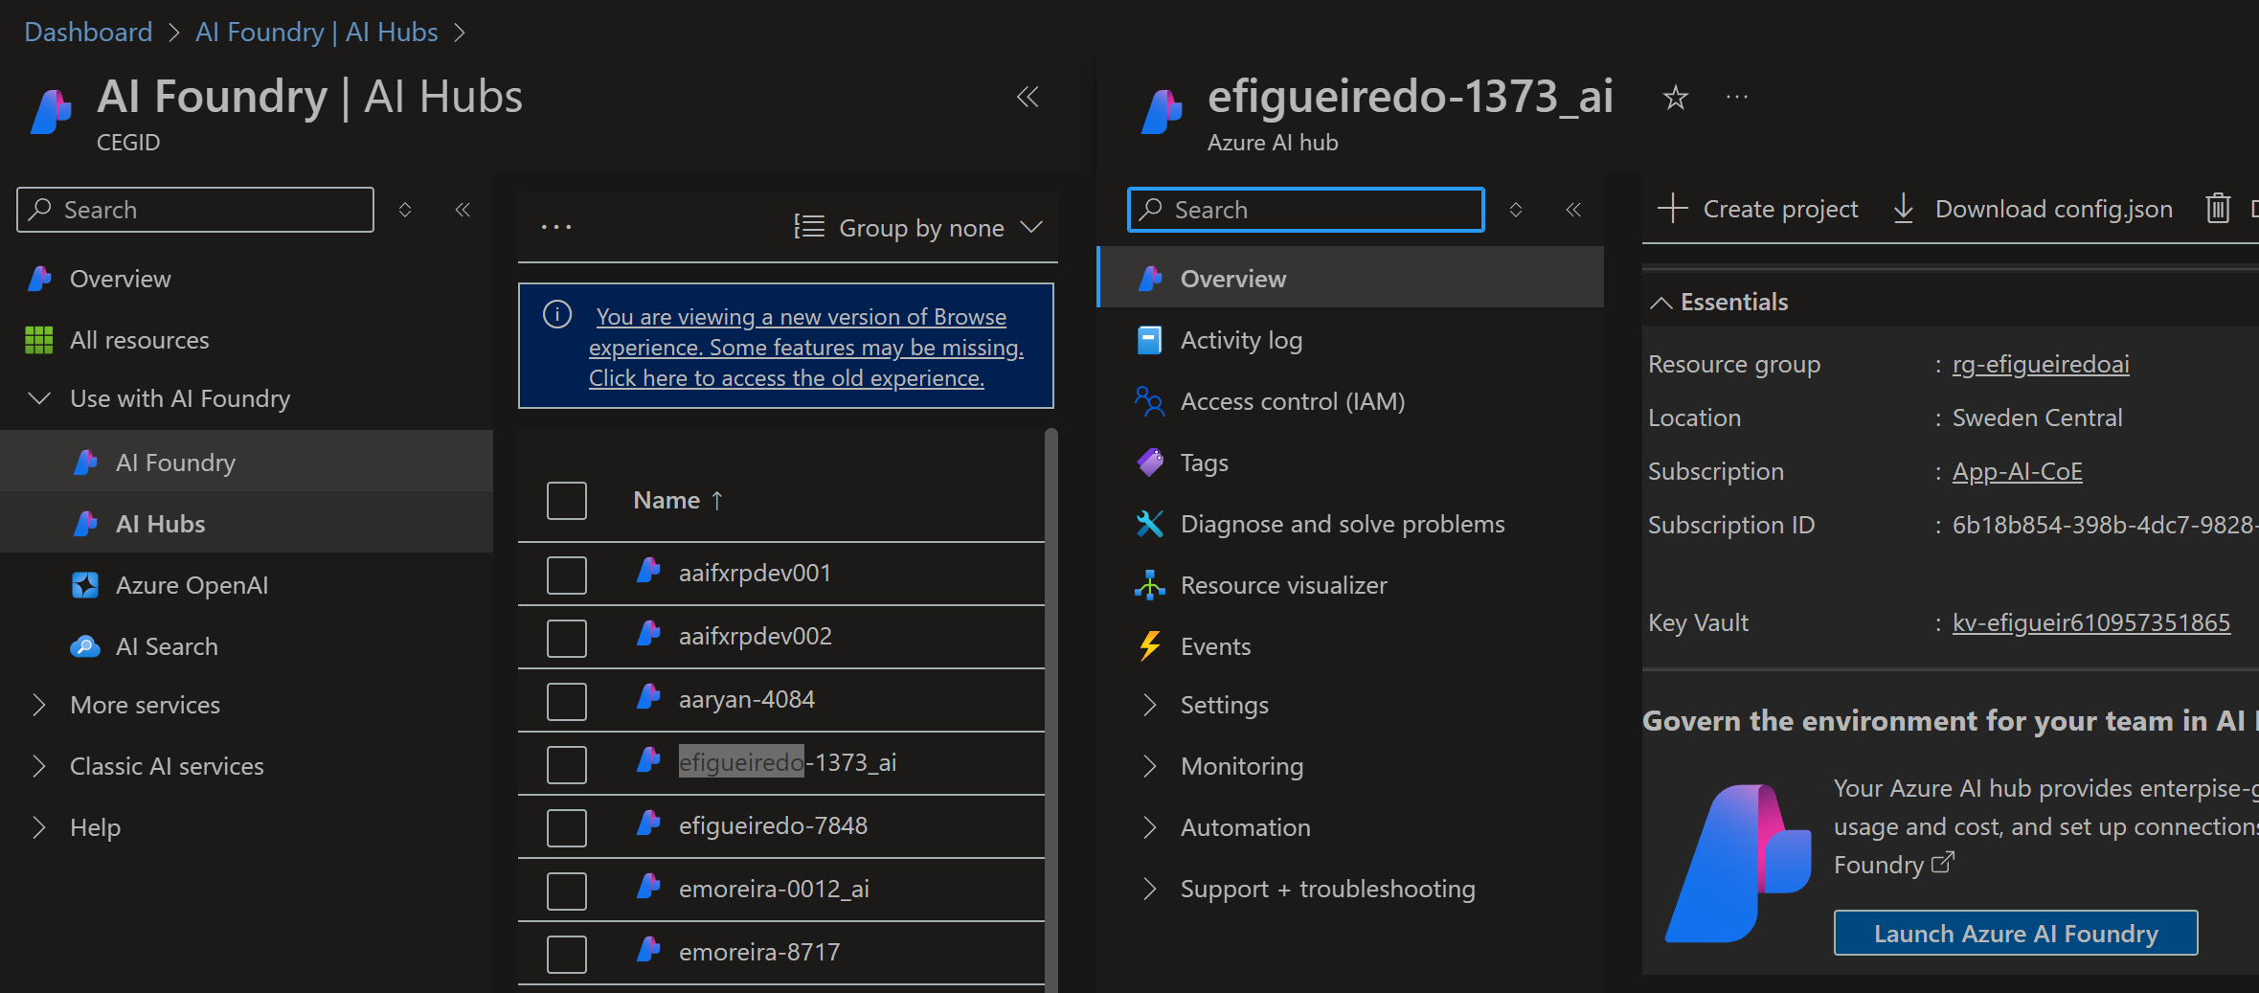
3. resources
azure
foundry
portal
foundry
project
hub

Slide 4
2. summary
V
1. CPA
cpa
3. CHAT
chat
2. FOUNDRY
what
V
1. project
projects
V
2. client
client
3. inference
inference

Slide 5
3. pending
1. FOUNDRY
V
1. deployments
deployments
2. connections
connetions
3. dataset
dtasets
4. indexes
indexes
5. evaluation
evaluation
6. exceptions
exceptions
7. logging
logging
8. test inference with old model to test the second path

Slide 6





Z. template
new project
ExecuteAsync
square post-it
download
  exe
download
  exe
why
A slash
  followed
by
  two consecutive asterisks
D:\A1_research\C2_c0dice\B1_jmeter\A1_install
functionalities
introduction
build-exe
entity framework plus
zig help
⊂
4
every key-frame
defines the operation
success

