Slide 1

1. structure
language
python

Slide 2
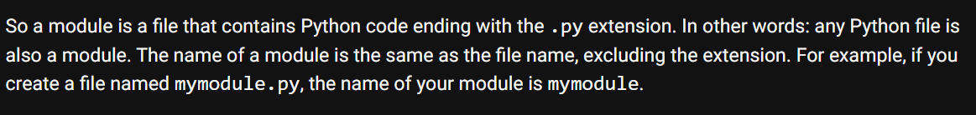

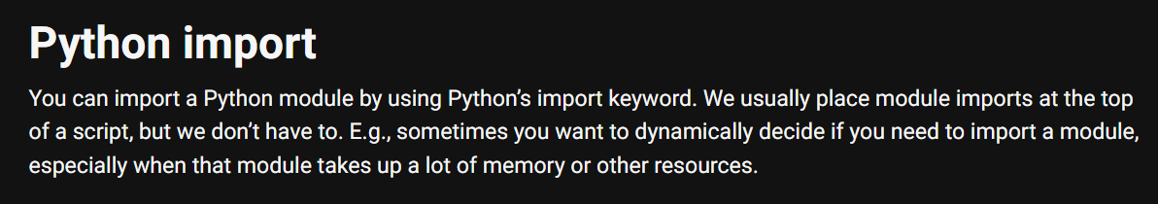
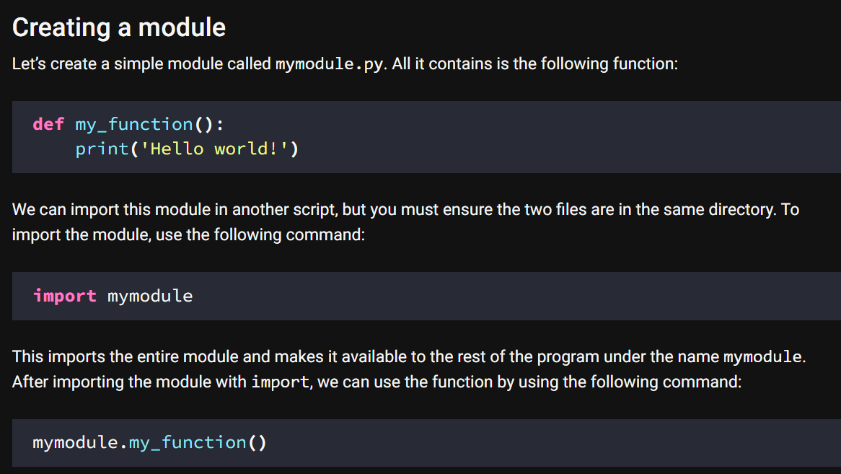
2. modules
what
python-modules
import

Slide 3
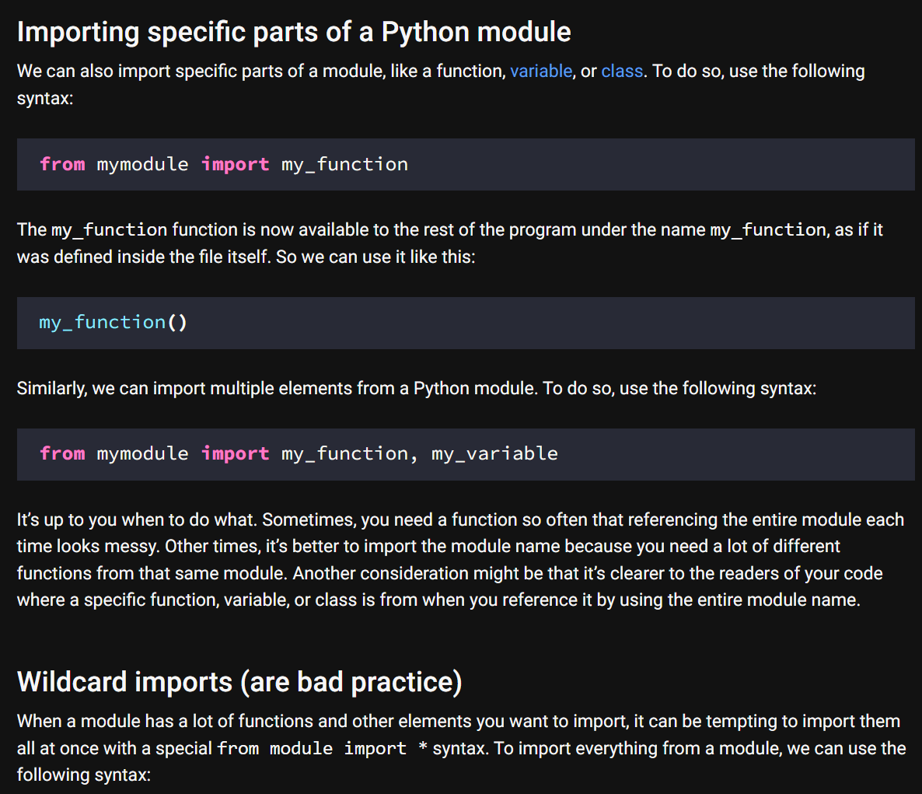
2.1 import
what
import

Slide 4
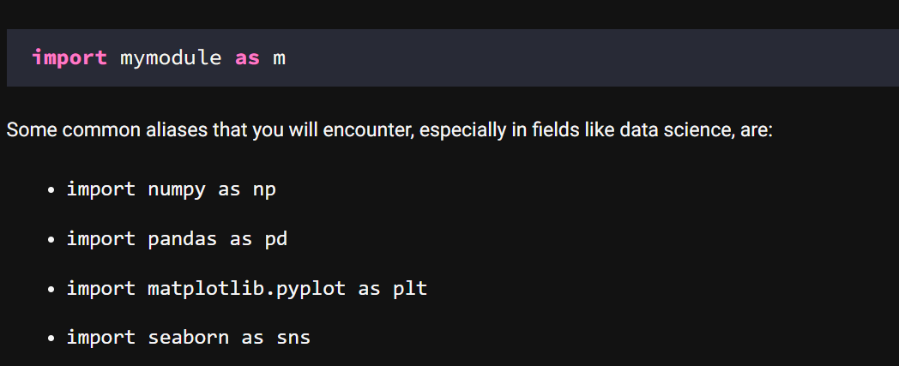
2.2 aliases
what
Import aliases

Slide 5
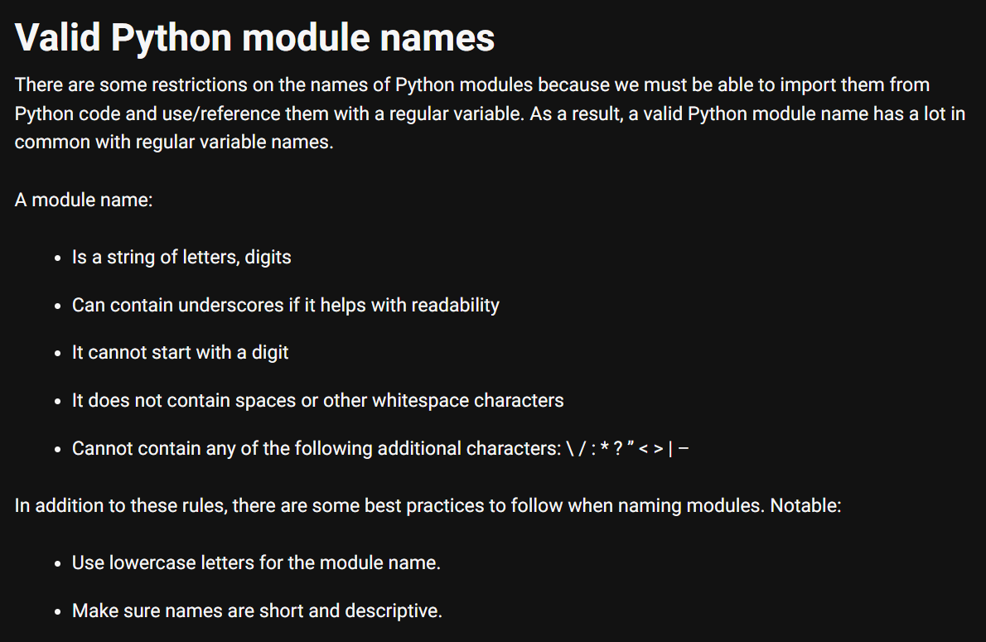
2.3 names
what
names

Slide 6
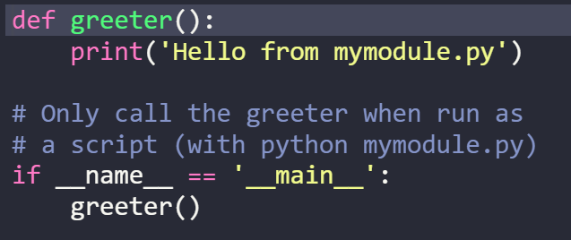
2.4 main
what
The If __name__ == '__main__' check

Slide 7
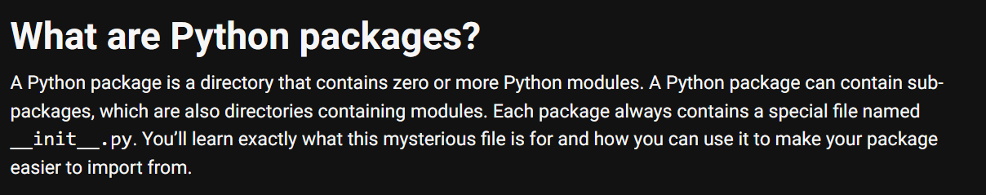
3. packages
what
python-packages

Slide 8
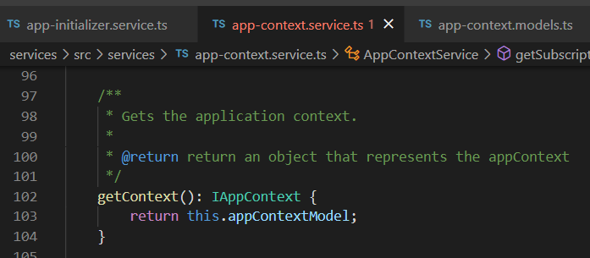





Z. template
new project
ExecuteAsync
square post-it
download
exe
download
exe
why
A slash
followed
by
two consecutive asterisks
D:\A1_research\C2_c0dice\B1_jmeter\A1_install
functionalities
introduction
build-exe
entity framework plus
zig help
⊂
4
every key-frame
defines the operation
success

