Slide 1

1. debug
grafana
k6

Slide 2

2. debug
how to debug
no:
debug;
node.js
use:
profile
DEBUG https
Debugging+in+k6

Slide 3
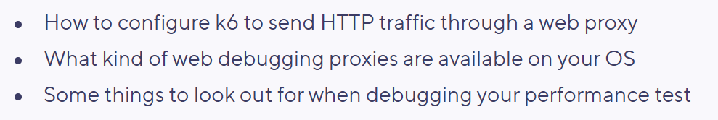
3. web proxy
/k6-load-testing-debugging-using-a-web-proxy
to be done

Slide 4
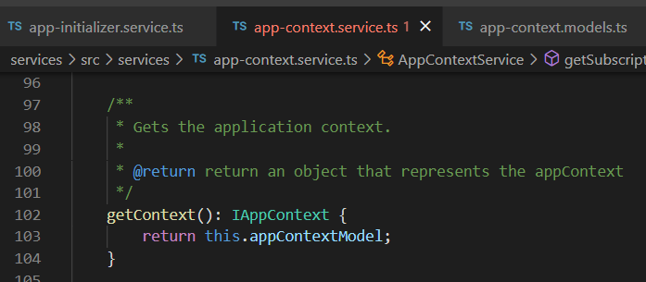





Z. template
new project
ExecuteAsync
square post-it
download
exe
download
exe
why
A slash
followed
by
two consecutive asterisks
D:\A1_research\C2_c0dice\B1_jmeter\A1_install
functionalities
introduction
build-exe
entity framework plus
zig help
⊂
⊂
4
every key-frame
defines the operation
deploy

