Slide 1

1. errors
grafana
k6

Slide 2

2. what
overview
error-codes
fail
examples

Slide 3
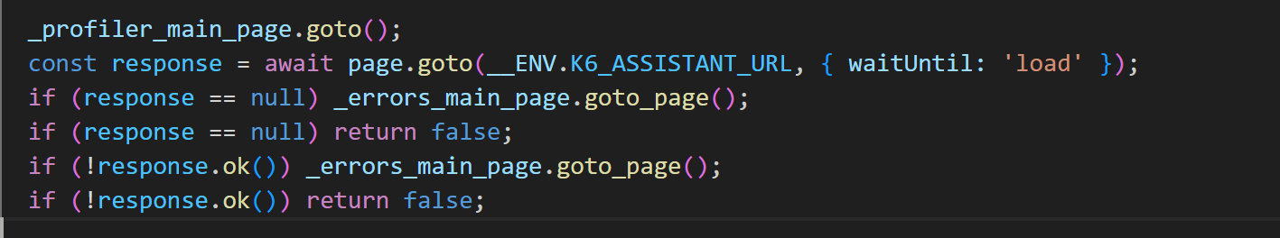
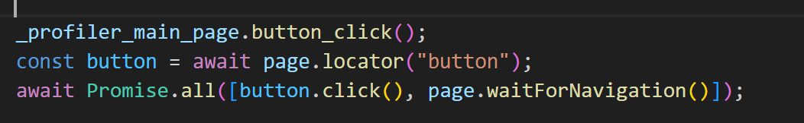
3. page
always
test
null and ok
always
wait
for page to change

Slide 4
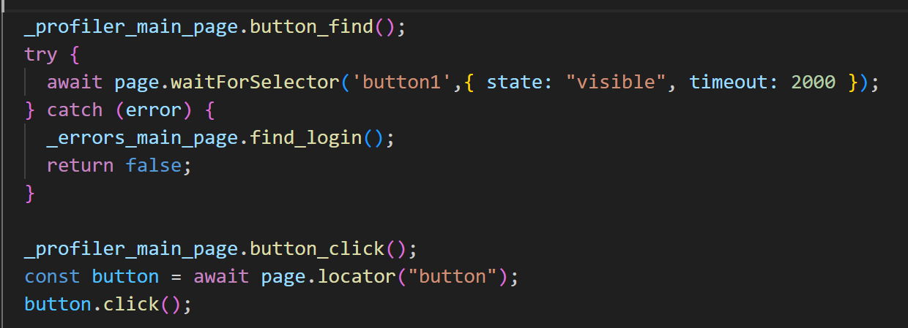
3. elements
always
use
wait selector
locator
never returns:
null,
error

Slide 5
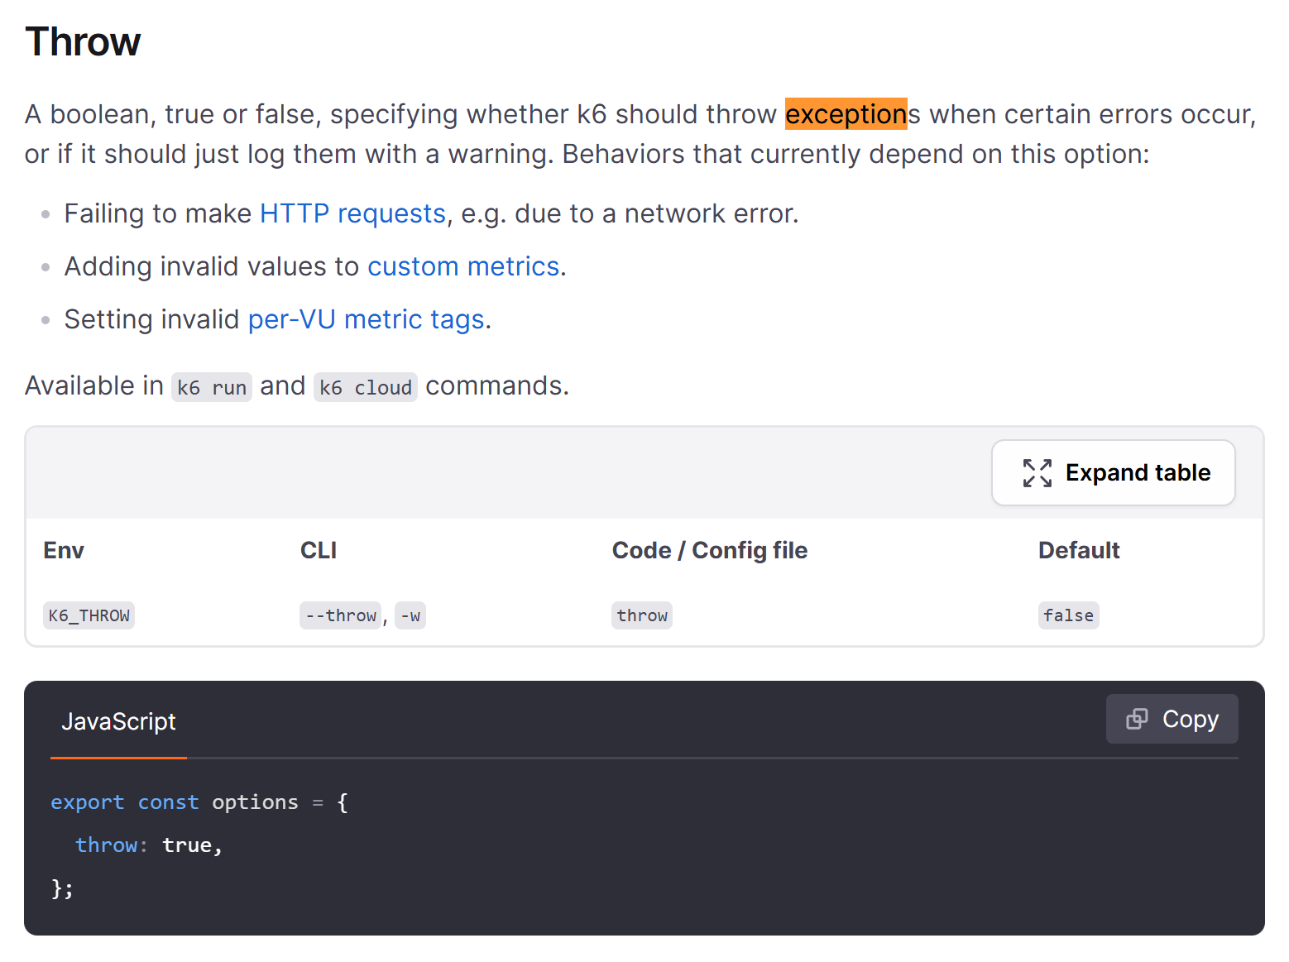
3. options
throw

Slide 6
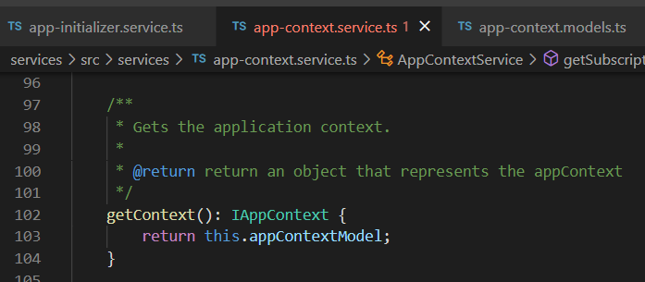





Z. template
new project
ExecuteAsync
square post-it
download
exe
download
exe
why
A slash
followed
by
two consecutive asterisks
D:\A1_research\C2_c0dice\B1_jmeter\A1_install
functionalities
introduction
build-exe
entity framework plus
zig help
⊂
⊂
4
every key-frame
defines the operation
deploy

