Slide 1

1. install
grafana
k6

Slide 2

2. download
install
not used
command line
installer
download MSI
when running the installer
need permissions from ITD
after ask permission
run installer

Slide 3
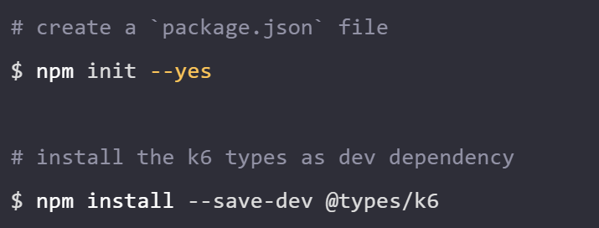

3. vsCode
configure-your-code-editor
Auto-completion of k6 functions, methods, and classes.
Auto imports of k6 modules.
Access to k6 documentation when writing and hovering code.
type definitions
install-k6-type-definitions
extension
extension

Slide 4
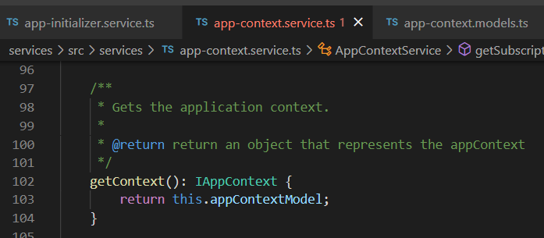





Z. template
new project
ExecuteAsync
square post-it
download
exe
download
exe
why
A slash
followed
by
two consecutive asterisks
D:\A1_research\C2_c0dice\B1_jmeter\A1_install
functionalities
introduction
build-exe
entity framework plus
zig help
⊂
⊂
4
every key-frame
defines the operation
deploy

