Slide 1

1. logs
grafana
k6

Slide 2

2. what
using-loki-to-store-and-query-k6-logs
install-with-docker
to be done

Slide 3
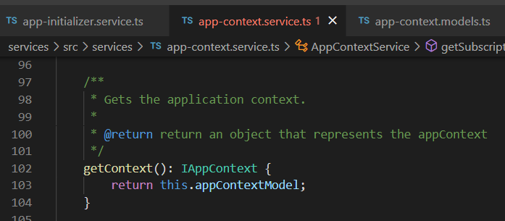





Z. template
new project
ExecuteAsync
square post-it
download
exe
download
exe
why
A slash
followed
by
two consecutive asterisks
D:\A1_research\C2_c0dice\B1_jmeter\A1_install
functionalities
introduction
build-exe
entity framework plus
zig help
⊂
⊂
4
every key-frame
defines the operation
deploy

