Slide 1

1. problem
grafana
k6

Slide 2
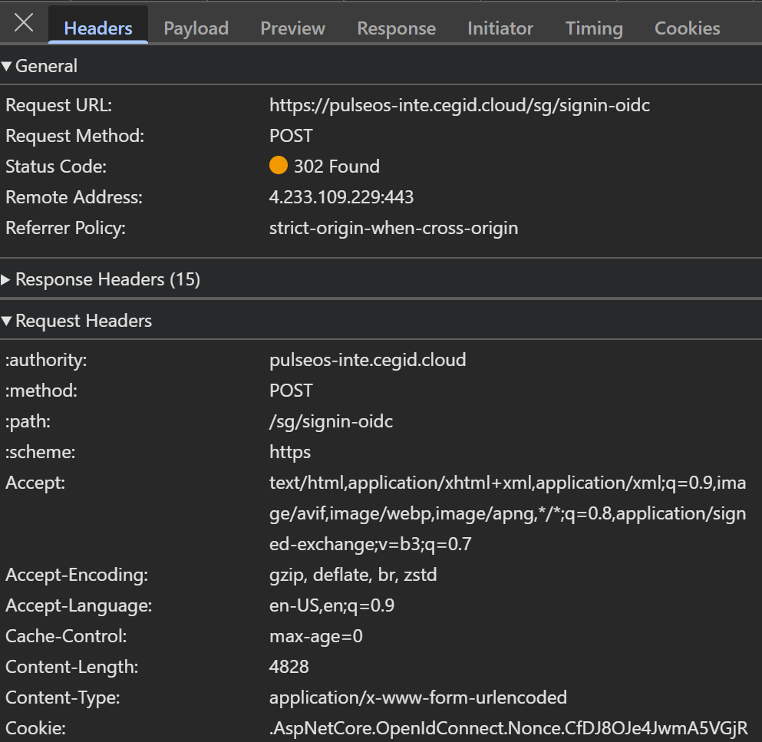
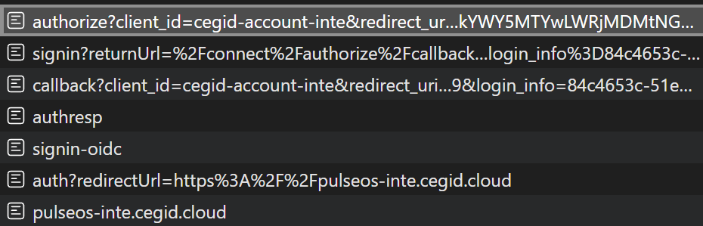
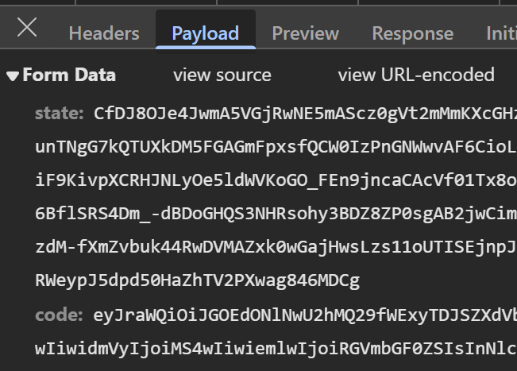
2. description
when run tests
with multiple VU/iterations
the OAUTH2 call back POST
changes to GET

Slide 3

3. research
context
this behavior
is expected
in
OAuth2 code flow
what
the server
sends
an HTTP redirect
(often a 302 or 303 status)
to
your callback endpoint
according to
the HTTP specification,
when a browser
follows a redirect
after a POST request,
it converts
the request method
to
GET
even if your backend
initially intended to use POST,
the redirection
causes the browser
to issue a GET request
to the callback URL
after the user logs in
at
the OAuth2 server,
sources:
RFC 7231
(HTTP/1.1 Semantics and Content)
details
303 See Other;
other redirect status codes
rfc7231#section-6.4.4
solutions
Update Your Test Environment (or Callback Endpoint) to Accept GET Requests
Intercept and Handle the Redirect in Your k6 Script
impossible

Slide 4
3.1 why
context
When you run your k6 tests with only 1 or 2 VUs/iterations, the timing and load conditions are minimal, and the OAuth2 flow usually completes as expected.
However, when you increase the number of virtual users and iterations, several factors come into play that can expose the issue:Concurrency and
Timing Variations:
With more VUs running concurrently, the exact timing of each request and redirect can vary.
This increases the likelihood that some requests will encounter the automatic redirect behavior (where a POST becomes a GET)
during the OAuth2 flow.Session State and Race Conditions:Under higher load, each VU operates independently and may not share
session state in the same way as a single-user test.
This can lead to situations where the state needed for the POST callback isn’t properly maintained, causing some iterations to follow the redirect
path that converts the request method.Aggregated Behavior Masking Individual Errors:When running only a couple of iterations,
a single failure can cause a noticeable test failure. With many iterations, some failures might be aggregated into overall error thresholds that are
acceptable for the load test, so the test "completes" even though some iterations are experiencing the issue.In essence, the problem appears with
more VUs/iterations because the increased concurrency exposes timing and state management issues—like the automatic method change on redirect—
that aren’t as evident in lower-load scenarios.
This is typical behavior in complex authentication flows under load, and addressing it might require handling the redirect manually or adapting your
backend to handle the GET as well during testing.

Slide 5
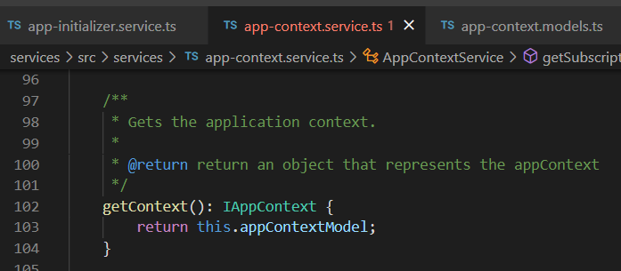





Z. template
new project
ExecuteAsync
square post-it
download
exe
download
exe
why
A slash
followed
by
two consecutive asterisks
D:\A1_research\C2_c0dice\B1_jmeter\A1_install
functionalities
introduction
build-exe
entity framework plus
zig help
⊂
⊂
4
every key-frame
defines the operation
deploy

