Slide 1

1. project
grafana
k6

Slide 2
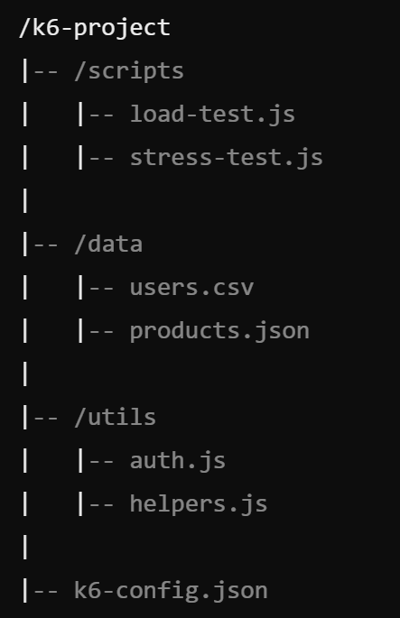
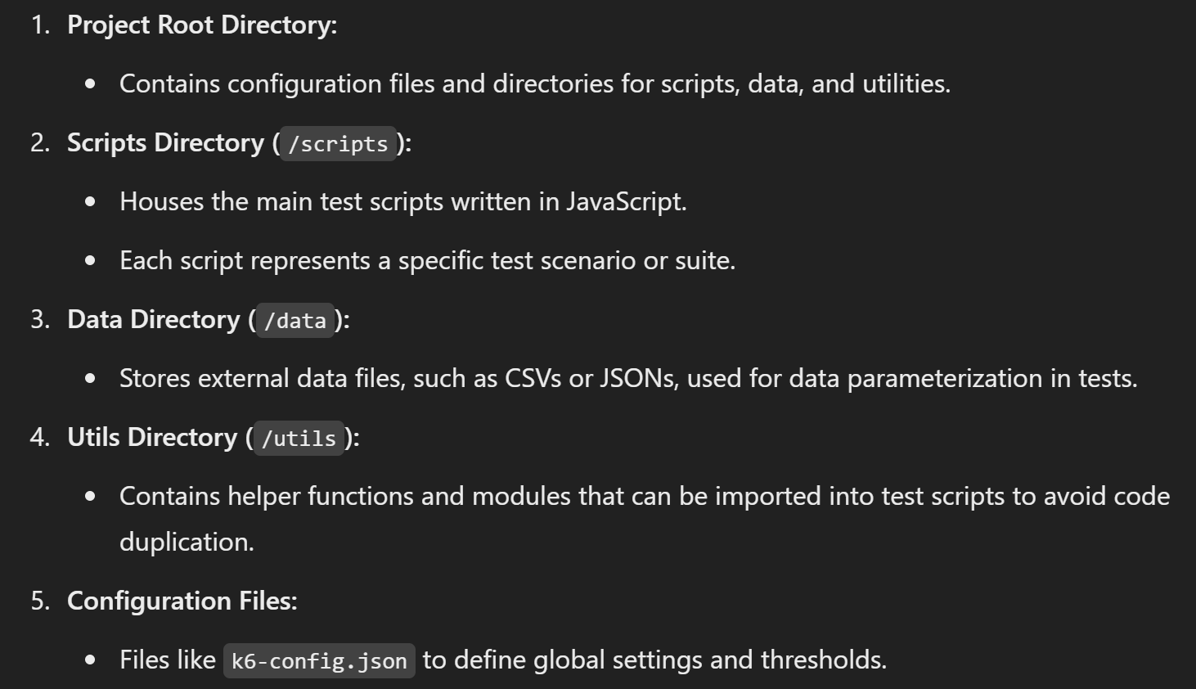

2. structure
what
Structuring Performance Projects

Slide 3
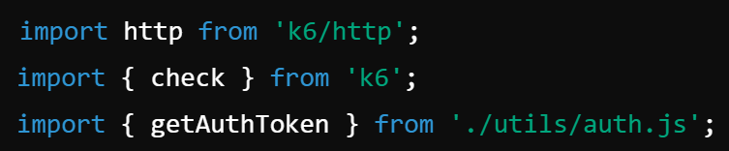
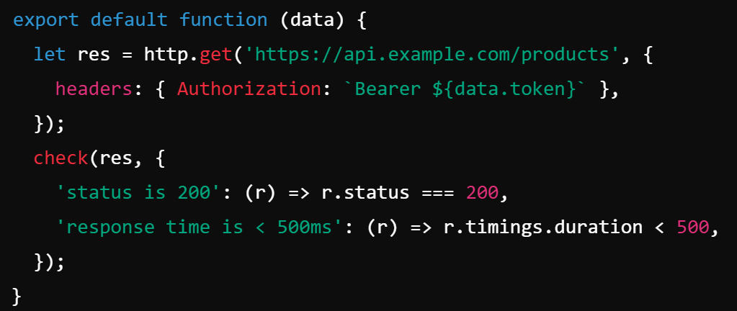
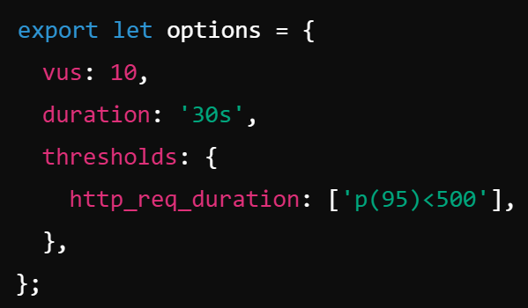
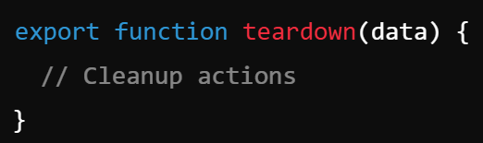
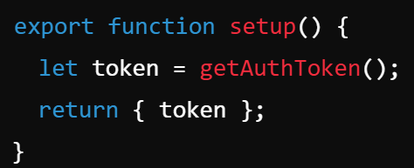
3. scripts
what
JavaScript files
define the behavior of virtual users (VUs) during a test
specify
the requests to be made;
the data to be sent;
conditions to be validated
setting-up-your-grafana-k6-performance-testing-suite-javascript-tools-shared-libraries
components
imports
main
options
tear down
setup

Slide 4
3.1 main
purpose
primary actions
Virtual Users (VUs) will perform
ex.:
HTTP requests
validating responses
requirement
must be exported default
the k6 CLI
automatically identifies;
executes
this function
as the main entry point
for VU operations
functions

Slide 5
3.2 setup
purpose
executed once
before the VUs start
used to
initialize test data,
set up the test environment
requirement
must be exported
if implemented
the k6 CLI detects and runs
this function
before
the default function
functions

Slide 6
3.3 tear down
purpose
executed once
after
all VUs have completed
used for
cleaning up,
processing data post-test
requirement
must be exported
if implemented
the k6 CLI
calls this function
after
the default function
has finished executing
functions

Slide 7
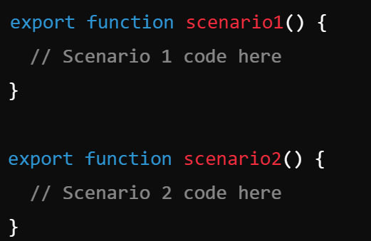
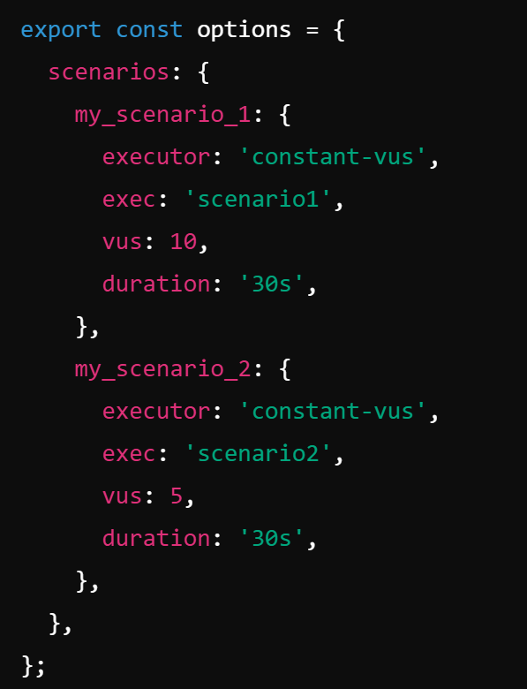
3.4 scenarios
purpose
define multiple scenarios
within a single script,
each
with its own behavior
requirement
must be
exported;
referenced in
the options configuration
the k6 CLI
executes these functions
based on
the defined scenarios
functions

Slide 8
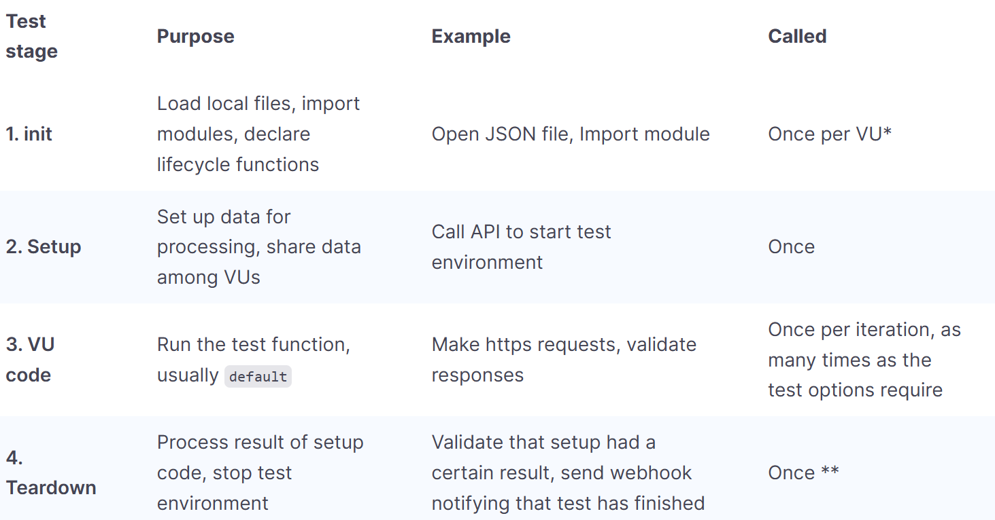
5. life cycle
what
In k6 scripts,
certain functions
must be exported
to define
the test's lifecycle stages
allowing the k6 CLI
to recognize;
execute
them appropriately
life cycle
test-lifecycle
test-lifecycle 1

Slide 9
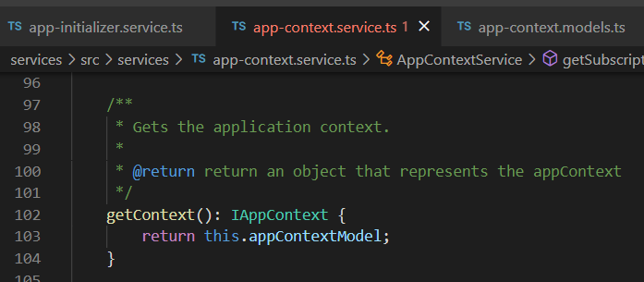





Z. template
new project
ExecuteAsync
square post-it
download
exe
download
exe
why
A slash
followed
by
two consecutive asterisks
D:\A1_research\C2_c0dice\B1_jmeter\A1_install
functionalities
introduction
build-exe
entity framework plus
zig help
⊂
⊂
4
every key-frame
defines the operation
deploy

