Slide 1

1. reference
grafana
k6

Slide 2

1.1 index
executors
browser
env
checks
options

Slide 3

2. executors
executors
Name | Value | Description
Shared iterations | shared-iterations | A fixed number of iterations are shared between several VUs.
Per VU iterations | per-vu-iterations | Each VU executes an exact number of iterations.
Constant VUs | constant-vus | A fixed number of VUs execute as many iterations as possible for a specified amount of time.
Ramping VUs | ramping-vus | A variable number of VUs execute as many iterations as possible for a specified amount of time.
Constant Arrival Rate | constant-arrival-rate | A fixed number of iterations are executed in a specified period of time.
Ramping Arrival Rate | ramping-arrival-rate | A variable number of iterations are executed in a specified period of time.
Externally Controlled | externally-controlled | Control and scale execution at runtime via k6’s REST API or the CLI.

Slide 4
3. browser
k6/browser
browser module
browser context
browser automation;
end-to-end web testing
rough compatibility with
Playwright API
for NodeJS
multiple
independent sessions
with
separate pages;
cache;
and cookies
supporting
core k6
features
k6 does not run in NodeJS
the browser module APIs
will slightly differ
from
Playwright
a default Browser Context
is created
when a browser
is
launched
if a page opens another page
e.g. with a window . open call,
the popup
will belong to
the parent page’s
Browser Context.

Slide 5
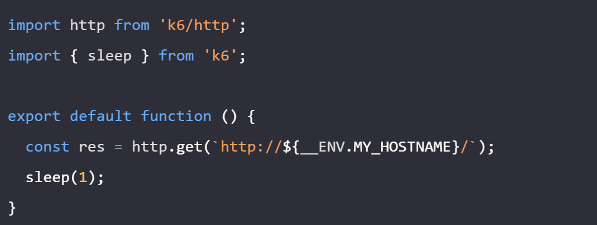
4. env
using cli parameters
environment-variables
read variables

Slide 6
5. checks
group
check
to be done

Slide 7
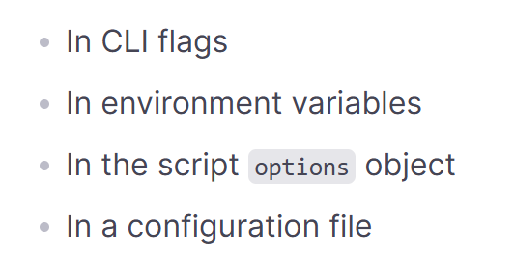
6. options
options overview

Slide 8
6.1 reference
options reference
Option | Description
Address | Address of the REST API server
Batch | Max number of simultaneous connections of a http.batch() call
Batch per host | Max number of simultaneous connections of a http.batch() call for a host
Blacklist IP | Blacklist IP ranges from being called
Block hostnames | Block any requests to specific hostnames
Compatibility mode | Support running scripts with different ECMAScript modes
Config | Specify the config file in JSON format to read the options values
Console output | Redirects logs logged by console methods to the provided output file
Discard response bodies | Specify whether response bodies should be discarded
DNS | Configure DNS resolution behavior
Duration | A string specifying the total duration of the test run; together with the vus option
Execution segment | Limit execution to a segment of the total test
Exit on running | Exits when test reaches the running status
Cloud options | An object used to set configuration options for cloud parameters.
Hosts | An object with overrides to DNS resolution
HTTP debug | Log all HTTP requests and responses
Include system Env vars | Pass the real system environment variables to the runtime
Insecure skip TLS verify | A boolean specifying whether k6 should ignore TLS verifications for connections established from code
Iterations | A number specifying a fixed number of iterations to execute of the script; together with the vus option,
Linger | A boolean specifying whether k6 should linger around after test run completion
Local IPs | A list of local IPs, IP ranges, and CIDRs from which VUs will make requests
Log output | Configuration about where logs from k6 should be send
LogFormat | Specify the format of the log output
Max redirects | The maximum number of HTTP redirects that k6 will follow

Slide 9
6.2 reference
options reference
Option | Description
Max redirects | The maximum number of HTTP redirects that k6 will follow
Minimum iteration duration | Specify the minimum duration for every single execution
No color | A boolean specifying whether colored output is disabled
No connection reuse | A boolean specifying whether k6 should disable keep-alive connections
No cookies reset | This disables resetting the cookie jar after each VU iteration
No summary | disables the end-of-test summary
No setup | A boolean specifying whether setup() function should be run
No teardown | A boolean specifying whether teardown() function should be run
No thresholds | Disables threshold execution
No usage report | A boolean specifying whether k6 should send a usage report
No VU connection reuse | A boolean specifying whether k6 should reuse TCP connections
Paused | A boolean specifying whether the test should start in a paused state
Profiling Enabled | Enables profiling endpoints
Quiet | A boolean specifying whether to show the progress update in the console or not
Results output | Specify the results output
RPS | The maximum number of requests to make per second globally
Scenarios | Define advanced execution scenarios
Setup timeout | Specify how long the setup() function is allow to run before it’s terminated
Show logs | A boolean specifying whether the cloud logs are printed out to the terminal
Stages | A list of objects that specify the target number of VUs to ramp up or down
Supply environment variable | Add/override environment variable with VAR=value
System tags | Specify which System Tags will be in the collected metrics
Summary export | Output the end-of-test summary report to a JSON file
Option | Description
Summary trend stats | Define stats for trend metrics in the end-of-test summary
Summary time unit | Time unit to be used for all time values in the end-of-test summary
Tags | Specify tags that should be set test-wide across all metrics
Teardown timeout | Specify how long the teardown() function is allowed to run before it’s terminated
Thresholds | Configure under what conditions a test is successful or not
Throw | A boolean specifying whether to throw errors on failed HTTP requests
TLS auth | A list of TLS client certificate configuration objects
TLS cipher suites | A list of cipher suites allowed to be used by in SSL/TLS interactions with a server
TLS version | String or object representing the only SSL/TLS version allowed
Traces output | Configuration about where traces from k6 should be sent
User agent | A string specifying the User-Agent header when sending HTTP requests
Verbose | A boolean specifying whether verbose logging is enabled
VUs | A number specifying the number of VUs to run concurrently

Slide 10
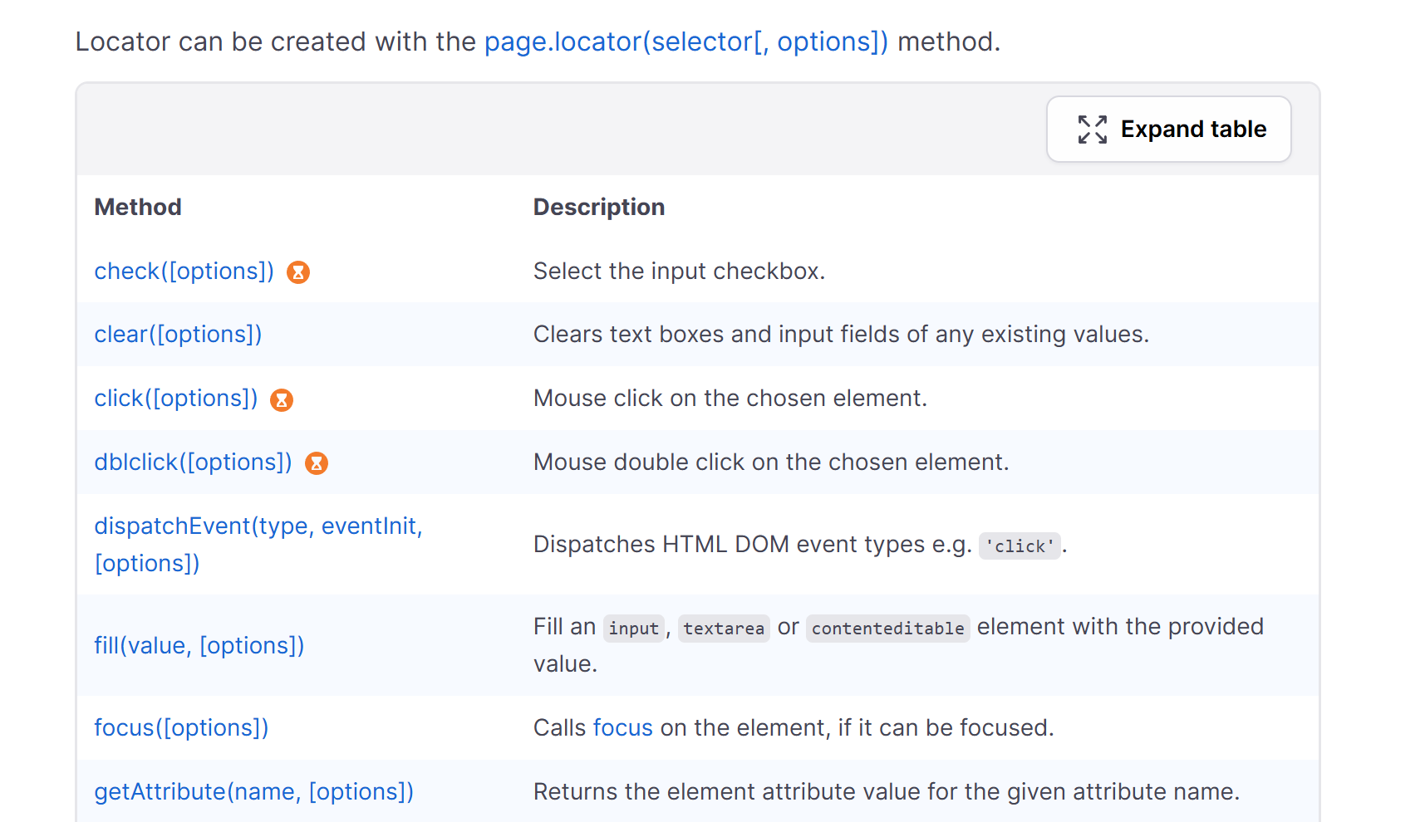
7. locator
locator
never returns
null
nor
error

Slide 11
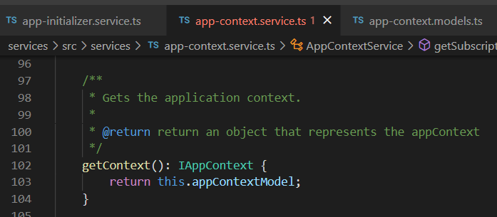




Z. template
new project
ExecuteAsync
square post-it
download
exe
download
exe
why
A slash
followed
by
two consecutive asterisks
D:\A1_research\C2_c0dice\B1_jmeter\A1_install
functionalities
introduction
build-exe
entity framework plus
zig help
⊂
⊂
4
every key-frame
defines the operation
deploy

