Slide 1

1. wait
grafana
k6

Slide 2

2. what
wait strategies
if a page opens another page
e.g. with a window . open call,
the popup
will belong to
the parent page’s
Browser Context.
sleep
Method | Description
browserContext.waitForEvent | Waits for the selected event to fire and returns its value.
page.waitForFunction | Waits for the given function to return a truthy value.
page.waitForLoadState | Waits for the specified page life cycle event.
page.waitForNavigation | Waits for the navigation to complete after one starts.
page.waitForTimeout | Waits the given time. Use this instead of sleep in your frontend tests.
locator.waitFor | Wait for the element to be in a particular state.

Slide 3
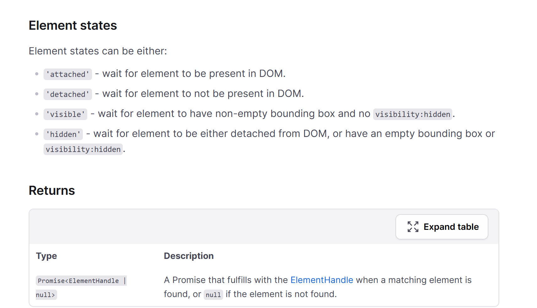
4. selector
wait for selector
When dealing with
multiple redirects,
wait for a specific element or state that indicates the final page has loaded.
javascriptCopyEditawait
page.waitForSelector('css-selector-for-final-element', { timeout: 30000 });
This approach often simplifies the script, as you’re focusing on the final state rather than each
individual navigation.

Slide 4
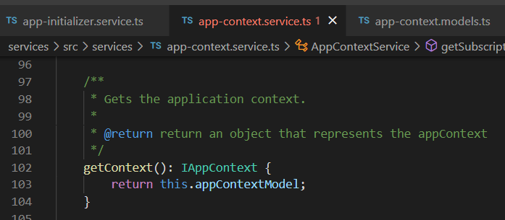





Z. template
new project
ExecuteAsync
square post-it
download
exe
download
exe
why
A slash
followed
by
two consecutive asterisks
D:\A1_research\C2_c0dice\B1_jmeter\A1_install
functionalities
introduction
build-exe
entity framework plus
zig help
⊂
⊂
4
every key-frame
defines the operation
deploy

