Slide 1

1. k6
grafana

Slide 2

1.1 index
project
reference
executors
browser
env
checks
options
install
download
vsCode
debug
errors
logs
problem
wait

Slide 3

2. what
why
assess the
performance;
reliability
of applications
features
Tests-as-Code:
performance tests in JavaScript
Extensibility:
modular architecture
various protocols/integrations
Developer-Friendly:
command-line interface
scripting APIs
grafana
real-time visualization;
analysis of test results;
monitor system performance metrics during tests;
correlate results with other observability data;
make informed decisions
grafana docs

Slide 4
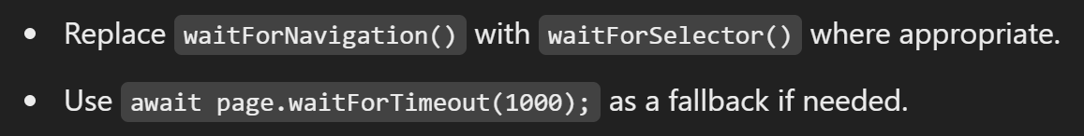
5. best practices
hardcoded credentials
better element selectors
wait strategies
screenshot paths
create folder
display browser
profiling
errors

Slide 5
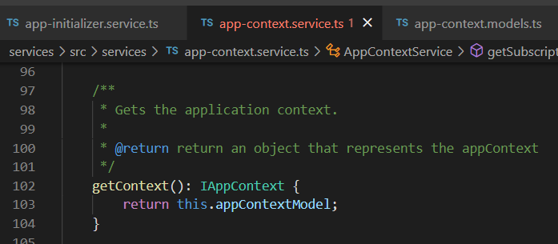




Z. template
new project
ExecuteAsync
square post-it
download
exe
download
exe
why
A slash
followed
by
two consecutive asterisks
D:\A1_research\C2_c0dice\B1_jmeter\A1_install
functionalities
introduction
build-exe
entity framework plus
zig help
⊂
⊂
4
every key-frame
defines the operation
deploy

