Slide 1

1. environment
portfolio
python

Slide 2
1.1 index
deployment
devpi
formats
first
modules
package management
pip
pipenv
poetry
pdm
packages
scopes
shell
structure
virtual environments
wsl

Slide 3
2. lexicon
packages
modules
internals
scopes
virtual environments

Slide 4
3. structure
structure

Slide 5
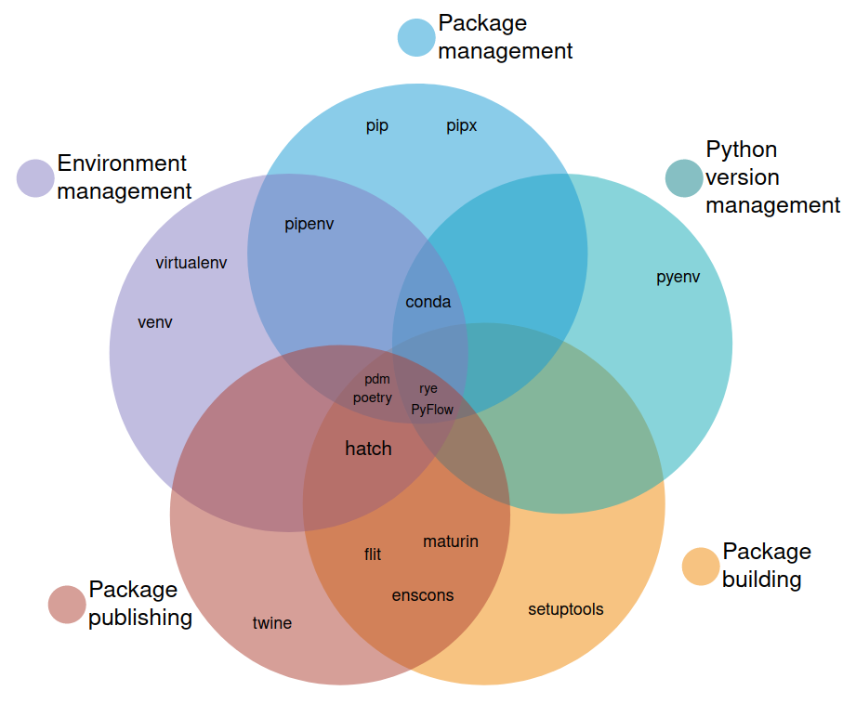
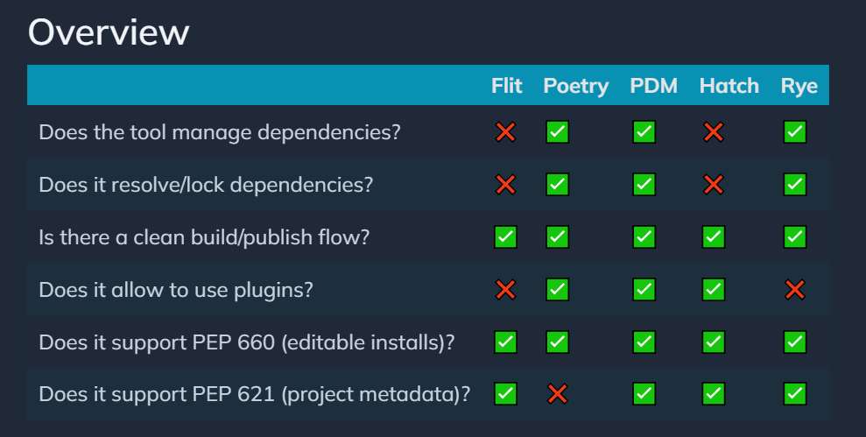

4. environment
an unbiased evaluation of Python packaging tools
site
video

Slide 6
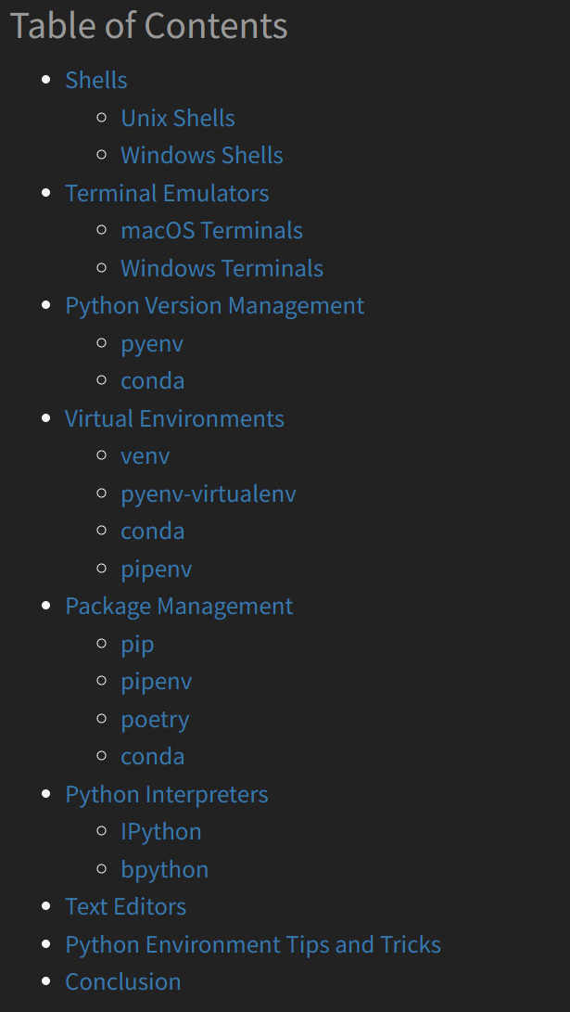

4.1 how
An Effective Python Environment: Making Yourself at Home – Real Python
shell
windows terminal
pyenv
virtual environments
missing vsCode
missing poetry
venv
python -m venv .venv
pipenv
package management
tree
pip
poetry
pdm
deployment
python site

Slide 7
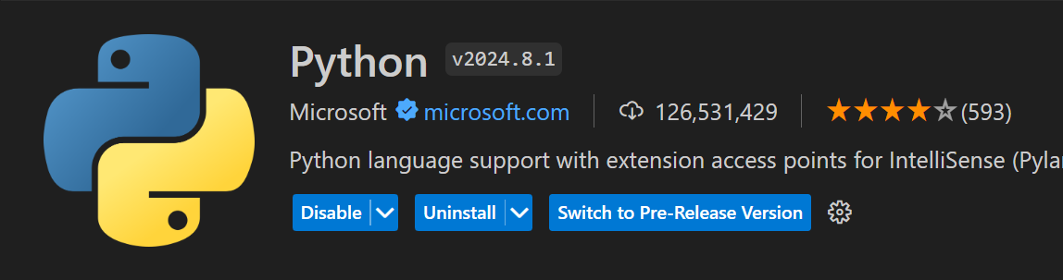
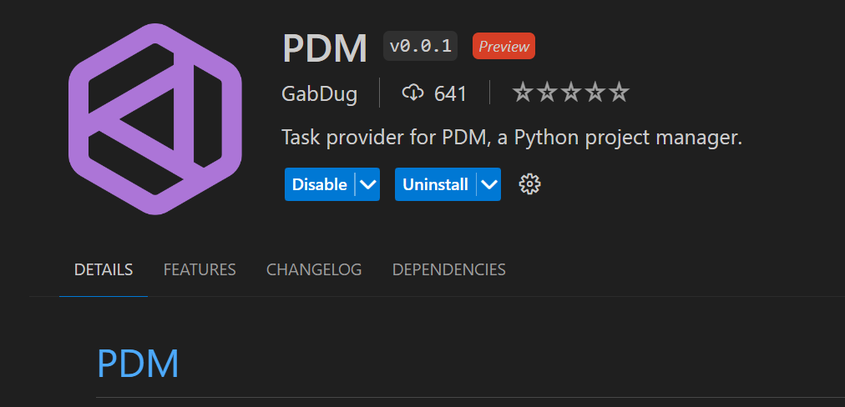
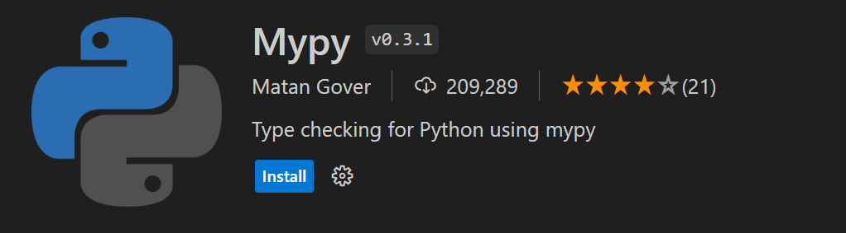
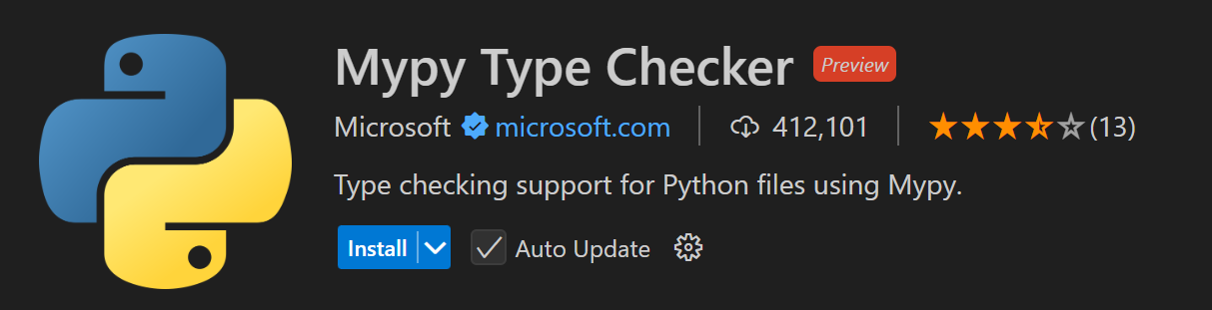
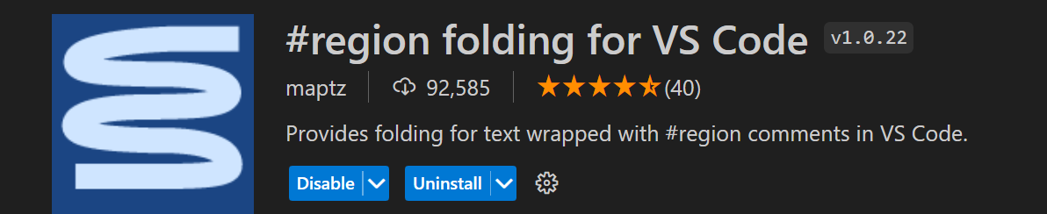
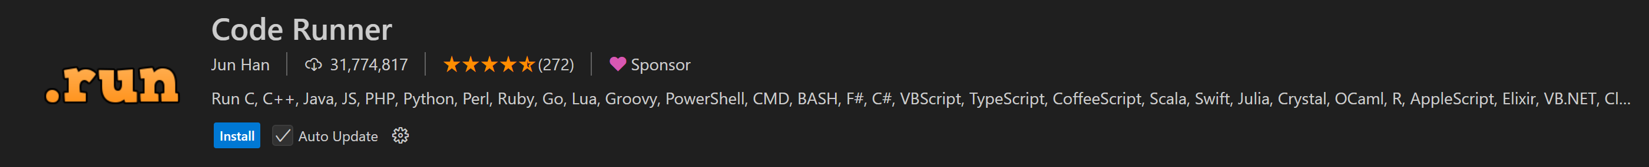
4.2 vsCode

Slide 8
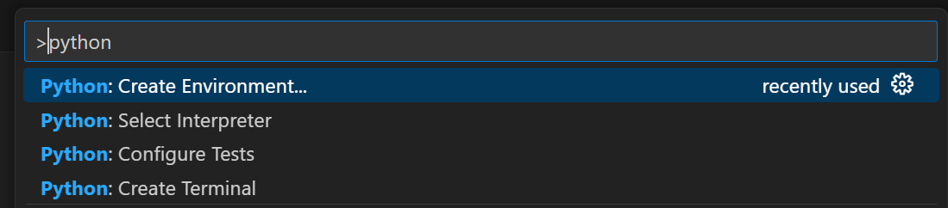
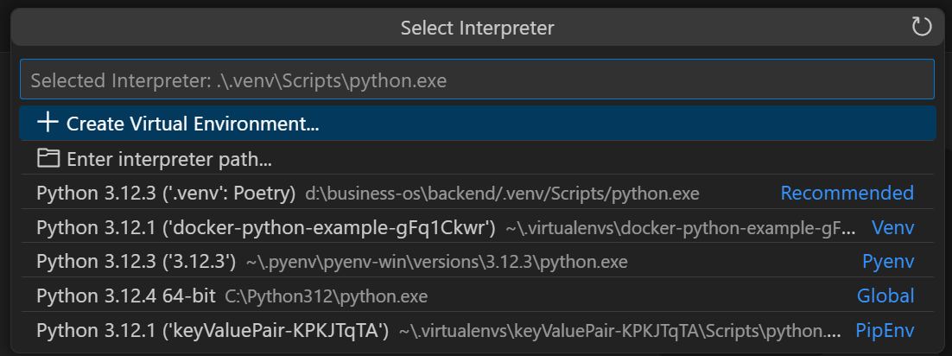
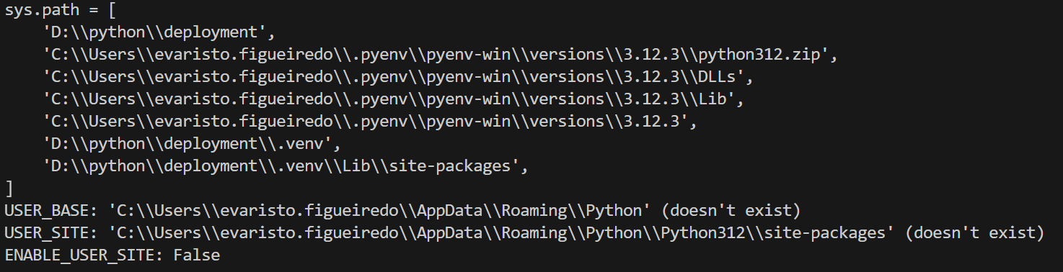
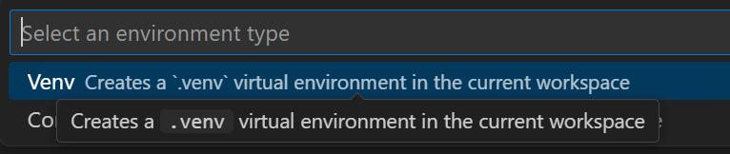
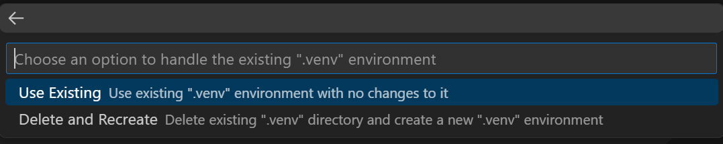
4.2.1 env

Slide 9
5. deployment
deployment
formats
devpi

Slide 10
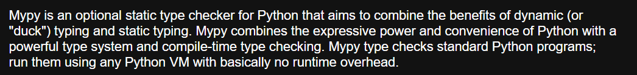
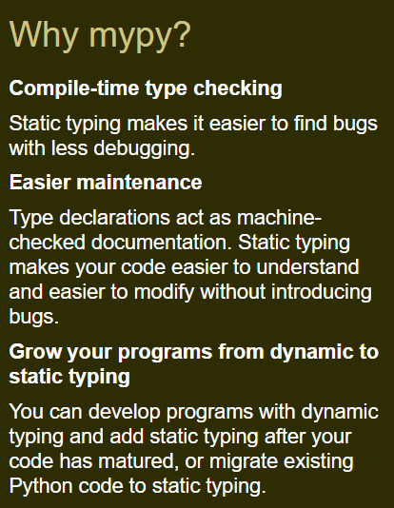
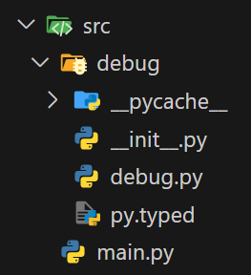

6. types
site
importance-of-adding-py-typed-file-to-your-typed-package
don't-forget-py.typed-for-your-typed-python-package/

Slide 11
7. tests

Slide 12
A. conclusion
vsCode
pyenv
pdm
mypy
CI/CD
azure devops
repository: devpi
deployment
packages
future:
create team code style
pylint
black
sphinx

Slide 13
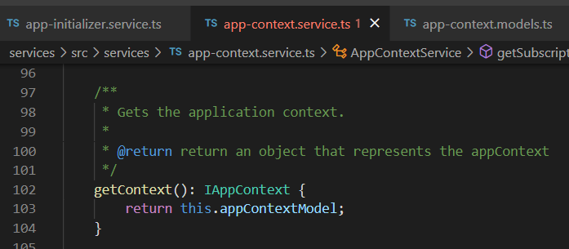



Z. template
new project
ExecuteAsync
square post-it
download
exe
download
exe
why
A slash
followed
by
two consecutive asterisks
D:\A1_research\C2_c0dice\B1_jmeter\A1_install
functionalities
introduction
build-exe
entity framework plus
zig help
⊂
4
every key-frame
defines the operation
success

