Slide 1

1. devpi
deployment
environment
python

Slide 2
1.1 index
docker
entry point
setup
use
setup package managers

Slide 3

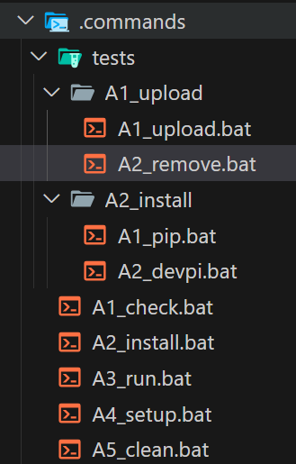

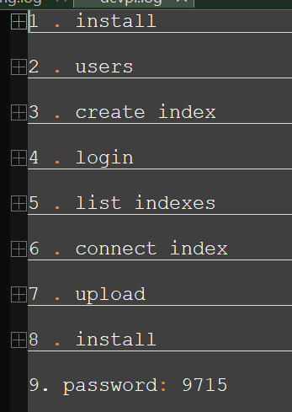
1.2 sources
tutorial: Private Python Packages With devpi
_resources\devpi.log
devpi server documentation
setup
_resources\devpi_setup.pdf
commands
installing devpi-client
getting started with devpi
installing container
_resources\getting_started_with_devpi.pdf
setup server
..\..\..\..\..\python\deployment

Slide 4
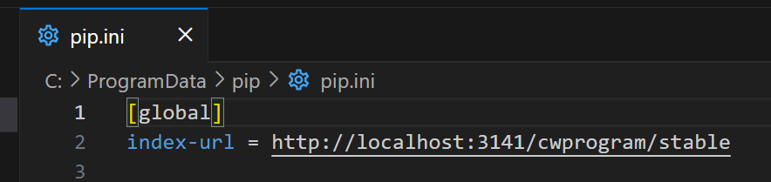
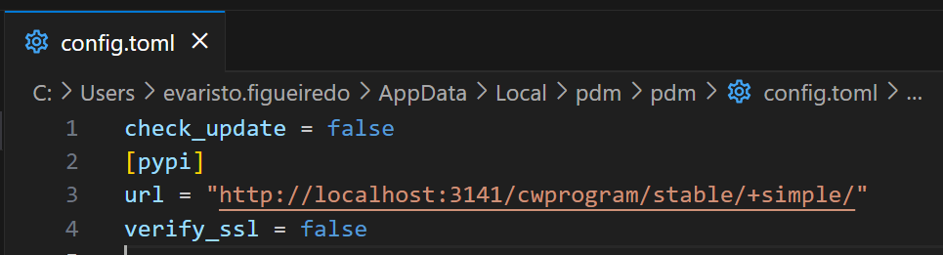
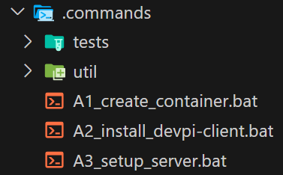
2. how
1
reset package managers
C:\ProgramData\pip\pip.ini
rename this file to pip.ini.old
C:\Users\evaristo.figueiredo\AppData\Local\pdm\pdm\config.toml
remove this part of the file
2
delete docker container
in steps 4 and 5 I need to access
python repo without using devapi
3
create docker container
4
install devpi-client locally
5
setup server
not possible in batch
run command by command in shell
..\..\..\..\..\python\deployment
6
restore package managers setup

Slide 5
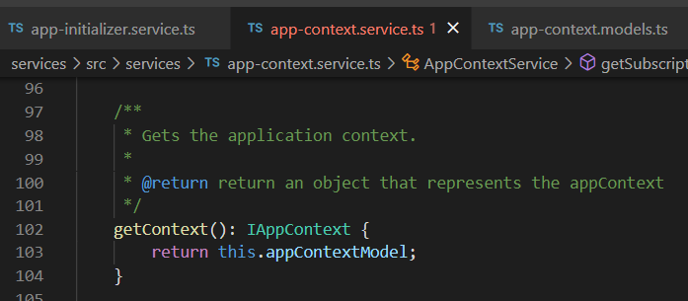

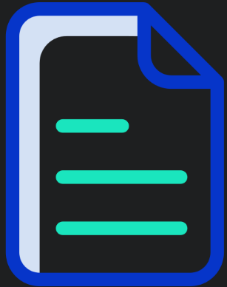

Z. template
new project
ExecuteAsync
square post-it
download
exe
download
exe
why
A slash
followed
by
two consecutive asterisks
D:\A1_research\C2_c0dice\B1_jmeter\A1_install
functionalities
introduction
build-exe
entity framework plus
zig help
⊂
4
every key-frame
defines the operation
success

