Slide 1

1. projects
foundry

Slide 2
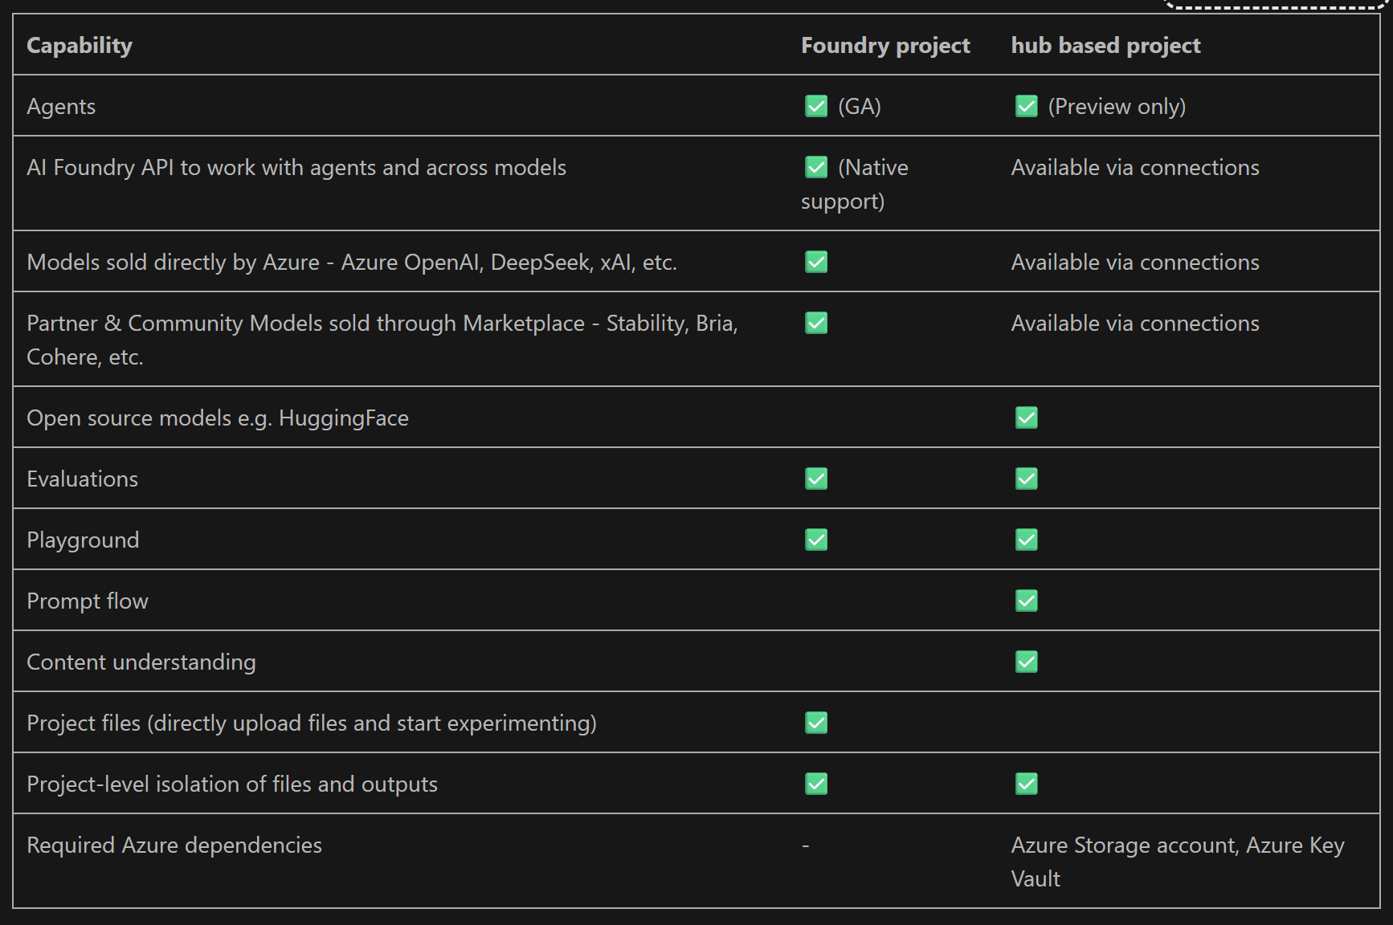
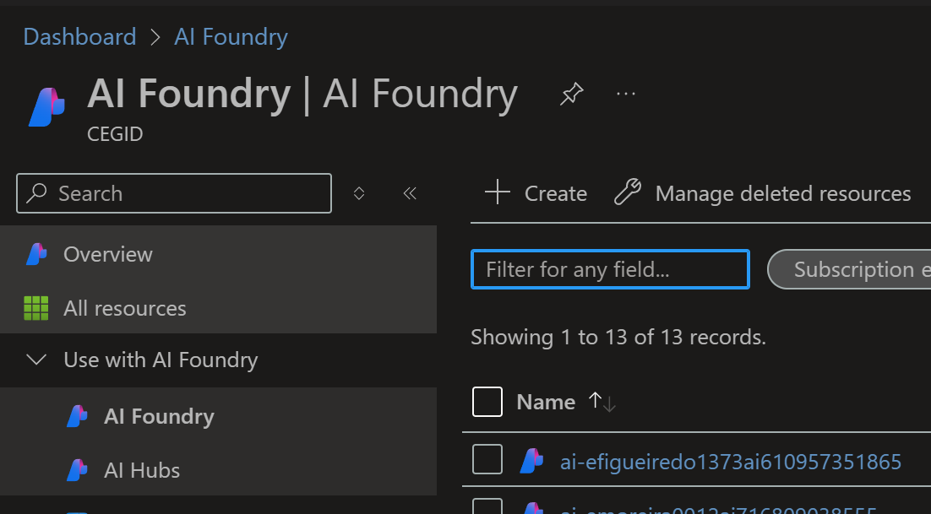

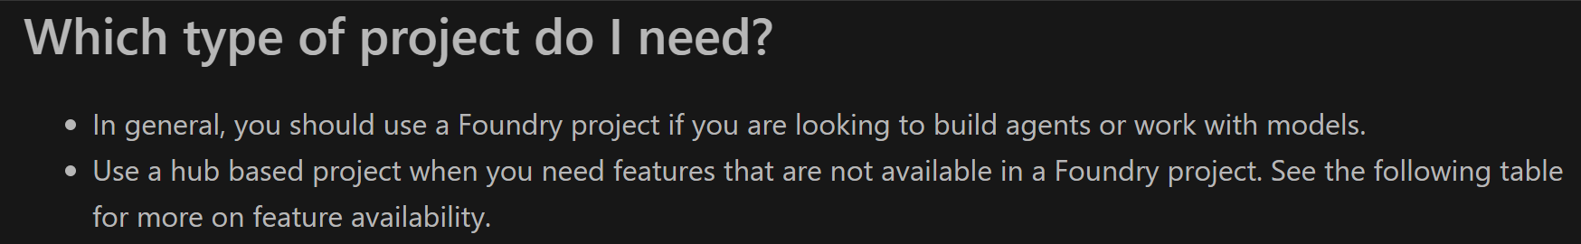
2. types
types
project types

Slide 3
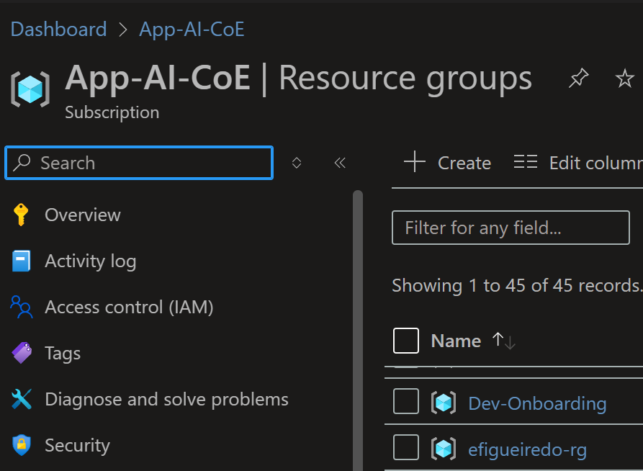
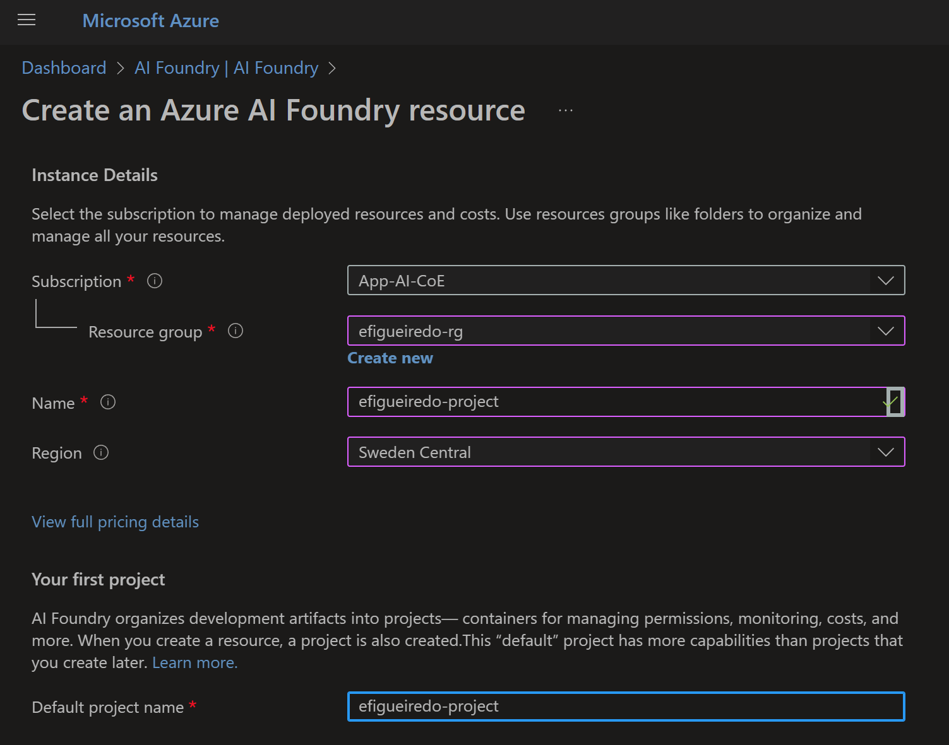
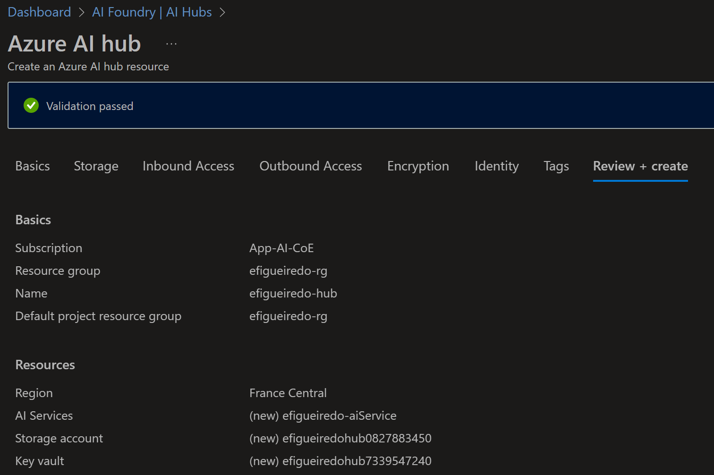
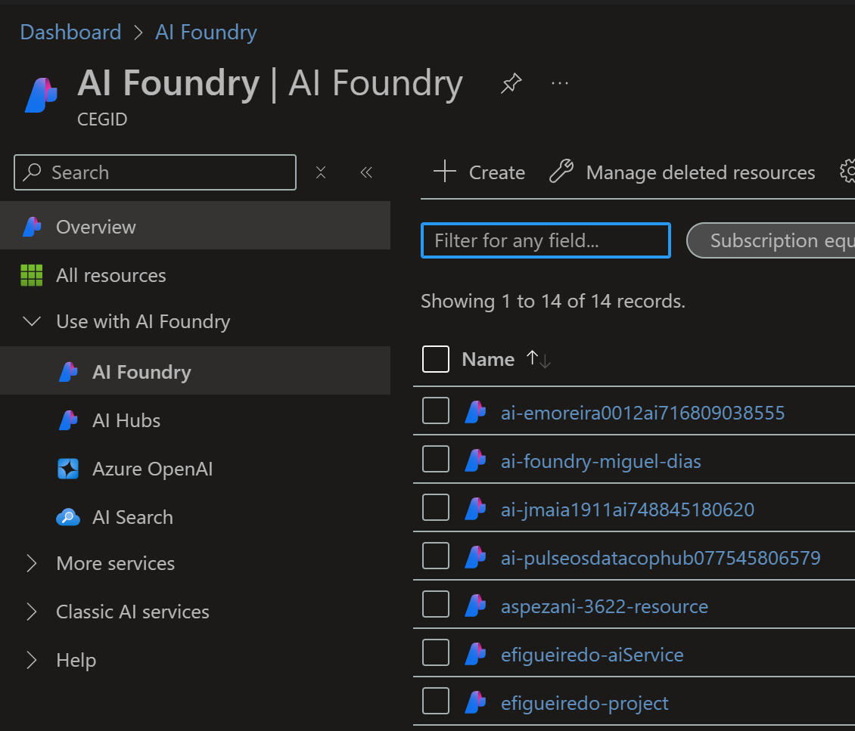
3. create
resource group
project
App-AI-CoE\resource groups
create hub
create project
create
  new
create Ai services

Slide 4





Z. template
new project
ExecuteAsync
square post-it
download
  exe
download
  exe
why
A slash
  followed
by
  two consecutive asterisks
D:\A1_research\C2_c0dice\B1_jmeter\A1_install
functionalities
introduction
build-exe
entity framework plus
zig help
⊂
4
every key-frame
defines the operation
success

