Slide 1
VALUE ANALYSIS AND FUNCTION ANALYSIS SYSTEM TECHNIQUE
Stéphane CARO
stephane.caro@irccyn.ec-nantes.fr
2015/02/04

Slide 2
THE CONCEPT OF VALUE
The value of a product will be interpreted in different ways by different customers.
Its common characteristic is a high level of performance, capability, emotional appeal, style, etc. relative to its cost.
This can also be expressed as maximizing the function of a product relative to its cost:
Value = (Performance + Capability)/Cost = Function/Cost
Value is not a matter of minimizing cost. In some cases the value of a product can be increased by increasing its function (performance or capability) and cost as long as the added function increases more than its added cost.
The concept of functional worth can be important. Functional worth is the lowest cost to provide a given function.

Slide 3
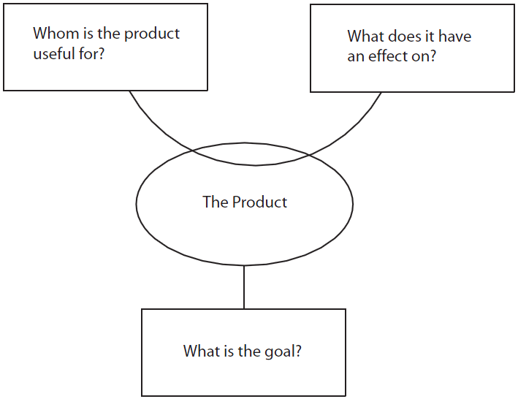
“Bête à Cornes” (Horned Beast) flowchart

Slide 4
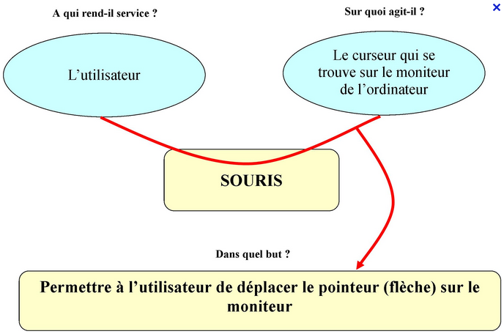

Slide 5
Function Analysis System Technic (FAST)
Goal:
The main functions of a design problem are decomposed into technical functions in order to end up with techological solutions

Slide 6
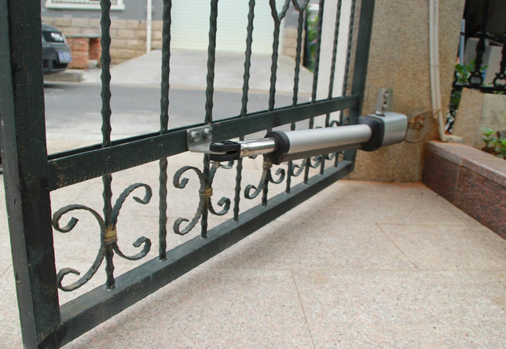
“Octopus” flowchart for the design of a gate opener
gate opener

Slide 7
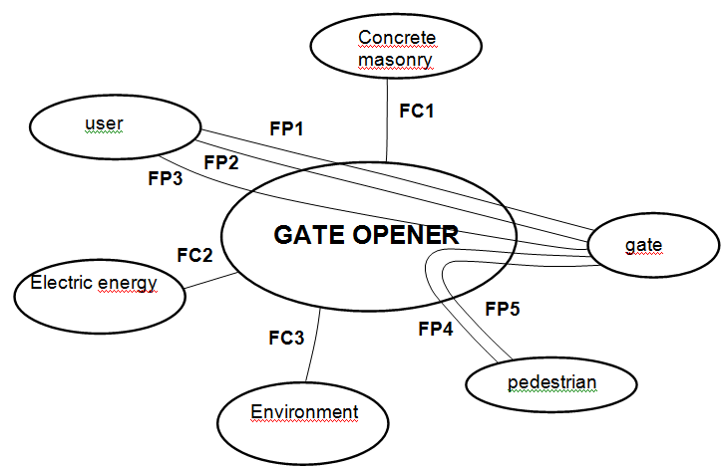
“Octopus” flowchart
FP1 : to open and close the gate

Slide 8
“Octopus” flowchart
FP2 : to be able to close the gate manually in case of energy cut

Slide 9
“Octopus” flowchart
FP3 : to tune the gate opening and closing

Slide 10
“Octopus” flowchart
FP4 : to be locked

Slide 11
“Octopus” flowchart
FP5 : cannot hurt the persons

Slide 12
“Octopus” flowchart
FC1 : to mount the gate on the wall

Slide 13
“Octopus” flowchart
FC2 : to connect to the electrical network

Slide 14
“Octopus” flowchart
FC3 : to be robust with regard to the environment

Slide 15
Main and Constraint Functions
FP1 : to open and close the gate
FP2 : to be able to close the gate manually in case of energy cut
FP3 : to tune the gate opening and closing
FP4 : to be locked
FP5 : cannot hurt the persons
FC1 : to mount the gate on the wall
FC2 : to connect to the electrical network
FC3 : to be robust with regard to the environment

Slide 16
INTRODUCTION TO VALUE ANALYSIS
Lawrence Miles conceived of Value Analysis (VA) in the 1945 based on the application of function analysis to the component parts of a product.
Value analysis defines a "basic function" as anything that makes the product work or sell.
A function that is defined as "basic" cannot change.
Secondary functions, also called "supporting functions", described the manner in which the basic function(s) were implemented. Secondary functions could be modified or eliminated to reduce product cost.
As VA progressed to larger and more complex products and systems, emphasis shifted to "upstream" product development activities where VA can be more effectively applied to a product before it reaches the production phase. However, as products have become more complex and sophisticated, the technique needed to be adapted to the "systems" approach that is involved in many products today. As a result, value analysis evolved into the "Function Analysis System Technique" (FAST)

Slide 17
FUNCTION ANALYSIS SYSTEM TECHNIQUE
FAST is not an end product or result, but rather a beginning. It describes the item or system under study and causes the team to think through the functions that the item or system performs, forming the basis for a wide variety of subsequent approaches and analysis techniques.
FAST contributes significantly to perhaps the most important phase of value engineering: function analysis.
FAST is a creative stimulus to explore innovative avenues for performing functions.
The importance of the FAST approach is that it graphically displays function dependencies and creates a process to study function links while exploring options to develop improved systems.

Slide 18
CREATING A FAST MODEL
The FAST model has a horizontal directional orientation described as the HOW-WHY dimension.
This dimension is described in this manner because HOW and WHY questions are asked to structure the logic of the system's functions.
Starting with a function, we ask HOW that function is performed to develop a more specific approach.
This line of questioning and thinking is read from left to right. To abstract the problem to a higher level, we ask WHY is that function performed.
When addressing any function on the FAST model with the question WHY, the function to its left expresses the goal of that function.
The question HOW, is answered by the function on the right, and is a method to perform that function being addressed. A systems diagram starts at the beginning of the system and ends with its goal. A FAST model, reading from left to right, starts with the goal, and ends at the beginning of the "system" that will achieve that goal.

Slide 19
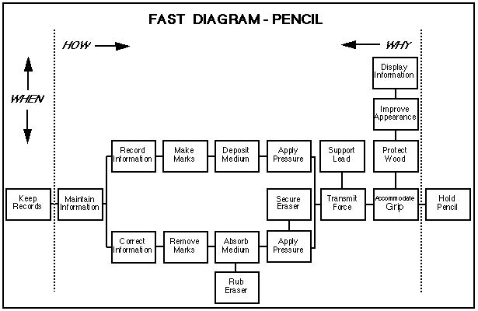
CREATING A FAST MODEL

Slide 20
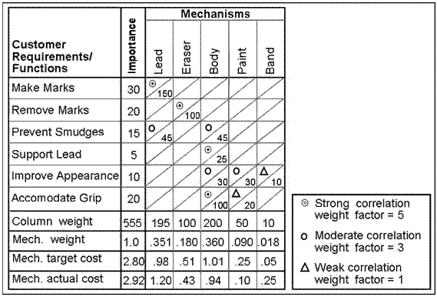
INTEGRATING QUALITY FUNCTION DEPLOYMENT (QFD) WITH FAST
A powerful analysis method is created when FAST is used in conjunction with QFD.
QFD enables the uses of the Value Analysis Matrix. An example of a value analysis matrix for the pencil example:

Slide 21
INTEGRATING QUALITY FUNCTION DEPLOYMENT (QFD) WITH FAST

Slide 23
EXAMPLES (IN FRENCH)

Slide 24
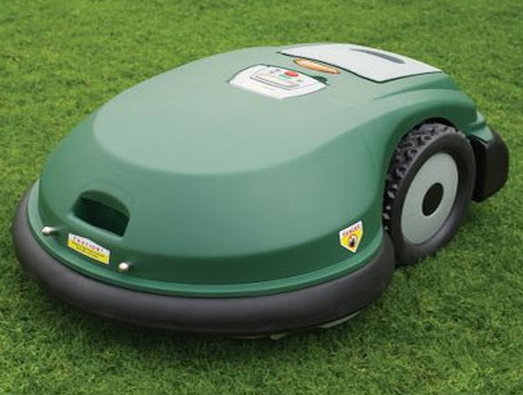
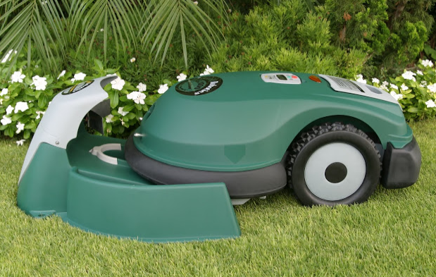
DESIGN OF AN AUTOMATIC LAWN MOWER

Slide 25
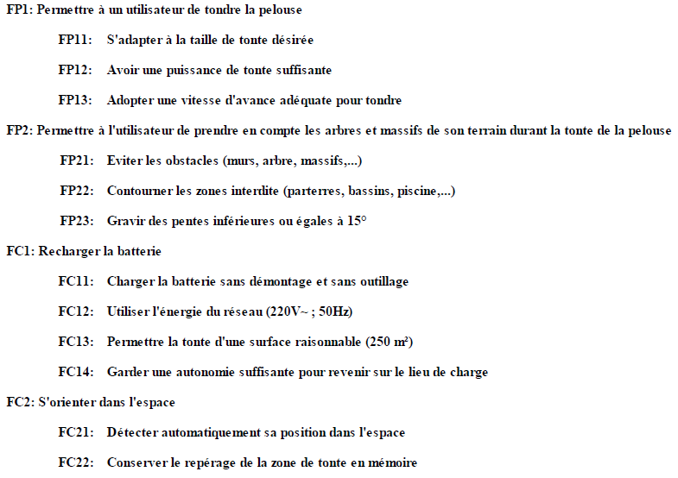

Slide 26
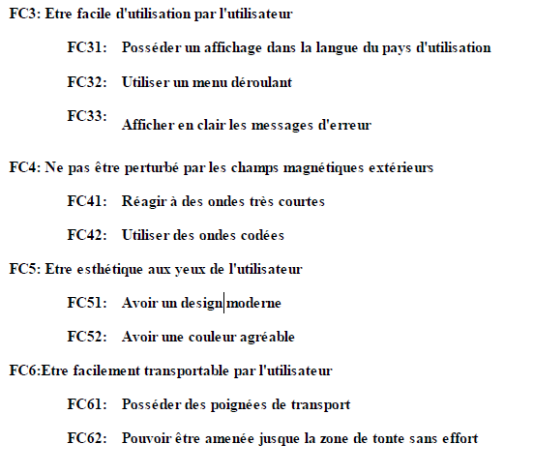

Slide 27
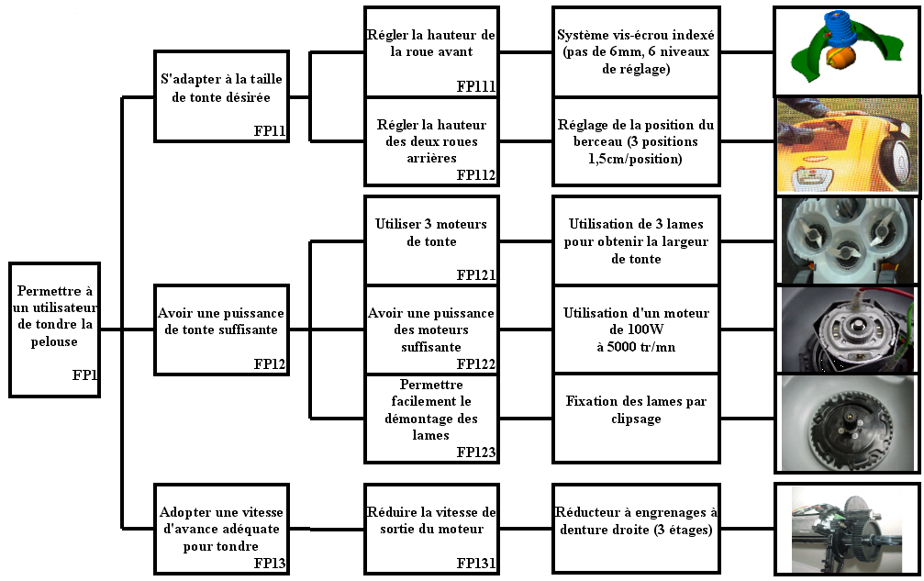

Slide 28
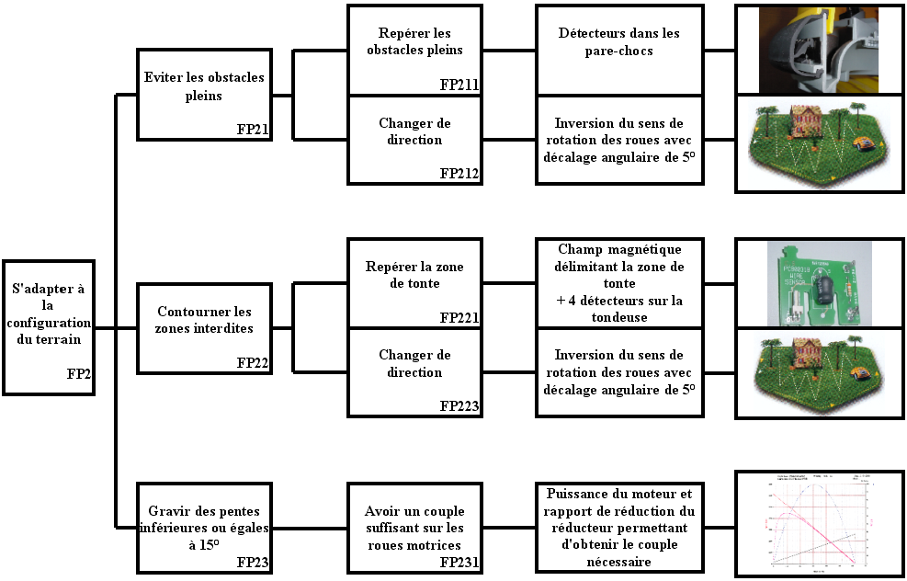

Slide 29
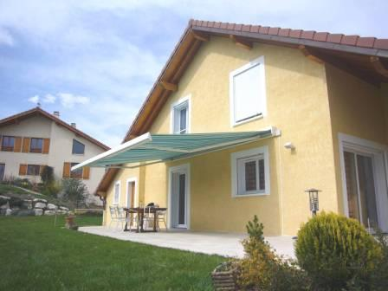
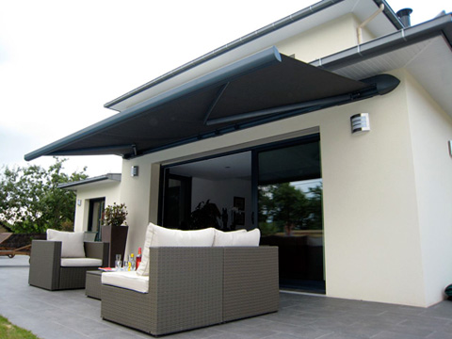
Automatic “Awning” device

Slide 30
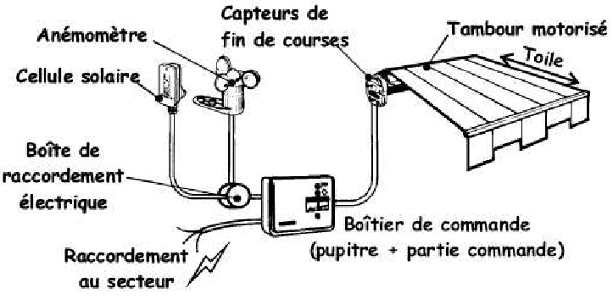

Slide 31
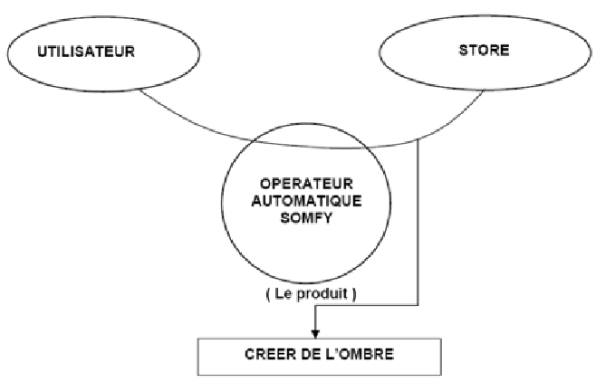

Slide 32
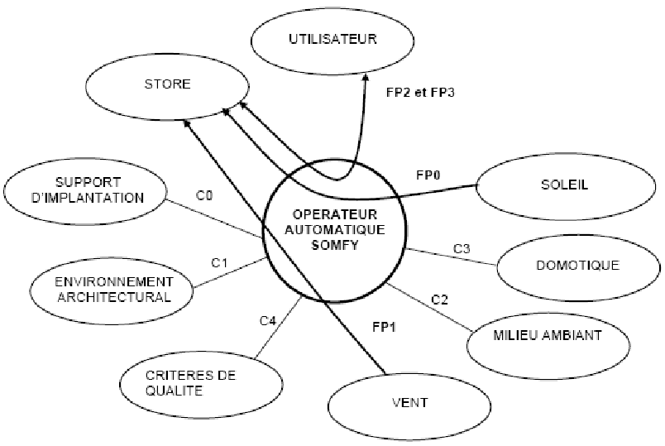

Slide 33
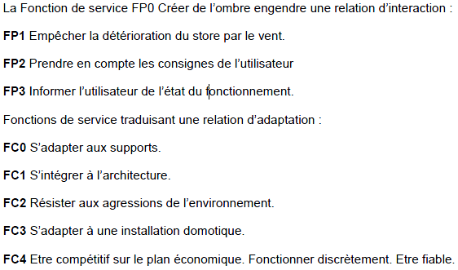

Slide 34
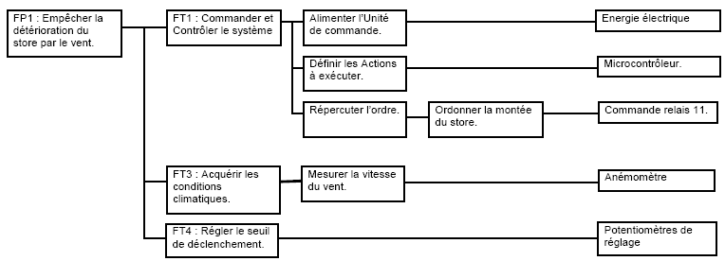

Slide 35
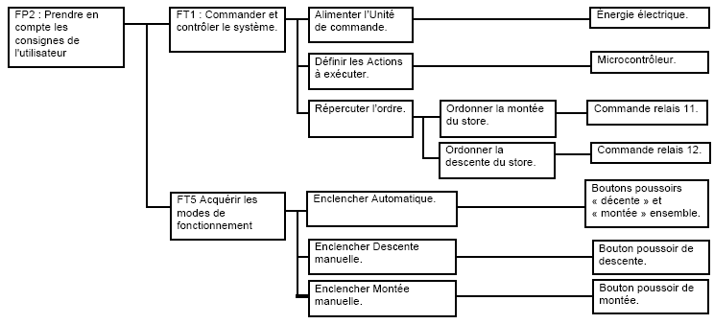

Slide 36
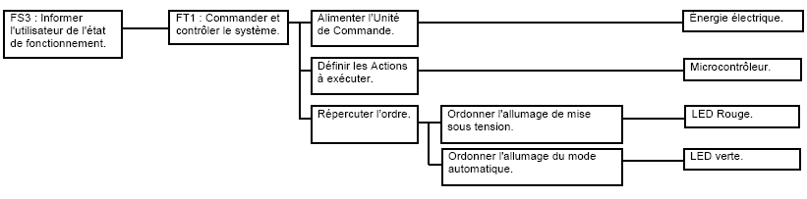

Slide 37
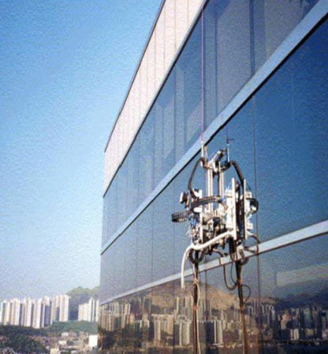
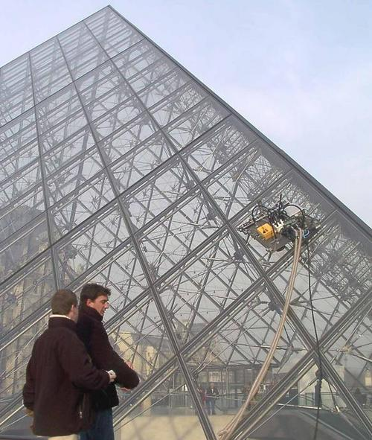
Exercise: Window Cleaning Robot for High-rise Buildings
1- Project Description:
The project deals with the design of an autonomous window cleaning robot for high-rise buildings.
The robot should move freely on the window and clean it efficiently. It should also have a safety system for the user and the robot.
2- Product requirements:
the robot should be autonomous
the robot can have an external device for water and power supply
there should be an external device to prevent the robot from falling down
3- Work to do:
Analyze the system in order to well identify the need and formulate the design
problem

