Slide 1
Introduction
The presentation will address the following questions:
  What is systems analysis and how does it relate the term to the survey, study, and definition phases of the FAST methodology?
  What are the systems analysis strategies for solving business system problems?
  How do you describe the survey, study, and definition phases in terms of your information system building blocks?
  How do you describe the survey, study, and definition phases in terms of objectives, roles, inputs, outputs, techniques, and steps?
Notes:
This chapter you will learn more about the systems analysis phases in a systems development project: survey, study, and definition. These three phases are collectively referred to as systems analysis.
118

Slide 2
What is System Analysis?
What is System Analysis?
  A Formal Definition:
    Systems analysis is the dissection of a system into its component pieces for purposes of studying how those component pieces interact and work.
  Systems analysis is done for the purpose of subsequently performing a systems synthesis.
    Systems synthesis is the re-assembly of a system’s component pieces back into a whole system – hopefully an improved system.
Notes:
Through the process of systems analysis and synthesis, we may add, delete, and modify system components toward our goal of improving the overall system.
Systems analysis is a term that collectively describes the early phases of systems development.
120

Slide 3
What is System Analysis?
What is System Analysis?
  For this presentation we will use the following definition:
    Systems analysis is (1) the survey and planning of the system and project, (2) the study and analysis of the existing business and information system, and (3) the definition of business requirements and priorities for a new or improved system. A popular synonym is logical design.
  Systems analysis is driven by business concerns, specifically, those of system users.
Notes:
No additional notes provided.
121

Slide 4
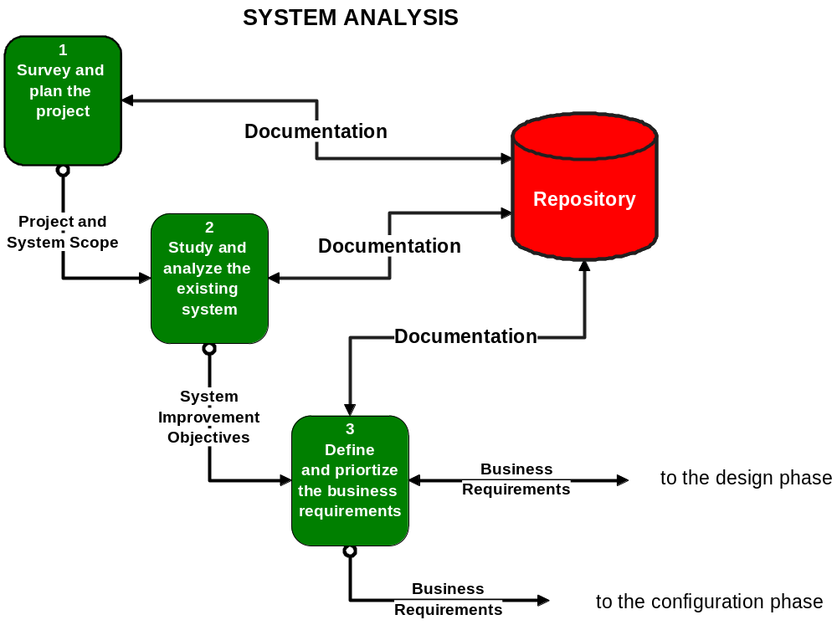

Notes:
Figure 4.1 The Systems Analysis Phases of a Project
The figure above is a view of a FAST phase diagram that illustrates the three analysis phases (only). Notice the repository.
121-122

Slide 5
What is System Analysis?
What is a Repository?
  A repository is a collection of those places where we keep all documentation associated with the application and project.
  Although the Previous figure shows only one project repository, it is normally implemented as some combination of the following:
    A disk or directory of word processing, spreadsheet, and other computer-generated files that contain project correspondence, reports, and data.
    One or more CASE local repositories.
    Hardcopy documentation (stored in notebooks, binders, and system libraries).
Notes:
No additional notes provided.
121-122

Slide 6
What is System Analysis?
The Repository and FAST
  FAST is a repository-based methodology.
    Phases (and activities included in phases) communicate across a shared repository.
    Work in one phase can and should overlap work in another phase, so long as the necessary information is already in the repository.
    This permits the developer to backtrack when an error or omission is discovered.
Notes:
No additional notes provided.
122

Slide 7
Strategies for Systems Analysis and Problem Solving
Modern Structured Analysis
  Structured analysis was one the first formal strategies developed for systems analysis of information systems and computer applications.
    Modern structured analysis is a process-centered technique that is used to model business requirements for a system. The models are structured pictures that illustrate the processes, inputs, outputs, and files required to respond to business events.
Notes:
Traditionally, systems analysis is associated with application development projects, that is, projects that produce information systems and their associated computer applications. But systems analysis methods can be applied to projects with different goals and scope. In addition to single information systems and computer applications, systems analysis techniques can be applied to strategic information systems planning, and to the redesign of business processes.
There are also many strategies or techniques for performing systems analysis. They include modern structured analysis, information engineering, prototyping, and object-oriented analysis. These strategies are often viewed as competing alternatives. In reality, certain combinations complement one another.
By process-centered, we mean that the initial emphasis in this technique is on the PROCESS building blocks in our information system framework. The technique has evolved to also include the DATA building blocks as a secondary emphasis.
122

Slide 8
Strategies for Systems Analysis and Problem Solving
Modern Structured Analysis
  Structured analysis introduced an overall strategy that has been adopted by many of the other techniques – model-driven development.
    A model is a representation of reality. Just as ‘a picture is worth a thousand words’, most models use pictures to represent reality.
    Model-driven development techniques emphasis the drawing of models to define business requirements and information system designs. The model becomes the design blueprint for constructing the final system.
Notes:
No additional notes provided.
122

Slide 9
Strategies for Systems Analysis and Problem Solving
Modern Structured Analysis
  Modern structured analysis is simple in concept.
    Systems and business analysts draw a series of process models called data flow diagrams that depict the essential processes of a system along with inputs, outputs, and files.
    Because these pictures represent the logical business requirements of the system independent of any physical, technical solution, the models are said to be a logical design for the system.
Notes:
No additional notes provided.
122-123

Slide 10
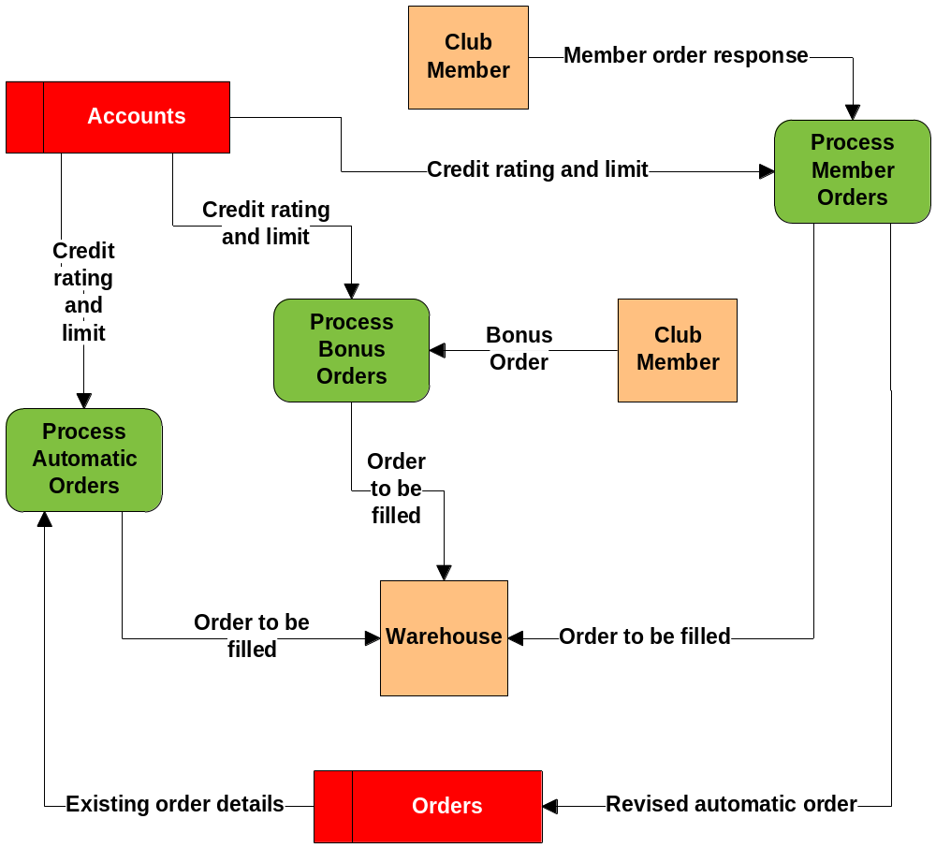

Notes:
Figure 4.2 A Process Model (also Called a Data Flow Diagram)
No additional notes provided.
122-123

Slide 11
Strategies for Systems Analysis and Problem Solving
Information Engineering (IE)
  Today, many organizations have evolved from a structured analysis approach to an information engineering approach.
    Information engineering is a data-centered, but process-sensitive technique that is applied to the organization as a whole (or a significant part therefore – such as a division), rather than on an ad-hoc, project-by-project basis (as in structured analysis).
  The basic concept of information engineering is that information systems should be engineered like other products.
Notes:
No additional notes provided.
123

Slide 12
Strategies for Systems Analysis and Problem Solving
Information Engineering (IE)
  The phases are the following:
    Information Strategy Planning (ISP) applies systems analysis methods to examine the business as a whole for the purpose of defining an overall plan and architecture for subsequent information systems development.
    Based on the strategic plan, business areas are ‘carved out’ and prioritized.
      A business area is a collection of cross-organizational business processes that should be highly integrated to achieve the information strategy plan (and business mission).
      A Business Area Analysis (BAA) uses systems analysis methods to study the business area and define the business requirements for a highly streamlined and integrated set of information systems and computer applications to support that business area.
Notes:
Information Strategy Planning (ISP) - No actual information systems or computer applications are developed. Instead, the project team studies the business mission and goals, and defines an information systems architecture and plan to optimally align information systems to help the organization achieve its business goals.
123-124

Slide 13
Strategies for Systems Analysis and Problem Solving
Information Engineering (IE)
  The phases are the following: (continued)
    Based on the business area requirements analysis, information system applications are ‘carved out’ and prioritized.
      These applications become projects to which other systems analysis and design methods are applied to develop production systems.
  Information engineering is said to be a data-centered paradigm.
  Since information is a product of data, that data must be planned first!
    Data models are drawn first.
    In addition to data models, information engineers also draw process models similar to those drawn in structured analysis.
Notes:
Information engineering is said to be a data-centered paradigm because it emphasizes the study and definition of DATA requirements prior to that of PROCESS, INTERFACE, or GEOGRAPHIC requirements. This is consistent with the contemporary belief that information is a corporate resource that should be planned and managed.
Although information engineering has gradually replaced structured analysis and design as the most widely practiced strategy for systems analysis, information engineering actually integrates all of the process models of structured analysis with its data models. That should make sense, since we know that an information system must include both DATA and PROCESS building blocks. Information engineering was the first formal strategy for synchronizing those building blocks! Information engineering was also the first widely practiced strategy that considered GEOGRAPHY building blocks through application of tools that plan and document the distribution of data and processes to locations.
124

Slide 14
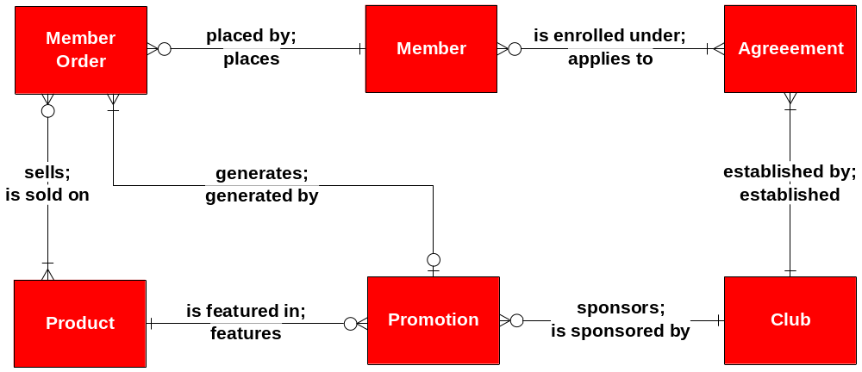

Notes:
Figure 4.4 A Data Model (also Called a Entity Relationship Diagram
No additional notes provided.
124-125

Slide 15
Strategies for Systems Analysis and Problem Solving
Prototyping
  Prototyping is an engineering technique used to develop partial, but functional versions of a system or applications. When extended to system design and construction, a prototype can evolve into the final, implemented system.
  Two ‘flavors’ of prototyping are applicable to systems analysis:
    Feasibility prototyping is used to test the feasibility of a specific technology that might be applied to the business problem.
    Discovery prototyping (sometimes called requirements prototyping) is used to ‘discover’ the users’ business requirements by having them react to a ‘quick-and-dirty’ implementation of those requirements.
Notes:
Prototyping has become a preferred technique for accelerating system development. Many systems developers extend the prototyping techniques to perform what they call rapid application development. Unfortunately, some developers are using prototyping to completely replace model-driven strategies, only to learn what true engineers have known for years – you cannot prototype without some degree of more formal design models.
124-125

Slide 16
Strategies for Systems Analysis and Problem Solving
Joint Application Development (JAD)
  Joint application development (JAD) uses highly organized and intensive workshops to bring together system owners, users, analysts, designers, and builders to jointly define and design systems. Synonyms include joint application design and joint requirements planning.
    A JAD-trained systems analyst usually plays the role of facilitator for a workshop.
    A JAD workshop will typically run from three to five full working days.
      This workshop may replace months of traditional interviews and follow-up meetings.
Notes:
As previously described, modern structured analysis and information engineering both place emphasis on model-driven development. Prototyping places emphasis on construction of the working prototypes. Joint application development (JAD) complements both of these techniques by emphasizing participative development among system owners, users, designers, and builders.
JAD provides a working environment in which to accelerate methodology activities and deliverables. It promotes enhanced system owner and user participation in system development. But it also requires a facilitator with superior mediation and negotiation skills in order to ensure that all parties receive appropriate opportunities to contribute to the system’s development.
125-126

Slide 17
Strategies for Systems Analysis and Problem Solving
Business Process Redesign (BPR)
  Business process redesign (also called business process reengineering) is the application of systems analysis (and design) methods to the goal of dramatically changing and improving the fundamental business processes of an organization, independent of information technology.
    BPR projects focus almost entirely on non-computer processes.
    Each process is studied and analyzed for bottlenecks, value-returned, and opportunities for elimination or streamlining.
    Once the business processes have been redesigned, most BPR projects conclude by examining how information technology might best be applied to the improved business processes.
    This creates new application development projects.
Notes:
The interest in BPR was driven by the discovery that most current information systems and applications have merely ‘automated’ existing and inefficient business processes. Automated bureaucracy is still bureaucracy – it does not contribute value to the business; and in fact, may actually subtract value from the business. BPR is one of many types of projects triggered by the trend we call total quality management (TQM).
126

Slide 18
Strategies for Systems Analysis and Problem Solving
Object-Oriented Analysis (OOA)
  Data and the processes that act upon that data are combined or encapsulated into things called objects.
  The only way to create, delete, change, or use the data in an object (called properties) is through one of its encapsulated processes (called methods).
  Object-oriented analysis (OOA) techniques are used to (1) study existing objects to see if they can be reused or adapted for new uses, and to (2) define new or modified objects that will be combined with existing objects into a useful business computing application.
Notes:
For the past thirty years, most systems development strategies have deliberately separated concerns of DATA from those of PROCESSES. The COBOL language, which dominated business application programming for years, was representative of this separation – the DATA DIVISION was separated from the PROCEDURE DIVISION. Most systems analysis (and design) techniques similarly separated these concerns in order to maintain consistency with the programming technology. Although most systems analysis and design methods have made significant attempts to synchronize data and process models, the results have been less than fully successful.
At the risk of oversimplification, the system and software development strategy is changed to focus on the ‘assembly’ of the system from a library of reusable objects. Of course, those objects must be defined, designed, and constructed. Thus, in the early part of the system development process, we need to use object-oriented analysis techniques.
Object-oriented analysis techniques are best suited to projects that will implement systems using emerging object technologies to construct, manage, and assemble those objects into useful computer applications. Examples include Smalltalk, C++, Delphi, and Visual BASIC.
126-127

Slide 19
Strategies for Systems Analysis and Problem Solving
FAST Systems Analysis Strategies
  The FAST methodology does not impose a single technique on system developers. Instead, it integrates all of the popular techniques: structured analysis (via process modeling), information engineering (via data modeling), prototyping (via rapid application development), and joint application development (for all methods).
  Progressive FAST developers can use object-oriented analysis in conjunction with object technology for prototyping to fully exploit the object paradigm
  The FAST methodology supports different types of projects including:
    application development, information strategy planning, business area analysis, decision support system development, and business process redesign.
Notes:
No additional notes provided.
127-128

Slide 20
The Survey Phase of Systems Analysis
Introduction
  The first phase of a FAST project is to survey the project.
  The purpose of the survey phase is threefold.
    First, the survey phase answers the question, “Is this project worth looking at?”
    The survey phase must define the scope of the project and the perceived problems, opportunities, and directives that triggered the project.
    The survey phase must also establish the project team and participants, the project budget, and the project schedule.
  The survey phase is concerned with the system owner’s view of the overall information system, which includes very few details.
Notes:
No additional notes provided.
128-129

Slide 21
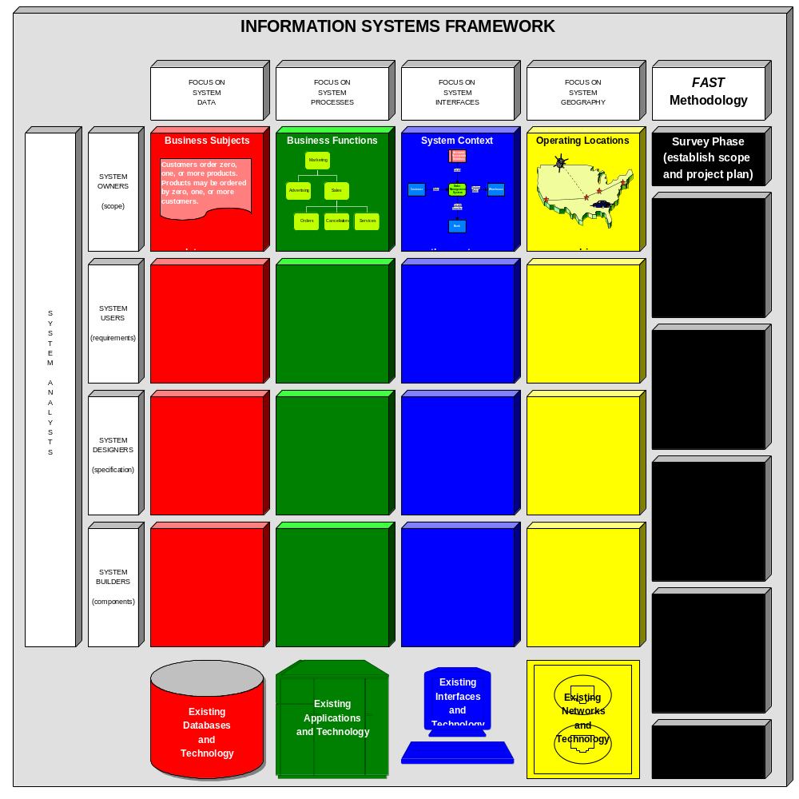

Notes:
Figure 4.5 Building Blocks for the Survey Phase
The figure above provides the context for defining scope and understanding the basic problem domain.
128-129

Slide 22
The Survey Phase of Systems Analysis
Introduction
  A FAST activity diagram shows the activities or work that must be completed in order to accomplish a FAST phase.
    Solid lines indicate information and documentation flows.
    Dashed lines indicate flow of control based on specific criteria.
    A small, shaded circle at the beginning of any input or output information flow indicates feasibility checkpoint.
  The survey phase is intended to be ‘quick.’ – the entire phase should not exceed two or three days for most projects.
Notes:
No additional notes provided.
129

Slide 23
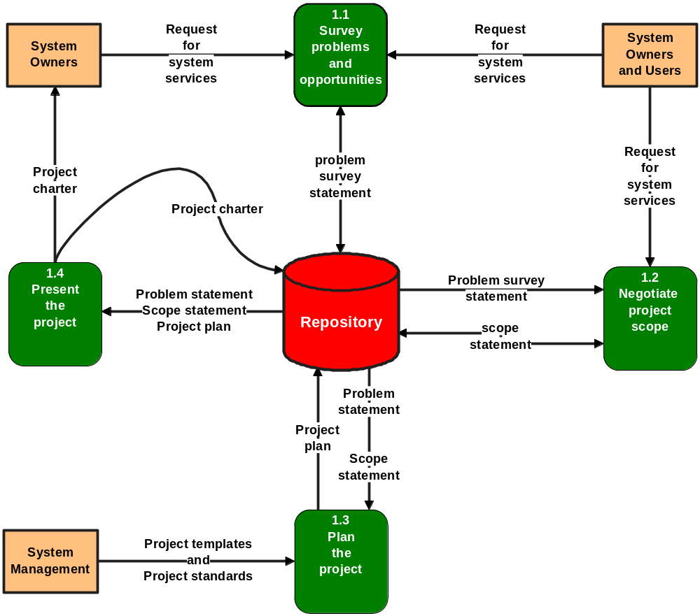

Notes:
Figure 4.6 Activity Diagram for the Survey Phase
No additional notes provided.
129

Slide 24
The Survey Phase of Systems Analysis
Activity: Survey Problems, Opportunities, and Directives
  Purpose:
    The purpose of this activity is to quickly survey and evaluate each identified problem, opportunity, and directive with respect to urgency, visibility, tangible benefits, and priority.
    Optionally, the participants can explore ‘possible’ solutions, although everyone should be informed that other solutions may and should be explored at later stages of the project.
Notes:
One of the most important activities of the survey phase is to establish an initial reading of the problems, opportunities, and/or directives that triggered the project. Participants should keep in mind that a more thorough analysis of the same will occur during the study phase.
129-130

Slide 25
The Survey Phase of Systems Analysis
Activity: Survey Problems, Opportunities, and Directives
  Roles:
    Project manager - facilitator
    System owner roles:
      executive sponsor
      user managers
      (optional) system managers
      project manager
    System user roles:
      (optional) business analysts
      other users are typically not involved in this activity at this time.
Notes:
Executive sponsor – the highest-level manager who will pay for and support the project.
User managers – the manager(s) of the organizational units most likely to be supported by the system developed in this project.
System managers – the information systems unit manager(s) to whom the project manager report (e.g., the manager of systems development).
Project manager – the information systems unit manager who will directly manage the project team. This is usually a senior systems analyst.
Business analysts – an analyst(s) who is (are) on loan from the user community to the information systems unit (applicable only to organizations who practice this concept)
130

Slide 26
The Survey Phase of Systems Analysis
Activity: Survey Problems, Opportunities, and Directives
  Roles:
    System analyst roles:
      system modelers
    System designer roles are not typically involved in this activity unless deemed appropriate by a system owner
    System builder roles are not typically involved in this activity unless deemed appropriate by a system owner
Notes:
System modelers – systems analysts who are skilled with the system modeling techniques and CASE tools that will be used in the project.
131

Slide 27
The Survey Phase of Systems Analysis
Activity: Survey Problems, Opportunities, and Directives
  Prerequisites (Inputs):
    This activity is triggered by a request for system services.
      This input implements the following two logical project triggers:
      a planned system project directive
      an unplanned system request
Notes:
No additional notes provided.
131

Slide 28


Notes:
Figure 4.7 A Request for System Services
No additional notes provided.
130-131

Slide 29
The Survey Phase of Systems Analysis
Activity: Survey Problems, Opportunities, and Directives
  Deliverables (Outputs):
    The principle deliverable of this activity is a problem statement which documents the problems, opportunities, and directives that were discussed.
  Applicable Techniques:
    Fact Finding. Fact finding methods are used to interact with people to identify problems, opportunities, and directives.
    Interpersonal Skills. Interpersonal skills are related to fact finding skills. They impact the way we communicate and negotiate with one another. Clearly, good interpersonal relations are essential to this activity.
Notes:
No additional notes provided.
131-132

Slide 30
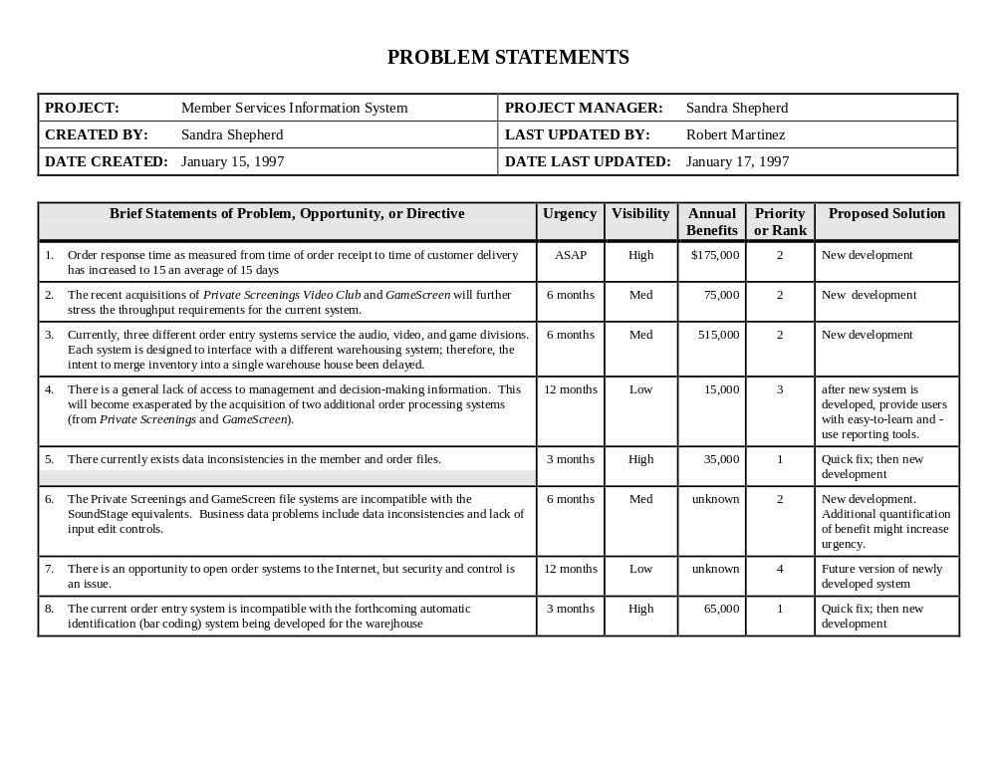

Notes:
Figure 4.8 A Representative Problem Statement
The figure above is a sample document that summarizes problems, opportunities, and directives in terms of:
Urgency. In what time frame must/should the problem be solved, or the opportunity or directive realized?
Visibility. To what degree would a solution or new system be visible to customers and/or executive management?
Benefits. Approximately how much would a solution or new system increase annual revenues or reduce annual costs. This is often a ‘guess’, but if all participants are involved in that guess, it should prove sufficiently conservative.
Priority. Based on the above answers, what are the consensus priorities for each problem, opportunity, or directive. If budget or schedule becomes a problem, these priorities will help to adjust project scope.
Possible Solutions. At this early stage of the project, possible solutions are best expressed in simple terms such as (1) ‘leave well enough alone’, (2) a quick fix’, (3) ‘a simple-to-moderate enhancement of the existing system’, (4) ‘redesign the existing system’, or (5) ‘design a new system’.
131-132

Slide 31
The Survey Phase of Systems Analysis
Activity: Survey Problems, Opportunities, and Directives
  Steps:
    The following steps are suggested to complete this activity:
      Step 1 - Collect and review all documentation submitted to begin this project.
      Step 2 - Schedule and conduct a meeting of the people tentatively assigned to the aforementioned roles for this activity. (Alternative: Interview the people tentatively assigned to those roles.)
      Step 3 - Document problems, opportunities and constraints.
Notes:
No additional notes provided.
132

Slide 32
The Survey Phase of Systems Analysis
Activity: Negotiate Project Scope
  Purpose:
    The purpose of this activity is to define the boundary of the system and project.
      The boundary should be defined as precisely as possible to minimize the impact of ‘creeping scope’.
        Creeping scope is the subtle, but significant increase of scope that frequently occurs during system projects.
        By defining scope, we are not eliminating creeping scope, but are merely providing a mechanism to document and track that scope so that the impact on budget and schedule can be continuously reassessed.
Notes:
Scope defines the boundary of the project – what aspects of the system will and will not be included in the project. Scope can change during the course of the project; however, the initial project plan must be based on some agreement regarding scope. Then if the scope changes significantly, all parties involved will have a better appreciation for why the budget and schedule has also changed. This activity can occur in parallel with the prior activity.
132-133

Slide 33
The Survey Phase of Systems Analysis
Activity: Negotiate Project Scope
  Roles:
    Project manager - facilitator
    System owner roles:
      executive sponsor
      user managers
      (optional) system managers
      project manager
    System user roles:
      (optional) business analysts
      other users are typically not involved in this activity at this time.
Notes:
Executive sponsor – the highest-level manager who will pay for and support the project.
User managers – the manager(s) of the organizational units most likely to be supported by the system developed in this project.
System managers – the information systems unit manager(s) to whom the project manager report (e.g., the manager of systems development).
Project manager – the information systems unit manager who will directly manage the project team. This is usually a senior systems analyst.
Business analysts – an analyst(s) who is (are) on loan from the user community to the information systems unit (applicable only to organizations who practice this concept)
133

Slide 34
The Survey Phase of Systems Analysis
Activity: Negotiate Project Scope
  Roles:
    System analyst roles:
      system modelers
    System designer roles are not typically involved in this activity unless deemed appropriate by a system owner
    System builder roles are not typically involved in this activity unless deemed appropriate by a system owner
Notes:
System modelers – systems analysts who are skilled with the system modeling techniques and CASE tools that will be used in the project.
133

Slide 35
The Survey Phase of Systems Analysis
Activity: Negotiate Project Scope
  Prerequisites (Inputs):
    This activity is triggered by a request for system services.
    The problem survey statement produced by the previous activity can be a useful input for defining scope.
  Deliverables (Outputs):
    The principle deliverable of this activity is a scope statement.
Notes:
A scope statement corresponds to the four building blocks for this phase:
Business subjects define the scope for DATA. This might be a simple list of ‘things’ about which the system needs to ‘know’ information.
Business functions define the scope for PROCESSES. This might be a simple list of on-going business functions that would be included in, or affected by this system.
System context defines the scope for INTERFACES. This might be a list of external people, organization units, organizations, or other systems with which our system might have to interact.
Operating locations define the scope for GEOGRAPHY. This might be a simple list of specific business operating locations that will be included within the scope of the project.
Notice that each statement of scope was described as a simple ‘list.’ We don’t necessarily define the items in the list. Nor are we very concerned with precise definitions. And we definitely are not concerned with any time consuming steps such as modeling or prototyping.
133

Slide 36
The Survey Phase of Systems Analysis
Activity: Negotiate Project Scope
  Applicable Techniques:
    Fact Finding. Fact finding methods are used to interact with people to define scope. Typically, scope is defined by way of interviews or a group meeting.
    Interpersonal Skills. Interpersonal skills are related to fact finding skills. They impact the way we communicate and negotiate with one another. Clearly, good interpersonal relations are essential to this activity.
Notes:
No additional notes provided.
133-134

Slide 37
The Survey Phase of Systems Analysis
Activity: Negotiate Project Scope
  Steps:
    The following steps are suggested to complete this activity:
      Step 1 - Collect and review all documentation submitted to begin this project.
      Step 2 - Schedule and plan a meeting of the people tentatively assigned to the aforementioned roles for this activity. The meeting or interviews should focus on ‘negotiating’ the scope in terms of the four building blocks of information systems: DATA, PROCESSES, INTERFACES, and GEOGRAPHY.
      Step 3 - Document scope.
Notes:
No additional notes provided.
134

Slide 38
The Survey Phase of Systems Analysis
Activity: Plan The Project
  The initial project plan should consist of the following:
    A first-draft master plan and schedule for completing the entire project. This schedule will be modified at the end of each phase of the project. This is sometimes called a baseline plan.
    A detailed plan and schedule for completing the next phase of the project (the study phase). In most cases this schedule will be more accurate, but still subject to a lack of detailed knowledge about the current system and user requirements.
  Purpose:
    The purpose of this activity is to develop the initial project schedule and resource assignments.
Notes:
Based on the prior activities, you can now answer the question ‘Is the project worth looking at.’ If the answer is ‘yes’, the group needs to formally plan the project. At this stage of the project, we know too little to accurately predict costs or schedules.
The project plan is derived from experience plus the problem survey and scope definitions produced in the prior activities.
134

Slide 39
The Survey Phase of Systems Analysis
Activity: Plan The Project
  Roles:
    Project manager - facilitator
    System owner roles:
      executive sponsor
      user managers
      system managers
      project manager
      (optional) steering body
    System user roles:
      (optional) business analysts
Notes:
Executive sponsor – the highest-level manager who will pay for and support the project.
User managers – the manager(s) of the organizational units most likely to be supported by the system developed in this project.
System managers – the information systems unit manager(s) to whom the project manager report (e.g., the manager of systems development).
Project manager – the information systems unit manager who will directly manage the project team. This is usually a senior systems analyst.
Business analysts – an analyst(s) who is (are) on loan from the user community to the information systems unit (applicable only to organizations who practice this concept)
Steering body – many organizations require that all project plans be formally presented to a steering body (sometimes called a steering committee) for final approval.
134

Slide 40
The Survey Phase of Systems Analysis
Activity: Plan The Project
  Roles:
    System analyst roles are not typically involved in this activity unless deemed appropriate by the project manager.
    System designer roles are not typically involved in this activity unless deemed appropriate by the project manager.
    System builder roles are not typically involved in this activity unless deemed appropriate by the project manager.
Notes:
No additional notes provided.
134

Slide 41
The Survey Phase of Systems Analysis
Activity: Plan The Project
  Prerequisites (Inputs):
    This activity is triggered by the completion of the problem survey and scope definition activities.
      The problem statement and the scope statement, if formally documented, are very helpful references for the project planning group.
  Deliverables (Outputs):
    The principle deliverable of this activity is the project plan. This initial project plan consists of two components:
      a phase-level plan that covers the entire project
      an activity-level plan the details the study phase of the project
Notes:
No additional notes provided.
134-135

Slide 42
The Survey Phase of Systems Analysis
Activity: Plan The Project
  Applicable Techniques:
    Process Management. Process management defines the standards for applying the methodology to a project. It defines skill requirements and training for each role, CASE tool standards, documentation standards, quality management standards, and project management standards.
    Project Management. Project management builds on process management by applying the methodology to specific projects in the form of schedule planning, staffing and supervision, progress reporting, management of expectations, budgeting, and schedule management.
Notes:
No additional notes provided.
135

Slide 43
The Survey Phase of Systems Analysis
Activity: Plan The Project
  Applicable Techniques:
    Presentation Skills. The project charter and any verbal presentations of the project and plan obviously require presentation skills.
  Steps:
    The following steps are suggested to complete this activity:
      Step 1 - Review system problems, opportunities, and directives; as well as, project scope.
      Step 2 - Select the appropriate FAST project template. FAST templates support different strategies and/or different system development goals (e.g., purchase a package versus object-oriented development).
Notes:
No additional notes provided.
135

Slide 44
The Survey Phase of Systems Analysis
Activity: Plan The Project
  Steps:
    The following steps are suggested to complete this activity: (continued)
      Step 3 - Assign specific people to each FAST role.
      Step 4 - Estimate time required for each project activity, assign roles to activities, and construct a schedule.
      Step 5 - (optional) Negotiate expectations.
      Step 6 - Negotiate the schedule with system owners, adjusting resources, scope, and expectations as necessary.
      Step 7 - Write the project charter.
Notes:
No additional notes provided.
135

Slide 45
The Survey Phase of Systems Analysis
Activity: Present The Project
  In most organizations, there are more potential projects than resources to staff and fund those projects.
  If a project has not been predetermined to be of the highest priority (by some sort of prior tactical or strategic planning process), then it must be presented and defended to some sort of steering body for approval.
    A steering body is a committee of executive business and system managers that studies and prioritizes competing project proposals to determine which projects will return the most value to the organization and thus, should be approved for continued systems development.
Notes:
The majority of any steering body should consist of non-information systems professionals or managers. Many organizations designate vice presidents to serve on a steering body. Other organizations assign the direct reports of vice presidents to the steering body. And some organizations utilize a two steering bodies, one for vice presidents and one for their direct reports. Information system managers serve on the steering body only to answer questions and to communicate priorities back to developers and project managers.
135-136

Slide 46
The Survey Phase of Systems Analysis
Activity: Present The Project
  Purpose:
    The purpose of this activity is to:
      (1) secure any required approvals to continue the project, and
      (2) to communicate the project and goals to all staff.
  Roles:
    Executive sponsor - facilitator
    System owner roles:
      executive sponsor
      user managers
      system managers
      project manager
      steering body
Notes:
Executive sponsor – the highest-level manager who will pay for and support the project.
User managers – the manager(s) of the organizational units most likely to be supported by the system developed in this project.
System managers – the information systems unit manager(s) to whom the project manager report (e.g., the manager of systems development).
Project manager – the information systems unit manager who will directly manage the project team. This is usually a senior systems analyst.
Business analysts – an analyst(s) who is (are) on loan from the user community to the information systems unit (applicable only to organizations who practice this concept)
Steering body – many organizations require that all project plans be formally presented to a steering body (sometimes called a steering committee) for final approval.
136

Slide 47
The Survey Phase of Systems Analysis
Activity: Present The Project
  Roles:
    System user roles:
      business analysts
      all direct and indirect users
    System designers:
      any system analysts assigned to the project
      any system designers and specialists likely to be assigned to the project
    System builders:
      any system builders likely to be assigned to the project
      (optional) representatives of any technology vendors whose products are likely to be involved in the project
Notes:
No additional notes provided.
136

Slide 48
The Survey Phase of Systems Analysis
Activity: Present The Project
  Prerequisites (Inputs):
    This activity is triggered by the completion of the project planning activity.
    The inputs include:
      problem statement
      scope statement
      project plan
      (optional) project templates
      project standards
Notes:
No additional notes provided.
136

Slide 49
The Survey Phase of Systems Analysis
Activity: Present The Project
  Deliverables (Outputs):
    The key deliverable of this activity is the project charter.
      This charter is usually a formal consolidation of all of the inputs to the activity. It might be thought of as an internal contract for the project, should the project continue to the next phase.
    The final deliverable of the activity is the problem statement and scope statement that become the triggers for various study phase activities.
      They may take the form of a verbal presentation, a written document (possibly the project charter or a summary thereof), a letter of authority from the executive sponsor, or some combination of these formats.
Notes:
No additional notes provided.
136

Slide 50
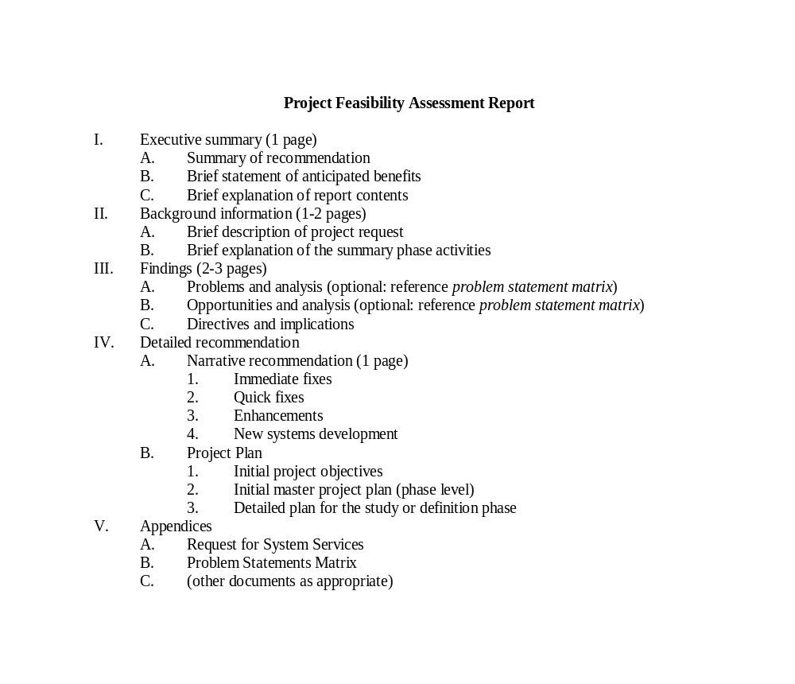

Notes:
Figure 4.9 Outline for a Survey Phase Final Report
No additional notes provided.
136-137

Slide 51
The Survey Phase of Systems Analysis
Activity: Present The Project
  Applicable Techniques:
    Interpersonal Skills. Good interpersonal skills are essential to this activity. These include persuasion, sales (of ‘ideas’), writing, and speaking.
  Steps:
    The following steps are suggested to complete this activity:
      Step 1 - Review the deliverables of all prior activities.
      Step 2 - (optional) Reformat the project charter for presentation to the steering body.
      Step 3 - Present the project proposal (charter) to the steering body. Be prepared to defend recommendations, address issues and controversies, and answer questions as posed by the steering body.
Notes:
No additional notes provided.
136-137

Slide 52
The Survey Phase of Systems Analysis
Activity: Present The Project
  Steps:
    The following steps are suggested to complete this activity: (continued)
      Step 4 - Plan an event to communicate the approved project to any and all affected staff, or distribute the project charter or summary over a cover letter of authority from the executive sponsor.
        This launch event presents the project and plan to both participants and all interested parties.
        The executive sponsor’s visible support of the project can prevent many ‘political’ problems from ever surfacing.
Notes:
No additional notes provided.
137

Slide 53
The Survey Phase of Systems Analysis
Survey Phase Conclusion
  It is possible that the participants in the survey phase will decide the project is not worth proposing.
  It is also possible that the steering body may decide that other projects are more important.
  It is also possible that the executive sponsor might not endorse the project.
  In each of these instances, the project is terminated. Little time and effort has been expended.
  With the blessing of all system owners, the project can now proceed to the study and/or definition phases.
Notes:
No additional notes provided.
137

Slide 54
The Study Phase of Systems Analysis
Introduction
  The study phase provides the analyst with a more thorough understanding of problems, opportunities, and/or directives.
  The study phase answers the questions:
    Are the problems really worth solving? and
    Is a new system really worth building?
  The study phase is rarely skipped.
Notes:
You may recall the old saying, “Don’t try to fix it unless you understand it.” That statement aptly describes the next phase of a systems analysis, study and analyze the current system. There is always a current system, regardless of whether or not it currently uses computers.
Can you ever skip the study phase? Rarely! You almost always need some understanding of the current system. But there may be some reasons to accelerate the study phase. First, if the project was triggered by systems planning, the worthiness of the project is not in doubt – the study phase is reduced to understanding the current system, not analyzing it. Second, if the project was initiated by a directive (such as, ‘process financial aid applications according to new federal regulations that go into effect on July 1’), then worthiness is, once again, not in doubt.
The goal of the FAST study phase is to understand the problem domain well enough to thoroughly analyze its problems, opportunities, and constraints. Like many other methodologies, FAST once encouraged a detailed understanding of the current system that was documented with painstaking precision in various models such as data flow diagrams. Historically, the value-added by this documentation proved questionable. Thus, the current version of FAST encourages some modeling, but only enough to refine our understanding of project scope and to define a common vocabulary for the system.
137-138

Slide 55
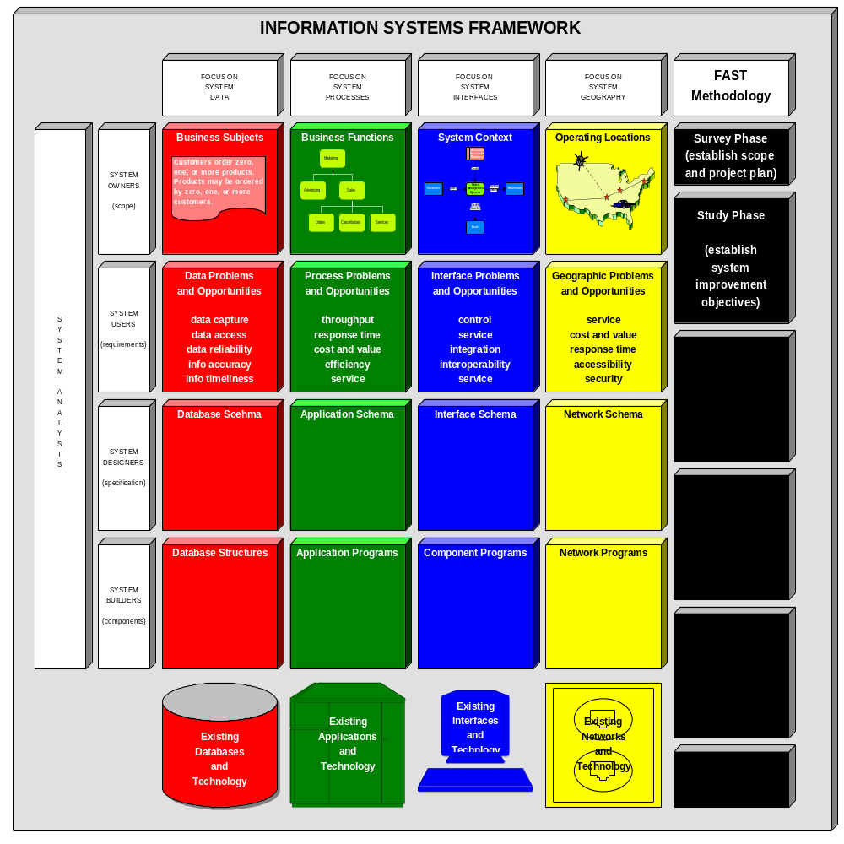

Notes:
Figure 4.10 Building Blocks for the Study Phase
In the figure above, notice that the study phase is concerned jointly with the system owners’ and users’ views of the overall information system in somewhat greater detail than the survey phase.
138-139

Slide 56
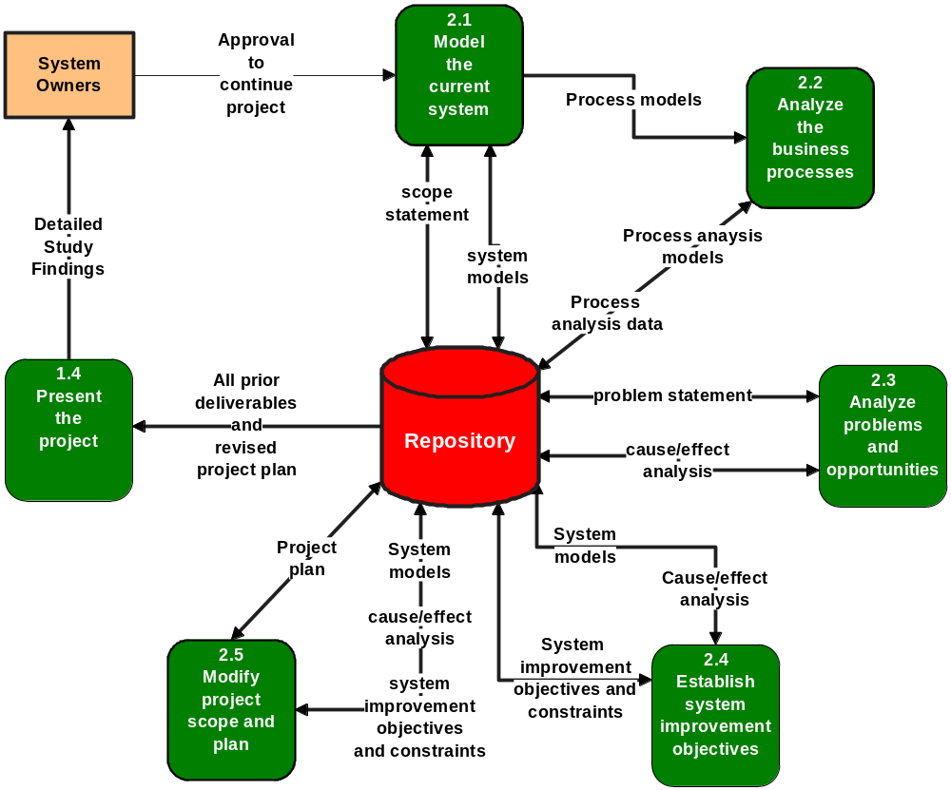

Notes:
Figure 4.11 Activity Diagram for the Study Phase
Depending on the size of the system, its complexity, and the degree to which project worthiness is already known, these activities may consume one to six weeks. Most of these activities can be accelerated by JAD sessions.
139

Slide 57
The Study Phase of Systems Analysis
Activity: Model the Current System
  FAST suggests one of two modeling strategies for the study phase:
    a combination of high-level data, process, and geographic models, or
    a combination of object and geographic models
  Purpose:
    The purpose of this activity is to learn enough about the current system’s data, processes, interfaces, and geography to expand the understanding of scope, and to establish a common working vocabulary for that scope.
Notes:
During the study phase, the team is attempting to learn about the current system. Each team member brings a different level of understanding to the process – different scope; different detail; different vocabulary; different perceptions; and different opinions. A well conducted study can prove revealing to all parties, including management and users. How do you verify the team’s consensus understanding of the current system? One way is to model the current system. Recall that a model is a representation of reality, usually pictorial.
The value of modeling in the study phase has come under some debate in recent years. Many early techniques, such as De Marco’s structured analysis, called for very detailed models of the current system. This consumed considerable time. Users and managers frequently became frustrated with endless reviews of a system that they wanted to replace anyway! This problem has sometimes been referred to as analysis paralysis.
139-140

Slide 58
The Study Phase of Systems Analysis
Activity: Model the Current System
  Roles:
    Executive sponsor or systems analyst - facilitator
    System owner roles:
      user managers
      (optional) system managers
      project manager
    System user roles:
      business analyst
      all other users as needed to fully represent the business scope of the project
Notes:
User managers – the manager(s) of the organizational units most likely to be supported by the system developed in this project.
System managers – the information systems unit manager(s) to whom the project manager report (e.g., the manager of systems development).
Project manager – the information systems unit manager who will directly manage the project team. This is usually a senior systems analyst.
Business analysts – an analyst(s) who is (are) on loan from the user community to the information systems unit (applicable only to organizations who practice this concept)
140

Slide 59
The Study Phase of Systems Analysis
Activity: Model the Current System
  Roles:
    System analyst roles:
      system modelers
    System designer roles are not typically involved in this activity unless deemed appropriate by a system owner.
    System builder roles are not typically involved in this activity unless deemed appropriate by a system owner.
Notes:
System modelers – systems analysts who are skilled with the system modeling techniques and CASE tools that will be used in the project.
140

Slide 60
The Study Phase of Systems Analysis
Activity: Model the Current System
  Prerequisites (Inputs):
    This activity is triggered by completion of the survey phase activities and approval from the system owners to continue the project.
    The key informational input is the project and system scope statement that was completed as part of the survey phase.
Notes:
No additional notes provided.
140

Slide 61
The Study Phase of Systems Analysis
Activity: Model the Current System
  Deliverables (Outputs):
    The principle deliverable of this activity are system models that serve two purposes:
      (1) to expand understanding of scope, and
      (2) to verify the team’s consensus understanding of the business situation.
    The overriding modeling strategy is information hiding.
      The principle of information hiding, as applied to system models, suggests that models should hide inappropriate details in an effort to focus attention on what’s really important.
Notes:
According to our information system framework, appropriate current system models may include:
DATA – A one-page data model is very useful for establishing business vocabulary, rules, and policies.
PROCESSES –Today, it is widely accepted that a one- or two-page functional decomposition diagram should prove sufficient to get a feel for the current system processing.
INTERFACES – A one-page context diagram is useful for clarifying the system’s inputs and outputs with other systems, organizations, and departments.
GEOGRAPHY – A one-page geographic model adequately identifies current operating locations that are relevant to the system.
140-141

Slide 62
The Study Phase of Systems Analysis
Activity: Model the Current System
  Applicable Techniques:
    Fact Finding – By now, a common theme has emerged. Good fact finding skills are absolutely essential to most activities in the systems analysis phases.
      Fact finding skills include interviewing, sampling, questionnaires, and research.
    Joint Application Development – The preferred technique for gathering information as rapidly as possible is joint application development (JAD).
      The requisite system models can be developed in one or two facilitated group sessions with all of the participants.
    Data, Process, and Geographic Modeling
Notes:
No additional notes provided.
141

Slide 63
The Study Phase of Systems Analysis
Activity: Model the Current System
  Applicable Techniques:
    Interpersonal Skills – And yet another common theme of systems analysis emerges – good interpersonal skills are essential to most systems analysis activities.
  Steps:
    The following steps are suggested to complete this activity:
      Step 1 - Review the scope statement completed in the survey phase.
      Step 2 - Collect facts and gather information about the current system.
        The preferred technique is JAD, but JAD sessions may be preceded or followed by traditional fact finding and information gathering activity.
Notes:
No additional notes provided.
141

Slide 64
The Study Phase of Systems Analysis
Activity: Model the Current System
  Steps:
    The following steps are suggested to complete this activity: (continued)
      Step 3 - Draw system models.
        The recommended sequence of models is (1) INTERFACE, (2) DATA, (3) PROCESS, and (4) GEOGRAPHY.
      Step 4 - Verify the system models.
        The goal is to reach consensus agreement on ‘what’ the current system is all about.
Notes:
The interface model is drawn first because it verifies and expands on the project scope. The data model is second because it helps establish basic business vocabulary and rules. The process model identifies high-level business functions. The geography model identifies the potential operating locations to which data, processes, and interfaces might eventually be distributed. Together, the models provide a solid foundation for problem and opportunity analysis.
If JAD techniques are used, steps 2, 3, and 4 are consolidated into the group sessions.
141-142

Slide 65
The Study Phase of Systems Analysis
(optional) Activity: Analyze Business Processes
  Purpose:
    Applicable only to business process redesign projects.
    The purpose of this activity is to analyze each business process in a set of related business processes to determine if the process is necessary, and what problems might exist in that business process.
Notes:
This activity is only applicable to business process redesign (BPR) projects. In such a process, the team is asked to examine business processes in much greater detail. The team models those business processes in greater detail, and measures the value added or subtracted by each process as it relates to the total organization. Business process analysis is an activity that can be politically charged. Managers and users alike can become very defensive about their existing business processes. The analysts involved must keep the focus on the processes, not the people – and constantly remind everyone that the goal is to identify opportunities for fundamental business change that will benefit the business and everyone in the business.
142

Slide 66
The Study Phase of Systems Analysis
(optional) Activity: Analyze Business Processes
  Roles:
    Executive sponsor or systems analyst - facilitator
    System owner roles:
      user managers
      (optional) system managers
      project manager
    System user roles:
      business analyst
      all other users as needed to fully represent the business scope of the project
Notes:
User managers – the manager(s) of the business processes that will be analyzed.
Appropriate business users – those who are involved or familiar with the intricacies of the business processes
Business process analyst – an individual who is skilled in the BPR techniques being applied. This individual should also be skilled in keeping the team emphasis on the process, not the people who perform the process.
Business analysts – an analyst(s) who is (are) on loan from the user community to the information systems unit (applicable only to organizations who practice this concept)
142

Slide 67
The Study Phase of Systems Analysis
(optional) Activity: Analyze Business Processes
  Prerequisites (Inputs):
    This activity is triggered by completion of the system models from the previous activity.
    This activity is only interested in the process models.
      These process models are much more detailed than in other types of projects. They show every possible work flow path through the system, including error processing.
Notes:
No additional notes provided.
142

Slide 68
The Study Phase of Systems Analysis
(optional) Activity: Analyze Business Processes
  Deliverables (Outputs):
    The deliverables of this activity are process analysis models and process analysis data.
      The process analysis models look very much like data flow diagrams except that they are significantly annotated to show:
        (1) the volume of data flowing through the processes,
        (2) the response times of each process, and
        (3) any delays or bottlenecks that occur in the system.
      The process analysis data provides additional information such as:
        (1) the cost of each process,
        (2) the value added by each process, and
        (3) the consequences of eliminating or streamlining the process.
Notes:
The combination of the models and analysis will be used to redesign the business processes in the systems design phases.
142

Slide 69
The Study Phase of Systems Analysis
(optional) Activity: Analyze Business Processes
  Applicable Techniques:
    Process Modeling
    Process Analysis
  Steps:
    The following steps are suggested to complete this activity:
      Step 1 - If necessary, refine process models to include all possible work flows and data flows that can occur in the business area under examination.
      Step 2 - For each primitive business process, analyze throughput and response time, as well as any average delays that may occur.
      Step 3 - For each primitive business process, analyze cost and value added. Identify candidates for elimination, consolidation, and optimization.
Notes:
No additional notes provided.
143

Slide 70
The Study Phase of Systems Analysis
Activity: Analyze Problems and Opportunities
  Purpose:
    The purpose of this activity is to:
      (1) understand the underlying causes and effects of all perceived problems and opportunities, and
      (2) understand the effects and potential side effects of all perceived opportunities.
Notes:
In addition to learning about the current system, the project team must work with system owners and system users to analyze problems and opportunities. The team may use the current system model(s) to serve as a framework that identifies those aspects of the current system to be analyzed. (Note: Some problems and opportunities may be apparent on the models, but many will not.)
You might be asking, Weren’t problems and opportunities identified earlier in the survey phase? Yes, they were, in a sense. But as is frequently the case, initial problems may be only symptoms of other problems, perhaps not well known or understood by the users. Besides, we haven’t yet really analyzed any problems in the classical sense.
True problem analysis is a difficult skill for inexperienced systems analysts. Experience suggests that most new analysts (and many users and managers) try to solve problems without truly analyzing them. They might state a problem like this: “We need to …” or “We want to …”. Do you see what’s wrong with such an approach? They are stating the problem in terms of a solution. More effective problem solvers have learned to state and analyze the problem, not the solution. They analyze each perceived problem for causes and effects. That cause/effect analysis provides true understanding that can lead to not so obvious solutions. And that analysis can also uncover other, more significant problems to be analyzed.
143

Slide 71
The Study Phase of Systems Analysis
Activity: Analyze Problems and Opportunities
  Roles:
    Business process analyst - facilitator
    System owner roles:
      user managers
      project manager
    System user roles:
      (optional) business analyst
      other user experts as necessary to fully analyze the problems and opportunities
    System analyst roles:
      systems analyst
Notes:
User managers – the manager(s) of the organizational units most likely to be supported by the system developed in this project.
Project manager – the information systems unit manager who will directly manage the project team. This is usually a senior systems analyst.
Business analysts – an analyst(s) who is (are) on loan from the user community to the information systems unit (applicable only to organizations who practice this concept)
System analyst – specifically, systems analysts who are skilled at cause/effect analysis.
143-144

Slide 72
The Study Phase of Systems Analysis
Activity: Analyze Problems and Opportunities
  Roles:
    System designer roles are not typically involved in this activity unless deemed appropriate by a system owner.
    System builder roles are not typically involved in this activity unless deemed appropriate by a system owner.
Notes:
No additional notes provided.
144

Slide 73
The Study Phase of Systems Analysis
Activity: Analyze Problems and Opportunities
  Prerequisites (Inputs):
    This activity is triggered by completion of the survey phase activities and approval from the system owners to continue the project.
    One key informational input is the problem statement that was completed as part of the survey phase.
    Other key informational inputs are problems and opportunities, and causes and effects which are collected from the business analysts and other system users.
  Deliverables (Outputs):
    The principle deliverable of this activity is the cause/effect analysis.
Notes:
No additional notes provided.
144

Slide 74
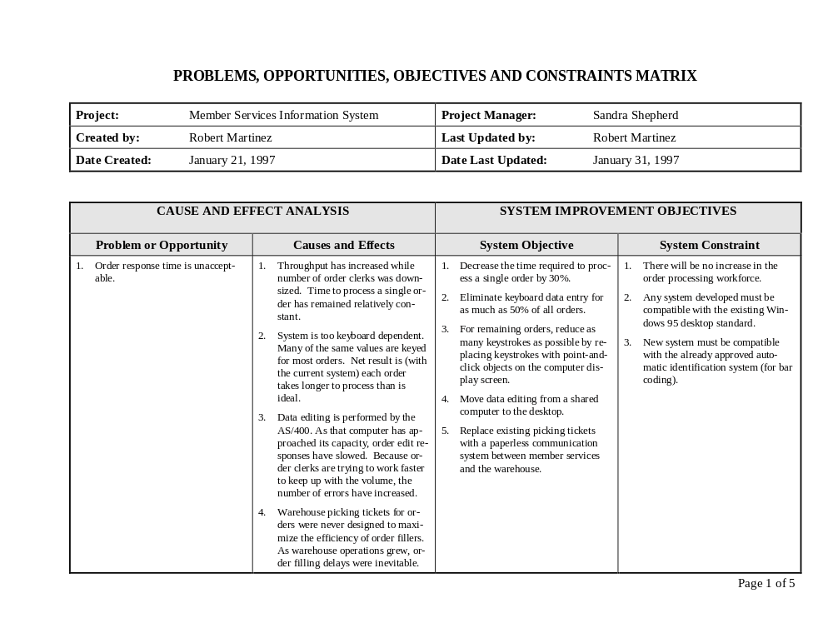

Notes:
Figure 4.12 Cause-Effect Analysis
No additional notes provided.
144

Slide 75
The Study Phase of Systems Analysis
Activity: Analyze Problems and Opportunities
  Applicable Techniques:
    Fact Finding – Fact finding skills are necessary to both identify and analyze the problems and opportunities.
    Joint Application Development – The preferred technique for rapid problem analysis is Joint Application Development (JAD).
      The requisite analysis can usually be completed in one full-day session or less.
      The JAD facilitator must be especially skilled at conflict resolution because people tend to view problem analysis as personal criticism.
Notes:
No additional notes provided.
144-145

Slide 76
The Study Phase of Systems Analysis
Activity: Analyze Problems and Opportunities
  Applicable Techniques:
    Interpersonal Skills – This activity can easily generate controversy and conflict. Good interpersonal skills are necessary to maintain a focus on the problems, and not the personalities.
    Cause/Effect Analysis – Cause/effect analysis, when applied with discipline, can help the team avoid a premature concern with solutions.
Notes:
No additional notes provided.
145

Slide 77
The Study Phase of Systems Analysis
Activity: Analyze Problems and Opportunities
  Steps:
    The following steps are suggested to complete this activity:
      Step 1 - Review the problem statement completed in the survey phase.
      Step 2 - Collect facts and gather information about the perceived problems and opportunities in the current system.
        The preferred technique is JAD, but JAD sessions may be preceded or followed by traditional fact finding and information gathering activity.
      Step 3 - Analyze and document each problem and opportunity.
        The PIECES framework is most useful for cause/effect analysis.
Notes:
As you collect facts, note problems and limitations according to the PIECES categories. Remember, a single problem may be recorded into more than one category of PIECES. Also, don’t restrict yourself to only those problems and limitations noted by end-users. As the analyst, you may also identify potential problems! Next, for each problem, limitation, or opportunity, ask yourself the following questions and record answers to them.
What is causing the problem? What situation has led to this problem? Understanding why is not as important. Many current systems were never designed. They simply evolved. It is usually pointless to dwell on history. In fact, you should be careful not to insult system owners and users who may have played a role in how things evolved.
What are the negative effects of the problem or failure to exploit the opportunity? Learn to be specific. Don’t just say, excessive costs. How excessive? You don’t want to spend $20,000 to solve a $1,000 problem.
The effect sometimes identifies another problem. If so, repeat steps one and two.
Opportunities do not have causes. But they do have effects (and side effects) that will eventually have to be weighed against the cost of implementing the opportunity.
145

Slide 78
The Study Phase of Systems Analysis
Activity: Establish System Improvement Objectives and Constraints
  Success should be measured in terms of the degree to which objectives are met for the new system.
    An objective is a measure of success. It is something that you expect to achieve, if given sufficient resources.
    Objectives represent the first attempt to establish expectations for any new system.
  In addition to objectives, we must also identify any known constraints.
    A constraint is something that will limit your flexibility in defining a solution to your objectives. Essentially, constraints cannot be changed.
Notes:
Given our understanding of the current system’s scope, problems, and opportunities, we can now establish system improvement objectives.
145-146

Slide 79
The Study Phase of Systems Analysis
Activity: Establish System Improvement Objectives and Constraints
  Purpose:
    The purpose of this activity is to establish the criteria against which any improvements to the system will be measured, and to identify any constraints that may limit flexibility in achieving those improvements.
Notes:
No additional notes provided.
146

Slide 80
The Study Phase of Systems Analysis
Activity: Establish System Improvement Objectives and Constraints
  Roles:
    Project manager or systems analyst - facilitator
    System owner roles:
      user managers
      project manager
    System user roles:
      (optional) business analyst
      other user experts as necessary to fully analyze the problems and opportunities
    System analyst roles:
      systems analyst
Notes:
User managers – the manager(s) of the organizational units most likely to be supported by the system developed in this project.
Project manager – the information systems unit manager who will directly manage the project team. This is usually a senior systems analyst.
Business analysts – an analyst(s) who is (are) on loan from the user community to the information systems unit (applicable only to organizations who practice this concept)
System analyst – systems analysts who are skilled in the formulation and documentation of objectives and constraints.
146

Slide 81
The Study Phase of Systems Analysis
Activity: Establish System Improvement Objectives and Constraints
  Roles:
    System designer roles are not typically involved in this activity unless deemed appropriate by a system owner.
    System builder roles are not typically involved in this activity unless deemed appropriate by a system owner.
  Prerequisites (Inputs):
    This activity is triggered by the completion of the two previous activities.
    The inputs are the system models and the cause/effect analysis.
      Together, they define the context for establishing objectives and constraints.
Notes:
No additional notes provided.
146

Slide 82
The Study Phase of Systems Analysis
Activity: Establish System Improvement Objectives and Constraints
  Deliverables (Outputs):
    The deliverable of this activity is system improvement objectives and constraints.
    This deliverable also corresponds to the net deliverable of the study phase, system objectives.
Notes:
Objectives should be precise, measurable statements of business performance that define the expectations for the new system. Some examples might include the following:
Reduce the number of uncollectible customer accounts by 50 percent within the next year.
Increase by 25 percent the number of loan applications that can be processed during an eight-hour shift.
Decrease by 50 percent the time required to reschedule a production lot when a workstation malfunctions.
The following is an example of a poor objective:
Create a delinquent accounts report.
Reference figure 4.12 for additional examples.
146-147

Slide 83
The Study Phase of Systems Analysis
Activity: Establish System Improvement Objectives and Constraints
  Applicable Techniques:
    Joint Application Development – The preferred technique for rapid problem analysis is Joint Application Development (JAD).
      The requisite brainstorming can usually be completed in one full-day session or less.
    Benefit Analysis – Whenever possible, objectives should be stated in terms that can be measured.
    Interpersonal Skills – This activity can easily generate controversy and conflict. Good interpersonal skills are necessary to maintain a focus on what’s best for the organization.
Notes:
No additional notes provided.
147

Slide 84
The Study Phase of Systems Analysis
Activity: Establish System Improvement Objectives and Constraints
  Steps:
    The following steps are suggested to complete this activity:
      Step 1 - Review scope and problem analyses from the prior activities.
      Step 2 - Negotiate business-oriented objectives to solve each problem and exploit each opportunity.
        Ideally, each objective should establish the way you will ‘measure’ the improvement over the current situation.
        Measures should be as tangible (measurable) as you can possibly make them.
Notes:
No additional notes provided.
147

Slide 85
The Study Phase of Systems Analysis
Activity: Establish System Improvement Objectives and Constraints
  Steps:
    The following steps are suggested to complete this activity: (continued)
      Step 3 - Brainstorm any constraints that ‘may’ limit your ability to fully achieve objectives.
        Use the four categories previously listed in this section (time, cost, technology, and policy) to organize your discussion.
Notes:
No additional notes provided.
147

Slide 86
The Study Phase of Systems Analysis
Activity: Modify Project Scope and Plan
  Purpose:
    The purpose of this activity is to reevaluate project scope, schedule, and expectations. The overall project plan is then adjusted as necessary, and a detailed plan is prepared for the next phase.
Notes:
Recall that project scope is a moving target. Based upon our initial understanding and estimates from the survey phase, it may have grown or diminished in size and complexity. (Note: Growth is much more common!) Now that we’re approaching the completion of the study phase, we should reevaluate project scope and revise the project plan accordingly. The systems analyst and system owner are the key individuals in this activity.
The analyst and system owner will consider the possibility that not all objectives may be met by the new system. Why? The new system may be larger than expected, and they may have to reduce the scope to meet a deadline. In this case the system owner will rank the objectives in order of importance. Then, if the scope must be reduced, the higher-priority objectives will tell the analyst what’s most important.
147-148

Slide 87
The Study Phase of Systems Analysis
Activity: Modify Project Scope and Plan
  Roles:
    Project manager - facilitator
    System owner roles:
      (optional) executive sponsor
      (optional) user managers
      (optional) system managers
      project manager
    System users are not typically involved in this activity unless deemed appropriate by the project manager.
    Systems analyst, system designer, and system builder roles are not typically involved in this activity unless deemed necessary by the project manager.
Notes:
Executive sponsor – It may be necessary to renegotiate scope, expectations, schedule, and budget with the executive sponsor.
User managers – User managers should also be involved any renegotiation of scope, expectations, and schedule.
System managers – System managers commit information services resources to projects; therefore, they need to be made aware of any scope, schedule, or budget changes.
148

Slide 88
The Study Phase of Systems Analysis
Activity: Modify Project Scope and Plan
  Prerequisites (Inputs):
    This activity is triggered by the completion of the system modeling, problem analysis, and objective definition activities.
    The system models, cause/effect analysis, and system improvement objectives and constraints are inputs for the activity.
    The original project plan from the survey phase (if available) is also an input.
  Deliverables (Outputs):
    The principle deliverable of this activity is a revised project plan. Additionally, a detailed definition phase plan may be produced.
Notes:
No additional notes provided.
148

Slide 89
The Study Phase of Systems Analysis
Activity: Modify Project Scope and Plan
  Applicable Techniques:
    Process Management. Process management defines the standards for applying the methodology to a project.
    Project Management. Project management builds on process management by applying the methodology to specific projects in the form of schedule planning, staffing and supervision, progress reporting, management of expectations, budgeting, and schedule management.
    Presentation Skills. The project charter and any verbal presentations of the project and plan obviously require presentation skills.
Notes:
No additional notes provided.
148

Slide 90
The Study Phase of Systems Analysis
Activity: Modify Project Scope and Plan
  Steps:
    The following steps are suggested to complete this activity:
      Step 1 - Review the original plan.
      Step 2 - Review the system models, problems and opportunities, causes/effect analyses, system improvement objectives, and scope. Ask yourself two questions:
        Has the scope of the project significantly expanded?
        Are the problems, opportunities, or objectives more difficult to solve than originally anticipated?
      Step 3 - Estimate time required for each project activity in the next phase – the definition phase.
Notes:
No additional notes provided.
148-149

Slide 91
The Study Phase of Systems Analysis
Activity: Modify Project Scope and Plan
  Steps:
    The following steps are suggested to complete this activity: (continued)
      Step 4 - If necessary, refine baseline estimates for the overall project plan.
      Step 5 - If necessary, renegotiate scope, schedule, and/or budget with the system owner group.
Notes:
No additional notes provided.
149

Slide 92
The Study Phase of Systems Analysis
Activity: Present Findings and Recommendations
  Purpose:
    The purpose of this activity is to communicate the project and goals to all staff. The report or presentation, if developed, is a consolidation of the activities’ documentation.
  Roles:
    Business Analyst - facilitator
    System owner roles:
      (optional) executive sponsor
      user managers
      system managers
      project manager
Notes:
As with the survey phase, the study phase findings and recommendations should be communicated to all affected personnel. The format may be a report, a verbal presentation, or an inspection by an auditor or peer group (called a walkthrough).
Executive sponsor – the highest-level manager who will pay for and support the project.
User managers – the manager(s) of the organizational units most likely to be supported by the system developed in this project.
System managers – the information systems unit manager(s) to whom the project manager report (e.g., the manager of systems development).
Project manager – the information systems unit manager who will directly manage the project team. This is usually a senior systems analyst.
Business analysts – an analyst(s) who is (are) on loan from the user community to the information systems unit (applicable only to organizations who practice this concept)
149

Slide 93
The Study Phase of Systems Analysis
Activity: Present Findings and Recommendations
  Roles:
    System user roles:
      business analysts
      all direct and indirect users
    System analysts:
      any system analysts assigned to the project
    System designers are not typically involved in this activity.
    System builders are not typically involved in this activity.
Notes:
No additional notes provided.
149

Slide 94
The Study Phase of Systems Analysis
Activity: Present Findings and Recommendations
  Prerequisites (Inputs):
    This activity is triggered by the completion of the system objectives or project plan activity.
    The inputs include the system models, the cause/effect analysis, the system improvement objectives and constraints, and the revised project plan generated by the prior activities.
  Deliverables (Outputs):
    The key deliverable of this activity is the detailed study findings. It usually includes a feasibility update and the revised project plan.
Notes:
No additional notes provided.
149

Slide 95
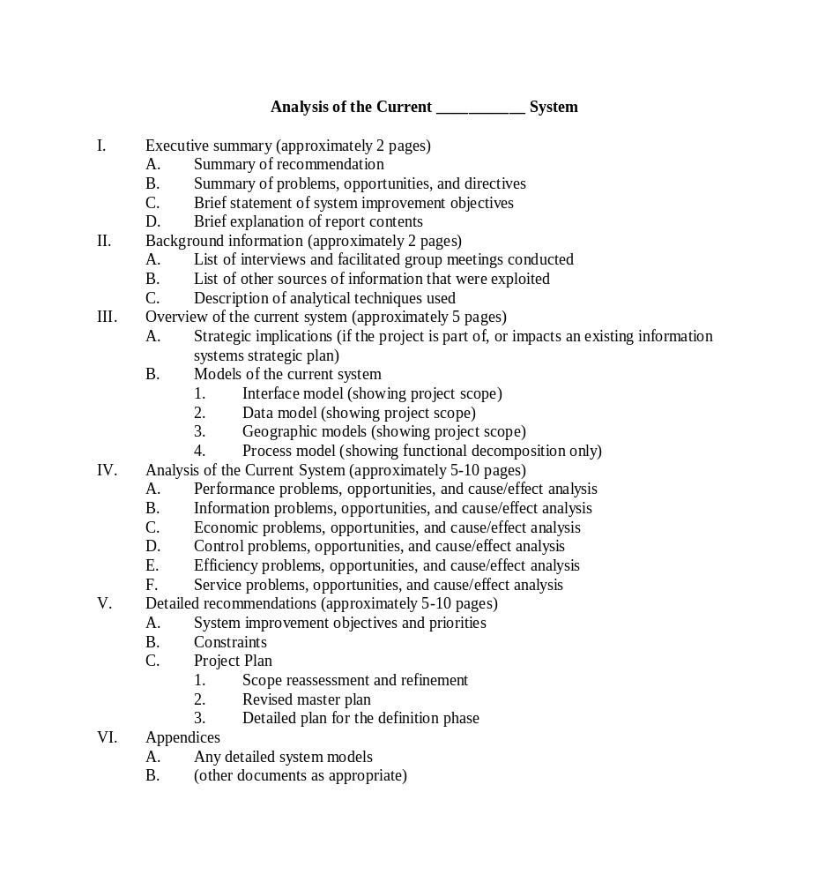

Notes:
Figure 4.13 Detailed Study Report Outline
No additional notes provided.
149-150

Slide 96
The Study Phase of Systems Analysis
Activity: Present Findings and Recommendations
  Applicable Techniques:
    Interpersonal Skills. Good interpersonal skills are essential to this activity. These include persuasion, sales (of ‘ideas’), writing, and speaking.
  Steps:
    The following steps are suggested to complete this activity:
      Step 1 - Review the deliverables of all prior activities.
      Step 2 - Write the detailed study findings.
Notes:
No additional notes provided.
150

Slide 97
The Study Phase of Systems Analysis
Activity: Present Findings and Recommendations
  Steps:
    The following steps are suggested to complete this activity:
      Step 3 - Present the findings to the system owners. Be prepared to defend recommendations, address issues and controversies, and answer questions. One of the following decisions must be made:
        Authorize the project to continue, as is, to the definition phase.
        Adjust the scope, cost, and/or schedule for the project and then continue to the definition phase.
        Cancel the project due to either (1) lack of resources to further develop the system, (2) realization that the problems and opportunities are simply not as important as anticipated, or (3) realization that the benefits of the new system are not likely to exceed the costs.
      Step 4 - Present findings to all affected staff.
Notes:
No additional notes provided.
150

Slide 98
The Definition Phase of Systems Analysis
Introduction
  The definition phase answers the question, ‘What does the user need and want from a new system?’
  The definition phase can never be skipped.
Notes:
Many analysts make a critical mistake after completing the study of the current information system. The temptation at that point is to begin looking at alternative solutions, particularly technical solutions. The most frequently cited error in new information systems is illustrated in the statement,
“Sure the system works, and it is technically impressive, but it just doesn’t do what we wanted (or needed) it to do.”
Did you catch the key word? The key word is ‘what.’ Analysts are frequently so preoccupied with the technical solution that they inadequately define the business requirements for that solution. The definition phase answers the question, ‘What does the user need and want from a new system?’ The definition phase is critical to the success of any new information system! In different methodologies the definition phase might be called the requirements analysis or logical design phase.
Can you ever skip the definition phase? Absolutely not! New systems will always be evaluated, first and foremost, on whether or not they fulfilled business objectives and requirements regardless of how impressive or complex the technological solution might be!
151

Slide 99
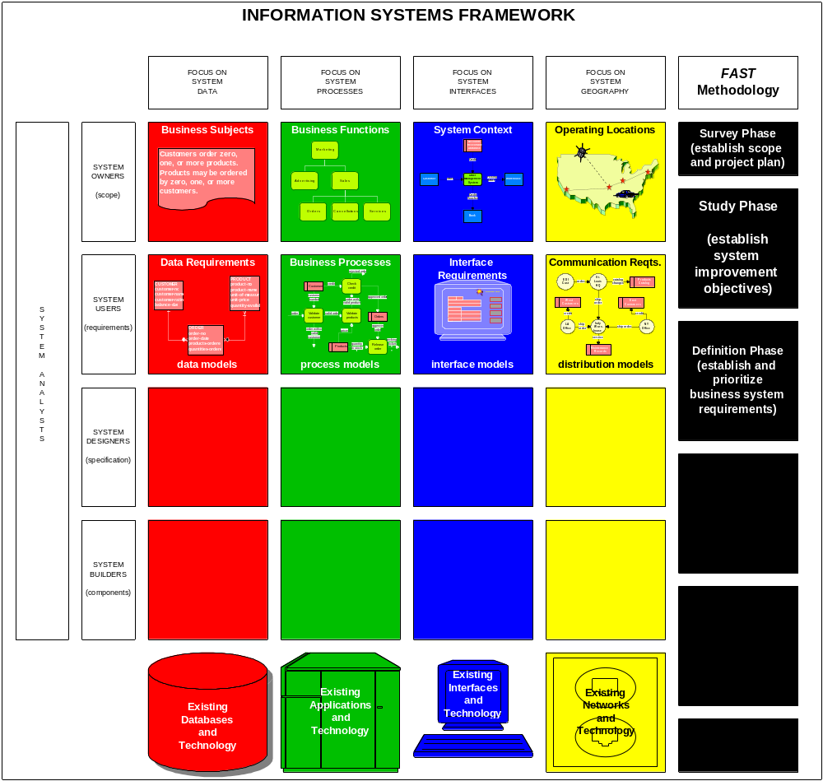

Notes:
Figure 4.14 Building Blocks for the Definition Phase
In the figure above, notice that we are still concerned with the system users’ perspectives. Also notice that for most of the building blocks, it is possible to draw graphical models to document the requirements for a new and improved system. This information represents the system users’ view of the new application’s requirements.
151-152

Slide 100

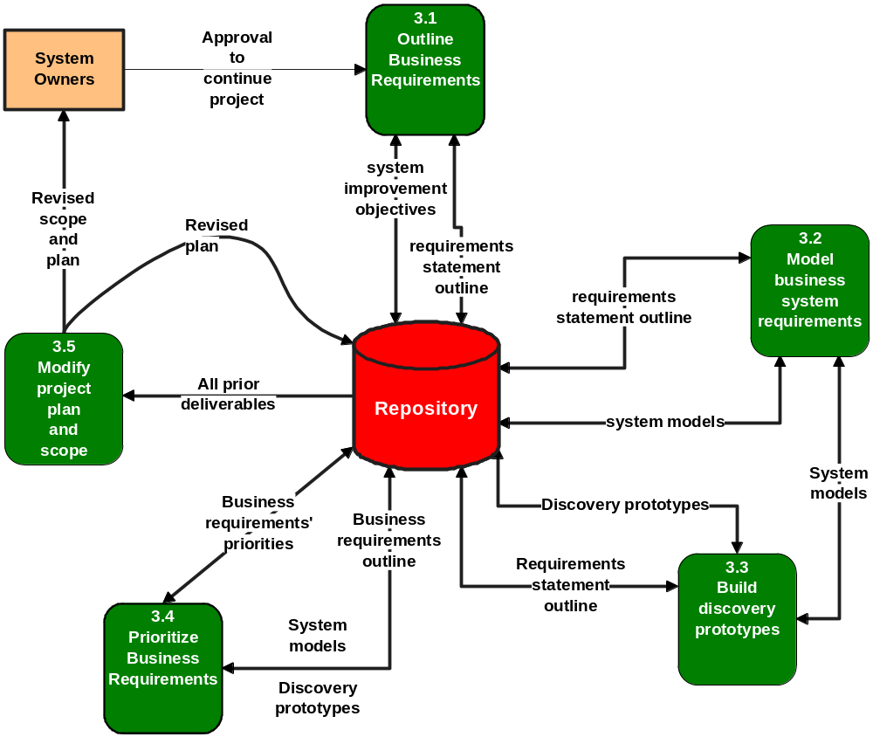
Notes:
Figure 4.15 Activity Diagram for the Definition Phase
No additional notes provided.
151,153

Slide 101
The Definition Phase of Systems Analysis
Activity: Outline Business Requirements
  Purpose:
    The purpose of this activity is to identify, in general terms, the business requirements for a new or improved information system. A classic input-process-output framework should prove sufficient to structure the activity.
Notes:
The initial activity of the definition phase is to outline business requirements. Effective writers ‘outline’ their publications. This activity serves the same purpose. The foundation for this activity was established in the study phase when we identified system improvement objectives. This activity translates those objectives into inputs, outputs, and processes that will be specified in greater detail during subsequent activities. Rarely will this activity identify all the business requirements – no more than an initial outline for a written publication will include all headings and subheadings for a final publication. But the outline will frame your thinking as you proceed. Neither completeness nor perfection is a goal. The entire activity can be completed in as little as an hour.
151

Slide 102
The Definition Phase of Systems Analysis
Activity: Outline Business Requirements
  Roles:
    Business analyst or systems analyst - facilitator
    System owner roles:
      user managers
      (optional) project manager
    System user roles:
      business analyst
      (optional) appropriate direct and indirect users
    System designers are not typically involved in this activity.
    System builders are not typically involved in this activity.
Notes:
User managers –user managers played a key role in defining system improvement objectives. In this activity, they are especially helpful in identifying the outputs (information) to be produced by a system.
Business analysts – Because business analysts are actually users on loan from the business community, they are well suited to the task of identifying high-level requirements, especially the inputs and processes required in the system.
Appropriate direct and indirect users – be careful! If too many users are involved in this activity, the team can easily become overly preoccupied with details.
151-152

Slide 103
The Definition Phase of Systems Analysis
Activity: Outline Business Requirements
  Prerequisites (Inputs):
    This activity is triggered by approval from the system owners to continue the project into the definition phase.
    The key input is the system improvement objectives from the study phase.
    Any and all relevant information from the study phase should be available for reference as needed.
Notes:
No additional notes provided.
153

Slide 104
The Definition Phase of Systems Analysis
Activity: Outline Business Requirements
  Deliverables (Outputs):
    The only deliverable of this activity is a requirements statement outline.
      In its simplest format, the outline could be divided into four logical sections:
        (1) the original list of objectives,
        (2) inputs,
        (3) processes, and
        (4) outputs.
Notes:
According to our information system framework, appropriate current system models may include:
DATA – A one-page data model is very useful for establishing business vocabulary, rules, and policies.
PROCESSES –Today, it is widely accepted that a one- or two-page functional decomposition diagram should prove sufficient to get a feel for the current system processing.
INTERFACES – A one-page context diagram is useful for clarifying the system’s inputs and outputs with other systems, organizations, and departments.
GEOGRAPHY – A one-page geographic model adequately identifies current operating locations that are relevant to the system.
153

Slide 105
The Definition Phase of Systems Analysis
Activity: Outline Business Requirements
  Applicable Techniques:
    Joint Application Development – The preferred technique for rapidly outlining business system requirements is joint application development (JAD).
      The requisite analysis can usually be completed in less than one-half a working day.
    Interpersonal Skills –Good interpersonal skills are necessary to maintain a focus on the requirements.
Notes:
No additional notes provided.
153

Slide 106
The Definition Phase of Systems Analysis
Activity: Outline Business Requirements
  Steps:
    The following steps are suggested to complete this activity:
      Step 1 - Review and refine the system improvement objectives.
      Step 2 - For each objective:
        Identify and document any business events or inputs to which the system must respond. Briefly define each event or input, but do not define the specific data content of any input.
        Identify and document any special business policies, processing, or decisions that must be made to adequately respond to each event or input.
        Identify and document the normal business outputs or responses to the aforementioned business events or inputs.
        Identify and document any information that must be produced or made available.
Notes:
No additional notes provided.
153-154

Slide 107
The Definition Phase of Systems Analysis
Activity: Outline Business Requirements
  Steps:
    The following steps are suggested to complete this activity: (continued)
      Step 3 - Compare the system improvement objectives and requirements against the original problem statements from the study phase.
        Are you still solving the original problems or is the scope of the project growing?
        Increased scope is not necessarily wrong; however, an appropriate adjustment of expectations (particularly schedule and budget) my eventually become necessary.
Notes:
No additional notes provided.
154

Slide 108
The Definition Phase of Systems Analysis
Activity: Model Business System Requirements
  The best systems analysts can develop models that provide no hint of how the system will or might be implemented. This is called logical or essential system modeling.
    Logical models depict what a system is, or what a system must do – not ‘how’ the system will be implemented. Because logical models depict the essence of the system, they are sometimes called essential models.
    Logical models express business requirements – sometimes referred to as the logical design.
Notes:
Identifying requirements is only the tip of the iceberg. We must also find a way to express the requirements such that they can be verified and communicated to both business and technical audiences. Technicians must understand requirements so they can transform them into appropriate technical solutions. Business users must understand requirements so they can prioritize the needs and justify the expenditures for any technical solution. Best current practice suggests that we model business system requirements. Recall that system models are pictures (similar to flowcharts) that express requirements or designs.
154

Slide 109
The Definition Phase of Systems Analysis
Activity: Model Business System Requirements
    By focusing on the logical design of the system, the project team will:
      (1) appropriately separate business concerns from their technical solutions,
      (2) be more likely to conceive and consider new and different ways to improve business processes, and
      (3) be more likely to consider different, alternative technical solutions (when the time comes for physical design).
  Purpose:
    The purpose of this activity is model business system requirements such that they can be verified by system users, and subsequently understood and transformed by system designers into a technical solution.
Notes:
No additional notes provided.
154

Slide 110
The Definition Phase of Systems Analysis
Activity: Model Business System Requirements
  Roles:
    Systems analyst - facilitator
    System owner roles:
      user managers
      project manager
    System user roles:
      business analyst
      appropriate direct and indirect users
    System analysts roles:
      system architect
Notes:
No additional notes provided.
154-155

Slide 111
The Definition Phase of Systems Analysis
Activity: Model Business System Requirements
  Roles:
    System designers are not recommended since they tend to talk in technical terms that intimidate and frustrate the users and user managers.
    System builders are not typically involved in this activity. On the other hand, programmers who are skilled in user interface construction might be invited to observe the activity as a preface to constructing rapid prototypes of user interfaces for later activities.
Notes:
No additional notes provided.
155

Slide 112
The Definition Phase of Systems Analysis
Activity: Model Business System Requirements
  Prerequisites (Inputs):
    This activity is usually triggered by completion of the requirements statement outline.
  Deliverables (Outputs):
    The deliverable of this activity are the system models.
      Data models are used to model the data requirements for many new systems.
      Process models are frequently used to model the work flow through business systems.
Notes:
Because system modeling is a mature technique, there may already exist many system models or templates in the corporate repository. These models may be very general or very detailed, depending on their source.
It is also possible to reverse engineer some system models directly from existing databases and program libraries. The resulting models tend to be very physical, meaning technology-oriented. The systems analyst would need to translate those physical system models into logical system models.
155

Slide 113
The Definition Phase of Systems Analysis
Activity: Model Business System Requirements
  Deliverables (Outputs):
    The deliverable of this activity are the system models. (continued)
      Interface Models such as context diagrams, depict net inputs to the system, their sources, net outputs from the system, their destinations, and shared databases.
      Distribution models serve as a starting point for designing the communication systems for distributing the data, processes, and interfaces to the various geographical locations.
Notes:
Most system analysts use Computer-Aided Systems Engineering (CASE) software to construct and maintain system models and their underlying documentation.
155

Slide 114
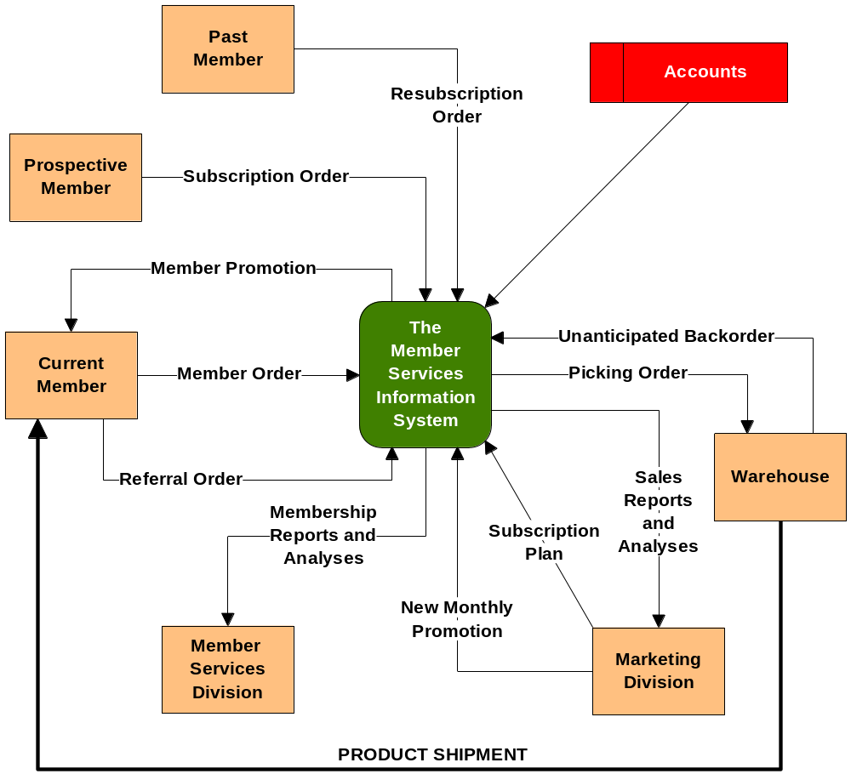
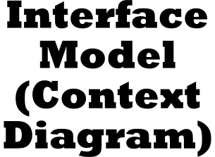
Notes:
Figure 4.16 Interface Model (also Called a Context Diagram)
No additional notes provided.
155-156

Slide 115
The Definition Phase of Systems Analysis
Activity: Model Business System Requirements
  Applicable Techniques:
    Data Modeling – Data modeling the most popular technique for expressing the business requirements for data that will be stored in a system’s database.
    Process Modeling – Arguably, process modeling is the oldest and most widely practiced technique for expressing both business process requirements, work flow, inputs, and outputs.
    Distribution Modeling – Distribution modeling is used to express the business geography to be supported by a system.
    Object Modeling – Object modeling is being driven by the growing use of object technology and object-oriented analysis methods to exploit that technology.
Notes:
No additional notes provided.
156

Slide 116
The Definition Phase of Systems Analysis
Activity: Model Business System Requirements
  Applicable Techniques:
    Fact Finding – You can’t build models without facts. These techniques are taught in Part Five, Module B, Fact Finding and Information Gathering.
    Joint Application Development – JAD has become the most popular technique for quickly constructing system models in direct cooperation with system owners and system users. JAD techniques merge the model construction and verification into the same meetings to accelerate the project.
Notes:
No additional notes provided.
156-157

Slide 117
The Definition Phase of Systems Analysis
Activity: Model Business System Requirements
  Steps:
    The following steps are suggested to complete this activity:
      Step 1 - Review the system improvement objectives and requirements statement outline.
      Step 2 - Collect or retrieve any system models that may have been developed in prior projects.
      Step 3 - (optional) If the appropriate CASE technology is available, consider reverse engineering existing databases or applications into physical system models. Then translate those physical models into more business-friendly logical system models.
      Step 4 - Draw the interface model.
        The interface model establishes the scope and boundary for the entire project.
Notes:
High-level system models may have been created as part of an information strategy planning project or business process redesign project. Detailed models may have been created as part of prior application development projects. In either case, existing models are typically stored in the corporate repository. Many organizations have formal checkout/check in procedures for using and updating existing system models.
157

Slide 118
The Definition Phase of Systems Analysis
Activity: Model Business System Requirements
  Steps:
    The following steps are suggested to complete this activity: (continued)
      Step 5a - If you practice structured analysis:
        Construct and verify the process models.
        Construct and verify data models.
        Synchronize process and data models. This synchronization ensures that the models are consistent and compatible with one another.
        Construct and verify distribution models.
Notes:
No additional notes provided.
157

Slide 119
The Definition Phase of Systems Analysis
Activity: Model Business System Requirements
  Steps:
    The following steps are suggested to complete this activity: (continued)
      Step 5b - If you practice information engineering :
        Construct and verify data models.
        Construct, verify, and synchronize the process models.
        Construct and verify the distribution models.
      Step 5c - If you practice object-oriented analysis:
        Identify use-cases. Use-cases are an object method that connects objects to familiar business events. Use-cases are taught in the object modeling chapter.
        Construct and verify object models. Several popular object model standards exist.
Notes:
No additional notes provided.
157

Slide 120
The Definition Phase of Systems Analysis
(optional) Activity: Build Discovery Prototypes
  An alternative or complementary approach to system modeling of business requirements is to build discovery prototypes.
    Prototyping is the act of building a small-scale, representative, or working model of the users’ requirements for purposes of discovering or verifying the users’ requirements.
  Prototyping is typically used in the requirements definition phase to establish user interface requirements.
  User interface prototypes are often called discovery prototypes.
    Discovery prototypes are simple mock-ups of screens and reports that are intended to help systems analysts discover requirements. The discovered requirements would normally be added to system models. A synonym is requirements prototypes.
Notes:
No additional notes provided.
157-158

Slide 121
The Definition Phase of Systems Analysis
(optional) Activity: Build Discovery Prototypes
  Prototypes are developed using fourth generation languages (4GLs), most of which include rapid application development (RAD) facilities for quickly ‘painting’ screens, forms, and reports.
  Purpose:
    The purpose of this optional activity is to:
      establish user interface requirements, and
      discover detailed data and processing requirements interactively with users through the rapid development of sample inputs and outputs.
Notes:
Although discovery prototyping is optional, it is frequently applied to systems development projects, especially in those cases when the parties involved are having difficulty developing or completing system models. The philosophy is that the users will recognize their requirements when they see them.
Prototypes are developed using fourth generation languages (4GLs), most of which include rapid application development (RAD) facilities for quickly ‘painting’ screens, forms, and reports. Examples of such languages include Powerbuilder and Focus; however, most third generation languages are evolving to include the same RAD facilities (e.g., Visual BASIC and Delphi – which is based on Pascal). Furthermore, most PC-based database management systems now include rapid application development facilities that can be used to prototype inputs and outputs (e.g., Access, Visual dBASE, and Paradox).
158

Slide 122
The Definition Phase of Systems Analysis
(optional) Activity: Build Discovery Prototypes
  Roles:
    Business analyst or systems analyst- facilitator
    System owners usually do not elect to participate unless they are also system users.
    System user roles:
      business analyst
      direct system users
    Systems analyst roles – systems analysts facilitate, observe, and assist this activity. It should be recognized that many systems analysts have the skills necessary to play the system designer and builder roles described below.
Notes:
No additional notes provided.
158

Slide 123
The Definition Phase of Systems Analysis
(optional) Activity: Build Discovery Prototypes
  Roles:
    System designer roles:
      (optional) user interface specialist
    System builders roles:
      prototyper
      (optional) programmer
Notes:
User interface specialist – if prototypes are to evolve into the final system, a user interface specialist is suggested. User interface specialists are system designers who have become skilled in the standards or guidelines of a particular graphical user interface (such as MacOS or Windows 95). They are also responsible of local interface standards that ensure that all internally developed applications exhibit the same look and feel.
Prototyper – this is a systems analyst or programmer who is skilled in the use of rapid application development (RAD) technology for the purpose of developing discovery prototypes.
Programmer – it is not the purpose to write complete application programs at this stage of the project; however, the current trend is toward using the same prototyping languages to rapidly complete the development of the applications. Consequently, programmers may get useful insights from observing this activity.
158

Slide 124
The Definition Phase of Systems Analysis
(optional) Activity: Build Discovery Prototypes
  Prerequisites (Inputs):
    This activity is not triggered by any event.
    It uses the system requirements outline and any system models as they are developed.
  Deliverables (Outputs):
    The deliverable of this activity are discovery prototypes of selected inputs and outputs.
Notes:
This activity is not triggered by any event. It occurs, as deemed appropriate or desirable, during the system modeling activity. Thus, it occurs in parallel with system modeling.
These prototypes are shared with the system modeling activity since they can be very helpful in refining the system models. The models are also stored in the repository since they can eventually evolve into the final, production system.
158-159

Slide 125
The Definition Phase of Systems Analysis
(optional) Activity: Build Discovery Prototypes
  Applicable Techniques:
    Prototyping – Prototyping is predominantly considered to be a design technique because it is based on design and construction of actual program components.
    Technology – The actual use of prototyping will require an investment in learning the technology to be used. Fortunately, most of today’s visual programming languages are easy to learn and use as prototyping tools.
      (Note – It will take a much greater knowledge of these languages to complete the application’s development beyond the prototype.)
Notes:
No additional notes provided.
159

Slide 126
The Definition Phase of Systems Analysis
(optional) Activity: Build Discovery Prototypes
  Steps:
    The following steps are suggested to complete this activity:
      Step 1 - Review the system improvement objectives and requirements statement outline.
      Step 2 - Study any system models that may have been developed.
      Step 3 - (optional) Working directly with system users, construct a simple, single-user prototype of the database and load it with some sample data. Do not become preoccupied with data editing and perfection.
      Step 4 - Working directly with the system users, construct input prototypes for each business event. Do not worry about input editing, system security, etc. – the focus is completely on business requirements. Do not spend too much time on any one input since this stage does not develop the final system.
Notes:
No additional notes provided.
159

Slide 127
The Definition Phase of Systems Analysis
(optional) Activity: Build Discovery Prototypes
  Steps:
    The following steps are suggested to complete this activity:
      Step 5 - Working directly with system users, construct output prototypes for each business output. Do not worry about whether the data is real or whether or not it makes sense. Focus on identifying the columns, totals, and graphs the users are seeking.
        If you built a sample database in step 3, and used step 4 to collect data for that database, you can probably use that database prototype to quickly generate sample reports.
      Step 6 - Return to the system modeling activity to formalize the requirements that have been discovered through the above prototyping steps.
Notes:
No additional notes provided.
159

Slide 128
The Definition Phase of Systems Analysis
Activity: Prioritize Business Requirements
  Prioritization of business requirements also enables a popular technique called timeboxing.
    Timeboxing is a technique which develops larger fully functional systems in versions. The development team selects the smallest subset of the system that, if fully implemented, will return immediate value to the system owners and users. That subset is developed, ideally with a time frame of 6-9 months or less. Subsequently, value-added versions of the system are developed in similar time frames.
  Purpose:
    The purpose of this activity is to prioritize business requirements for a new system.
Notes:
We stated earlier that the success of a systems development project can be measured in terms of the degree to which business requirements are met. But actually, all requirements are not equal. If a project gets behind schedule or over budget, it may be useful to recognize which requirements are more important than others. Systems can be built in versions. Early versions should deliver the most important requirements.
Thus, given the proposed system requirements, models, and prototypes defined earlier, the systems owner and systems analyst should prioritize business requirements. The actual priorities should be specified jointly by the system owners and users.
It is not the intent of this activity to eliminate any business requirement – only to recognize that some requirements can be implemented later than others.
159-160

Slide 129
The Definition Phase of Systems Analysis
Activity: Prioritize Business Requirements
  Roles:
    Business analyst or project manager - facilitator
    System owner roles:
      (optional) executive sponsor
      user managers
      project manager
    System user roles:
      business analyst
      appropriate direct and indirect users
Notes:
Executive Sponsor – most executive sponsors will empower their user managers (below) to make these decisions.
User Managers – the reason should be obvious. If management strongly disagrees with priorities, the project could lose support.
Business analyst – a great choice for facilitator of this activity since business analysts come from the user community and have the trust of that community.
160

Slide 130
The Definition Phase of Systems Analysis
Activity: Prioritize Business Requirements
  Roles:
    Good system analysts listen to discussion and answer questions during this activity. User ‘buy-in” to priorities is critical to the political feasibility of any new system if a systems analyst or project manager facilitates this activity.
    System designers are not typically involved in this activity because they tend to influence priorities for technical, non-business reasons.
    System builders are not typically involved in this activity.
Notes:
No additional notes provided.
160

Slide 131
The Definition Phase of Systems Analysis
Activity: Prioritize Business Requirements
  Prerequisites (Inputs):
    This activity can begin in parallel with the other definition phase activities.
    The inputs are business requirements as expressed in the updated business requirements outline, system models, and discovery prototypes.
  Deliverables (Outputs):
    The deliverable of this activity are business requirements’ priorities as recorded in the repository.
Notes:
While some priorities can be established as requirements are established, the priorities can never be finalized until all of the business requirements have been identified.
160

Slide 132
The Definition Phase of Systems Analysis
Activity: Prioritize Business Requirements
  Applicable Techniques:
    There are no special techniques for prioritizing requirements.
  Steps:
    The following steps are suggested to complete this activity:
      Step 1 - For each system input and output, categorize it as mandatory, optional, or desirable.
      Step 2 - For each desirable requirement above, rank it with respect to the other desirable requirements. Make note of any dependencies that exist between requirements.
      Step 3 - For each optional requirement, rank it with respect to the other optional requirements. Make note of any dependencies that exist between requirements.
Notes:
A simple but effective technique is described as follows:
Is the business requirement mandatory? In other words, is it something that the system owner must have? Careful! There is a temptation to label too many requirements as mandatory. By definition, if a system does not include a mandatory requirement, that system cannot fulfill its purpose. Perform the following test on any suspected mandatory requirements: Rank them. If you can rank them, they are not mandatory. Why? Because you should not be able to rank requirements that you absolutely must have! All mandatory requirements are essential to the first version of the system!
Is the business requirement desirable but not essential? Desirable requirements are things the user eventually wants; however, the early versions of the system can provide value without them. Unlike mandatory requirements, desirable requirements can and should be ranked.
Is the business requirement optional? This is a catch-all category for those features and capabilities that you could live without indefinitely. Although these would be nice to have, they are not really requirements. These requirements can also be ranked.
The priorities resulting from this analysis will allow the system owner and systems analyst to make intelligent decisions if cost and schedule become constrained.
160-161

Slide 133
The Definition Phase of Systems Analysis
Activity: Prioritize Business Requirements
  Steps:
    The following steps are suggested to complete this activity:
      Step 4 - (optional) Define system versions. A recommended scheme follows:
        Version one consists of all mandatory requirements.
        Versions two through X consist of logical groupings of desirable requirements.
        Optional requirements are usually added to versions as time permits, or deferred to maintenance releases of the system. Many such requirements are for new reports.
Notes:
No additional notes provided.
161

Slide 134
The Definition Phase of Systems Analysis
Activity: Modify the Project Plan and Scope
  Purpose:
    The purpose of this activity is to:
      modify the project plan to reflect changes in scope that have become apparent during requirements definition, and
      secure approval to continue the project into the next phase.
        (Note: Work may have already started on the configuration or design phases; however, the decisions still require review.)
Notes:
Here again, recall that project scope is a moving target. Now that we’ve identified business system requirements, we should step back and redefine our understanding of the project scope and adapt our project plan accordingly. The team must consider the possibility that the new system may be larger than originally expected. If so, they must adjust the schedule, budget, or scope accordingly.
161

Slide 135
The Definition Phase of Systems Analysis
Activity: Modify the Project Plan and Scope
  Roles:
    Project Manager - facilitator
    System owner roles:
      executive sponsor
      user managers
      project manager
    System user roles:
      (optional) business analyst
    Other system analysts are not usually involved in this activity
Notes:
Executive Sponsor – As the final spending authority, the sponsor must approve project continuation.
User Managers – The system belongs to these managers; therefore, their input is crucial.
Project Manager – The project manager must make any changes to the schedule and budget.
161-162

Slide 136
The Definition Phase of Systems Analysis
Activity: Modify the Project Plan and Scope
  Roles:
    System designer roles:
      database administrator
      network administrator
      application administrator
    System builders are not involved in this activity.
Notes:
Database administrator – Given the data model, the database administrator will reassess time to design and implement the database.
Network administrator – Given the geographic model, the network administrator will reassess the time to design, expand, or implement the network.
Application administrator – Given the process and data, or object models, the application administrator will reassess the time to design, construct, and implement the application programs.
162

Slide 137
The Definition Phase of Systems Analysis
Activity: Modify the Project Plan and Scope
  Prerequisites (Inputs):
    This activity is triggered by initial completion of the system models, discovery prototypes, and the business requirements priorities.
  Deliverables (Outputs):
    The deliverable of this activity is a revised project plan that covers the remainder of the project.
      Additionally, a detailed configuration plan and design plan could be produced.
Notes:
No additional notes provided.
162

Slide 138
The Definition Phase of Systems Analysis
Activity: Modify the Project Plan and Scope
  Applicable Techniques:
    Process Management. Process management defines the standards for applying the methodology to a project.
    Project Management. Project management builds on process management by applying the methodology to specific projects in the form of schedule planning, staffing and supervision, progress reporting, management of expectations, budgeting, and schedule management.
    Presentation Skills. The project charter and any verbal presentations of the project and plan obviously require presentation skills.
Notes:
No additional notes provided.
162

Slide 139
The Definition Phase of Systems Analysis
Activity: Modify the Project Plan and Scope
  Steps:
    The following steps are suggested to complete this activity:
      Step 1 - Review the original plan.
      Step 2 - Review the up-to-date business requirements outline, system models, discovery prototypes, and business requirements’ priorities. Ask yourself two questions:
        Has the scope of the project significantly expanded?
        Are the requirements more substantial than originally anticipated?
      Step 3 - Estimate time required for each project activity in the next phase – the definition phase.
      Step 4 - If necessary, refine baseline estimates for the overall project plan.
Notes:
No additional notes provided.
162

Slide 140
The Definition Phase of Systems Analysis
Activity: Modify the Project Plan and Scope
  Steps:
    The following steps are suggested to complete this activity:
      Step 5 - (optional) If the answer is yes, renegotiate scope, schedule, and/or budget with the system owner group.
Notes:
No additional notes provided.
162

Slide 141
The Definition Phase of Systems Analysis
Some Final Words about System Requirements
  A consolidation of all system models, discovery prototypes, and supporting documentation is sometimes called a requirements statement.
    All elements of the requirements statement are stored in the repository, but most systems analysts find it useful to keep a printed copy of that documentation for reference and reporting.
Notes:
Finally, the definition phase is now complete – or is it? It was once popular to freeze the business requirements prior to beginning the system design and construction phases. But today’s economy has become increasingly fast paced. Businesses are measured on their ability to adapt to rapidly changing requirements and opportunities. Information systems can be no less responsive. FAST does not freeze the requirements statement. Nor does the methodology call for a gala presentation of requirements to the business community. Such an event might be construed to impart a false sense of completeness or perfection. No, the definition phase does not end with a bang. It quietly and efficiently transitions into the configuration and design phases. As new business requirements come up, they will be acknowledged and documented in the system models and repository. But they will also be carefully assessed to determine their impact on scope, schedule, and budget. System owners, when promptly supplied with new information, will ultimately decide whether the new requirements are mandatory, desirable, or optional; and then make the decision on their inclusion.
163

Slide 142
The Next Generation of Requirements Analysis
Some predictions:
  CASE technology will continue to improve making it easier to model system requirements. Two CASE technologies will lead the charge.
    CASE tools will include object modeling to support emerging object-oriented analysis techniques.
    CASE tools that support reverse engineering technology will improve our ability to more quickly generate first draft system models from existing databases and application programs.
  CASE technology and RAD technology will continue to complement one another.
Notes:
No additional notes provided.
163-164

Slide 143
The Next Generation of Requirements Analysis
Some predictions:
  Object-oriented analysis is poised to eventually replace structured analysis and information engineering as the methods of choice.
  Process modeling will still be required because of business process redesign projects.
Notes:
No additional notes provided.
163-164

Slide 144
Summary
Introduction
What is System Analysis?
Strategies for Systems Analysis and Problem Solving
The Survey Phase of Systems Analysis
The Study Phase of Systems Analysis
The Definition Phase of Systems Analysis
The Next Generation of Requirements Analysis
Notes:
118-164

