Slide 1
Introduction
The chapter will address the following questions:
  What is the systems design process in terms of the configuration, procurement, and design and integration phases of the life cycle.
  What are the configuration, procurement, and design and integration phases in terms of your information building blocks.
  What are the configuration, procurement, and design and integration phases in terms of purpose, activities, roles, inputs and outputs, techniques, and steps.
  What the traditional and prototyping approaches to systems design.
Notes:
In this lecture you will learn more about the design phases in the FAST systems development methodology: configuration, procurement, and design and integration phases.
310

Slide 2
What is System Design?
What is Systems Design?
  Systems design is the evaluation of alternative solutions and the specification of a detailed computer-based solution. It is also called physical design.
  Systems analysis primarily focused on the logical, implementation-independent aspects of a system (the requirements).
  Systems design deals with the physical or implementation-dependent aspects of a system (the system's technical specifications).
Notes:
Relative to the information building blocks, systems design addresses People, Data, Interfaces, Processes, and Geography from the system designer's perspective. What about the Technology building block? Often, that technology is in place, or specified by a predefined technology architecture (perhaps from systems planning). In other cases, the analyst must select or supplement the technology. In all cases, systems design builds on the knowledge derived from systems planning and systems analysis.
Most of us place too restrictive a definition on the process of design. We envision ourselves drawing blueprints of the computer-based systems to be programmed and developed by ourselves or our own programmers. Thus, we design inputs, outputs, files, databases, and other computer components. Recruiters of computer-educated graduates refer to this restrictive definition as the ``not-invented-here syndrome.'' In reality, many companies purchase more software than they write in-house. That shouldn't surprise you. Why reinvent the wheel? Many systems are sufficiently generic that computer vendors have written adequate -- but rarely, if ever, perfect -- software packages that can be bought and possibly modified to fulfill end-user requirements.
312

Slide 3
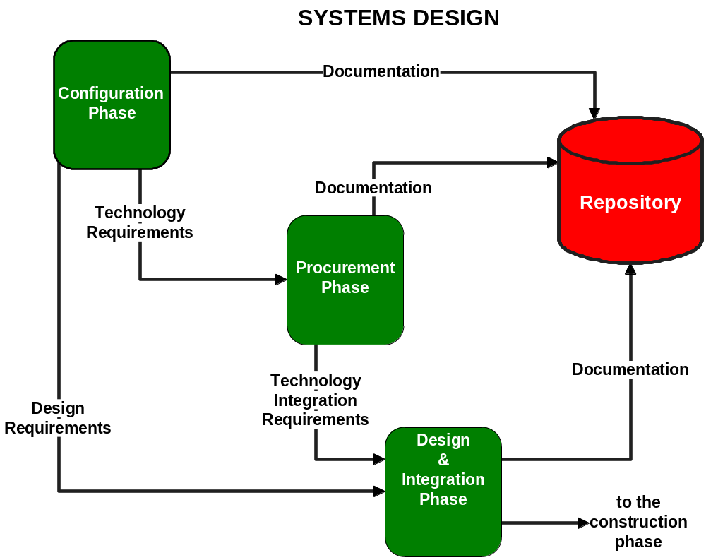
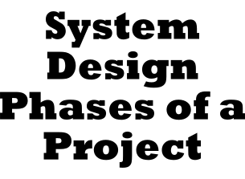
Notes:
Figure 9.1 The System Design Phases of a Project
No additional notes provided.
312-313

Slide 4
Strategies For System Design
Strategies For System Design
  There are also many strategies or techniques for performing systems design and they include:
    Modern Structured Design
    Information Engineering (IE)
    Prototyping
    JAD
    RAD
    Object-Oriented Design (OOD)
  These strategies are often viewed as competing alternative approaches to systems design, but in reality, certain combinations complement one another.
Notes:
No additional notes provided.
312

Slide 5
Strategies For System Design
Modern Structured Design
  Structured design techniques help developers deal with the size and complexity of programs.
    Modern Structured Design is a process-oriented technique for breaking up a large program into a hierarchy of modules that result in a computer program that is easier to implement and maintain (change). Synonyms (although technically inaccurate) are top-down program design and structured programming.
      A module is a group of instructions – a paragraph, block, subprogram, or subroutine.
Notes:
Design a program as a top-down hierarchy of modules. A module is a group of instructions – a paragraph, block, subprogram, or subroutine. The top-down structure of these modules is developed according to various design rules and guidelines. (Thus, merely drawing a hierarchy or structure chart for a program is not structured design).
Structured design is considered process technique because it’s emphasis is on the PROCESS building blocks in our information system – specifically, software processes.
312-313

Slide 6
Strategies For System Design
Modern Structured Design
  Structured design seeks to factor a program into the top-down hierarchy of modules that have the following properties:
    Modules should be highly cohesive; that is, each module should accomplish one and only one function.
      This makes the modules reusable in future programs.
    Modules should be loosely coupled; in other words, modules should be minimally dependent on one another.
      This minimizes the effect that future changes in one module will have on other modules.
Notes:
No additional notes provided.
313

Slide 7
Strategies For System Design
Modern Structured Design
  Structured design is performed during systems design.
  Structured design does not address all aspects of design – for instance, structured design will not help you design inputs, databases, or files.
  The software model derived from structured design is called a structure chart.
    The structure chart is derived by studying the flow of data through the program.
Notes:
Structured design has lost some of its popularity with many of today’s applications that call for newer techniques that focus event-driven programming techniques. However, it is still a popular technique involving the design of mainframe-based application software and to address coupling and cohesion issues at the “system” level.
313

Slide 8
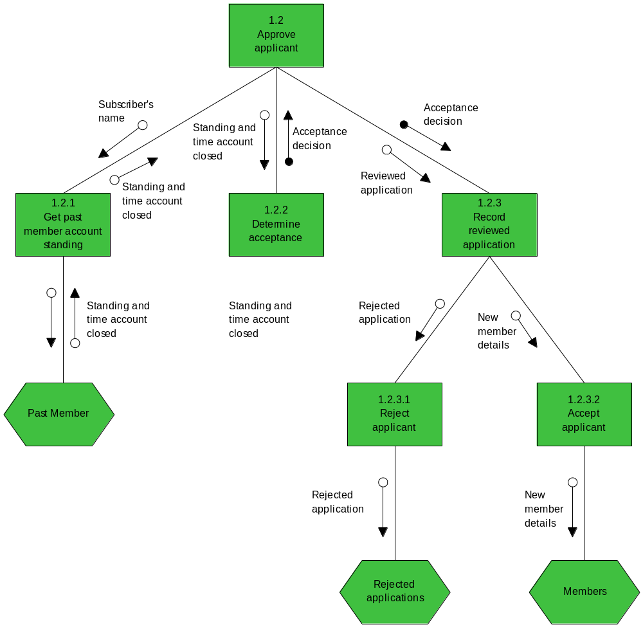
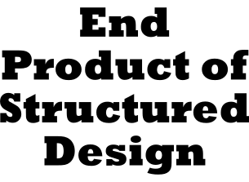
Notes:
Figure 9.2 The End Product of Structured Design
No additional notes provided.
313-314

Slide 9
Strategies For System Design
Information Engineering (IE)
  IE involves conducting a business area requirements analysis from which information system applications are ‘carved out’ and prioritized.
  Information Engineering is lacking on the design process.
  The applications identified in IE become projects to which other systems analysis and design methods are intended to be applied in order to develop the production systems.
Notes:
No additional notes provided.
314

Slide 10
Strategies For System Design
Prototyping
  A prototype, according to Webster's dictionary, is ``an original or model on which something is patterned'' and/or ``a first full-scale and usually functional form of a new type or design of a construction (as an airplane).''
  Engineers build prototypes of engines, machines, automobiles, and the like, prior to building the actual products.
  Prototyping allows engineers to isolate problems in both requirements and designs.
  The prototyping approach is an iterative process involving a close working relationship between the designer and the users.
Notes:
Traditionally, physical design has been a paper-and-pencil process. Analysts drew pictures that depicted the layout or structure of outputs, inputs, and files and the flow of dialogue and procedures. This is a time-consuming process that is prone to considerable error and omissions. Frequently, the resulting paper specifications did not prove themselves inadequate, incomplete, or inaccurate until programming started.
314-315

Slide 11
Strategies For System Design
Prototyping
  The prototyping approach has several advantages.
    Prototyping encourages and requires active end-user participation.
    Iteration and change are a natural consequence of systems development -- that is, end-users tend to change their minds.
    It has often been said that end-users don't fully know their requirements until they see them implemented.
    Prototypes are an active, not passive, model that end-users can see, touch, feel, and experience.
    An approved prototype is a working equivalent to a paper design specification, with one exception -- errors can be detected much earlier.
Notes:
Traditionally, physical design has been a paper-and-pencil process. Analysts drew pictures that depicted the layout or structure of outputs, inputs, and files and the flow of dialogue and procedures. This is a time-consuming process that is prone to considerable error and omissions. Frequently, the resulting paper specifications did not prove themselves inadequate, incomplete, or inaccurate until programming started.
314-315

Slide 12
Strategies For System Design
Prototyping
  The prototyping approach has several advantages. (continued)
    Prototyping can increase creativity because it allows for quicker user feedback which can lead to better solutions.
    Prototyping accelerates several phases of the life cycle, possibly bypassing the programmer.
Notes:
No additional notes provided.
315

Slide 13
Strategies For System Design
Prototyping
  The prototyping approach has several disadvantages.
    Prototyping encourages a return to the ``code, implement, and repair'' life cycle that used to dominate information systems.
    Prototyping does not negate the need for the survey and study phases.
    You cannot completely substitute any prototype for a paper specification.
    There are numerous design issues not addressed by prototyping.
    Prototyping often leads to premature commitment to a design.
    When prototyping, the scope and complexity of the system can quickly expand beyond original plans.
Notes:
There are disadvantages or pitfalls to using the prototyping approach. Prototyping is not without disadvantages. Most of these can be summed up in one statement: Prototyping encourages ill-advised shortcuts through the life cycle. Fortunately, the following pitfalls can all be avoided through proper discipline.
315-316

Slide 14
Strategies For System Design
Prototyping
  The prototyping approach has several disadvantages. (continued)
    Prototyping can reduce creativity in designs.
    Prototypes often suffer from slower performance than their third-generation language counterparts.
Notes:
No additional notes provided.
316

Slide 15
Strategies For System Design
Prototyping
  Prototypes can be quickly developed using many of the 4GLs and object-oriented programming languages available today.
  Prototypes can be built for simple outputs, computer dialogues, key functions, entire subsystems, or even the entire system.
    Each prototype system is reviewed by end-users and management, who make recommendations about requirements, methods, and formats.
    The prototype is then corrected, enhanced, or refined to reflect the new requirements.
    The revision and review process continues until the prototype is accepted.
Notes:
Building prototypes makes so much sense that you may wonder why we didn't always do it. The reason is simple: the technology wasn't available. Traditional languages such as COBOL, FORTRAN, BASIC, Pascal, and C (often called third-generation languages) don't lend themselves to prototyping. Prototypes must be developed and modified quickly, neither of which is possible with third-generation languages. Consider the prospects of continually modifying the DATA and PROCEDURE divisions of a COBOL program as end-users try to make up their mind what they want and how it should look.
Fourth-generation languages (4GLs), applications generators (AGs), and some object-oriented languages are software tools that make building systems a simpler task. At the risk of oversimplifying these tools, they are less procedural than traditional languages. This means that the tools specify more of what the system is or what it should do, and less of how to do it. In other words, they are not as dependent on specification of logic. Finally, it should also be noted that many computer-assisted systems engineering (CASE) products also contain limited prototyping tools for designing screens and reports.
Design by prototyping doesn't necessarily fulfill all design requirements. For instance, prototypes don't always address important performance issues and storage constraints. Prototypes rarely incorporate internal controls. These must still be specified by the analyst.
316

Slide 16
Strategies For System Design
Joint Application Development (JAD)
  JAD is a technique that complements other systems analysis and design techniques by emphasizing participative development among system owners, users, designers, and builders.
  During JAD sessions for systems design, the systems designer will take on the role of facilitator for possibly several full-day workshops intended to address different design issues and deliverables.
Notes:
No additional notes provided.
316

Slide 17
Strategies For System Design
Rapid Application Development (RAD)
  Rapid application development (RAD) is the merger of various structured techniques (especially the data-driven information engineering) with prototyping techniques and joint application development techniques to accelerate systems development.
  RAD calls for the interactive use of structured techniques and prototyping to define the users’ requirements and design the final system.
Notes:
No additional notes provided.
316

Slide 18
Strategies For System Design
Rapid Application Development (RAD)
  Using structured techniques:
    The developer first builds preliminary data and process models of the business requirements.
    Prototypes then help the analyst and users to verify those requirements, and to formally refine the data and process models.
    The cycle of models, then prototypes, then models, then prototypes, and so forth ultimately results in a combined business requirements and technical design statement to be used for constructing the new system.
Notes:
No additional notes provided.
317

Slide 19
Strategies For System Design
Object-Oriented Design (OOD)
  Object-oriented design (OOD) techniques are used to refine the object requirements definitions identified earlier during analysis, and to define design specific objects.
  Based on a design implementation decision, during OOD the designer may need to revise the data or process characteristics for an object that was defined during systems analysis.
  Likewise, a design implementation decision may necessitate that the designer define a new set of objects that will make up an interface screen that the user(s) may interact with in the new system.
Notes:
No additional notes provided.
317

Slide 20
Fast System Analysis Methods
FAST
  The FAST methodology does not impose a single design technique on system developers.
  FAST integrates all of the popular design strategies we’ve discussed: structured design (via process modeling), information engineering (via data modeling), prototyping (via rapid application development), joint application development (for all methods), and rapid application development.
  Progressive FAST developers can use object-oriented design in conjunction with object technology for prototyping to fully exploit the object paradigm.
Notes:
All FAST activities are completed by individuals who are assigned to roles. Roles are not the same as job titles. One person can play many roles in a project. Conversely, one role may require many people to adequately fulfill that role. For example, a system user role may require several users in order to adequately represent the interests of an entire system.
317-318

Slide 21
The Configuration Phase of Systems Design
Configuration Phase
  The purpose of the configuration phase is to identify candidate solutions, analyze those candidate solutions, and recommend a target system that will be designed and implemented.
  The fundamental objectives of the configuration phase are:
    To identify and research alternative manual and computer-based solutions to support our target information system.
    To evaluate the feasibility of alternative solutions and recommend the best overall alternative solution.
  The configuration phase marks the first point in the systems development process that we have placed emphasis on how the new system might operate.
Notes:
Alternative solutions to be considered should be those that address the business requirements of the information system. Given the business requirements for an improved information system, we can finally address how the new system -- including computer-based alternatives -- might operate. You should never automatically go with your first hunch. During the configuration phase, it is imperative that you identify options, analyze options, and then sell feasible solutions based on the analysis.
319

Slide 22
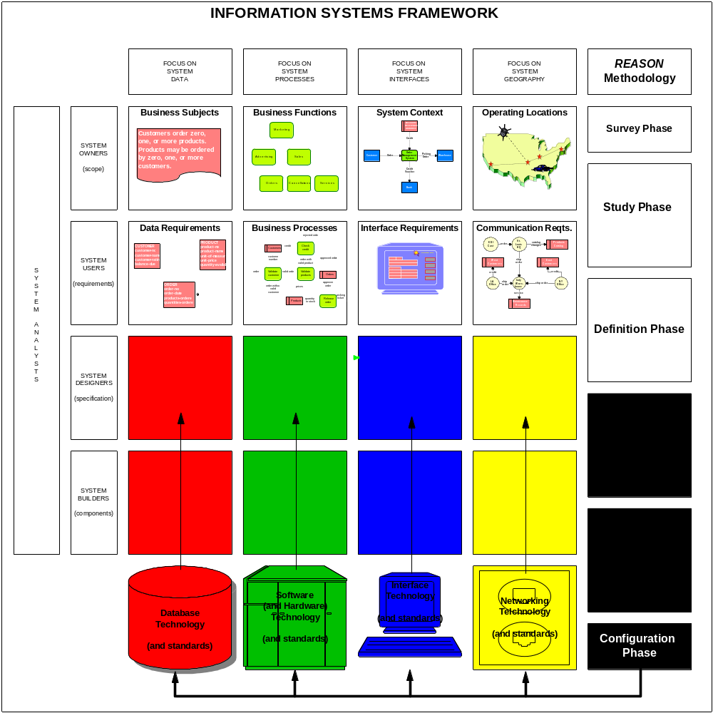

Notes:
Figure 9.3 Building Blocks for the Configuration Phase
The information system framework above provides the context for the focus of the configuration phase. As shown in the model, the configuration phase is primarily concerned with the Technology requirements for the target system.
Notice that the Technology decisions made during the configuration phase will impact the People, Data, Interface, Process, and Geography decisions made in later phases (this is suggested by the upward pointed dashed lines).
318-319

Slide 23
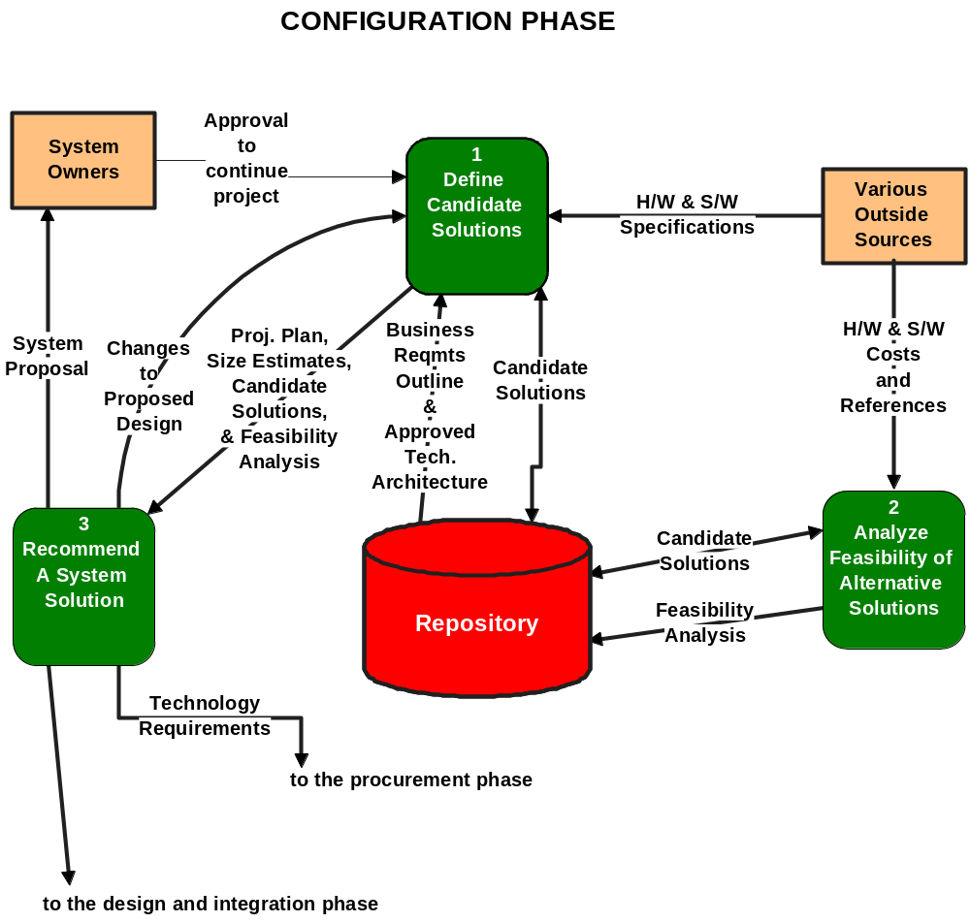

Notes:
Figure 9.4 Activity Diagram for the Configuration Phase
The figure above illustrates the typical activities of the configuration phase.
319-320

Slide 24
The Configuration Phase of Systems Design
Activity: Define Candidate Solutions
  Given the business requirements established in the definition phase of systems analysis, we must identify alternative candidate solutions.
  Purpose
    The purpose of this activity is to identify alternative candidate solutions to the business requirements defined during systems analysis.
Notes:
Some candidate solutions will be posed by design ideas and opinions from system owners and users. Others may come from various sources including: systems analysts, systems designers, technical consultants, and other IS professionals. Some technical choices may be limited by a predefined, approved technology architecture provided by system managers. It is not the intent of this activity to evaluate the candidates. Rather, simply to define possible candidate solutions to be considered.
319

Slide 25
The Configuration Phase of Systems Design
Activity: Define Candidate Solutions
  Roles
    The activity is facilitated by the project manager.
    System owner roles - system owners are not normally directly involved in this activity.
    System user roles - users are typically not involved in this activity at this time.
    System analyst roles - The systems analyst is most knowledgeable about the business requirements and therefore should be involved in brainstorming solutions that might fulfill those requirements.
Notes:
System owners are not normally directly involved in this activity. However, during this activity the systems designer will consider any propose ideas and solutions for candidate solutions that the owner may have communicated to them as possibilities. For example, the owner may have read an article or perhaps heard about learned how some competitor or acquaintance’s similar system was implemented. In either case, it is politically sound to consider an owners ideas.
319-320

Slide 26
The Configuration Phase of Systems Design
Activity: Define Candidate Solutions
  Roles
    System designer roles - The systems designer assumes the major role in this activity and will usually seek the input and advice from the following expertises:
      Database administer - This person will be a source of expertise regarding available database technology.
      Network administrator - This person can provide expertise regarding existing network technology.
      Applications administer - This person provides knowledge regarding new and existing applications development tools and standards.
    System builder roles - system builders are not typically involved in this activity.
Notes:
No additional notes provided.
320

Slide 27
The Configuration Phase of Systems Design
Activity: Define Candidate Solutions
  Prerequisites (Inputs)
    This activity is triggered by the approval from the system owners to continue the project into systems design.
    The key inputs are:
      business requirements outline defined during systems analysis
      hardware and software specifications from various sources such as vendors and customer referrals
      approved technology architecture
Notes:
Often times during systems analysis, when the primary focus is supposed to be logical business requirements, the analyst learns of a technical solution that he/she anticipates might be a viable alternative to consider when they reach systems design. Or, perhaps earlier in the project the system owner encouraged or insisted that a particular technical solution be considered. These facts are frequently documented as future candidate solutions to be considered when defining candidate solutions.
320-321

Slide 28
The Configuration Phase of Systems Design
Activity: Define Candidate Solutions
  Deliverables (outputs)
    The principle deliverables of this activity are the candidate solutions for a new system.
    A matrix is a useful tool for effectively capturing, organizing, and communicating the characteristics for candidate solutions.
Notes:
No additional notes provided.
321

Slide 29
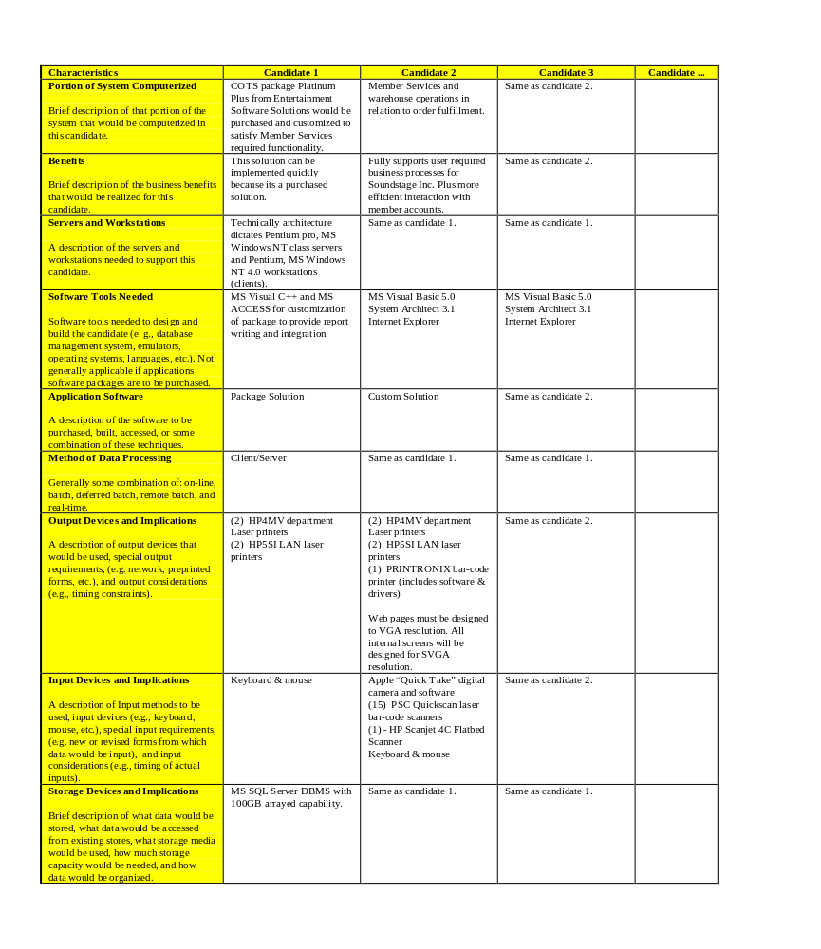

Notes:
Figure 9.5 Partially Completed Candidate Matrix
A partially completed candidate solutions matrix is depicted in the figure above. This allows for a side-by-side comparison of the different characteristics for a number of candidates.
321-322

Slide 30
The Configuration Phase of Systems Design
Activity: Define Candidate Solutions
  Applicable Techniques
    The following techniques are applicable to this activity.
      Fact Finding. Fact finding methods are used to interact with outside sources such as hardware and software vendors and stores to gather product specifications for each candidate.
Notes:
No additional notes provided.
321

Slide 31
The Configuration Phase of Systems Design
Activity: Define Candidate Solutions
  Steps
    The following steps are suggested to complete this activity.
      Step 1 - Review the business requirements outlined in the definition phase of systems analysis.
      Step 2 - If it exists, review the technology architecture to determine and hardware or software standards required for any candidate solution.
      Step 3 - Brainstorm alternative solutions that fulfill the business requirements. Also, identify solutions that were suggested prior to the design phase.
      Step 4 - Research technical specifications detailing the characteristics of each candidate solution.
Notes:
No additional notes provided.
321

Slide 32
The Configuration Phase of Systems Design
Activity: Analyze Feasibility of Alternative Solutions
  Feasibility analysis should not be limited to costs and benefits.
  Most analysts evaluate solutions against four sets of criteria:
    Technical feasibility.
      Is the solution technically practical?
      Does our staff have the technical expertise to design and build this solution?
    Operational feasibility.
      Will the solution fulfill the user's requirements?
      To what degree?
      How will the solution change the user's work environment?
      How do users feel about such a solution?
Notes:
No additional notes provided.
321

Slide 33
The Configuration Phase of Systems Design
Activity: Analyze Feasibility of Alternative Solutions
  Most analysts evaluate solutions against four sets of criteria: (continued)
    Economic feasibility.
      Is the solution cost-effective?
    Schedule feasibility.
      Can the solution be designed and implemented within an acceptable time period?
  The feasibility analysis is performed upon each individual candidate without regard to the feasibility of other candidates.
  Purpose
    The purpose of this activity is to evaluate the alternative candidate solutions according to their economic, operational, technical, and schedule feasibility.
Notes:
When completing this activity, the analyst and users are careful not to make comparisons between the candidates.
This approach discourages the analyst and users from prematurely making a decision concerning which candidate is the best.
321

Slide 34
The Configuration Phase of Systems Design
Activity: Analyze Feasibility of Alternative Solutions
  Roles
    The activity is facilitated by the project manager.
    System owner roles - The opinions of the following individuals may be sought when assessing the operational feasibility of a candidate solution:
      executive sponsor, user managers, system managers, and/or project manager
    System user roles - several users may be involved to assess their feelings toward a candidate solution.
      The financial or business analyst - this individual may be a source for determining the financial techniques to be used when analyzing the economic feasibility of an investment (a new system).
Notes:
No additional notes provided.
323

Slide 35
The Configuration Phase of Systems Design
Activity: Analyze Feasibility of Alternative Solutions
  Roles
    Systems analyst roles - Once again, this activity may be performed by the systems analyst.
    System designers are responsible for the completion of this activity.
      The designer may seek input from the following people regarding the technical feasibility of a of the technology for candidate solution:
        Database administer, Network administrator, and/or Applications administer
    System builder roles are not typically involved in this activity unless deemed appropriate by a system owner
Notes:
No additional notes provided.
323

Slide 36
The Configuration Phase of Systems Design
Activity: Analyze Feasibility of Alternative Solutions
  Prerequisites (Inputs)
    This activity is triggered by the definition of one or more candidate solutions.
    To conduct the feasibility analysis, hardware and software costs as well as feedback from customer references are needed.
  Deliverables (outputs)
    The principle deliverable of this activity is the completed feasibility analysis for each candidate.
    A matrix can be used to communicate the large volume of information about candidate solutions.
Notes:
No additional notes provided.
323

Slide 37
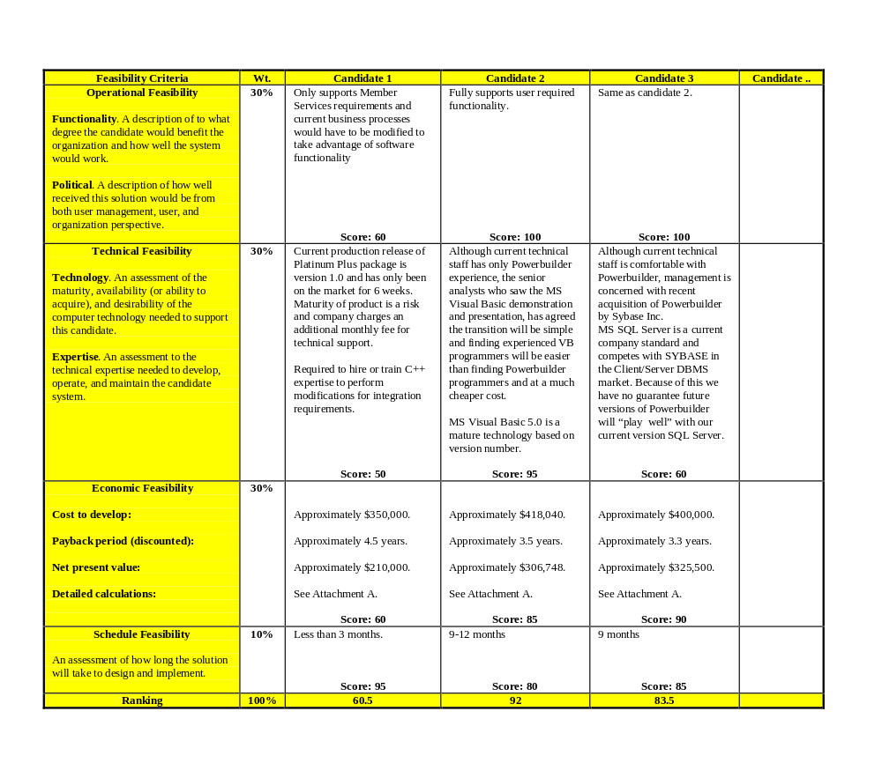

Notes:
Figure 9.6 Partially Completed Feasibility Matrix
The matrix in the figure above allows for a side-by-side unveiling of the different feasibility analyses for a number of candidates.
323-324

Slide 38
The Configuration Phase of Systems Design
Activity: Analyze Feasibility of Alternative Solutions
  Applicable Techniques
    The following techniques are applicable to this activity.
      Fact Finding. Fact finding methods are used obtain costs, opinions, and other facts about candidates from a variety of sources.
      Feasibility Analysis. The ability to perform a feasibility assessment is an extremely important skill requirement.
Notes:
No additional notes provided.
323

Slide 39
The Configuration Phase of Systems Design
Activity: Analyze Feasibility of Alternative Solutions
  Steps
    The following steps are suggested to complete this activity.
      Step 1 - Obtain all product cost information for each product.
      Step 2 - Discuss candidate solutions with system owners and users to obtain a feel for how well-received the solution would be from their perspectives.
      Step 3 - If possible, obtain feedback from customers who own or have used the hardware and software product(s).
      Step 4 - Determine what economic measures to use to conduct the cost-benefit feasibility analysis.
      Step 5 - Evaluate each candidate solution independently for operational, technical, economic, and schedule feasibility. Document your analysis of each candidate solution.
Notes:
No additional notes provided.
323-324

Slide 40
The Configuration Phase of Systems Design
Activity: Recommend a System Solution
  First, any infeasible candidates are usually eliminated from further consideration.
  Since we are looking for the most feasible solution of those remaining, we will identify and recommend the candidate that offers the “best overall” combination of technical, operational, economic, and schedule feasibilities.
  It should be noted that it selecting such a candidate that it is rarely that a given candidate is found to be the most operational, technical, economic, and schedule feasible.
  Purpose
    The purpose of this activity is to select a candidate solution to recommend.
Notes:
No additional notes provided.
324

Slide 41
The Configuration Phase of Systems Design
Activity: Recommend a System Solution
  Roles
    The activity is facilitated by the project manager.
    System owner roles:
      executive sponsor - As the final spending authority, the sponsor must approve recommendations and project continuation.
      user managers - The system belongs to these managers; therefore, their input is crucial.
      system managers - Systems managers commit information services resources to projects; therefore, they need to be made aware of any scope, schedule, or budget changes for the project.
      steering body - many organizations require that all system proposals be formally presented to a steering body (sometimes called a steering committee) for final approval.
Notes:
No additional notes provided.
324-325

Slide 42
The Configuration Phase of Systems Design
Activity: Recommend a System Solution
  Roles
    System users - are not normally involved in this process.
    Systems analysts - may assume responsibility for this activity.
    Systems designers - must make and defend the recommendation.
    System builders - are not typically involved in this activity unless deemed necessary by the project manager.
Notes:
No additional notes provided.
325

Slide 43
The Configuration Phase of Systems Design
Activity: Recommend a System Solution
  Prerequisites (Inputs)
    This activity is triggered by the completion of the feasibility analysis of all candidate solutions.
    The key inputs to this activity include:
      project plan
      size estimates
      candidate solutions
      completed feasibility analysis
Notes:
No additional notes provided.
325

Slide 44
The Configuration Phase of Systems Design
Activity: Recommend a System Solution
  Deliverables (outputs)
    The principle deliverable of this activity is a formal written or verbal system proposal.
      This proposal is usually intended for the system owners who will normally make the final decision.
      The proposal will contain the project plans, size estimates, candidate solutions, and feasibility analysis.
      Based on the outcome of the proposal, changes to proposed design requirements are established for the new systems components we will ``buy'' or ``make.''
Notes:
No additional notes provided.
325

Slide 45
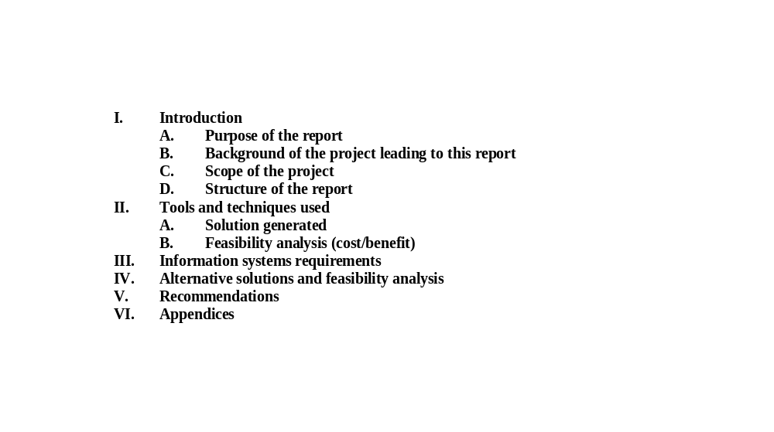

Notes:
Figure 9.7 Outline of Typical System Proposal
No additional notes provided.
325

Slide 46
The Configuration Phase of Systems Design
Activity: Recommend a System Solution
  Applicable Techniques
    The techniques and skills needed to complete this activity are all cross life cycle skills:
      Feasibility assessment.
      Report writing.
      Verbal presentations.
Notes:
No additional notes provided.
325

Slide 47
The Configuration Phase of Systems Design
Activity: Recommend a System Solution
  Steps
    The following steps are suggested to complete this activity.
      Step 1 - Not all feasibility criteria is necessarily viewed as having equal importance in deciding which candidate is the best overall candidate. If appropriate, establish the “weighting” to be given to each the feasibility criteria.
      Step 2 - Rank the candidates and to determine the candidate with the best overall feasibility criteria ranking.
      Step 3 - Prepare a formal written systems proposal containing your analysis and recommendations.
      Step 4 - Prepare and present an oral recommendation to management.
Notes:
No additional notes provided.
326

Slide 48
The Procurement Phase of Systems Design
The Procurement Phase
  The procurement of software and hardware is not necessary for all new systems.
  When new software or hardware is needed, the selection of appropriate products is often difficult.
  Decisions are complicated by technical, economic, and political considerations, and a poor decision can ruin an otherwise successful analysis and design.
  The systems analyst is becoming increasingly involved in the procurement of software packages, peripherals, and computers to support specific applications being developed by that analyst.
Notes:
No additional notes provided.
326

Slide 49
The Procurement Phase of Systems Design
The Procurement Phase
  There are four fundamental objectives of the configuration phase:
    To identify and research specific products that could support our recommended solution for the target information system.
    To solicit, evaluate, and rank vendor proposals.
    To select and recommend the best vendor proposal.
    To establish requirements for integrating the awarded vendor's products.
Notes:
No additional notes provided.
326

Slide 50
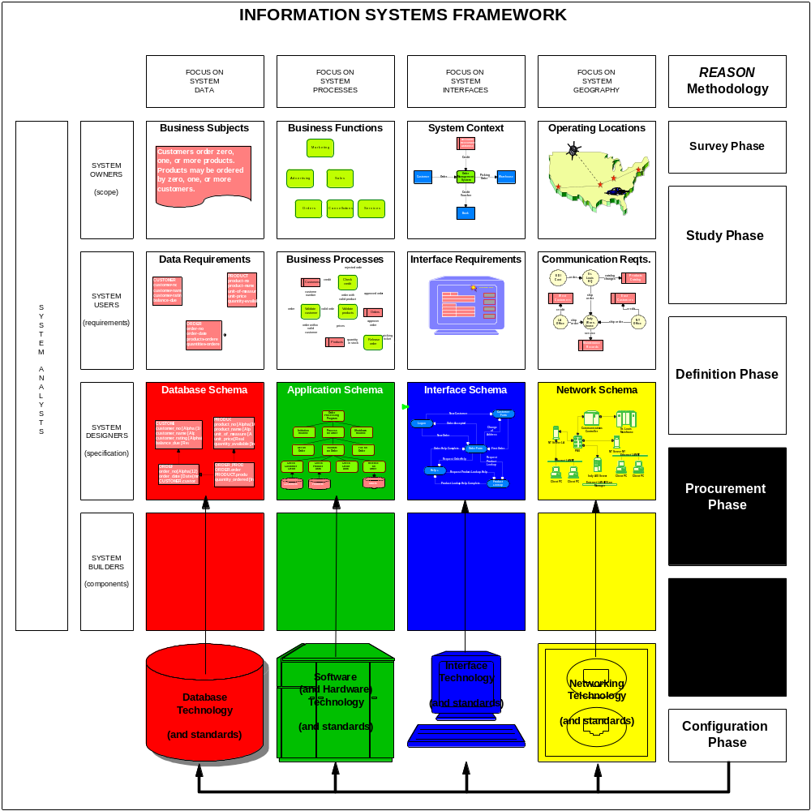

Notes:
Figure 9.8 Building Blocks for the Procurement Phase
The information system framework above provides the context for the focus of the procurement phase. Alternative vendor hardware or software products to be considered should be those that provide the best overall support for the target information system. As shown in the model, the procurement phase is concerned with addressing specific build/buy Technology products that support the People, Data, Processes, Interfaces, and Geography requirements for the target system.
326-327

Slide 51
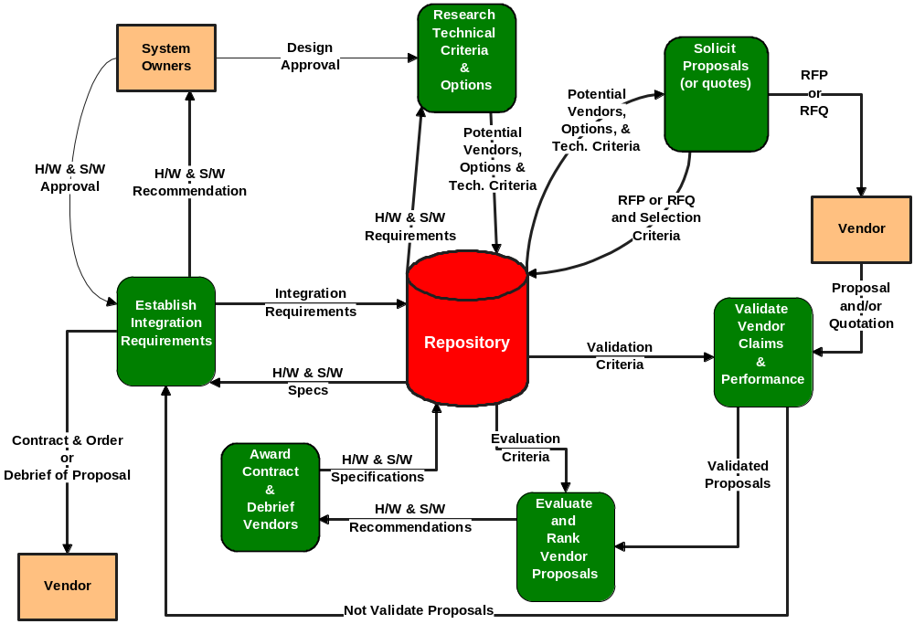
Notes:
Figure 9.9 Activity Diagram for the Procurement Phase
The figure above illustrates the typical activities of the procurement phase.
326,329

Slide 52
The Procurement Phase of Systems Design
Activity: Research Technical Criteria and Options
  This activity identifies specifications that are important to the hardware and/or software that is to be selected.
  The activity involves focusing on the hardware and/or software requirements established in the configuration phase.
    These requirements specify the functionality, features, and critical performance parameters for our new software/hardware
Notes:
No additional notes provided.
326

Slide 53
The Procurement Phase of Systems Design
Activity: Research Technical Criteria and Options
  Most analysts read appropriate magazines and journals to help them identify those technical and business issues and specifications that will become important to the selection decision.
    Other sources of information for conducting research include the following:
      Internal standards may exist for hardware and software selection.
      Information services are primarily intended to constantly survey the marketplace for new products and advise prospective buyers on what specifications to consider.
      Trade newspapers and periodicals offer articles and experiences on various types of hardware and software that you may be considering.
  Purpose
Notes:
Some companies insist that certain technology will be bought from specific vendors if those vendors offer it. For instance, some companies have standardized on specific brands of microcomputers, terminals, printers, database management systems, network managers, data communications software, spreadsheets, and programming languages. A little homework here can save you a lot of unnecessary research.
The research should also identify potential vendors that supply the products to be considered. After the analysts have completed their homework, they will initiate contact with these vendors. Thus, the analysts will be better equipped to deal with vendor sales pitches after doing their research!
326-328

Slide 54
The Procurement Phase of Systems Design
Activity: Research Technical Criteria and Options
  Purpose
    The purpose of this activity is to research technical alternatives to specify important criteria and options that will be important for the new hardware and/or software that is to be selected.
  Roles
    The activity is facilitated by the project manager.
    Systems owners - are not involved in this activity.
    Systems users - are not involved in this activity.
    Systems analysts - are not normally involved in this activity.
Notes:
No additional notes provided.
328

Slide 55
The Procurement Phase of Systems Design
Activity: Research Technical Criteria and Options
  Roles
    Systems designers - are responsible for the completion of this activity.
      The designer may seek input from the following people regarding the technical criteria:
        database administer, network administrator, and/or applications administer
    Systems builders - are not typically involved in this activity unless deemed appropriate by a system owner
Notes:
No additional notes provided.
328

Slide 56
The Procurement Phase of Systems Design
Activity: Research Technical Criteria and Options
  Prerequisites (Inputs)
    This activity is triggered by the system owners approval of a system proposal requiring new software or hardware.
    A key input to this activity is the hardware and/or software requirements established in the configuration phase.
    The analyst will also obtain additional product and vendor facts from various sources.
Notes:
The analyst will be careful not to get their information solely from a salesperson -- not that sales representatives are dishonest, but the number one rule of salesmanship is to emphasize your product's strengths and de-emphasize its weaknesses.
328

Slide 57
The Procurement Phase of Systems Design
Activity: Research Technical Criteria and Options
  Deliverables (outputs)
    The principle deliverable of this activity includes a list of potential vendors, product options, and technical criteria.
  Applicable Techniques
    Fact Finding. Fact finding methods are used to obtain additional facts about products from various sources.
Notes:
No additional notes provided.
328

Slide 58
The Procurement Phase of Systems Design
Activity: Research Technical Criteria and Options
  Steps
    The following steps are suggested to complete this activity.
      Step 1 - Conduct research to gain important facts concerning the hardware/software product and vendor. Carefully screen the various sources that may be utilized.
      Step 2 - Identify potential vendors from which the products might be obtained. This step may be optional if your company has a commitment or contract to acquire certain products from a particular source.
      Step 3 - Review the product, vendor, and supplier findings.
Notes:
No additional notes provided.
328

Slide 59
The Procurement Phase of Systems Design
Activity: Solicit Proposals (for Quotes) from Vendors
  This activity is to solicit proposals from vendors.
  The solicitation activity requires the preparation of one of two documents:
    Document 1 - request for quotations (RFQ)
      The request for quotations is used when you have already decided on the specific product, but that product can be acquired from several distributors.
        Its primary intent is to solicit specific configurations, prices, maintenance agreements, conditions regarding changes made by buyers, and servicing.
Notes:
If your company is committed to buying from a single source (IBM, for example), the task is quite informal. You simply contact the supplier and request price quotations and terms. On the other hand, most decisions offer numerous alternatives. In this situation, good business sense dictates that you use the competitive marketplace to your advantage.
328-329

Slide 60
The Procurement Phase of Systems Design
Activity: Solicit Proposals (for Quotes) from Vendors
  The solicitation activity requires the preparation of one of two documents:
    Document 2 - request for proposals (RFP)
      The request for proposals is used when several different vendors and/or products are candidates and you want to solicit competitive proposals and quotes.
      RFPs can be thought of as a superset of RFQs.
      The primary purpose of the RFP is to communicate requirements and desired features to prospective vendors.
  Purpose
    Solicit product proposals or quotes from candidate vendors.
Notes:
Requirements and desired features must be categorized as mandatory (must be provided by the vendor), extremely important (desired from the vendor but can be obtained in-house or from a third-party vendor), or desirable (can be done without). Requirements might also be classified by two alternate criteria: those that satisfy the needs of the systems and those that satisfy our needs from the vendor (for example, service).
329

Slide 61
The Procurement Phase of Systems Design
Activity: Solicit Proposals (for Quotes) from Vendors
  Roles
    The activity is facilitated by the project manager.
    Systems owners - are not involved in this activity.
    Systems users - are not involved in this activity.
    Systems analysts - are not involved in this activity.
    Systems designers - are responsible for the completion of this activity.
      The designer may seek input from the following people in writing the RFP or RFQ:
        database administer, network administrator, and/or applications administer
    Systems builders - are not typically involved in this activity unless deemed appropriate by a system owner.
Notes:
No additional notes provided.
329-330

Slide 62
The Procurement Phase of Systems Design
Activity: Solicit Proposals (for Quotes) from Vendors
  Prerequisites (Inputs)
    The key input to this activity is the potential vendors, options, and technical criteria that resulted from previous the research activity.
  Deliverables (outputs)
    The principle deliverable of this activity is the RFP or RFQ that is to be received by candidate vendors.
      The quality of an RFP has a significant impact on the quality and completeness of the resulting proposals.
Notes:
No additional notes provided.
330

Slide 63
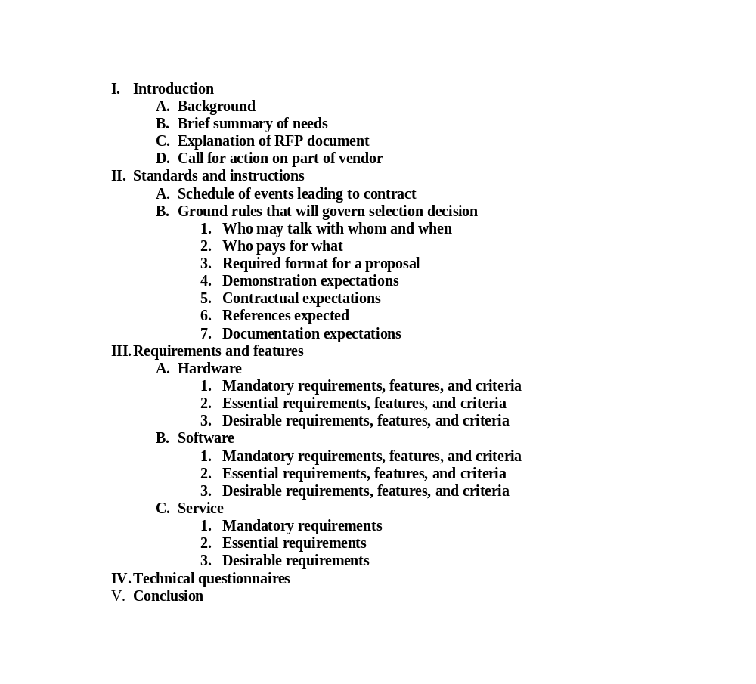

Notes:
Figure 9.10 Request For Proposals (RFP)
No additional notes provided.
330-331

Slide 64
The Procurement Phase of Systems Design
Activity: Solicit Proposals (for Quotes) from Vendors
  Applicable Techniques
    Process and Data Modeling.
    Report writing.
    Developing questionnaires.
Notes:
Many of the skills you developed in Part Two, such as process and data modeling, can be very useful for communicating requirements in the RFP. We have found that vendors are very receptive to these tools because they find it easier to match products and options and package a proposal that is directed toward your needs.
330

Slide 65
The Procurement Phase of Systems Design
Activity: Solicit Proposals (for Quotes) from Vendors
  Steps
    The following steps are suggested to complete this activity.
      Step 1 - Collect and review the facts pertaining to potential vendors, options, and technical criteria.
      Step 2 - If your company buys from a single source, or if the desired product can only be obtain from a single source, contact that source and request a price quotation and terms.
      Step 3 - Prepare a request for quotation (RFQ) and send to all distributors from which the product(s) can be obtained.
      Step 4 - Prepare a request for proposals (RFP) for those products you want to solicit competitive proposals and quotes.
      Step 5 - If deemed necessary or helpful, hold a vendors bidding meeting to address important issues and questions.
Notes:
No additional notes provided.
321

Slide 66
The Procurement Phase of Systems Design
Activity: Validate Vendor Claims and Performance
  Soon after the RFPs or RFQs are sent to prospective vendors, you will begin receiving proposal(s) and/or quotation(s).
  Proposals cannot and should not be taken at face value, therefore claims and performance must be validated.
  This activity is performed independently for each proposal; proposals are not compared with one another.
  Purpose
    The purpose of this activity is to validate request for proposals and/or quotations received from vendors.
Notes:
No additional notes provided.
330

Slide 67
The Procurement Phase of Systems Design
Activity: Validate Vendor Claims and Performance
  Roles
    The activity is facilitated by the project manager.
    Systems owners - are not involved in this activity.
    Systems users - are not involved in this activity.
    Systems analysts - are not involved in this activity.
    Systems designers - are responsible for the completion of this activity.
      The designer may involve the following individuals in validating the proposals:
        database administer, network administrator, and/or applications administer
    Systems builders - are not typically involved in this activity unless deemed appropriate by a system owner.
Notes:
No additional notes provided.
330-331

Slide 68
The Procurement Phase of Systems Design
Activity: Validate Vendor Claims and Performance
  Prerequisites (Inputs)
    This activity is triggered by the receipt of proposal(s) and/or quotation(s) received from prospective vendors.
  Deliverables (outputs)
    The key outputs of this activity are those vendor proposals that proved to be validated proposals or claims, and others whose claims were not validated.
  Applicable Techniques
    Interpersonal Skills. Interpersonal skills impact the way we communicate and negotiate with one another.
Notes:
No additional notes provided.
331

Slide 69
The Procurement Phase of Systems Design
Activity: Validate Vendor Claims and Performance
  Steps
    The following steps are suggested to complete this activity.
      Step 1 - Collect and review all facts pertaining to product requirements and features.
      Step 2 - Review vendor proposals and should eliminate any proposal that does not meet all of your mandatory requirements.
      Step 3 - For each vendor proposal not eliminated, validate the vendor claims and promises against validation criteria.
Notes:
If you clearly specified your requirements, no vendor should have submitted such a proposal. For proposals that cannot meet one or more extremely important requirements, verify that the requirements or features can be fulfilled by some other means.
Claims about mandatory, extremely important, and desirable requirements and features can be validated by completed questionnaires and checklists (included in the RFP) with appropriate vendor-supplied references to user's and technical manuals. Promises can only be validated by ensuring that they are written into the contract. Performance is best validated by a demonstration, which is particularly important when you are evaluating software packages. Demonstrations allow you to obtain test results and findings that confirm capabilities, features, and ease of use.
332

Slide 70
The Procurement Phase of Systems Design
Activity: Evaluate and Rank Vendor Proposals
  The evaluation and ranking task is, in reality, another cost-benefit analysis performed during systems development.
  The evaluation criteria and scoring system should be established before the actual evaluation takes place so as not to bias the criteria and scoring to subconsciously favor any one proposal.
  Purpose
    The purpose of this activity is to evaluate and rank all validated vendor proposals.
Notes:
No additional notes provided.
332

Slide 71
The Procurement Phase of Systems Design
Activity: Evaluate and Rank Vendor Proposals
  Roles
    Ideally, this activity should be facilitated by the executive sponsor.
    Systems owners - are not involved in this activity.
    Systems users - are not involved in this activity.
    Systems analysts - are not involved in this activity.
    Systems designers - are responsible for the completion of this activity.
      The designer may involve the following individuals in evaluating and ranking the proposals:
        database administer, network administrator, and/or applications administer
Notes:
No additional notes provided.
332

Slide 72
The Procurement Phase of Systems Design
Activity: Evaluate and Rank Vendor Proposals
  Roles
    Systems builders - are not typically involved in this activity unless deemed appropriate by a system owner.
  Prerequisites (Inputs)
    The inputs include validated proposals and the evaluation criteria to be used to rank the proposals.
  Deliverables (outputs)
    The key deliverable of this activity is the hardware and/or software recommendation.
Notes:
No additional notes provided.
332

Slide 73
The Procurement Phase of Systems Design
Activity: Evaluate and Rank Vendor Proposals
  Applicable Techniques
    Feasibility assessment. Once again the ability to perform a feasibility assessment is an extremely important skill requirement.
  Steps
    The following steps are suggested to complete this activity.
      Step 1 - Collect and review all details concerning the validated proposals.
      Step 2 - Establish an evaluation criteria and scoring system.
      Step 3 - Evaluate and rank the vendor proposals.
Notes:
Some methods suggest that requirements be weighted on a point scale. Better approaches use dollars and cents! Monetary systems are easier to defend to management than points. One such technique is to evaluate the proposals on the basis of hard and soft dollars. Hard-dollar costs are the costs you will have to pay to the selected vendor for the equipment or software. Soft-dollar costs are additional costs you will incur if you select a particular vendor (for instance, if you select vendor A, you may incur an additional expense to vendor B to overcome a shortcoming of vendor A's proposed system). This approach awards the contract to the vendor who fulfills all essential requirements while offering the lowest total hard-dollar cost plus soft-dollar penalties for desired features not provided (for a detailed explanation of this method see Isshiki, 1982 or Joslin, 1977).
332-333

Slide 74
The Procurement Phase of Systems Design
Activity: Award (or Let) Contract and Debrief Vendors
  Given management’s approval of the recommendation, a contract must then be drawn up and awarded to the winning vendor.
  Purpose
    The purpose of this activity is to negotiate a contract with the vendor who supplied the winning proposal, and to debrief those vendors that submitted losing proposals.
Notes:
Having ranked the vendor proposals, the next activity usually includes presenting a recommendation to management for final approval. Once again, communication skills, especially salesmanship, are important if the analyst is to persuade management to follow the recommendations. Given management’s approval of the recommendation, a contract must then be drawn up and awarded to the winning vendor. Careful not to burn bridges, this activity often times also includes debriefing losing vendors.
333

Slide 75
The Procurement Phase of Systems Design
Activity: Award (or Let) Contract and Debrief Vendors
  Roles
    Ideally, this activity should be facilitated by the executive sponsor.
    Systems owners roles:
      Executive sponsor - As the final spending authority, the sponsor must approve recommendations and project continuation.
      User managers - The system belongs to these managers; therefore, their input is crucial.
    Systems users - are not normally involved in this process.
    Systems analysts - may assume responsibility for this activity.
Notes:
No additional notes provided.
333

Slide 76
The Procurement Phase of Systems Design
Activity: Award (or Let) Contract and Debrief Vendors
  Roles
    Systems designers - must make and defend the recommendation and award the contract.
      The systems design may involve a company lawyer in drafting the contract.
    Systems builders - are not typically involved in this activity unless deemed appropriate by the project manager.
  Prerequisites (Inputs)
    The inputs include validated proposals and the evaluation criteria to be used to rank the proposals.
Notes:
No additional notes provided.
333

Slide 77
The Procurement Phase of Systems Design
Activity: Award (or Let) Contract and Debrief Vendors
  Deliverables (outputs)
    This activity results in a hardware and software recommendation that must receive final approval from the system owners.
      Pending the approval, a contract order would subsequently be produced for the “winning” vendor.
    A debriefing of proposals would be provided for the losing vendors.
  Applicable Techniques
    Report writing.
    Verbal presentations.
Notes:
No additional notes provided.
333-334

Slide 78
The Procurement Phase of Systems Design
Activity: Award (or Let) Contract and Debrief Vendors
  Steps
    The following steps are suggested to complete this activity.
      Step 1 - Having ranked the proposals, the analyst usually presents a hardware and software recommendation for final approval.
      Step 2 - Once the final hardware and software approval decision is made, a contract must be negotiated with the winning vendor.
      Step 3 - Out of common courtesy, and to maintain good relationships, provide a debriefing of proposals for losing vendors.
Notes:
Certain special conditions and terms may have to be written into the standard contract and order. Ideally, no computer contract should be signed without the advice of a lawyer. For microcomputers and software, legal advice can be prohibitively expensive (compared to the cost of the products themselves). In this case the analyst must be careful to read and clarify all licensing agreements. No final decision should be approved without the consent of a qualified accountant or management. Purchasing, leasing, and leasing with a purchase option involve complex tax considerations.
Out of common courtesy, and to maintain good relationships, provide a debriefing of proposals for losing vendors. The purpose of this meeting is not to allow the vendors a second-chance opportunity to be awarded the contract; rather, the briefing is strictly intended to inform the losing vendors of precise weaknesses in their proposal and/or product(s).
334

Slide 79
The Procurement Phase of Systems Design
Activity: Establish Integration Requirements
  The analyst must integrate or interface the new system to the myriad of other existing systems that are essential to the business.
  The integration requirements that are specified are vital to ensuring that the target system will work in harmony with those systems.
  Purpose
    The purpose of this activity is to establish requirements necessary for integrating the awarded vendor’s products into the company’s existing federation of information systems.
Notes:
Given the hardware and software specifications of the awarded vendor's products, the next activity is to determine how they can be integrated with other existing information systems. It is not merely enough to purchase or build systems that fulfill the target system requirements. The analyst must integrate or interface the new system to the myriad of other existing systems that are essential to the business. Many of these systems may use dramatically different technology, techniques, and file structures.
334

Slide 80
The Procurement Phase of Systems Design
Activity: Establish Integration Requirements
  Roles
    This activity should be facilitated by the project manager.
    Systems owners - are not involved in this activity.
    Systems users - are not involved in this activity.
    Systems analysts - are not normally involved in this activity.
    Systems designers - are responsible for the completion of this activity.
      The designer may seek input from the following individuals regarding the integration of new technology into existing applications:
        database administer, network administrator, and/or applications administer
Notes:
No additional notes provided.
334

Slide 81
The Procurement Phase of Systems Design
Activity: Establish Integration Requirements
  Roles
    Systems builders - are not typically involved in this activity unless deemed appropriate by a system owner.
  Prerequisites (Inputs)
    The input to this activity is the hardware and/or software specifications of the or the awarded vendor’s products.
  Deliverables (outputs)
    The principle deliverable of this activity is a set of integration requirements for ensuring that the systems will work in harmony with other production systems.
Notes:
No additional notes provided.
334-335

Slide 82
The Procurement Phase of Systems Design
Activity: Establish Integration Requirements
  Applicable Techniques
    Data and Process Modeling. Data and process models are frequently used to document systems.
      These “blue prints” can depict “integration” or interfacing points for different systems and business processes.
Notes:
No additional notes provided.
335

Slide 83
The Procurement Phase of Systems Design
Activity: Establish Integration Requirements
  Steps
    The following steps are suggested to complete this activity.
      Step 1 - Collect and review the hardware and software specifications of the awarded vendor’s products.
      Step 2 - Review data and process models for the new system to discover how the vendor product(s) will “fit” into the overall scheme of the new system.
      Step 3 - Revise data and process models to reflect integration or impact of new products.
Notes:
One thing will not change! We will continue to need systems analysts and business analysts who understand how to fundamentally analyze business problems and define logical business requirements as a preface to system design. But we will all have to do that with increased speed and accuracy in order to meet the accelerated system development schedules required in tomorrow’s faster-paced economy.
335

Slide 84
The Design and Integration Phase of
Systems Design
Design and Integration Phase
  Given design and integration requirements for the target system, this phase involves developing technical design specifications.
  The goal of the design and integration phase is twofold.
    First and foremost, the analyst seeks to design a system that both fulfills requirements and will be friendly to its end-users.
      Human engineering will play a pivotal role during design.
    Second, and still very important, the analyst seeks to present clear and complete specifications to the computer programmers and technicians.
Notes:
No additional notes provided.
335

Slide 85

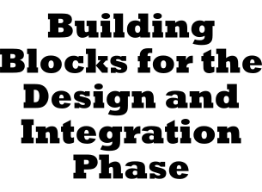
Notes:
Figure 9.11 Building Blocks for the Design and Integration Phase
Geography. During the systems analysis phase, we established the network requirements for the target system. Now we need to analyze and distribute the systems data and processes.
Data. We specified the content of each data and information flow during the definition phase. We specified the media during the selection phase. Now we need to design the style, organization, and format of all inputs and outputs. We also must specify format, organization, and access methods for all files and databases to be used in the computer-based system.
Processes. During design, the sequence of steps and flow of control through the new system must be specified. The processing methods and intermediate manual procedures must also be clearly documented.
People. The roles people play in the new system must be specified. For instance, who will capture and input data? Who will receive outputs?
Interface. During design, the designer must specify the interfaces that will exist between both systems and people.
Technology. Although hardware is not selected or designed during the physical design phase, the hardware does constrain the system. The specific hardware specified during the configuration phase must be considered as various other components are designed.
335-336

Slide 86
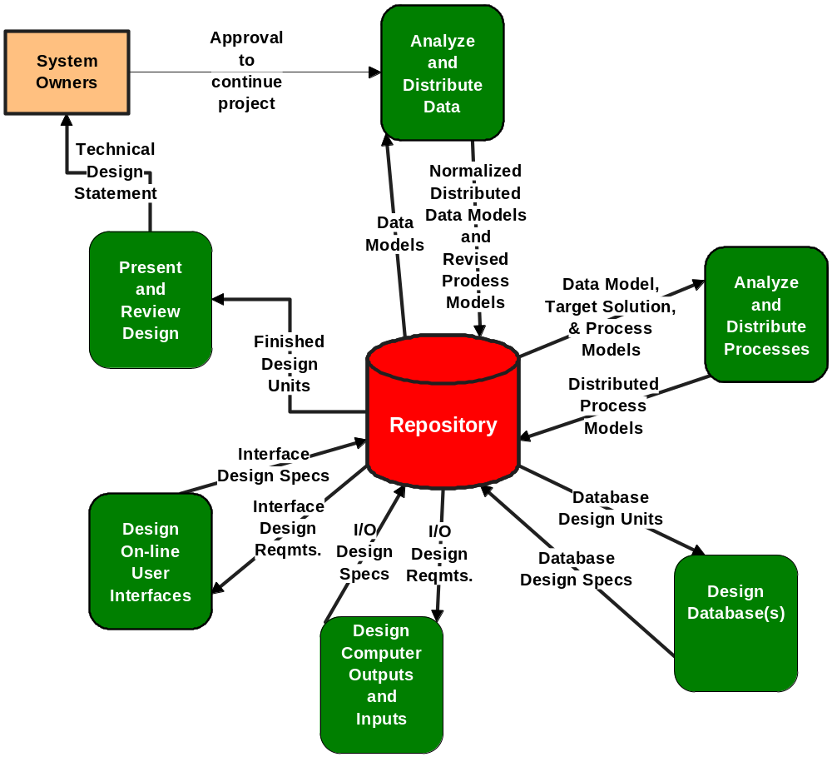
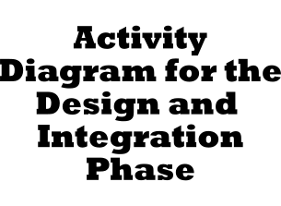
Notes:
Figure 9.12 Activity Diagram for the Design and Integration Phase
The figure above illustrates the typical activities of the design and integration phase.
Clearly, the physical design phase gets into considerably greater detail than any of the previous phases of the life cycle.
336-337

Slide 87
The Design and Integration Phase of
Systems Design
Activity: Analyze and Distribute Data
  During this activity, the analyst will work closely with users to develop a good data model -- that is, a data model that will allow the development of ideal file and database solutions.
  Data analysis is the technique used to derive a good data model.
    Data analysis is a procedure that prepares a data model for implementation as a nonredundant, flexible, and adaptable file/database.
  Normalization is the procedure that is used to simplify entities, eliminate redundancy, and build flexibility and adaptability into the data model.
    Normalization of data refers to the way data attributes are grouped together to form stable, flexible, and adaptive entities.
Notes:
Before the analyst can design computer files and/or databases for the target system, the analyst must perform some additional analysis and address distribution issues of the data. If you recall, a data model of the target system already exists. That model was created during systems analysis as a tool for communicating and documenting the data requirements for the target system. However, that data model does not usually represent a good file or database design. In fact, it may contain structural characteristics that may lead to numerous problems.
336-337

Slide 88
The Design and Integration Phase of
Systems Design
Activity: Analyze and Distribute Data
  Once data analysis has been completed, event analysis will be performed to address the analyst's obligations to ensure that the end-users' data will be kept accurate and up to date.
    Event analysis is a technique that studies the entities of a fully normalized data model to identify business events and conditions that cause data to be created, deleted, or modified.
  Since data and event analysis will likely have an impact on the process models for the target system, the target system data flow diagrams (DFDs) may need to be revised.
  The end products of this first activity are the normalized distributed data models and revised process models.
Notes:
No additional notes provided.
337-338

Slide 89
The Design and Integration Phase of
Systems Design
Activity: Analyze and Distribute Data
  Purpose
    The purpose of this activity is to develop a good data model – one that is simple, nonredundant, flexible and adaptable to future needs, and that will allow the development of ideal file and database solutions.
  Roles
    This activity should be facilitated by the project manager.
    Systems owners - are not involved in this activity.
    Systems users - may be involved in this activity to help develop the data model.
    Systems analysts - may participate in the data modeling effort.
Notes:
In addition, in those cases where the systems data is to be shared by different sites this activity will make decisions on how that data is to be distributed amongst the locations.
338

Slide 90
The Design and Integration Phase of
Systems Design
Activity: Analyze and Distribute Data
  Roles
    Systems designers - are responsible for the completion of this activity.
      The following individuals may play a role in the data distribution decision making:
        database administer, network administrator, and/or applications administer
    Systems builders - are not typically involved in this activity unless deemed appropriate by a system owner.
Notes:
No additional notes provided
338

Slide 91
The Design and Integration Phase of
Systems Design
Activity: Analyze and Distribute Data
  Prerequisites (Inputs)
    A key input to this activity is the existing data model(s) from systems analysis.
    This activity may have an impact on existing process models which would then have to be revised.
  Deliverables (outputs)
    The principle deliverable of this activity are the normalized distributed data models and revised process models.
Notes:
No additional notes provided.
338

Slide 92
The Design and Integration Phase of
Systems Design
Activity: Analyze and Distribute Data
  Applicable Techniques
    Data Modeling.
    Process Modeling.
    Data analysis and Normalization.
    Event Analysis.
Notes:
No additional notes provided.
338

Slide 93
The Design and Integration Phase of
Systems Design
Activity: Analyze and Distribute Data
  Steps
    The following steps are suggested to complete this activity.
      Step 1 - Collect existing data and process models constructed during systems analysis.
      Step 2 - Perform data analysis and normalization upon the data model(s).
      Step 3 - If the system has different locations, determine how the data will be distributed across the locations.
      Step 4 - Perform event analysis upon each data item on the data model.
      Step 5 - If process models were previously completed, revise any impacted models to reflect new business events and conditions.
Notes:
No additional notes provided.
338

Slide 94
The Design and Integration Phase of
Systems Design
Activity: Analyze and Distribute Processes
  Given the data model diagram, target solution, and process models the analyst will develop distributed process models.
  To complete this activity, the analyst may involve a number of systems designers and users.
  Purpose
    Analyze and distribute system processes to fulfill network requirements for the new system.
Notes:
No additional notes provided.
339

Slide 95
The Design and Integration Phase of
Systems Design
Activity: Analyze and Distribute Processes
  Roles
    This activity should be facilitated by the project manager.
    Systems owners - are not involved in this activity.
    Systems users - may be involved in this activity to help address business process issues.
    Systems analysts - may participate in the data modeling effort.
    Systems designers - are responsible for the completion of this activity.
      The following individuals may play a role in the process distribution decision making:
        database administer, network administrator, and/or applications administer
Notes:
No additional notes provided.
339

Slide 96
The Design and Integration Phase of
Systems Design
Activity: Analyze and Distribute Processes
  Roles
    Systems builders - are not typically involved in this activity unless deemed appropriate by a system owner.
  Prerequisites (Inputs)
    Key inputs to this activity include the existing data model diagrams, details about the target solution, and the process models.
  Deliverables (outputs)
    The principle deliverable of this is the distributed process model(s) and design units.
Notes:
No additional notes provided.
339

Slide 97
The Design and Integration Phase of
Systems Design
Activity: Analyze and Distribute Processes
  Applicable Techniques
    Data Modeling.
    Process Modeling.
    Process analysis and design.
    Event Analysis.
Notes:
No additional notes provided.
339

Slide 98
The Design and Integration Phase of
Systems Design
Activity: Analyze and Distribute Processes
  Steps
    The following steps are suggested to complete this activity.
      Step 1 - Collect and review existing data and process models
      Step 2 - Determine which essential processes will be implemented as computer processes and which as manual.
      Step 3 - Based on response time requirements, establish batch versus on-line computer processes.
      Step 4 - Factor the new systems into separate design units.
        Grouping processes that are related because they are involved in the processing of a particular business transaction or because they are triggered by a common business process cycles, or events (daily, weekly, monthly, etc.).
Notes:
No additional notes provided.
339

Slide 99
The Design and Integration Phase of
Systems Design
Activity: Analyze and Distribute Processes
  Steps
    The following steps are suggested to complete this activity.
      Step 5 - Develop network topology diagrams to document the locations or geography of the system.
      Step 6 - Distribute data and processes to these locations.
        Document these decisions in design unit data flow diagrams.
      Step 7 - Assign technology to design units.
        Using the technology approved in the earlier design phases, assign appropriate technology to the different design units.
Notes:
No additional notes provided.
340

Slide 100
The Design and Integration Phase of
Systems Design
Activity: Design Databases
  Typically the first activity of detailed design is develop the corresponding database design specifications.
  The designer must also analyze how programs will access the data in order to improve performance.
  The designer must also design internal controls to ensure proper security and disaster recovery techniques, in case data is lost or destroyed.
  Purpose
    Prepare technical design specifications for a database that will be adaptable to future requirements and expansion.
Notes:
Typically the first activity of detailed design is develop the corresponding database design specifications. The design of data goes far beyond the simple layout of records. Databases are a shared resource. Many programs will typically use them. Future programs may use databases in ways not originally envisioned. Consequently, the designer must be especially attentive to designing databases that are adaptable to future requirements and expansion.
The designer must also analyze how programs will access the data in order to improve performance. You may already be somewhat familiar with various programming data structures and their impact on performance and flexibility. These issues database organization decisions. Other issues to be addressed during database design include record size and storage volume requirements. Finally, because databases are shared resources, the designer must also design internal controls to ensure proper security and disaster recovery techniques, in case data is lost or destroyed.
340

Slide 101
The Design and Integration Phase of
Systems Design
Activity: Design Databases
  Roles
    This activity is facilitated by the project manager.
    Systems owners - are not involved in this activity.
    Systems users - are not involved in this activity.
    Systems analysts - may participate in the data modeling effort.
    Systems designers - are responsible for the completion of this activity.
      The data administrator may participate (or complete) the database design.
    Systems builders - may become involved at this stage of design.
      They may be asked to build a prototype database for the project.
Notes:
No additional notes provided.
340

Slide 102
The Design and Integration Phase of
Systems Design
Activity: Design Databases
  Prerequisites (Inputs)
    A key input to this activity is the database design unit(s).
  Deliverables (outputs)
    The principle deliverable of this is the database design specification(s).
  Applicable Techniques
    Database Design
Notes:
No additional notes provided.
340

Slide 103
The Design and Integration Phase of
Systems Design
Activity: Design Databases
  Steps
    The following steps are suggested to complete this activity.
      Step 1 - Collect and review requirements for database design units.
      Step 2 - Design the logical schema for the database.
        A schema is the structural model for a database. It is a picture or map of the records and relationships to be implemented by the database.
      Step 3 - Prototype the Database (if necessary).
        Prototype databases should be quickly created, loaded with test data, and tested.
Notes:
No additional notes provided.
340-341

Slide 104
The Design and Integration Phase of
Systems Design
Activity: Design Computer Outputs and Inputs
  Once the database has been design and possibly a prototype built, the systems designer can work closely with system users to develop input and output specifications.
  Purpose
    Prepare technical design specifications for a user inputs and outputs.
Notes:
Because end-users and managers will have to work with inputs and outputs, the designer must be careful to solicit their ideas and suggestions, especially regarding format.
Transaction outputs will frequently be designed as preprinted forms onto which transaction details will be printed. Reports and other outputs are usually printed directly onto paper or displayed on a terminal screen. In any event, the precise format and layout of the outputs must be specified. Finally, internal controls must be specified to ensure that the outputs are not lost, misrouted, misused, or incomplete.
For inputs, it is crucial to design the data capture method to be used. For instance, you may design a form on which data to be input will be initially recorded. You want to make it easy for the data to be recorded on the form, but you also want to simplify the entry of the data from the form into the computer or onto a computer-readable medium. This is particularly true if the data is to be input by people who are not familiar with the business application.
341

Slide 105
The Design and Integration Phase of
Systems Design
Activity: Design Computer Outputs and Inputs
  Roles
    This activity is facilitated by the project manager.
    Systems owners - are not involved in this activity.
    Systems users - should be involved in this activity!
      They will be asked to provide feedback regarding each input/output prototype.
    Systems analysts - may participate in the data modeling effort.
    Systems designers - are responsible for the completion of this activity.
      They may draw upon the expertise of systems designers that specialize in graphical user interface design.
    Systems builders - may prototype the inputs and outputs for the system.
Notes:
No additional notes provided
341

Slide 106
The Design and Integration Phase of
Systems Design
Activity: Design Computer Outputs and Inputs
  Prerequisites (Inputs)
    The key input to this activity are the input and output design requirements specified during systems analysis.
  Deliverables (outputs)
    The principle deliverable of this are the input and output design specification(s).
  Applicable Techniques
    Input Design and Prototyping.
    Output and Prototyping.
Notes:
No additional notes provided
341-342

Slide 107
The Design and Integration Phase of
Systems Design
Activity: Design Computer Outputs and Inputs
  Steps
    The following steps are suggested to complete this activity.
      Step 1 - Collect and review input and output design requirements.
      Step 2 - Determine methods and medium for each input and output.
      Step 3 - Prototype inputs and outputs.
        Optionally, and although not a common, traditional paper documentation could substitute or complement prototypes.
Notes:
No additional notes provided.
342

Slide 108
The Design and Integration Phase of
Systems Design
Activity: Design On-line User Interface
  The idea behind user interface design is to build an easy-to-learn and easy-to-use dialogue for the user’s new system.
  This dialogue must take into consideration such factors as terminal familiarity, possible errors and misunderstandings that the end-user may have or may encounter, the need for additional instructions or help at certain points in time, and screen content and layout.
  Purpose
    Prepare technical design specifications for an on-line user interface.
Notes:
This activity is omitted from many designs. However, for on-line systems, the development of interface (the dialogue between the end-user and the computer) design specifications from interface design requirements may well be the most critical design activity. Too many on-line systems are difficult to learn and use because they exhibit poor human engineering.
Essentially, you are trying to anticipate every little error or keystroke that an end-user might make -- no matter how improbable. Furthermore, you are trying to make it easy for the end-user to understand what the screen is displaying at any given time.
342

Slide 109
The Design and Integration Phase of
Systems Design
Activity: Design On-line User Interface
  Roles
    This activity is facilitated by the project manager.
    Systems owners - are not involved in this activity.
    Systems users - should be involved in this activity!
      The degree to which they are involved is emphasized in design efforts that involve prototyping.
    Systems analysts - may participate in the data modeling effort.
    Systems designers - are responsible for the completion of this activity.
      They may draw upon the expertise of systems designers that specialize in graphical user interface design.
    Systems builders - are not typically involved in this activity unless deemed appropriate by a system owner.
Notes:
No additional notes provided.
342

Slide 110
The Design and Integration Phase of
Systems Design
Activity: Design On-line User Interface
  Prerequisites (Inputs)
    The key inputs to this activity are interface design requirements specified during systems analysis.
  Deliverables (outputs)
    The principle deliverable of this activity is the interface design specification(s).
  Applicable Techniques
    User Interface Design and Prototyping.
Notes:
No additional notes provided.
342

Slide 111
The Design and Integration Phase of
Systems Design
Activity: Design On-line User Interface
  Steps
    The following steps are suggested to complete this activity.
      Step 1 - Collect and review input and output design specifications.
      Step 2 - Study the users’ behavioral characteristics.
      Step 3 - If they exist, review interface design standards.
      Step 4 - Prototype the user interface – be sure to involve the users.
        This should be an iterative process of building the model, getting user feedback, and making revisions!
Notes:
No additional notes provided.
343

Slide 112
The Design and Integration Phase of
Systems Design
Activity: Present and Review Design
  This final detailed design activity packages all of the specifications from the previous tasks into computer program specifications that will guide the computer programmer's activities during the construction phase of the systems development life cycle.
  Purpose
    Prepare technical design specifications for an on-line user interface.
Notes:
There is more to this task than packaging, however. How much more depends on where you draw the line between the systems designer's and computer programmer's responsibilities (this issue is moot if the analyst and programmer are the same person). In addition to packaging, this activity may require that you determine the overall program structure.
343

Slide 113
The Design and Integration Phase of
Systems Design
Activity: Present and Review Design
  Roles
    This activity is facilitated by the project manager.
    The systems design should be reviewed with all appropriate audiences, which may include the following:
      Systems owners - Management should get a final chance to question the project's feasibility, given the latest cost-benefit estimates.
      Systems users - The overall work and data flow for the new system should get a final walkthrough and approval.
      Technical support staff - Computer center operations management and staff should get a final chance to review the technical specifications to be sure that nothing has been forgotten and so that they can commit computer time to the construction and delivery phases of the project.
Notes:
No additional notes provided.
343

Slide 114
The Design and Integration Phase of
Systems Design
Activity: Present and Review Design
  Roles
    The systems design should be reviewed with all appropriate audiences, which may include the following: (continued)
      Audit staff - Many firms have full-time audit staffs whose job it is to pass judgment on the internal controls in a new system.
    Systems owner role:
      Executive sponsor - Management should get a final chance to question the project's feasibility, given the latest cost-benefit estimates.
      User managers - the manager(s) of the organizational units most likely to be supported by the system developed in this project.
      System managers - the information systems unit manager(s) to whom the project manager report.
Notes:
No additional notes provided.
343

Slide 115
The Design and Integration Phase of
Systems Design
Activity: Present and Review Design
  Roles
    Systems owner role: (continued)
      Project manager - the information systems unit manager who will directly manage the construction project team.
    Systems users - The overall work and data flow for the new system should get a final walkthrough and approval.
    Systems Analysts - are not normally involved in this activity.
      System modelers - systems analysts who are skilled with the system modeling techniques and CASE tools that will be used in the project.
    Systems designers - normally complete this activity and may involve a walkthrough with other design specialists to confirm the design.
Notes:
No additional notes provided.
343-344

Slide 116
The Design and Integration Phase of
Systems Design
Activity: Present and Review Design
  Roles
    Systems builders - are not typically involved in this activity.
  Prerequisites (Inputs)
    The key inputs to this activity are finished design units.
  Deliverables (outputs)
    The principle deliverable of this activity is the technical design statement.
Notes:
No additional notes provided.
344

Slide 117
The Design and Integration Phase of
Systems Design
Activity: Present and Review Design
  Applicable Techniques
    Feasibility assessment.
    Report writing.
    Verbal presentations.
    Project Management.
Notes:
No additional notes provided.
344

Slide 118
The Design and Integration Phase of
Systems Design
Activity: Present and Review Design
  Steps
    The following steps are suggested to complete this activity.
      Step 1 - Prepare an implementation plan that presents a proposed schedule for the construction and delivery phases.
      Step 2 - Prepare a final cost-benefit analysis that determines if the design is still feasible.
      Step 3 - Prepare a written technical design statement.
Notes:
The final technical design statement specifications are typically organized into a workbook or technical report. Technical design specifications evolve from the essential requirements specifications that were prepared during systems analysis. Thus, the project repository that was started during systems analysis will eventually become the design specifications document.
344

Slide 119
Summary
Introduction
What is System Design?
Strategies For System Design
Fast System Analysis Methods
The Configuration Phase of Systems Design
The Procurement Phase of Systems Design
The Design and Integration Phase of Systems Design
Notes:
310-344

